Slide 1

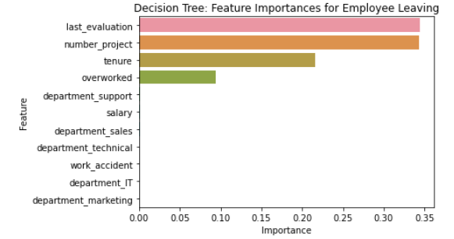
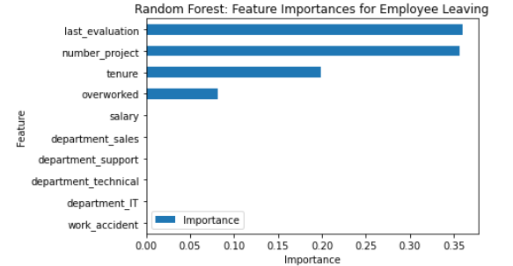

Salifort Motors
Employee Retention Project
Salifort Motors aims to enhance employee retention by addressing the question:
What factors are most likely to cause an employee to leave the company?
Since the variable we want to predict is categorical, the team could use either a logistic regression model or a tree-based machine learning model. The random forest model shows a slight improvement in performance over the decision tree model.
Barplot of most relevant variables for employees leaving
This model aids in predicting whether an employee will leave and identifies the most influential factors. These insights can assist HR in making decisions to enhance employee retention.
In the random forest model, the variables last_evaluation, tenure, number_project, overworked, salary_low, and work_accident are the most important. These factors are the most useful for predicting the outcome variable, left.
1. Limit the number of projects an employee can take on to prevent overwork.
2. Consider promoting employees who have been with the company for at least four years. Alternatively, investigate why employees with four years of tenure may be dissatisfied.
3. Either reward employees for working longer hours or avoid requiring them to do so, depending on your company’s needs.
4. Ensure employees are informed about the company’s overtime pay policies. If expectations regarding workload and time off are not clear, make them explicit.
5. Facilitate company-wide and team-specific discussions to better understand and improve the work culture.
6. Avoid reserving high evaluation scores solely for employees who work 200+ hours per month. Consider implementing a proportionate scale to recognize and reward contributions and effort more fairly.

