Slide 1
Slideshows
Company Logo
Home About Us Contact Us
PIC/ICON
PIC/ICON
PIC/ICON
PIC/ICON
Archery Lessons
Our Instructors
Our Students
Events/Social
Footer @2017 Straight to the Point Archery

Slide 2
Company Logo
Home About Us Contact Us
Our Location
Phone Number
Maps
Footer @2017 Straight to the Point Archery

Slide 3
Company Logo
Home About Us Contact Us
Pictures
Archery Lessons Content/Info
Footer @2017 Straight to the Point Archery

Slide 4
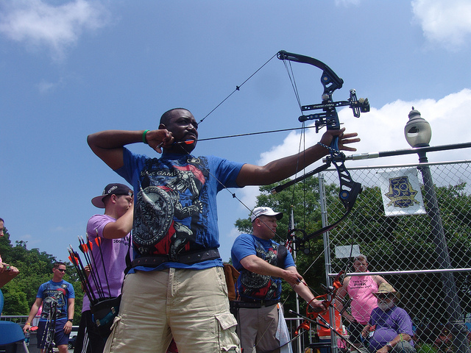
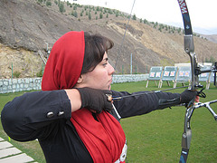
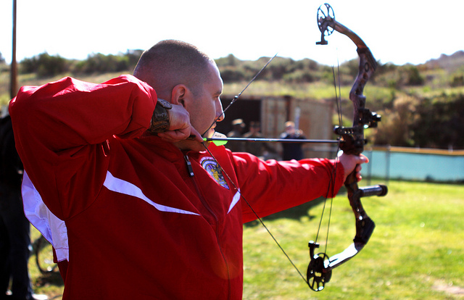
Company Logo
Home About Us Contact Us
Derek is a Washington native and an experienced outdoorsman with many years hunting, fishing, skiing, canoeing, archery, shooting and minimalistic camping. His skillful mastery of bush craft and wilderness survival knowledge helps define his character. He enjoys handcrafting his own long bows, flint knapped primitive arrows and making custom leather products.
Amy truly has a passion for archery. She comes from a long line of hunters, fisherman, and trappers of Canada. Amy places a strong emphasis on safety and is enthusiastic about teaching. Amy also loves fitness, and has been a YMCA group exercise and personal trainer for over 18 years.
Nathan is an USA Archery Certified Level 3 NTS – Coach and has been teaching archery since 2009. He has been interested in archery since he nocked his first arrow while a Boy Scout at Scout camp. Nathan has many years of experience teaching people of all ages, experience gained as a Martial Arts Instructor and Studio Manager.
Footer @2017 Straight to the Point Archery

Slide 5
Company Logo
Home About Us Contact Us
Pictures
Events/Social Info, schedules, etc.
Footer @2017 Straight to the Point Archery

