Slide 1
AI ENERGY OPTIMIZATION -- GREENAI
A look into quantifiable, energy focused profiling and refactoring.
Jake Nathanson, Cristian Rivera, Ahmed Bouhraoua, Layne Xia, Asif Imran

Slide 2
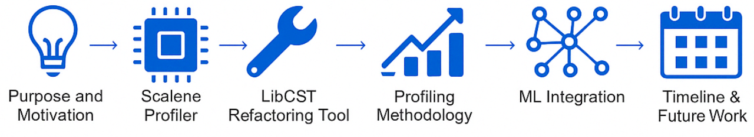
Presentation Overview
Purpose and Motivation
Scalene Profiler
LibCST Refactoring
Profiling Methodology
ML Integration
Timeline & Future Work
Call to Action & Q&A

Slide 3
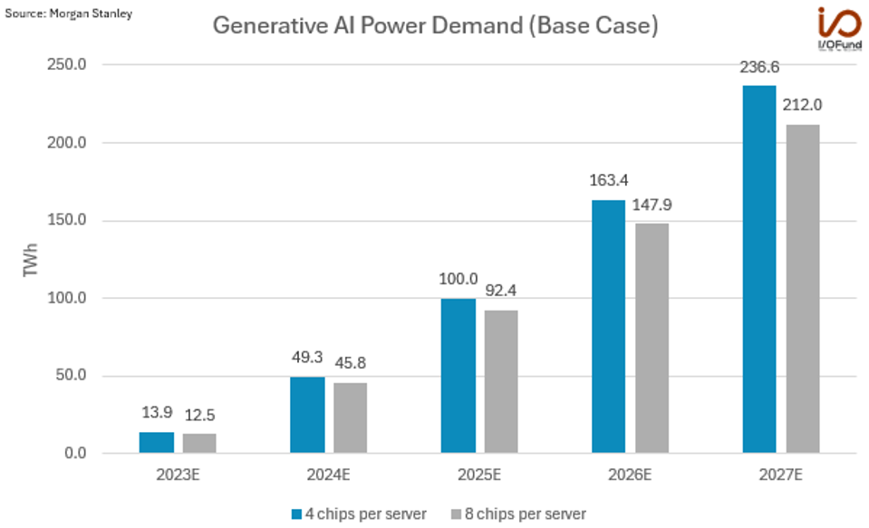
Our purpose
We want to measure and visualize energy use at the method level in AI programs.
Our goal is to build a highly granular tool to help developers optimize the sustainability of AI workloads.

Slide 4
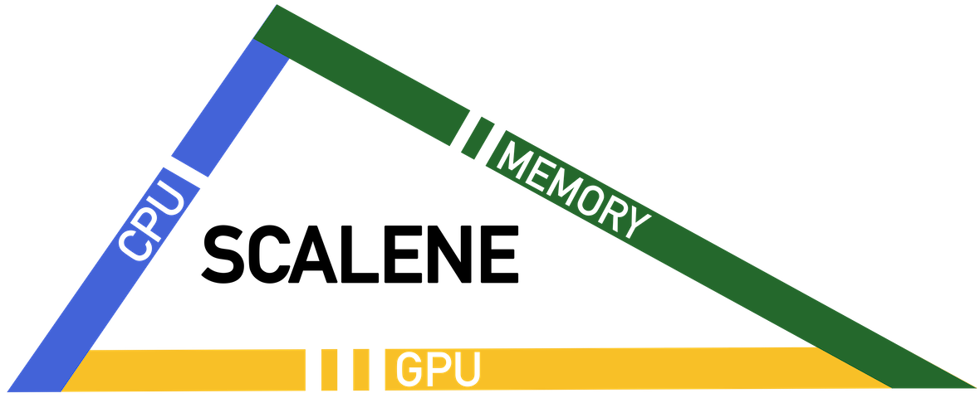

Our Toolchain
SCALENE
LIBCST
Scalene is a high-performance profiler designed specifically for Python.
Line by line profiling
Profiling is almost all inclusive
Parser fully preserves structure
Parsing code into a Concrete Syntax Tree (CST)
Use Visitor and Transformer Patterns to refactoring code
Notes:
CST is similar to AST but keeps all formatting details.(Whitespace, comments)Visitors traverse the CST to collect data;Transformers modify nodes

Slide 5
SCALENE – OUR PROFILER

Slide 6
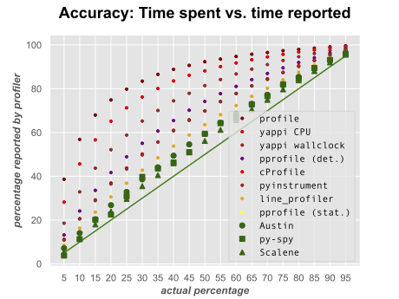
What is Scalene?
Fast, robust and accurate Python profiling tool (with <10% margin of error).
Provides developers with actionable data to optimize Python programs.
Minimal Overhead (20-30% slowdown).
Scalene VS other Python Profilers

Slide 7
Why Scalene?
Most Python Profilers struggle to separate noise and utilization from library/module method calls written in other languages.
It’s important to mention that Scalene filters out redundant background noise from external processes and profiles utilization from native C code in external libraries.

Slide 8
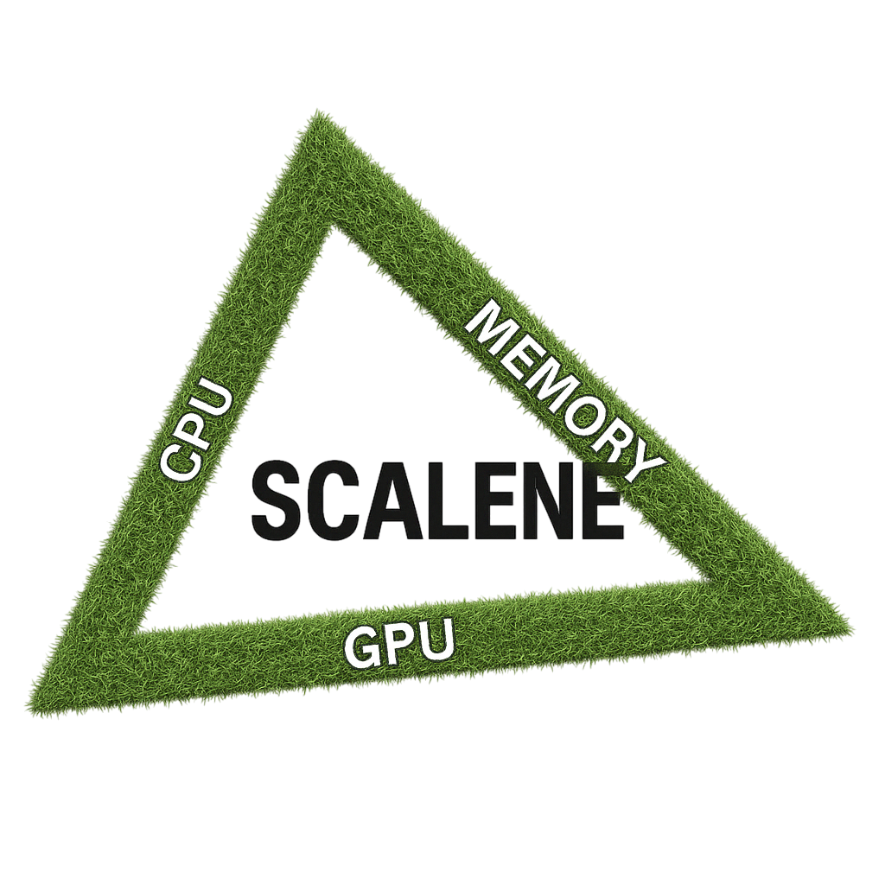
Modifying Scalene
CPU and GPU joule consumption through power estimation
Multi-GPU Computing support
Individual GPU Utilization and consumption metrics

Slide 9
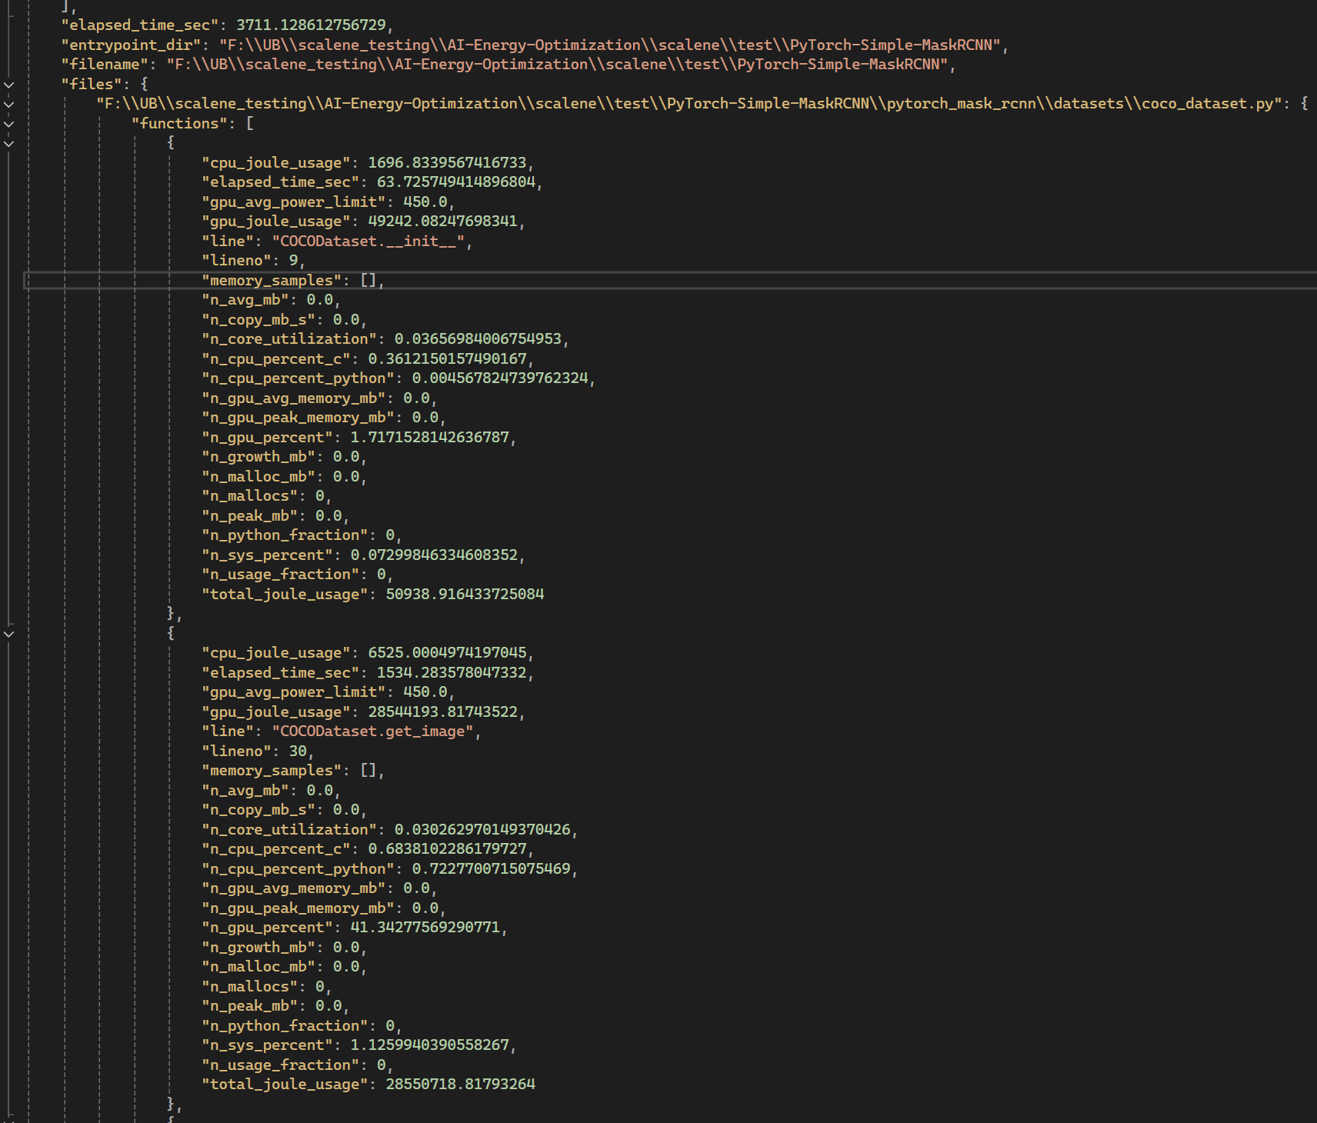
Profiling at the Method Level (and line by line)
Additions: Time per line, Avg Power Limit, GPU joule usage, CPU joule usage, and Total joule usage
Example JSON output of Scalene (obtainable data)

Slide 10
THERMAL DESIGN POWER FETCHING

Slide 11

TDP -- An Overview
TDP = “thermal design power” – vendor’s steady‑load watt target for cooling, not a live power reading
Why we use it → universal, no extra drivers; multiply Scalene CPU‑time × ((TDP – idle) × CPU Utilization) to get joules — a reasonably quantifiable estimate (similar methodology for GPU)
Accuracy → ± 15% vs. hardware meters — good enough for finding significant power draws
Notes:
Slide Title: TDP Overview & Accuracy
What is TDP?
Vendor‑published thermal design power: max sustained heat ≈ steady‑state watts at base clock
Cooling‑budget number → not the chip’s moment‑to‑moment draw
Why use it in Scalene?
Available for every CPU/GPU; no kernel/driver hoops
Stable upper bound lets us turn CPU‑time → joules fast
One lookup per host, then cached (MongoDB) → zero scrape‑maintenance
Handling “background processes” accuracy concerns
Idle baseline measured, then subtracted → effective TDP = TDP – idle_watts
Energy billed by process CPU‑time share → other apps’ cycles aren’t charged to your code
Periodic re‑sampling adjusts baseline if system load drifts
Validation vs. RAPL/NVML: ±15 % CPU, ±20 % GPU (flag available for tighter hardware meters)
Key takeaway
TDP + live idle subtraction = quick, portable, “good‑enough” energy estimate focused on your code

Slide 12
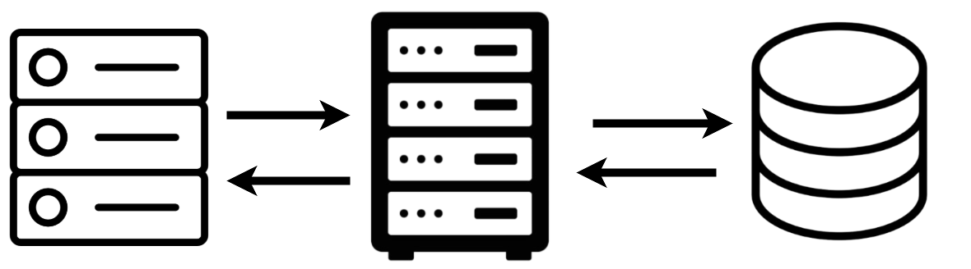
CPU TDP Fetch Methodology
Detect CPU info and send to a backend server
Backend server with a database that is updated with CPU TDP from the web
Notes:
Web scraping for CPU TDP values is unreliable and time-consuming Information is fragmented across vendor websites, forums, and third-party databases.
Scraping introduces maintenance overhead and is difficult to generalize Instead, we use py-cpuinfo to programmatically detect the user’s CPU model.
This model name is passed to OpenAI’s GPT-4o API, which retrieves or estimates the CPU’s TDP GPT-4o is capable of synthesizing information from various sources, eliminating the need for scraping This method is simpler to implement and maintain
To minimize API usage and cost, all results are cached in a backend MongoDB database:
Prevents duplicate queries
Enables faster responses over time
End users do not need an OpenAI account or API key which makes the tool more accessible
information is scattered across vendor sites, forums, and databases, making it hard to generalize.

Slide 13
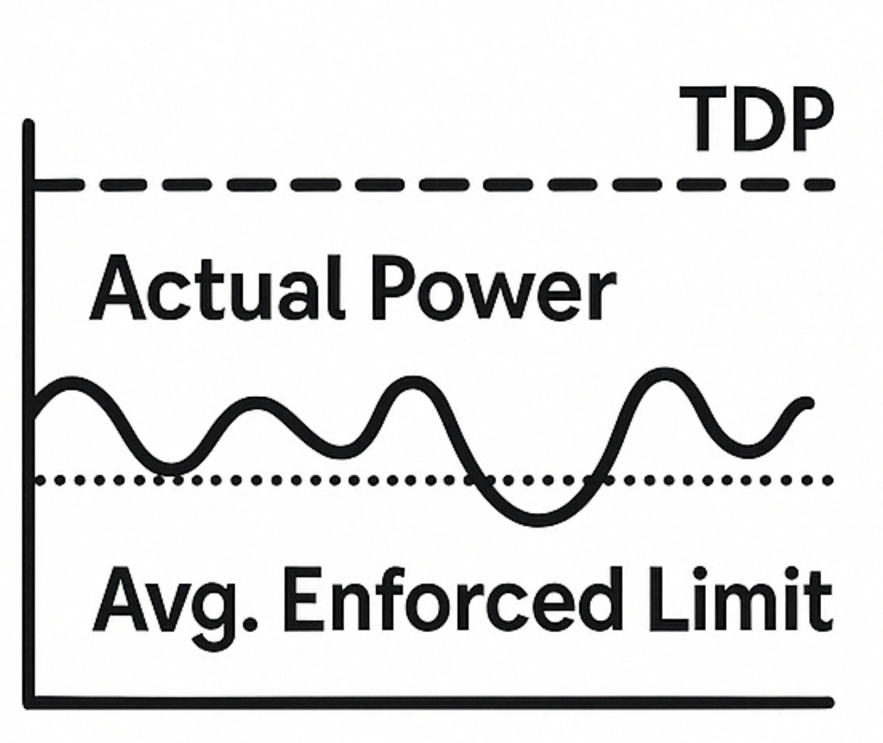
GPU TDP Fetch Methodology
GPU power draw is dynamic and changing
Solution: Collect samples of local enforced power limits and utilize an average in our computations.

Slide 14
LIBCST -
OUR REFACTORING TOOL

Slide 15
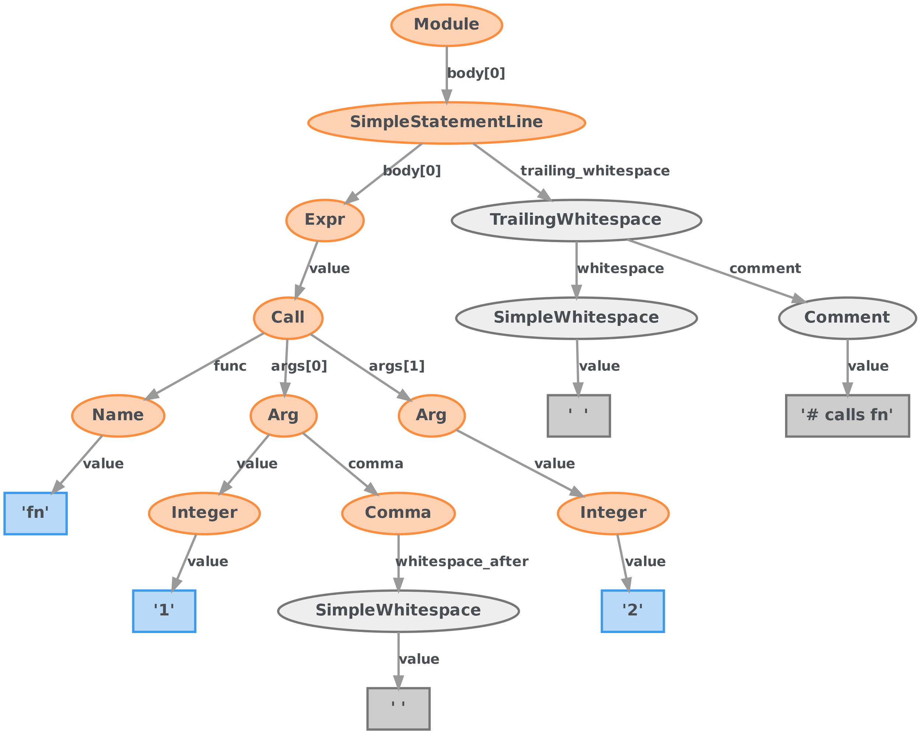
What is & Why LibCST?
Parsing code into a Concrete Syntax Tree
AST with formatting detail reserved
Better choice than AST
preserve readability
Modify code without losing style

Slide 16
Our Goal -
ML Driven Refactoring

Slide 17
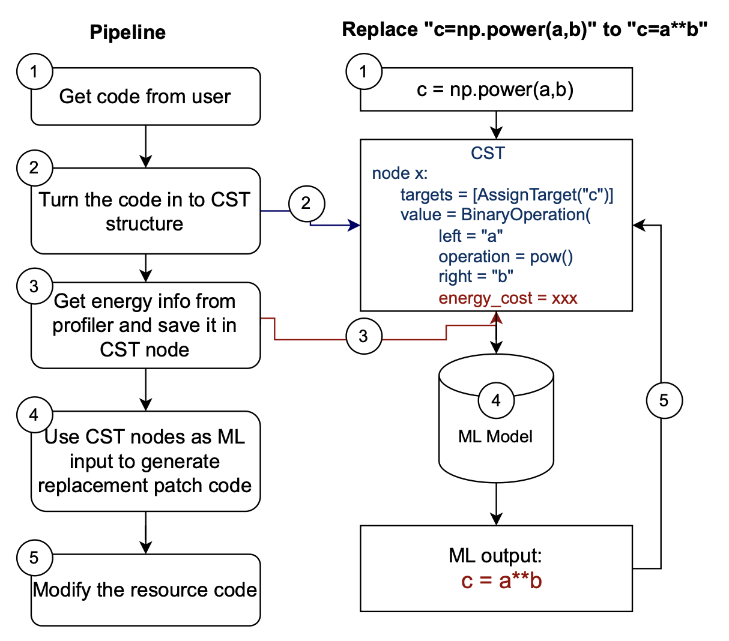
”

Slide 18
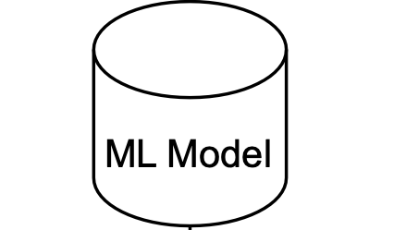
Possible solution: GNN
A Natural Fit
Structural Awareness

Slide 19
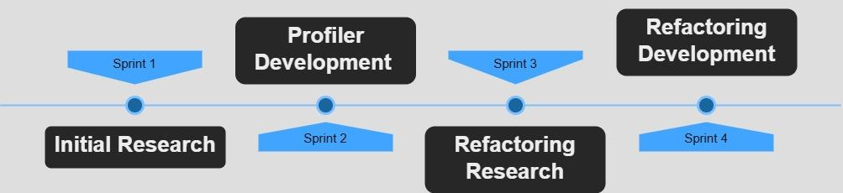
Past Work

Slide 20

Future Work
Our future goals include:
ML-Driven Refactoring
Extensive Testing, Server Power
UI Development and Data Visualization
Developing a Java Profiler (Meta Strobelight)

Slide 21
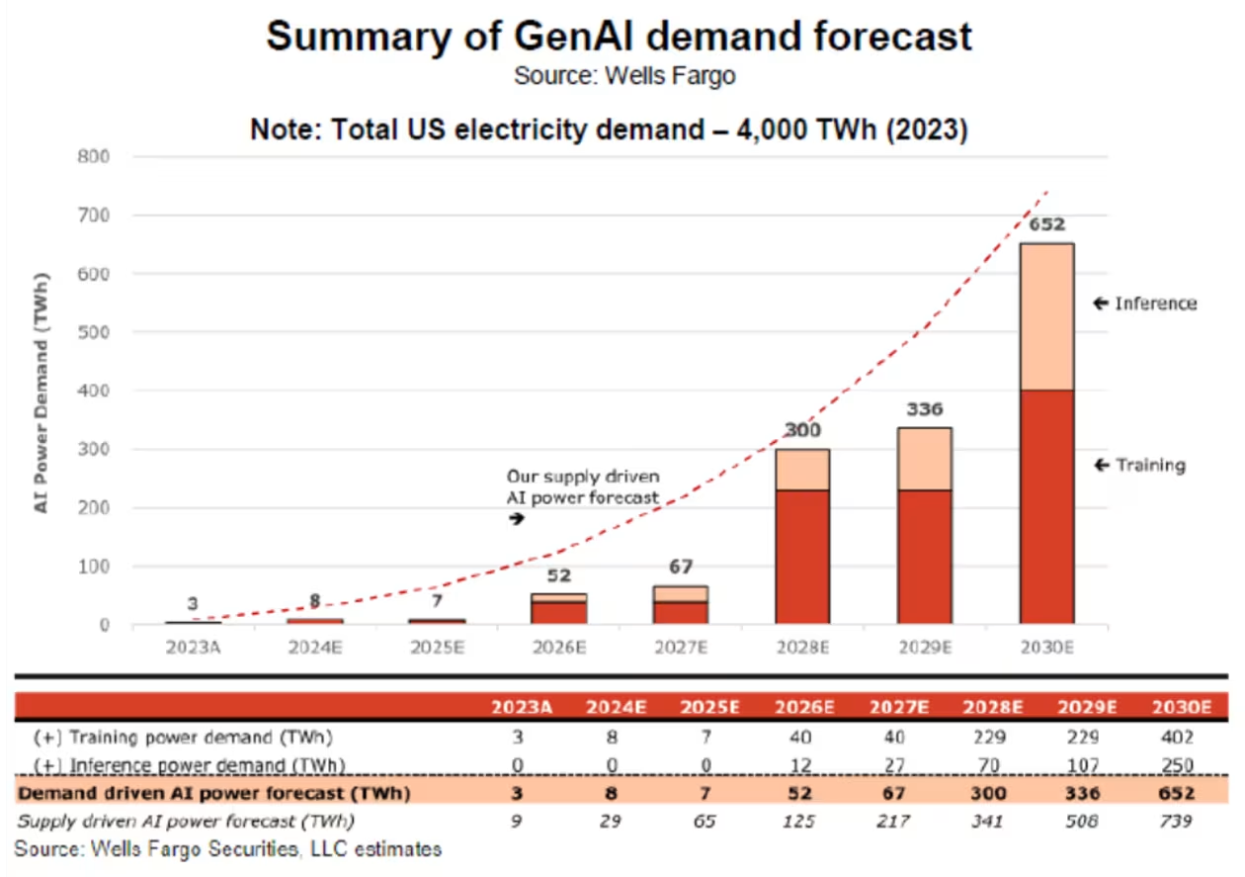
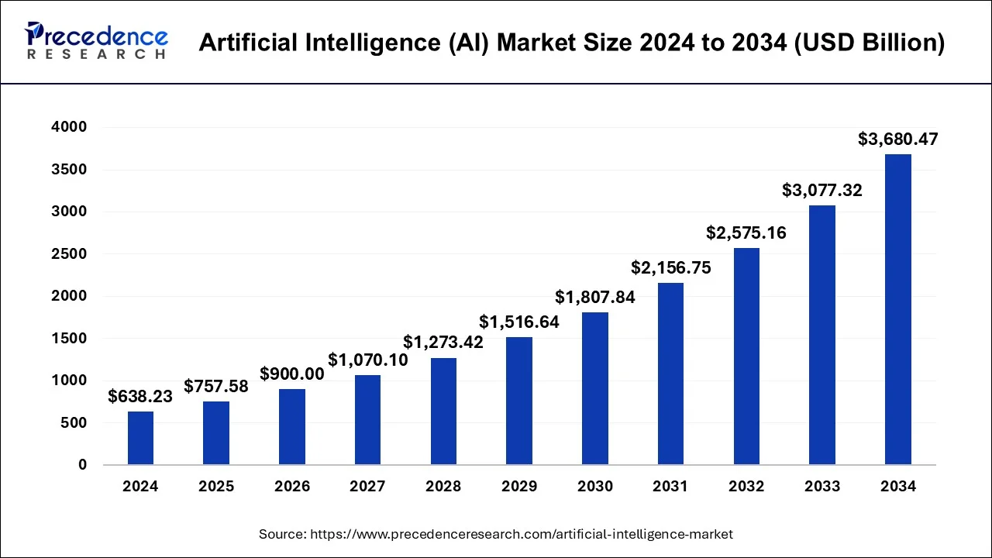
A Call to Action

Slide 22
Presentation Overview
Purpose and Motivation
Scalene Profiler
LibCST Refactoring
Profiling Methodology
ML Integration
Timeline & Future Work
Call to Action & Q&A

Slide 23
Accreditations and Sources
Berger, E. D., Stern, S., & Pizzorno, J. A. (2023). Triangulating Python Performance Issues with SCALENE. Proceedings of the 17th USENIX Symposium on Operating Systems Design and Implementation (OSDI '23).​

Slide 24
Thank You!
Any Questions?

