Slide 1



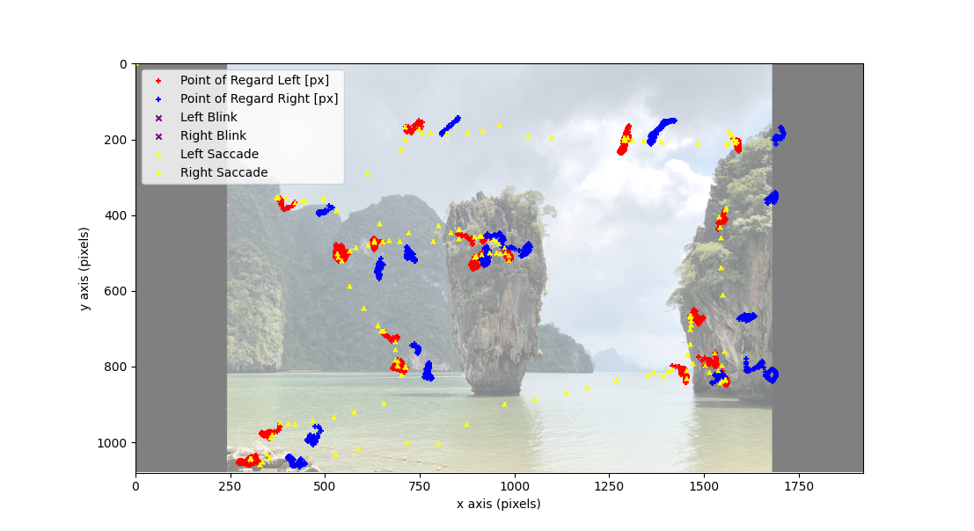
Scanpath Comparison
ScanMatch & Multimatch
By Robert Ahadizad Newport

Slide 2
Introduction
Papers
R. Dewhurst, M. Nyström, H. Jarodzka, T. Foulsham, R. Johansson, K. Holmqvist, It depends on how you look at it: Scanpath comparison in multiple dimensions with MultiMatch, a vector-based approach, Behavior Research Methods (2012).
doi:10.3758/s13428-012-0212-2.
F. Cristino, S. Mathôt, J. Theeuwes, I. D. Gilchrist, ScanMatch: A novel method for comparing fixation sequences, Behavior Research Methods (2010).
doi:10.3758/BRM.42.3.692.
CNS I Faculty of Medicine, Health and Human Sciences I Department of Clinical Medicine

Slide 3
Introduction
What is a scanpath?
Both ScanMatch and MultiMatch define a scanpath as a sequential collection of cartesian (x, y) fixation points.
Dimensionality reduction is done through
either semantic or gridded quantising with
ScanMatch, and amplitude or directional
clustering with MultiMatch.
CNS I Faculty of Medicine, Health and Human Sciences I Department of Clinical Medicine

Slide 4
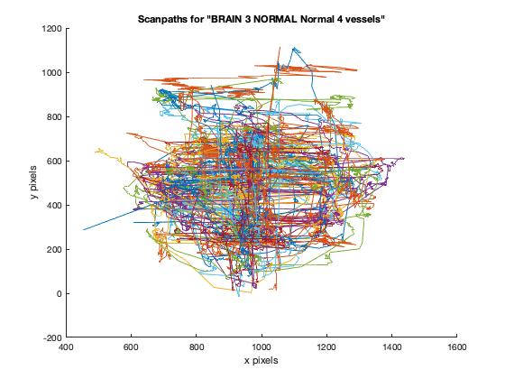
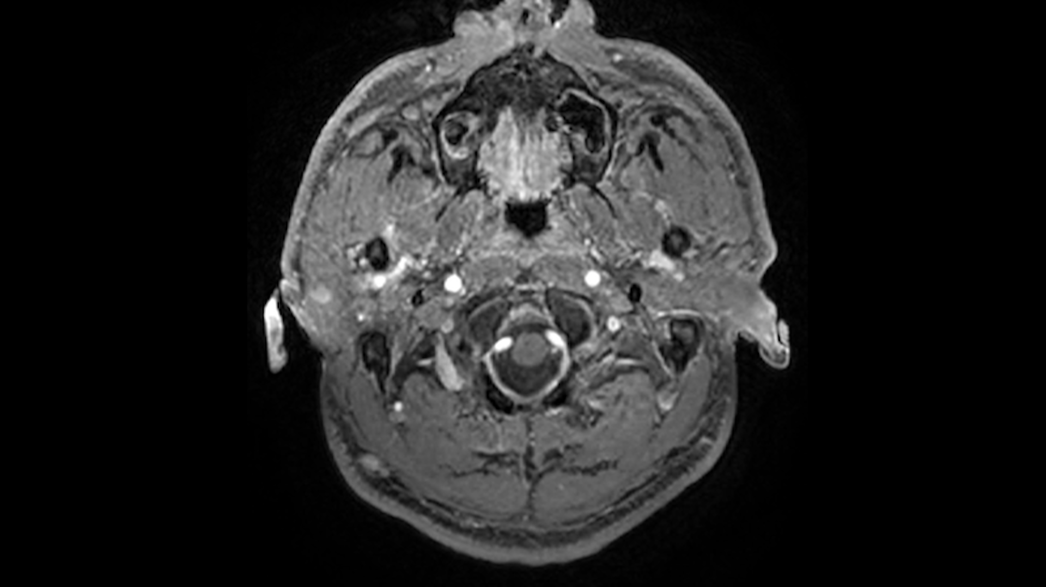
Introduction
scanpath
CNS I Faculty of Medicine, Health and Human Sciences I Department of Clinical Medicine

Slide 5
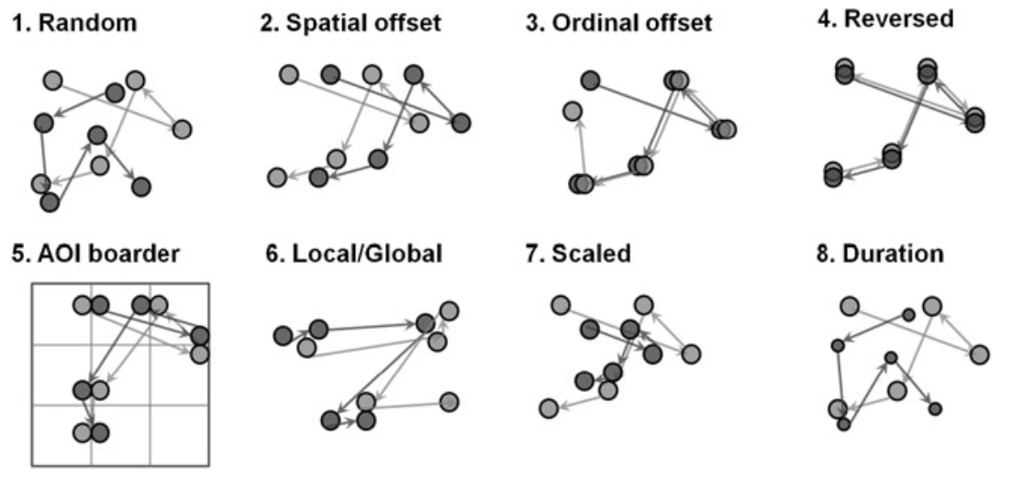
Introduction
Scanpath comparison
Known issues in scanpath comparison including chance, alignment problems, offset alignment issues, backwards, quantising, global to local agglomerative
issues, scale,
and duration.
CNS I Faculty of Medicine, Health and Human Sciences I Department of Clinical Medicine

Slide 6
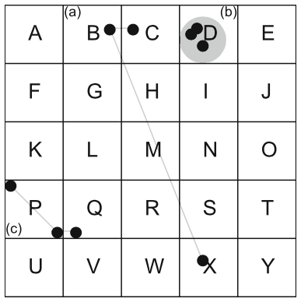
Introduction
ScanMatch dimensionality reduction
Gridded quantising of scanpath fixations.
CNS I Faculty of Medicine, Health and Human Sciences I Department of Clinical Medicine

Slide 7
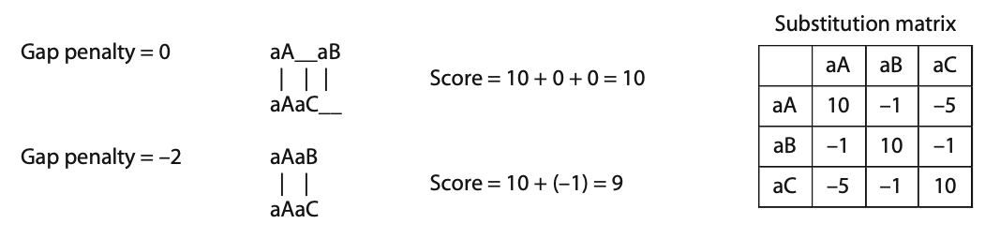
Introduction
string substitution
The Levenshtein distance between two strings a, b:
Sam → Bam (substitution of "S" for "B")
sit → sits (insertion of "s" at the end)
CNS I Faculty of Medicine, Health and Human Sciences I Department of Clinical Medicine

Slide 8
Introduction
ScanMatch string substitution
A large gap penalty favours larger gaps in sequences with tightly related string pairs whereas a smaller gap penalty favours smaller or no gaps with the alignment of loosely related pairs.
CNS I Faculty of Medicine, Health and Human Sciences I Department of Clinical Medicine

Slide 9
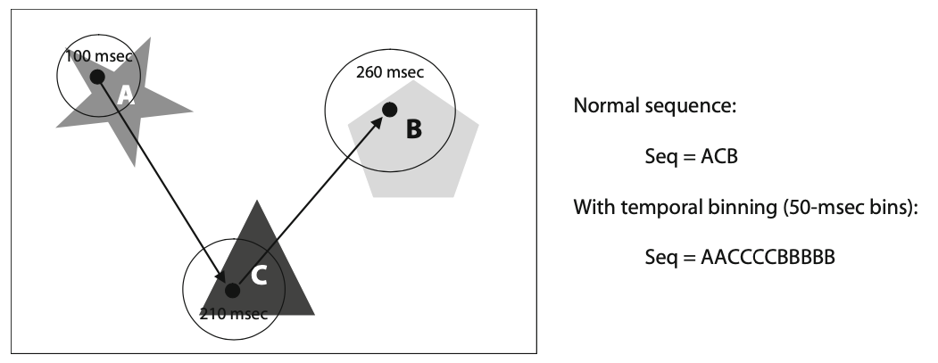
Introduction
ScanMatch string substitution
Temporal Binning using string substitution.
CNS I Faculty of Medicine, Health and Human Sciences I Department of Clinical Medicine

Slide 10
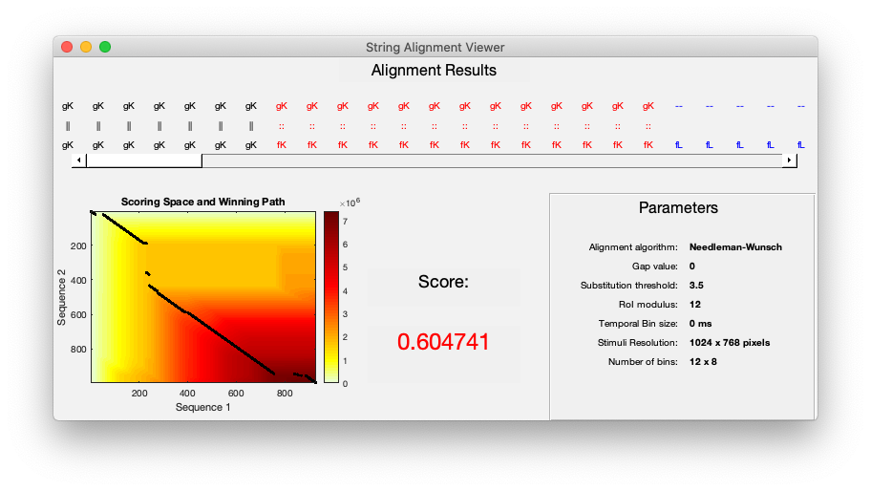
Introduction
ScanMatch results
CNS I Faculty of Medicine, Health and Human Sciences I Department of Clinical Medicine

Slide 11
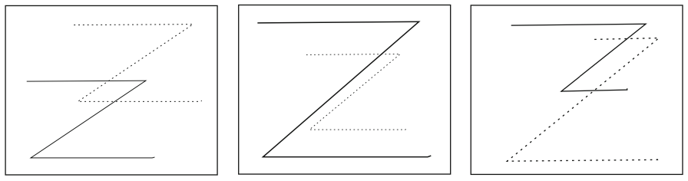
Introduction
Multimatch
MultiMatch identifies scanpaths that may be similar, but shifted in their locus (left), scale (middle), or saccadic amplitude (right).
CNS I Faculty of Medicine, Health and Human Sciences I Department of Clinical Medicine

Slide 12
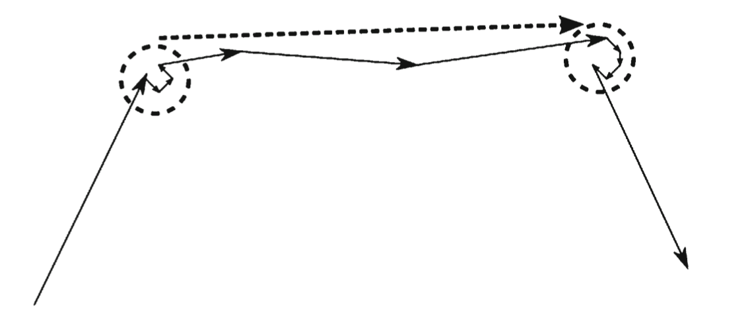
Strategy
Multimatch Clustering
Amplitude-based (dashed circles) and direction-based (dashed arrow) clustering used for dimensionality reduction.
CNS I Faculty of Medicine, Health and Human Sciences I Department of Clinical Medicine

Slide 13
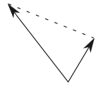

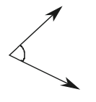


Strategy
Multimatch Dimensions
Shape: The vector difference between aligned pairs.
Length: The difference in length between endpoints of aligned pairs.
Direction: The angular difference between aligned pairs.
Position: The Euclidean difference in position between aligned pairs.
Duration: The difference in duration of time spent on aligned pairs.
CNS I Faculty of Medicine, Health and Human Sciences I Department of Clinical Medicine

Slide 14
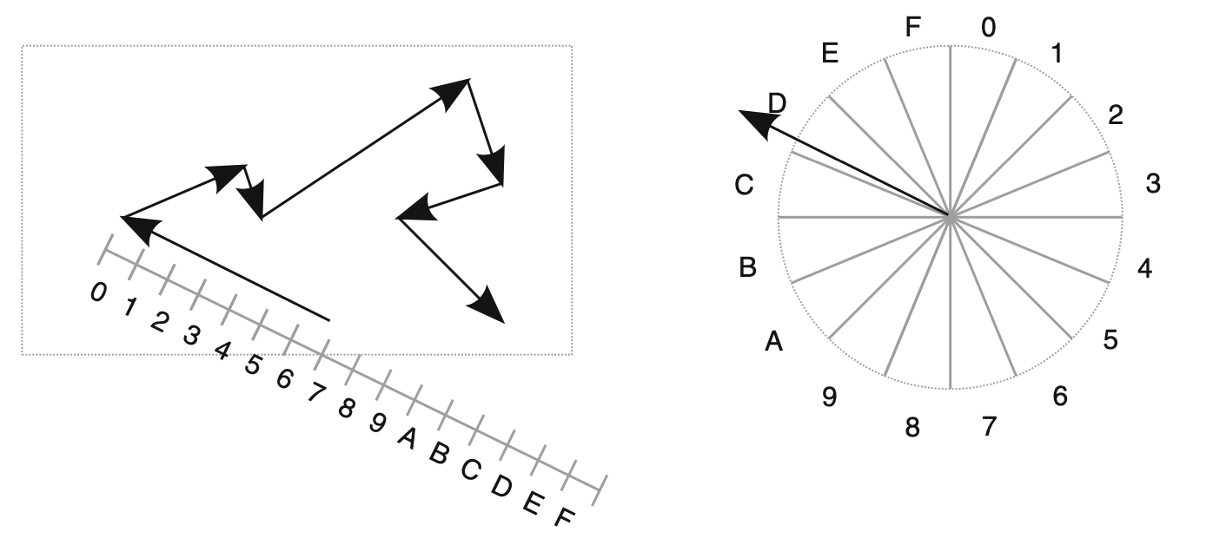
Strategy
Multimatch string substitution
Uses a hexidecimal representation for both amplitude (left) and direction (right). The example saccade has direction D with amplitude 7, representing sample value D7. An example scanpath sequence and be represented by the string:
D7 23 71 28 73 B3 54
From here, it is possible to
perform string editing
operations adopting the
same principles as in the
Levenshtein method seen in
ScanMatch.
CNS I Faculty of Medicine, Health and Human Sciences I Department of Clinical Medicine

Slide 15
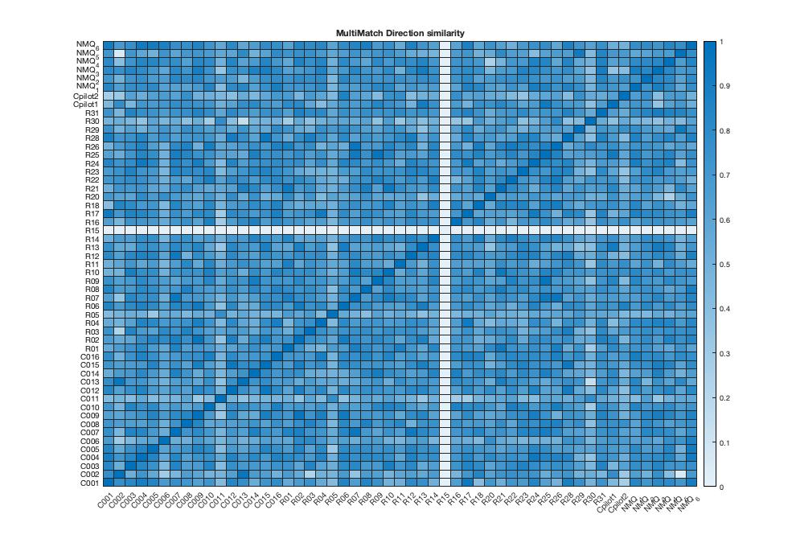
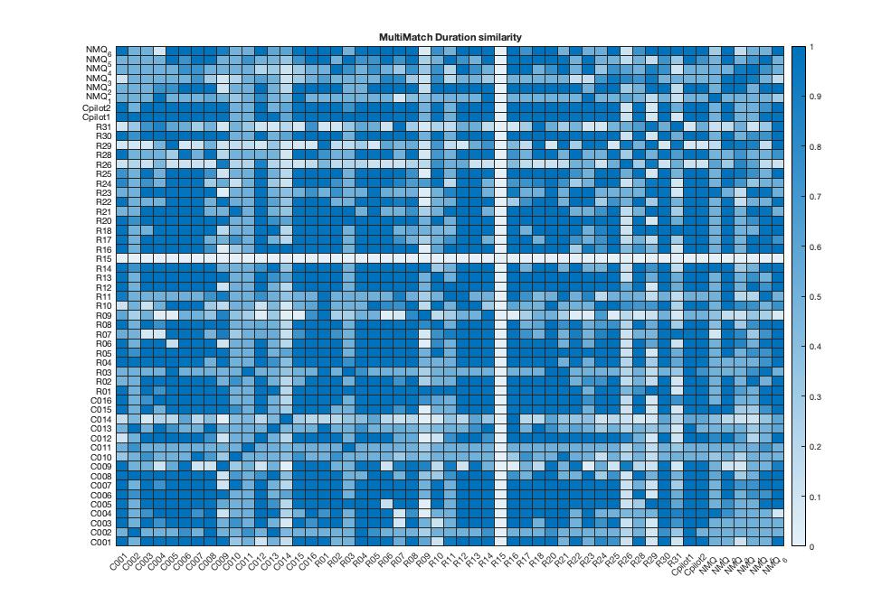
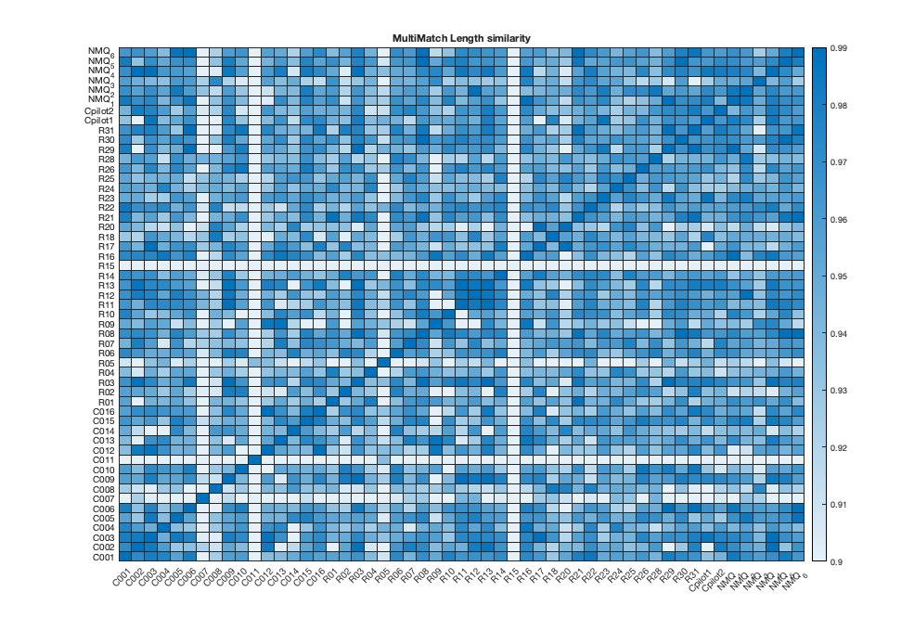
Strategy
Multimatch heatmaps and separability
Direction
Duration
Length
CNS I Faculty of Medicine, Health and Human Sciences I Department of Clinical Medicine

Slide 16
Thank you
Dr Antonio di ieva
Dr Sidon Liu
Dr Carlo Russo
Dr Abdulla suman
Macquarie University
Department of Clinical Medicine
Faculty of Medicine, Health and Human Sciences
OFFICE I FACULTY I DEPARTMENT

