Slide 1

SEGMENTATION analysis
Group 11
Ruturajsinh Solanki – 0827884
Isha Dhaduk – 0827577
Chris Chhotai - 0826416
Parth Tripathi – 0826520

Slide 2

Introduction
Segmentation, which involves categorizing target audiences or markets into distinct, similar groups, is crucial for data analytics and marketing strategies.
These groups are formed based on shared attributes, allowing for personalized approaches to cater to their unique needs.
Such tailored strategies enable informed decision-making, leveraging data and promoting individualized interactions.
The process of segmentation aids in identifying specific consumer preferences and behaviors, enhancing the effectiveness of marketing campaigns.
By recognizing the diverse requirements of various segments, companies can efficiently allocate resources and optimize their overall marketing ROI.

Slide 3
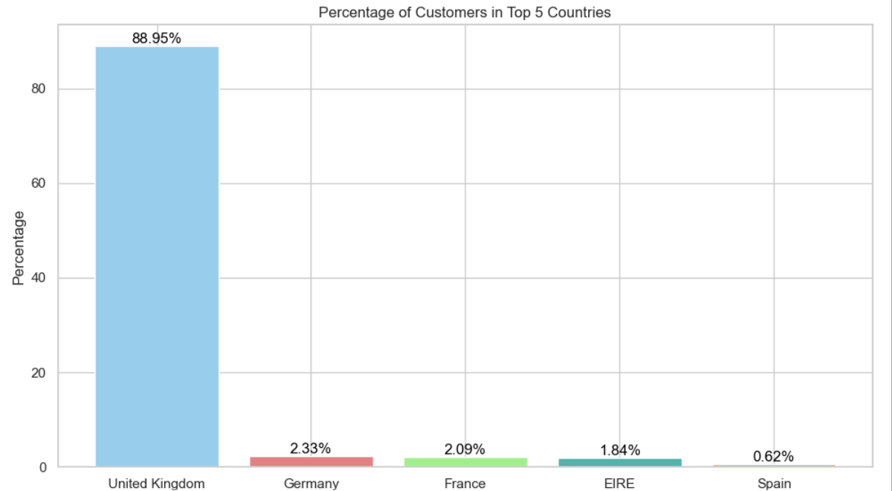
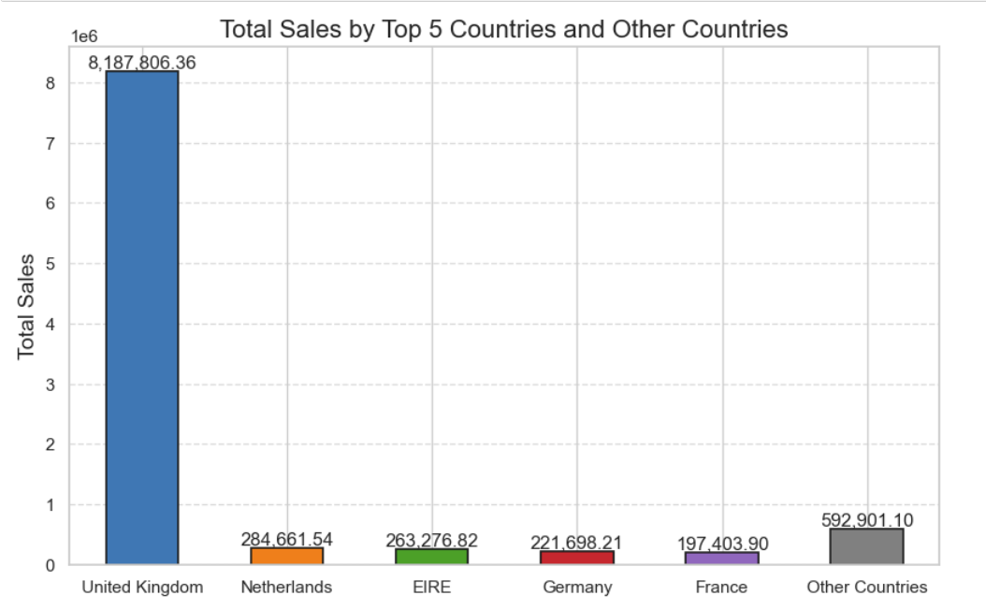
Demographic Segmentation
Country
We can clearly see from above graphs that most of the customers and sales are from United Kingdom.
Netherlands has second most sales while having just 0.43% of overall customer base.
Most of the Customers are from Europe.

Slide 4
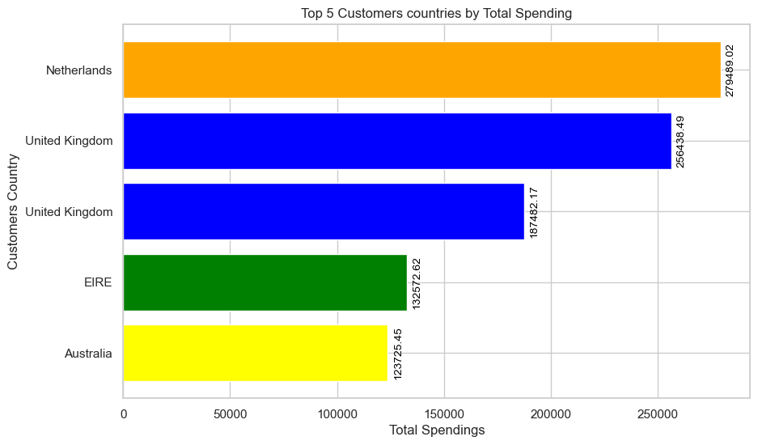
Demographic Segmentation
Customer
As we can see here our top 5 customers are from different countries.
Customer from Netherlands has spend the most amount.
A customer from Australia has fifth most spending when we know from above graphs that we don’t have many customers or sales from Australia.

Slide 5
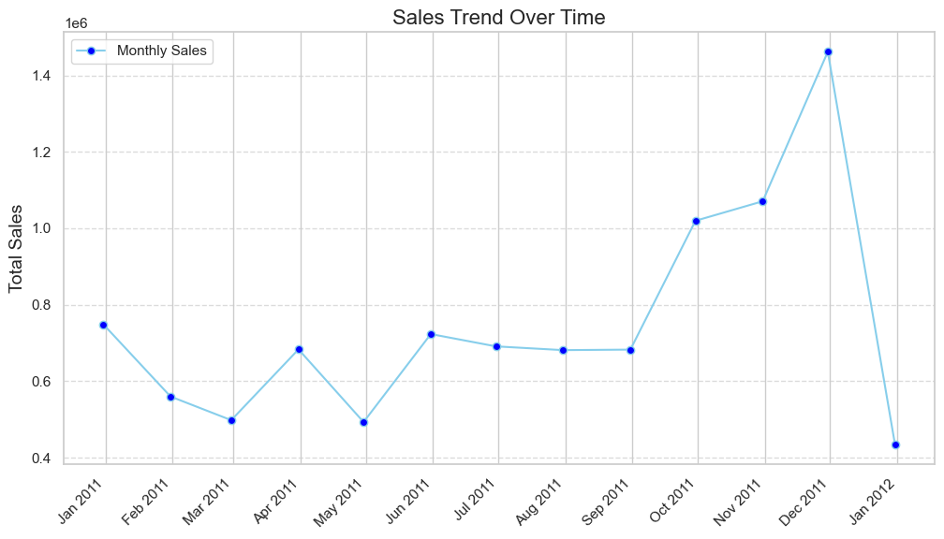
Sales trend over Time
Most of our sales are from October to December.
While least sales are from January to May.
We had our least sales in January 2012, and Highest sales in December 2011.

Slide 6
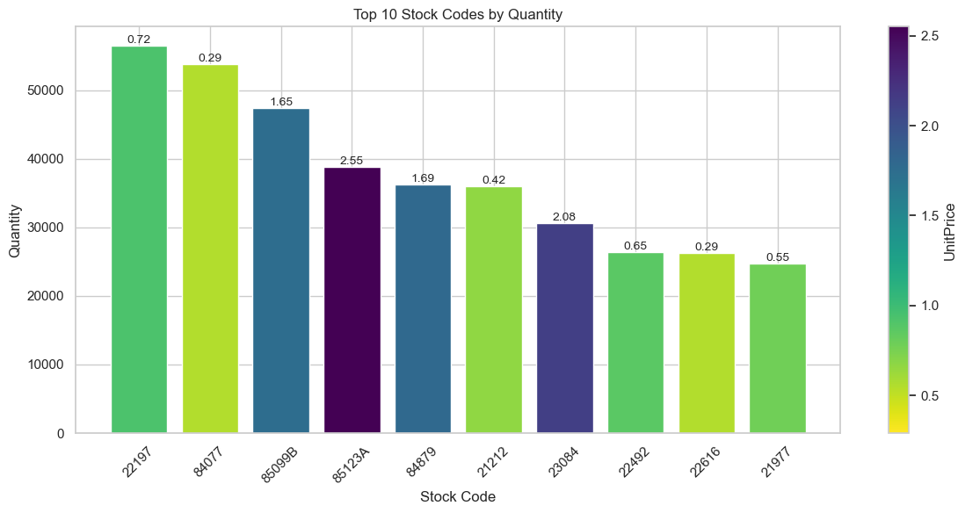
Top Products
By Quantity
In our top products most of the products has low unit prices.
Six out of ten product’s prices are less than 0.75.

Slide 7
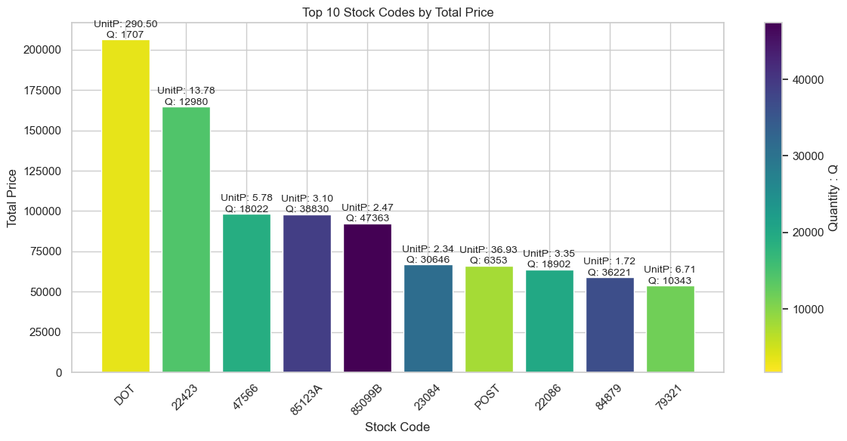
Top Products
By Total Sales
Our top product by sales has high unit price but less quantity sold.
Most of the product’s has low unit price.
Seven out of 10 products has less than 10 unit price.

Slide 8
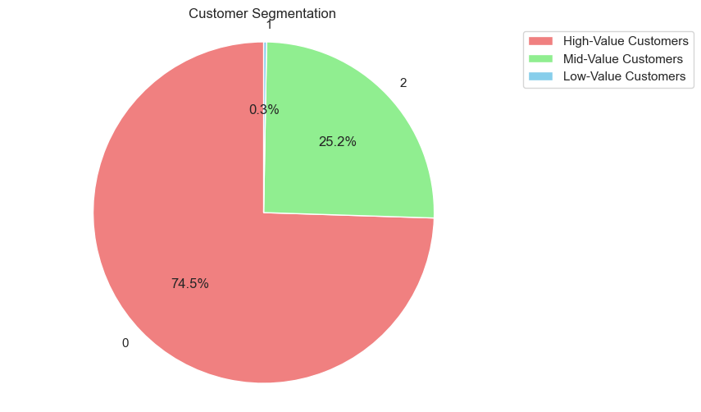
Customer Segments
By RFM
We have separated customers based on 3 segments.
Our 74.5% Customers are high value customers, which means they are frequent buyers, and has more sales.
This customers are less likely to churn.
Our 25.2% Customers are Mid value customers, which means they are not so frequent customers, and has moderate sales.
Their probability for churning is higher than high value customers.
Our 0.3% customers are low value customers they are most likely to churn.

Slide 9
Business Recommendation
Most customers are from United Kingdom, we need to focus on how to make them stick with our company.
We can introduce marketing campaigns specifically based on UK market. We can even further divide this using City or district.
Most sales are coming from products who’s unit prices are low. We can promote similar products who has low cost and similar categories.
There are some customers who has more total spendings from countries like Netherlands, and Australia.
This suggest us that we can introduce them with promotions and sales to increase our popularities in this countries as well.
Our 25.5% customer group is in mid value or lower tier, who have higher probability for churning. We need to introduce them with new sale options and rewards.
We have 74.5% customers in our high value tier, to make them stay with us we can introduce them with some loyalty rewards and benefits.

