Slide 1

Churn analysis
Group 11
Ruturajsinh Solanki – 0827884
Isha Dhaduk – 0827577
Chris Chhotai - 0826416
Parth Tripathi – 0826520

Slide 2
It is the rate at which your customers leave your business and go to your competitors. Many factors govern it, and even if there is a slight increase in churn percentage, it could negatively impact the company.
Thus, churn analysis helps to reduce the rate of customers leaving by assessing the products and understanding how customers use it.
It helps to understand the pain-points and develop a process to increase the customer retention rate.
Suppose a customer buys the product or service once and does not make any purchases afterward. This indicates that they initially got impressed by the service or product but needed to find better and reliable products in the long run.

Slide 3
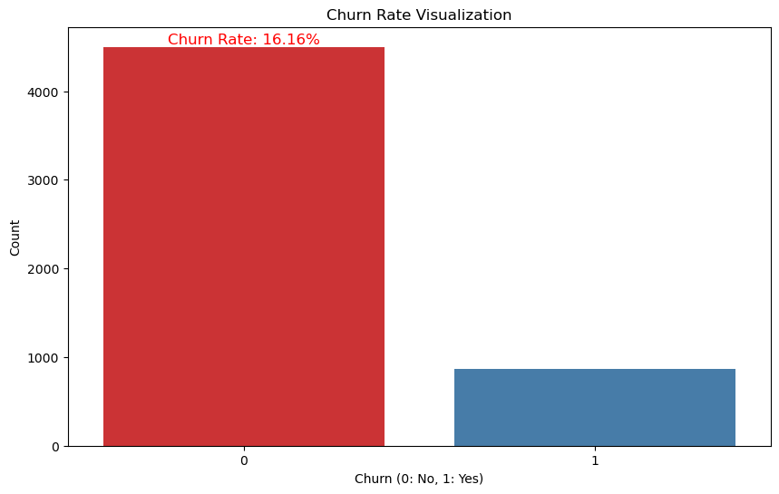
Churn Rate
- The churn rate of this organization is 16.16%.
- This means that from all the users ever used our services, 16.16% has left the organization.
- We will be analysing the variables that impact the churning most and how to retain the customers.

Slide 4
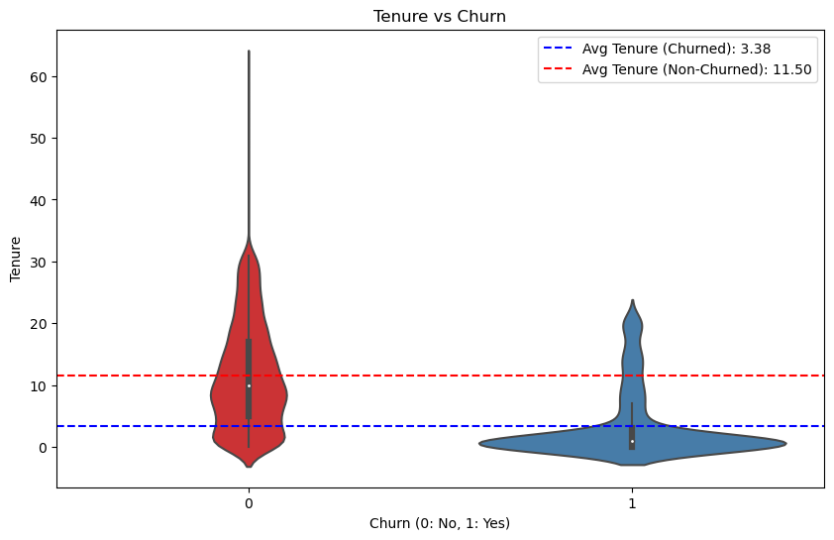
Impact of tenure on churning
- As we can see from the violin chart, the customers who have churned were with the organization for very less time comparing to non-churn group.
- Also, we can see that average tenure for churned customer is around 3.38 which is way less than non-churned customers(11.5).

Slide 5
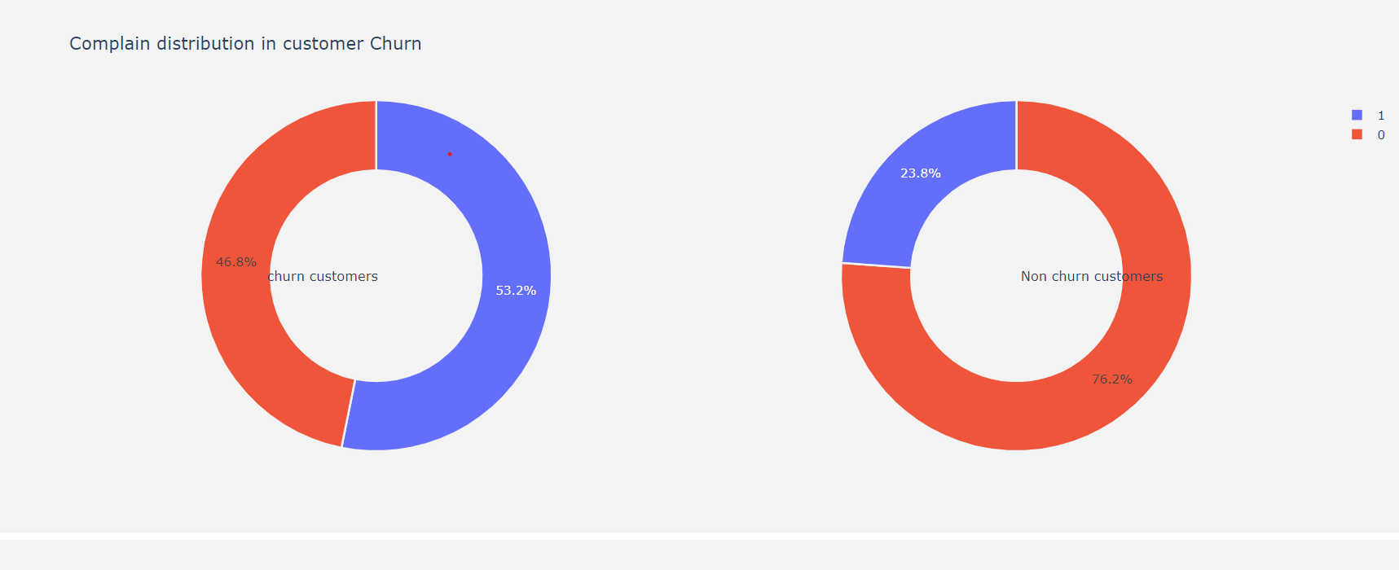
- This pie chart suggests that customers who have churned had complains. While there are some customers who have churned without any complaints, but that can mean that they did not submit any complaints.
-Also, for non-churned customers most of them have no complaints. But those who have complaints may leave the organization.

Slide 6
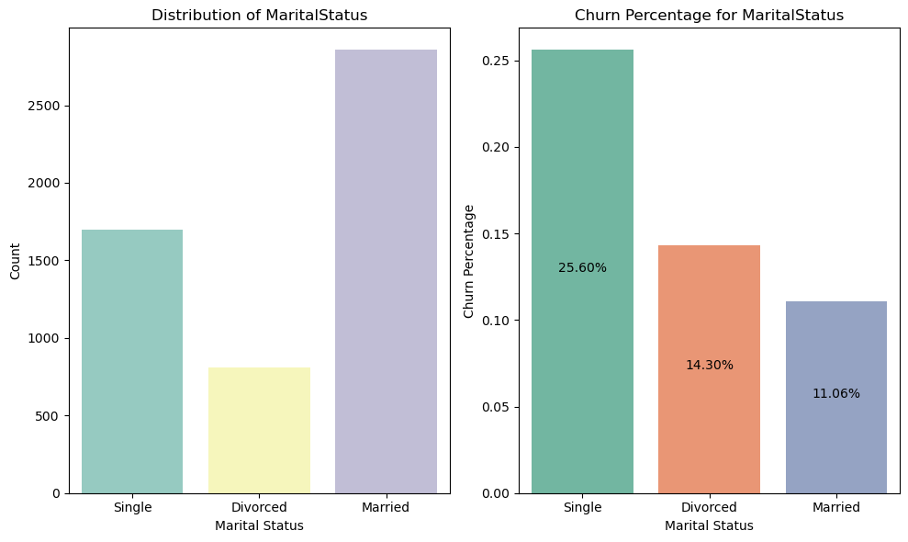
Impact of Marital Status on churning
- This visualisation explains us that our customer base has most married customers and second largest is singles.
- While churn rate for married customers is 11.06% but for singles it’s 25.06%.
- This suggests that we need to introduce some discount or schemes to single people for their retention.

Slide 7
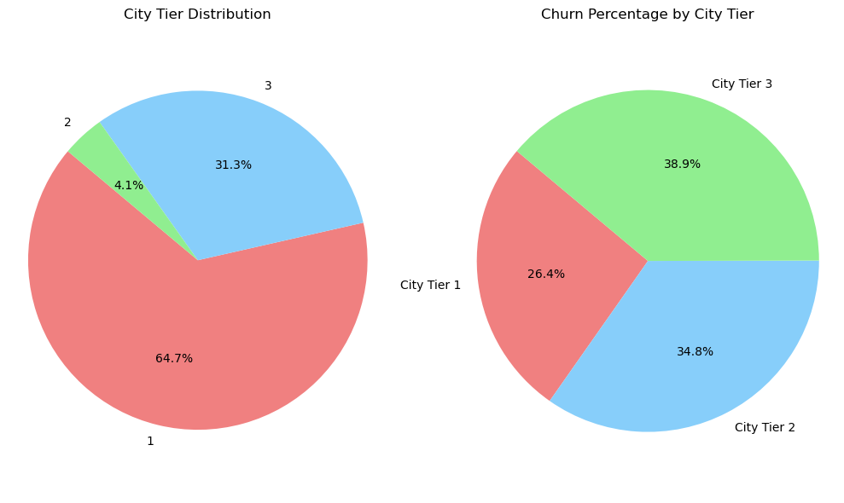
Impact of City Tier on churning
- This pie chart shows us the distribution of customers over all city tiers vs. churn percentage for city tiers.
- It is clear from the pie chart that majority of customers are from tier 1 and 3. And churn percentages are almost same for tier 3 and 2.
- We need to implement some city tier specific strategy.

Slide 8
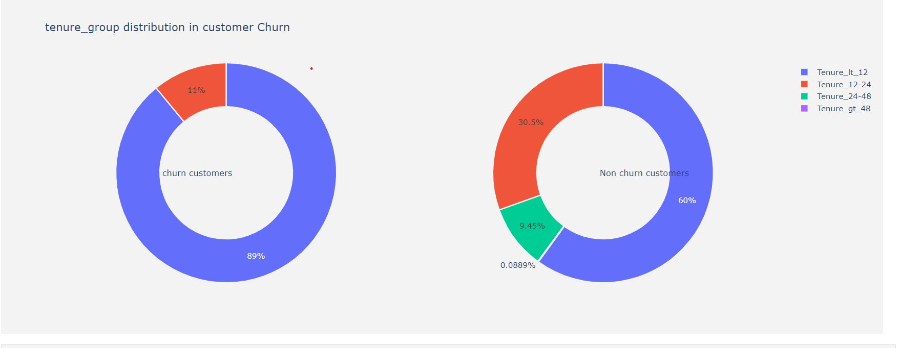
- This chart shows that most of the customers who have churned were in tenure group less than 12. And the others are from the tenure 12 to 14 group.
- this means that new customers are more likely to churn.
- We need to introduce some loyalty rewards and discounts for customers.

Slide 9
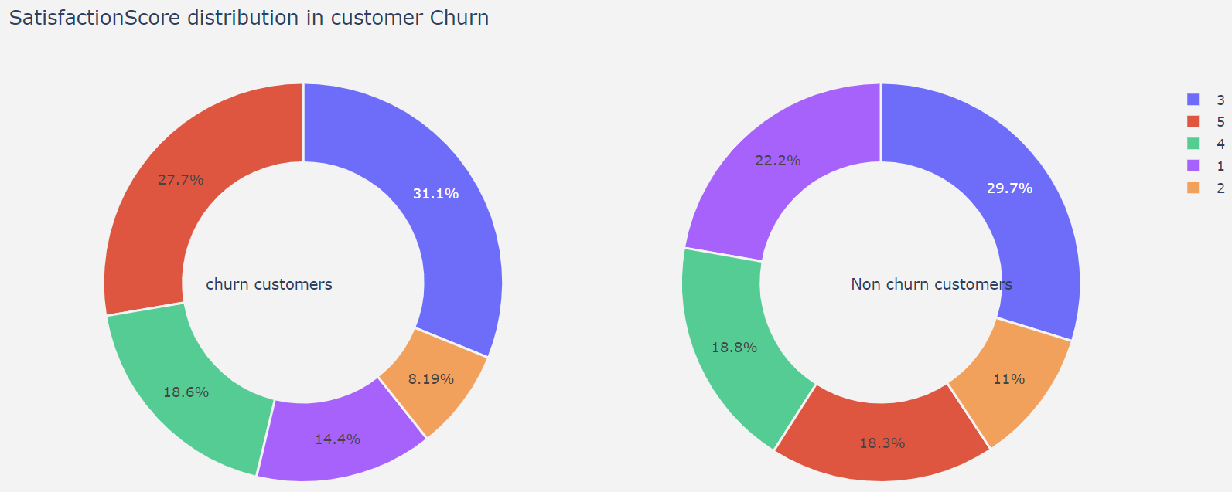
- Customer satisfaction distribution is confusing as we can see that there’s high percentage for more satisfaction scores.
- Which suggests us that we need to change our rating or feedback process, so we can accurately get the satisfaction score from customers.

Slide 10
Conclusion
- We can apply these strategies:
Complaint Resolution Program:
City Tier-Specific Strategies:
Improved Order Categories:
Satisfaction Enhancement:
Marital Status Targeting:
Tenure-Based Retention:
Customer Engagement:
Exit Surveys:

Slide 11

Thank You ☺

