Slide 1

Mental Health
DAB 100 – 004 F2023
DATA VIZ
Ruturajsinh Solanki - 0827884

Slide 2
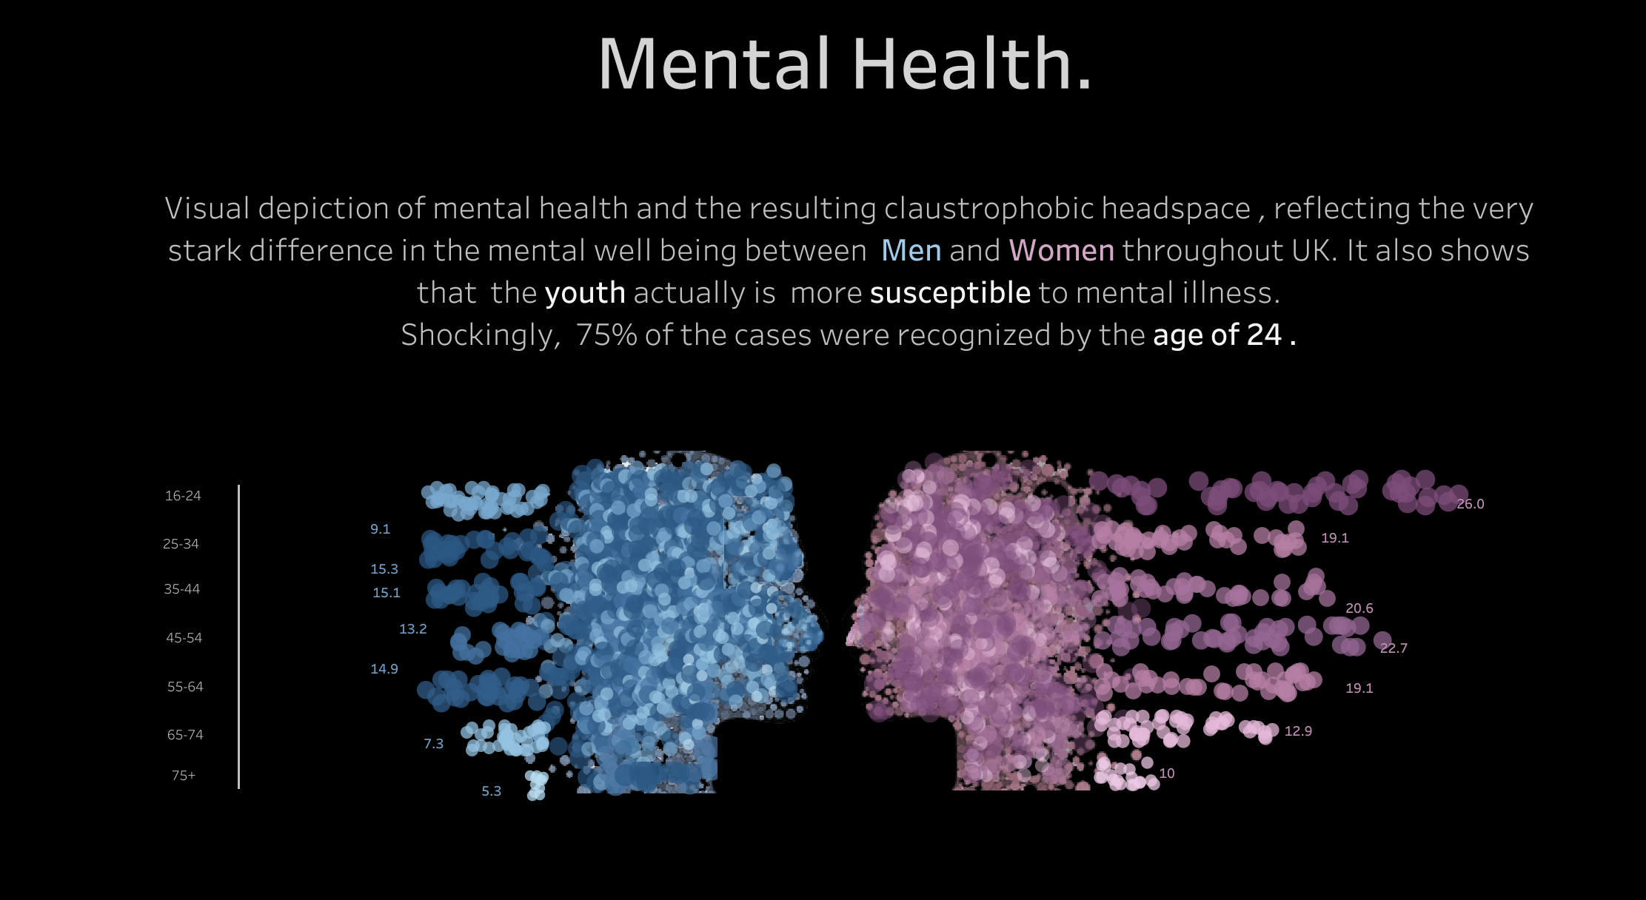

Slide 3

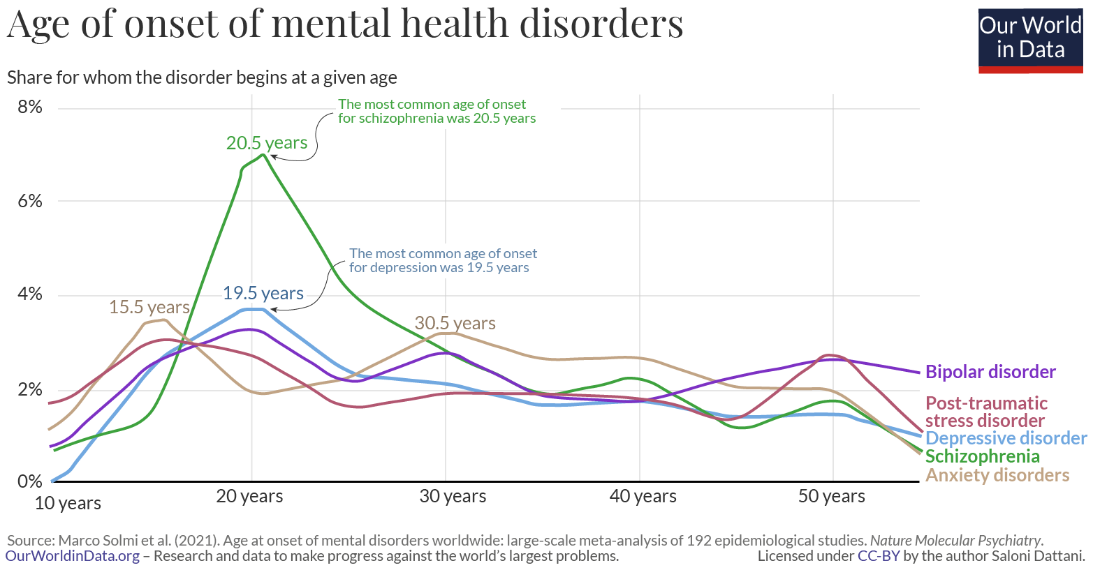

Slide 4
About the visualization
Visualization type – Line Chart
This visualisation shows us the proportion of men an women who suffers from mental health disorders. Also, it shows the gap between men’s and women’s acceptance of this issues.
According to the study it tells that men have less disorders and women have more. But often men with mental health issue don’t seek help. And it is found that men have higher suicide ration.

Slide 5
WHAT WE CAN LEARN FROM THIS VIZ
The thing that I really liked about this visualization is that it is so simple yet so effective as it gives clarity about the whole topic, the points are accurate and such visualization provides insides that can be used for better understanding of mental health in general as well as individually for both genders.
The most import aspect of this visualisation is that the issue of mental health is no joke! We need to speak up for this and we as humans need to help those who can not communicate their feelings well.

Slide 6
Thank you

