Slide 1
Hotel Reservation Analysis
DAB 501-004: Group 9

Slide 2
Agenda
Introduction
Project Phase 1
Project Phase 2
Project Phase 3
Conclusion

Slide 3



Group Members
KUNAL
RUTURAJ
SATYA

Slide 4
Introduction
The online hotel reservation channels have dramatically changed booking possibilities and customers’ behavior.
A significant number of hotel reservations are called-off due to cancellations or no-shows. The typical reasons for cancellations include change of plans, scheduling conflicts, etc.
This is often made easier by the option to do so free of charge or preferably at a low cost which is beneficial to hotel guests, but it is a less desirable and possibly revenue-diminishing factor for hotels to deal with

Slide 5

Project Phase 1
Data Description and Visualization

Slide 6
Booking_ID: a unique identifier for each booking
no_of_adults: the number of adults staying in the room
no_of_children: the number of children staying in the room
no_of_weekend_nights: the number of weekend nights (Saturday or Sunday) the guest stayed or booked to stay at the hotel
no_of_week_nights: the number of weeknights (Monday to Friday) the guest stayed or booked to stay at the hotel
type_of_meal_plan: the type of meal plan booked by the customer
required_car_parking_space: whether the customer requires a car parking space or not
room_type_reserved: the type of room reserved by the customer (encoded by INN Hotels)
lead_time: the number of days between the date of booking and the arrival date
arrival_year: the year of the arrival date
arrival_month: the month of the arrival date
arrival_date: the date of the month
market_segment_type: the market segment designation
repeated_guest: whether the customer is a repeated guest or not
no_of_previous_cancellations: the number of previous bookings that were canceled by the customer prior to the current booking
no_of_previous_bookings_not_canceled: the number of previous bookings not canceled by the customer prior to the current booking
avg_price_per_room: the average price per day of the reservation
no_of_special_requests: the total number of special requests made by the customer
booking_status: a flag indicating whether the booking was canceled or not

Slide 7
Data Description and Visualization
Phase 1 is all about the data visualization and exploration of the data that we have currently in the provided dataset.
In this Phase we have developed number of visuals that shows the different aspects of our dataset
We have used different libraries like ggplot2, plotly, and others for creating the interactive visualization of data

Slide 8
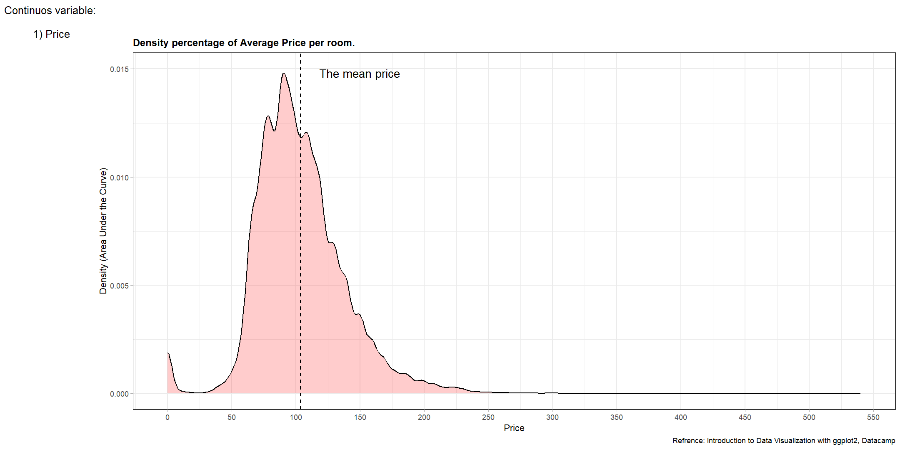

Slide 9
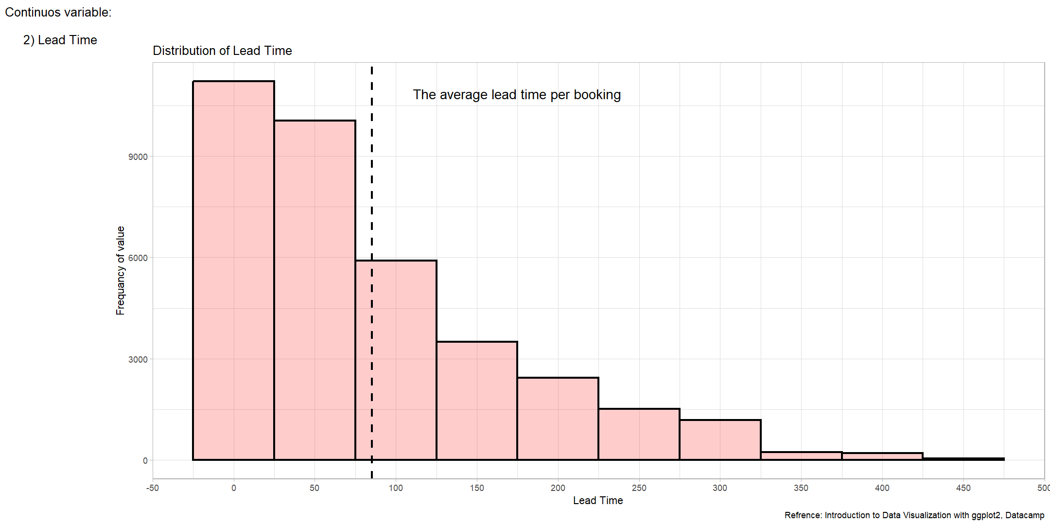

Slide 10
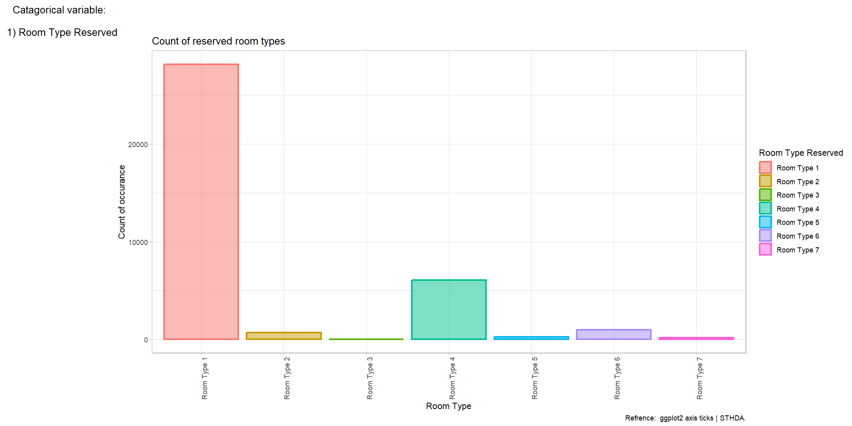

Slide 11
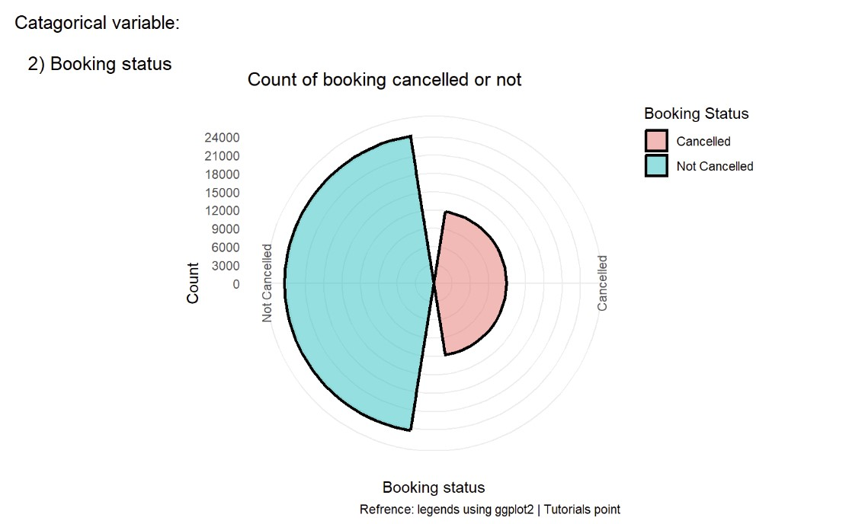

Slide 12

Project Phase 2
Data Cleaning and Analyzing

Slide 13
Data Cleaning and Transforming
Phase 2 is all about the data cleaning and analyzing the data
In this Phase we have done Univariate Analysis and Bivariate Analysis
Identifying Outliers
Compute the relation between the two variables
Describing the shape of the data
Identify the spread of the data and tendency
Show relationship between variables using plots
Explain relationship context
Describe observed variability

Slide 14
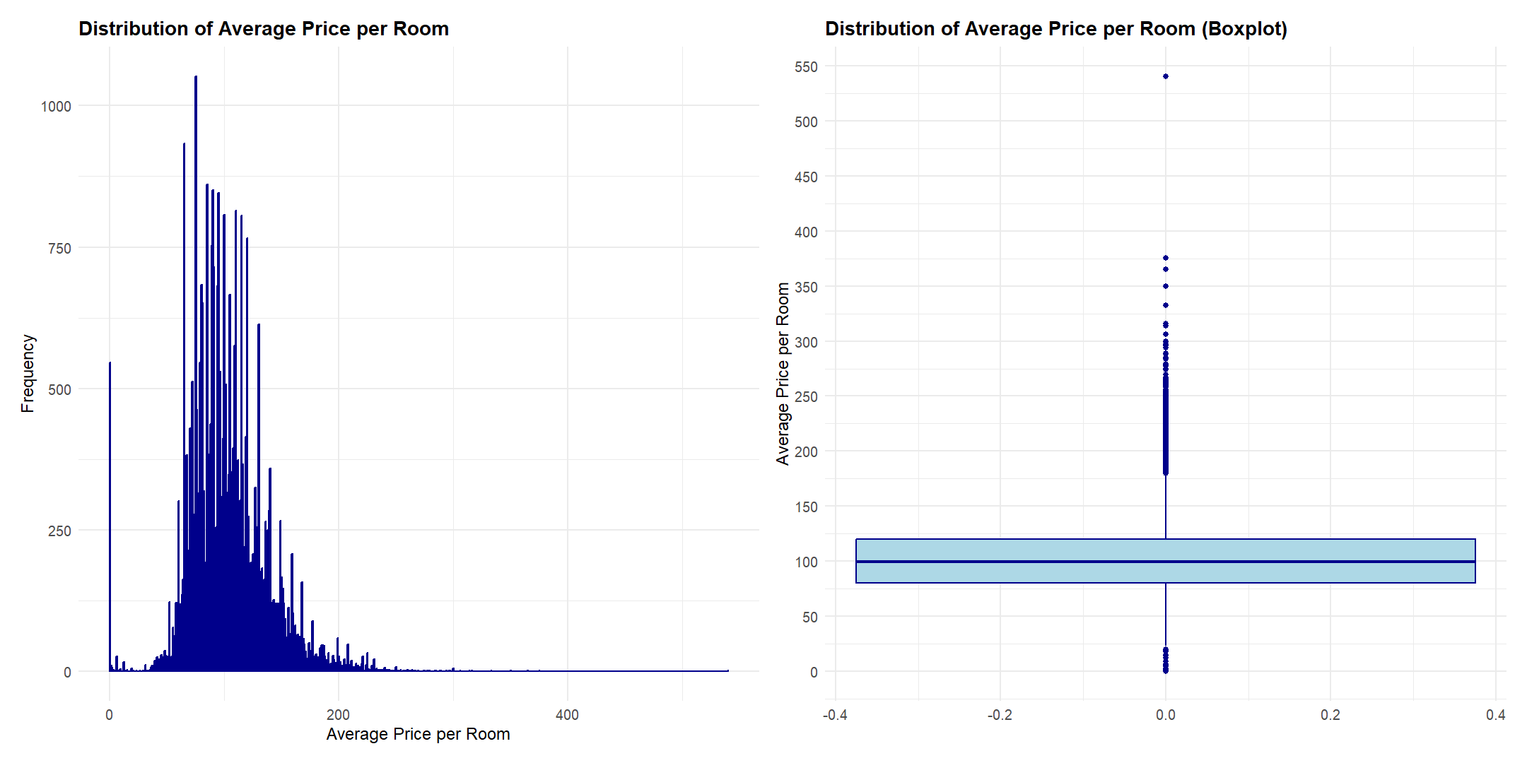

Slide 15
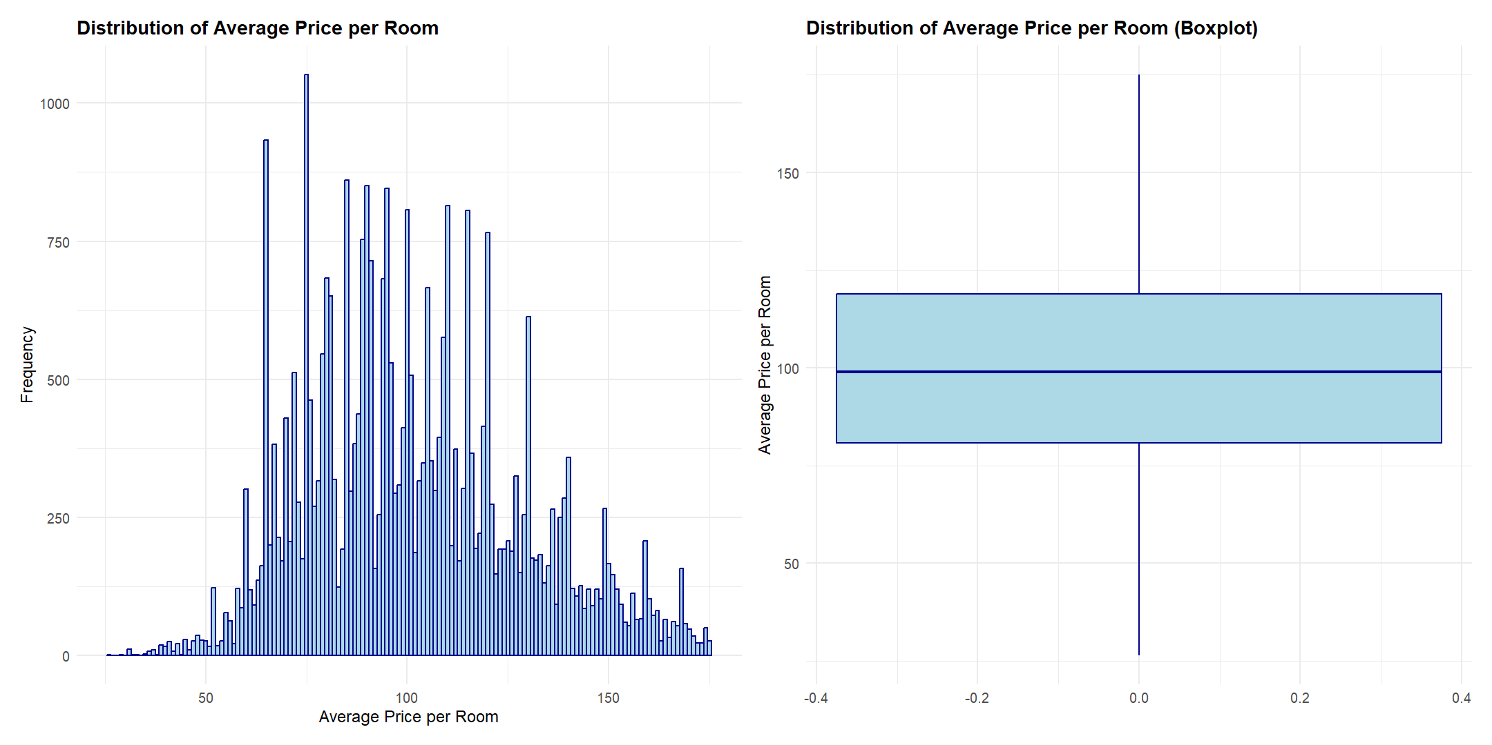
After Removing Outliers

Slide 16
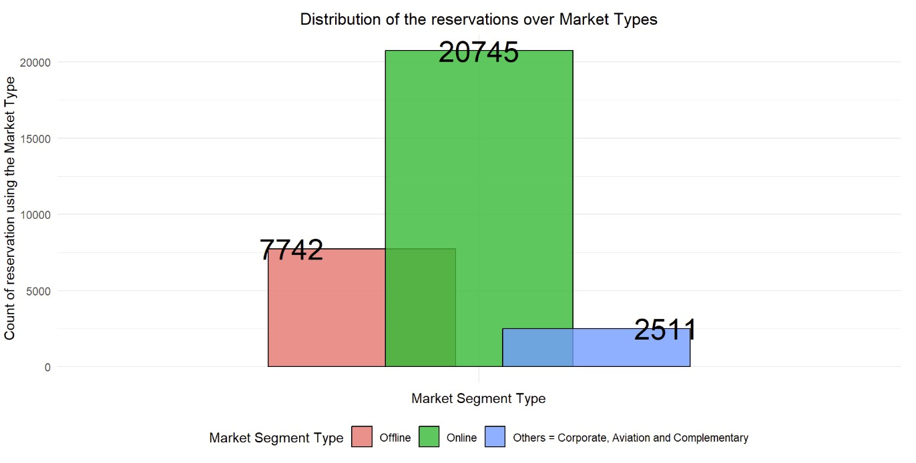

Slide 17
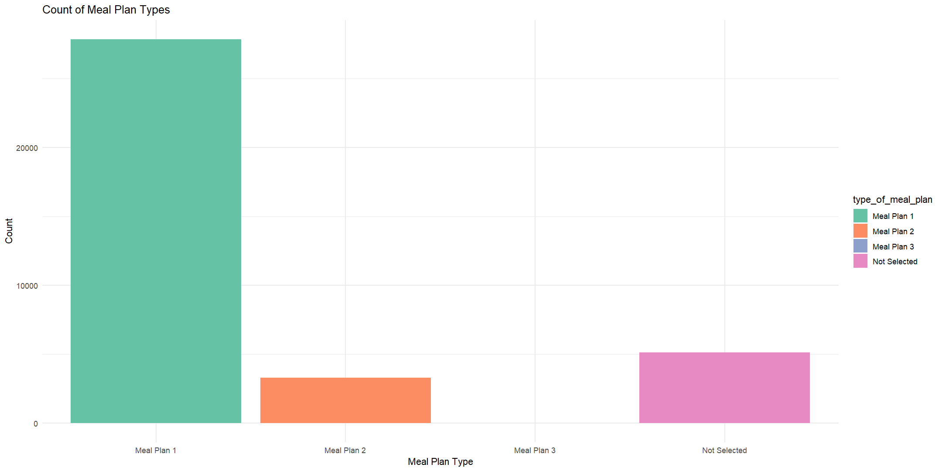

Slide 18
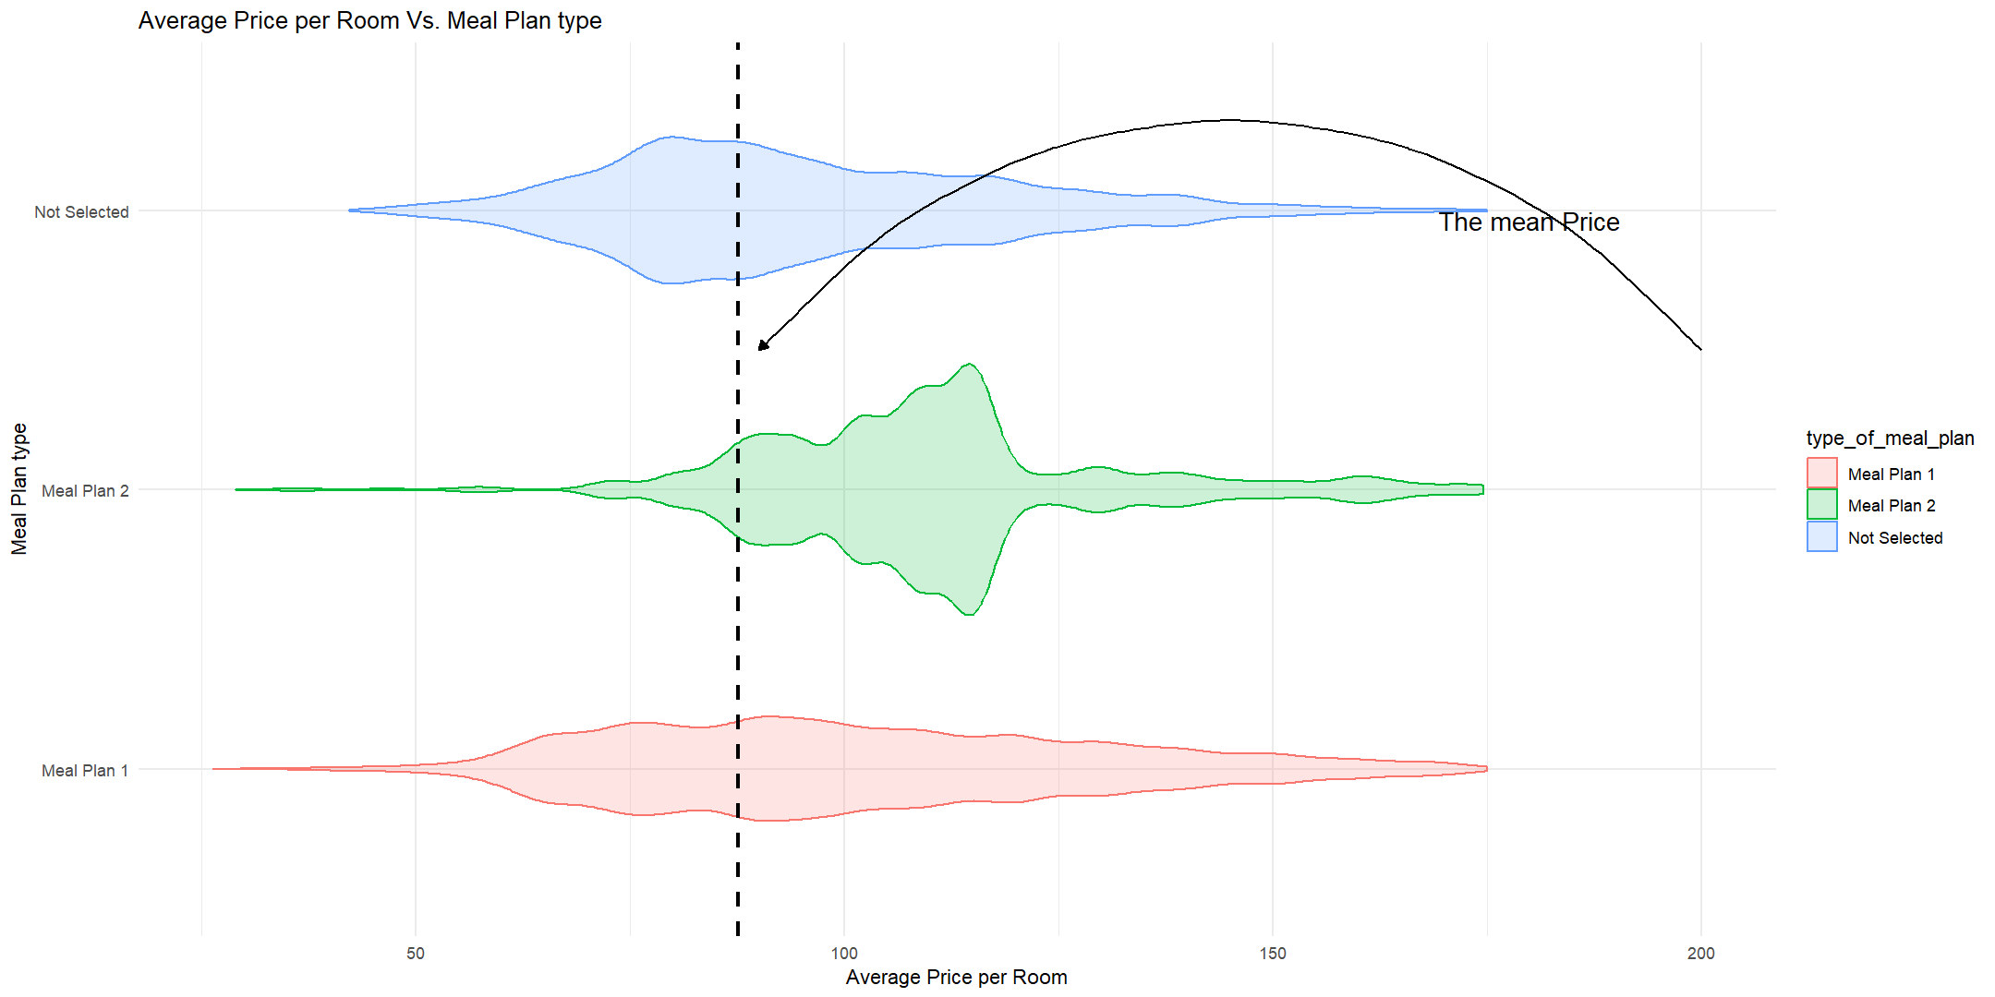

Slide 19

Project Phase 3
Data Modeling

Slide 20
Modeling
Logistic Regression:
Multinomial logistic regression
- Avg_price_per_room (Predictor) & room_type_reserved (Response)
Logistic Regression
- lead_time (Predictor) & booking_status (Response)
Provides log odds of response variable’s categories(i.e. predictions).

Slide 21
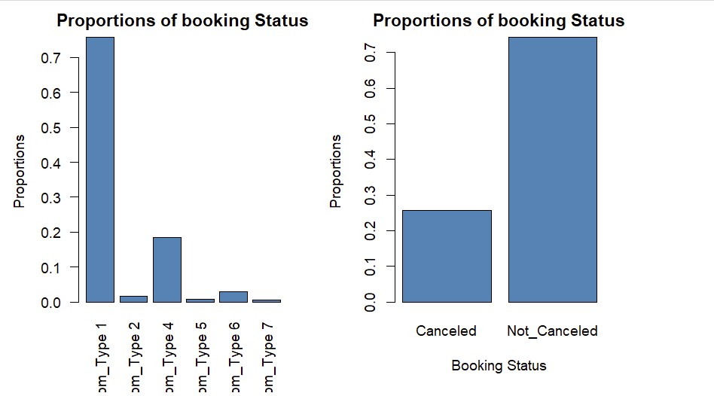
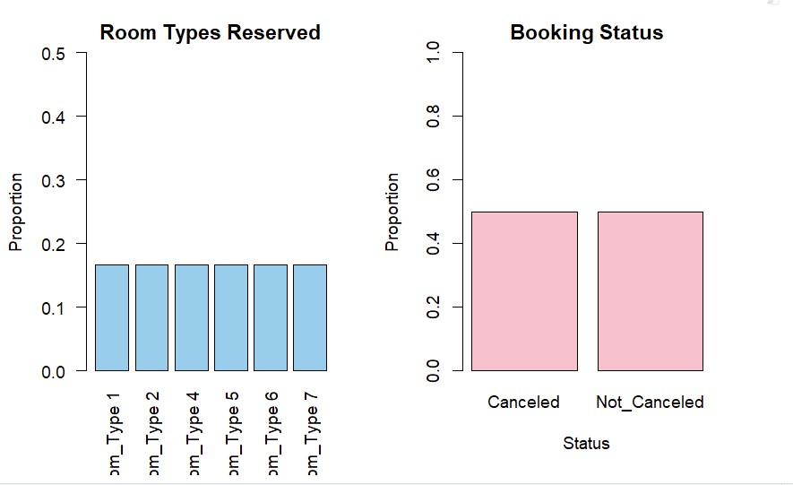
Balancing data

Slide 22
Model Training Process
Multinominal Logistic Regression:
Splitting data in 70/30 ration for training and validation respectively.
Equation using the O/P of trained model :
log(p(Room_Type = i) / p(Room_Type = 1)) = x0 + x1 * avg_price_per_room

Slide 23
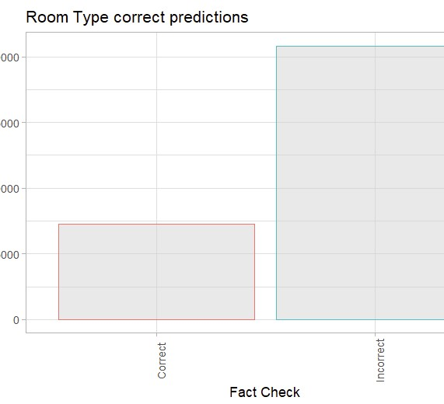
Testing Model

Slide 24
Model Training Process
Logistic Regression:
Splitting data in 70/30 ration for training and validation respectively.
Equation using the O/P of trained model :
log(p/(1-p)) =
-0.854157 + 0.013425 * lead_time

Slide 25
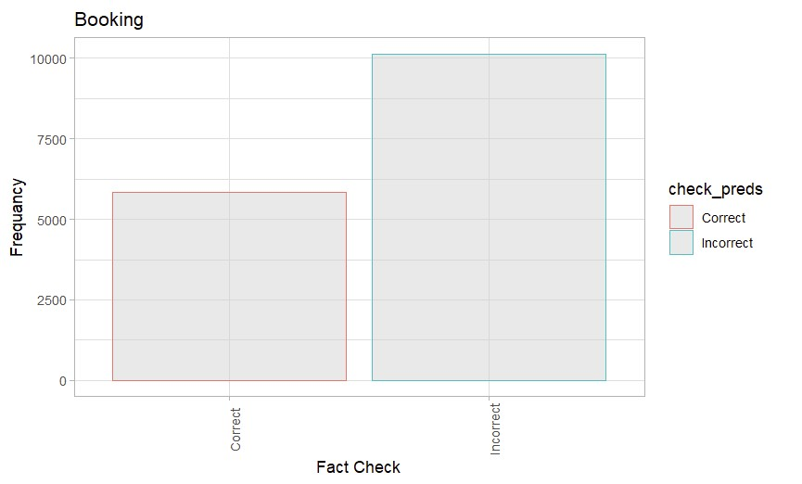
Testing Model

Slide 26

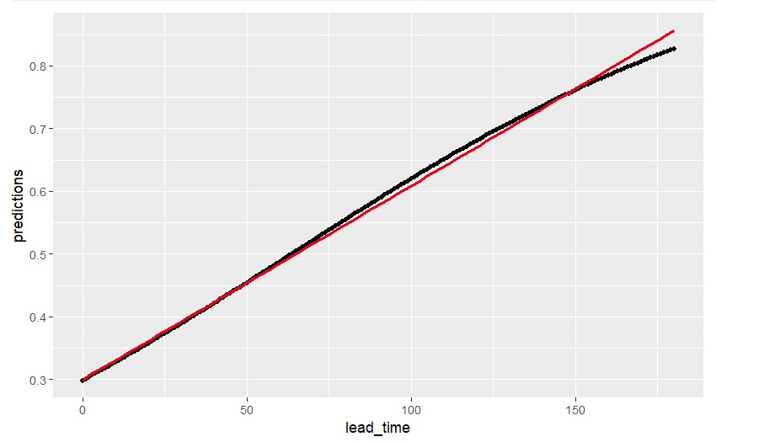
Linearity

Slide 27
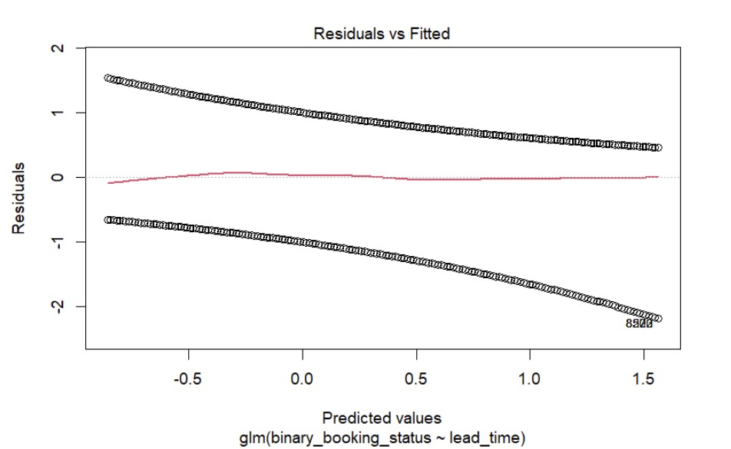
Model’s Fit

Slide 28
Conclusion
Linearity suggests that our model is correct for our dataset.
Where as, both of the model’s are not fitted very well as there are other variable having affects on the response variable’s values.
We can still try hyper tuning of parameters and other methods for better fit of data.

Slide 29

Thank You

