Slide 1
Worldwide Pursuits
- Group 2

Slide 2
Agenda/Topics to Be Covered
Problem Statement
Objective
Timeline
Tools and Techniques
Exploratory analysis
Challenges
Conclusion

Slide 3
Problem Statement
To address the challenge faced by international students in selecting the most suitable courses for their future endeavors, this research aims to analyze and provide guidance on the factors influencing optimal course selection, considering diverse academic, career and individual preferences among international student applicants.

Slide 4
Objective
To provide comprehensive guidance to international students, enabling them to make informed decision regarding their future academic pursuits by exploring and understanding the diverse range of courses available, aligning their interests, abilities and career aspiration with suitable educational paths.

Slide 5
Timeline
Task | Timeline
Project Initialisation | September 11th 2023
Data Collection | October 10th 2023
Data Cleaning | October 23rd 2023
Exploratory Data Analysis | November 8th 2023
Dashboarding/ Data Visualization | November 15th 2023
Model training | November 22nd 2023
Model testing | November 29th 2023
Model selection | November 29th 2023

Slide 6
Tools and Techniques
Python
Tableau
Google Collaboratory
Machine Learning models
Jupyter Notebook
Cloud services(Azure, google or AWS)

Slide 7
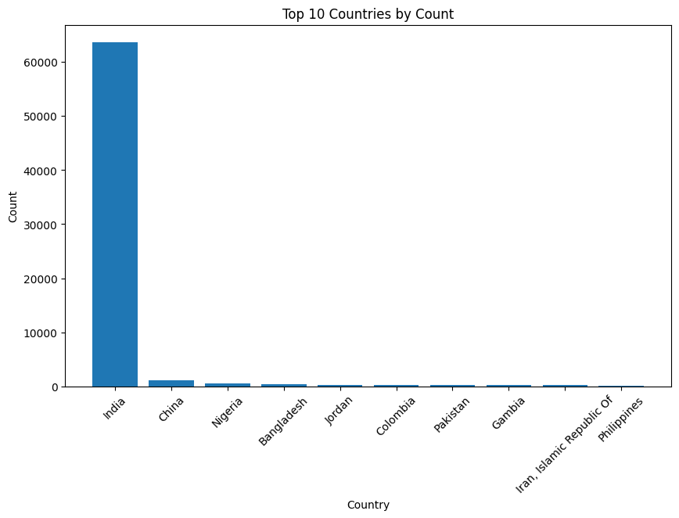
As we can see that, most of the students who are enrolled in St. Clair are coming from India.
There is no country that is closest to count of Indian students.
Then comes China with approximately 1000 count followed by Nigeria, Bangladesh, Jordan, Colombia, Pakistan and other countries.

Slide 8
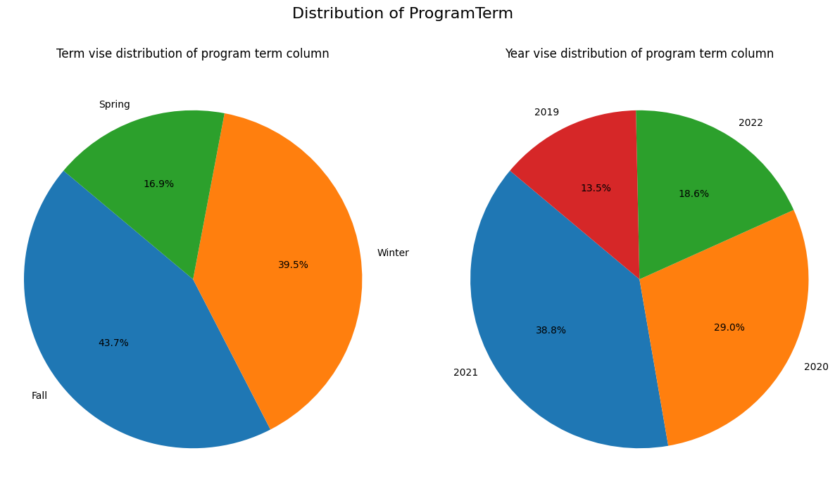
Majority of colleges new admits comes in fall term consisting of 43.7% and 39.5% in winter being almost same as the fall. While spring having the least admits (mainly due to it’s less program offerings). On the other hand, the year 2021 has the highest number of applications reason being the post epidemic year. While we do not have all terms data for 2019 and 2022 we can see we have less applications. In the year 2020, we can see almost 10% difference from 2021, again the reason being Covid19.

Slide 9
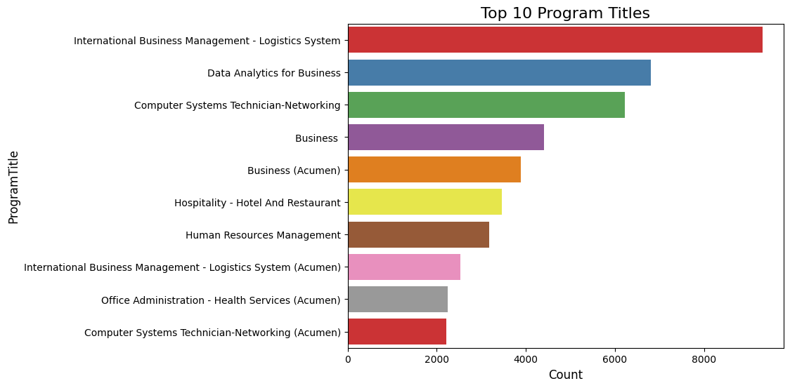
From the bar chart we can see that that international students coming to St. Clair are mostly interested in pursuing a business oriented or a course related to business background. They tend to enroll less in other courses which are related to health and office administration.

Slide 10
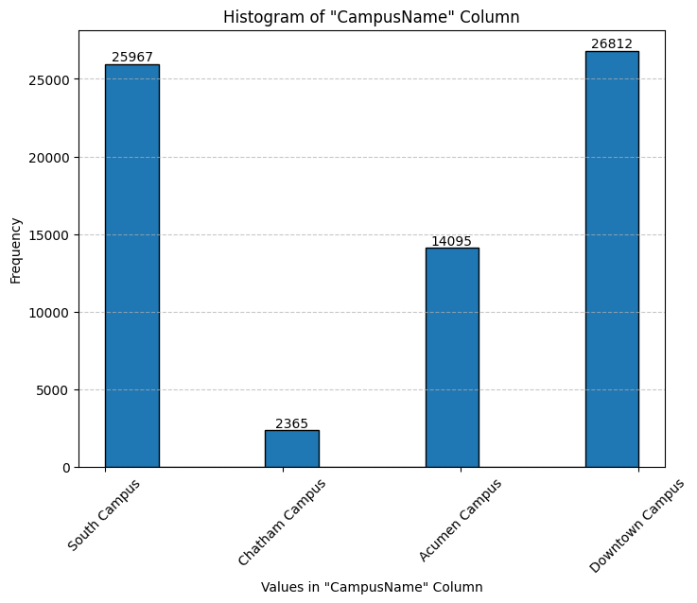
The campus is mainly based on the selected programs as programs will decide the campus and not the students.
We can see that Chatham campus has very less applications compared to other campus.
While downtown campus and south campus has most applications because of it’s program offerings.
Acumen campus only offers seven course option making it having the third in the list.

Slide 11
Challenges
Our dataset contained 55 columns and many of them were not contributing to the data quality.
Which columns to consider for further analysis and which columns to drop.
Some of our columns had null values considering which method to use for data cleaning and transforming.

Slide 12
Conclusion
The Exploratory data analysis provided us with many key insights.
Majority of our applications are from India.
Majority of our applications are for south campus and downtown campus.
Spring intake has very low applications.
Chatham campus has least applications.

Slide 13
Thank you!

