Slide 1


Cloud deployment of M2M applications
OpenHAB, RabbitMQ and Storm use case
February 19, 2014
Eclipse IoT day - Grenoble
Pierre-Yves Gibello : pygibello@linagora.com
Noël De Palma : noel.de_palma@imag.fr

Slide 2
Summary
M2M "ubilytics" big picture
Deployment issues
A processing chain
Roboconf dynamic (re)configuration
Demo scenario

Slide 3
M2M "ubilytics" big picture
Send selected
sensors meausrements
In elastic Cloud
M2M Gateway
@ Home, Office, Warehouse
(OpenHAB, IoTSys)
NoSQL Store
MongoDB,
Cassandra, HDFS
Reporting,
Dashboard, .
(history charts, ...)
In elastic Cloud
Message Broker
or MaaS or PSaaS
Mosquitto, RabbitMQ, …
Protocols : MQTT, AMQP, STOMP, XMPP, CoAP ...
M2M Gateway
@ Home, Office, Warehouse
MapReduce
Hadoop
Storing
agregates
Computed
prediction model
Sensors data messages
ie energy Consumption,
temperature, ...
Realtime ESP
Storm, Samza, S4, Spark Streaming, …
topologies
Embedded boards
smartphones
by millions
MQTT, AMQP,
STOMP ...
Predictions
Trends, ...
ESP
Monitoring
Placement
(static,dynamic)
Deployment & (Re)Configuration (Roboconf)

Slide 4
Deployment issues
Multi-scale
  From embedded (box, sensor, card...) to cloud / IaaS
  More and more devices while IoT emerges
Elastic & adaptative
  Add/remove components (eg. according to load patterns)
  Adapt data flow (eg. load balancing)
  Optimize (eg. co-locate)
Dependencies to be resolved at runtime
  Location of components (eg. where to send data)
  Configuration information (eg. database credentials)

Slide 5
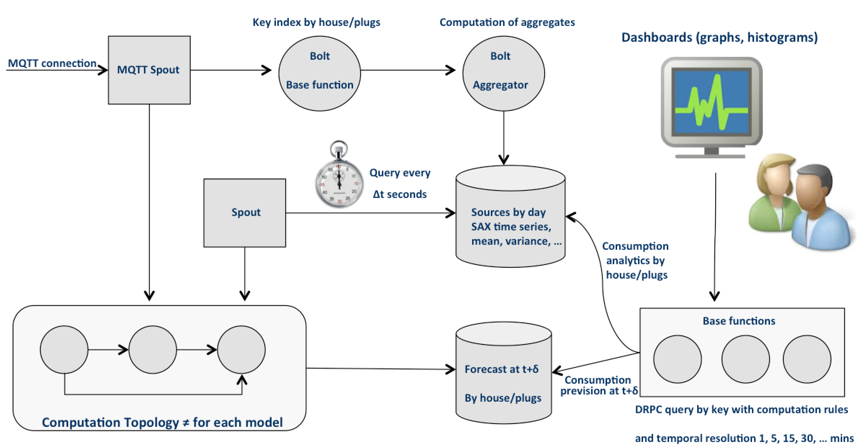
A processing chain
Example :
energy consumption forecast,
based on Storm.
Dynamic elasticity (eg. on IaaS)
Bottleneck detection
Shrink when possible (lower flow)
Insert additional node(s) + reconfigure
Remove useless node(s) + reconfigure

Slide 6
Roboconf dynamic (re)configuration
Application model
  Graph of components (eg. VMs or software packages) with dependencies (export/import of configuration variables)
  Initial deployment description (set of instances, deployed on VMs)
Deployment manager (DM)
  Creates VMs on IaaS when necessary
  Deploys the model (including software packages) on VMs
Agent
  Present on each VM
  Cross-instances communication (exchange of variables import/export)
  Admin communication with DM
  Lifecycle of software deployed on the VM (setup, start, stop...) according to dependency resolution
Asynchronous communication
  Based on RabbitMQ

Slide 7
RoboConf in details
MQ / JMS
Roboconf
Deployment
Manager
Exchange / resolve
imports / exports
Propagate
model
VM (EC2...)
or any device
VM (Beagle board...)
or any device
VMbeagle {
alias: Beagle board;
installer: iaas;
children: openhab;
}
VMaws {
alias: Virtual machine;
installer: iaas;
children: mqtt;
}
openhab {
installer: bash;
exports: httpPort;
imports: mqtt.ip;
}
mqtt {
installer: bash;
exports: ip;
}
Agent
Agent
instanceof VMbeagle {
name: Beagle1;
instanceof openhab {
name: openhab1;
httpPort: 8080;
}
}
instanceof VMaws {
name: VM_MQTT1;
instanceof mqtt {
name: MQTT1;
}
}
variables
import / export
variables
import / export
lifecycle
lifecycle
Configurable
software
...
Configurable
software
+ dependencies (RPMs...)
+ dependencies (RPMs...)

Slide 8
Demo scenario (1)
Replay load and work
from CSV data file
of house #0
OpenHAB
House #0
MQTT Connection
Port 1883
Mosquitto
MQTT broker
MQTT Connection
Port 1883
MQTT Connection
Port 1883
MQTT WebReport
Node.js
(Node RED)
VMo2
OpenHAB
House #1
VM AmazonWS
"VM" BeagleBone
RoboConf deployment & (re)configuration

Slide 9
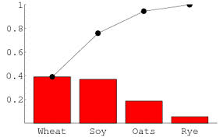
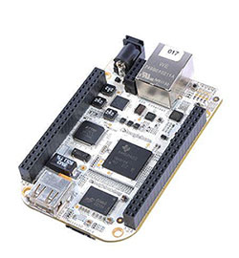

Demo scenario (2)
Client
Roboconf = DM (webapp) + messaging server
Roboconf
DM
Push
application
(5) Data
analysis
(1) Deploy MQTT server
on new VM
(1) Deploy OpenHAB
+ data simulation
MQTT
server
(2) No dependency
= ready to start
(2) Expecting dependency (IP of MQTT) = not ready
to start
(3) Export IP address of MQTT server
Messaging Server
(4) Publish sensor data on MQTT

Slide 10
That's all, Folks !
Any question ?

Slide 11
Groupe LINAGORA
80, rue Roque de Fillol
92800 PUTEAUX
FRANCE
Tél. : 0 810 251 251 (tarif local)
Fax : +33 (0)1 46 96 63 64
Courriel : vente@linagora.com
Web : http://www.linagora.com/
Éditeur de logiciels libres
Laboratoire LIG
Maison Jean Kuntzmann
110 av. de la Chimie - BP 53
Domaine Universitaire de Saint-Martin-d’Hères
38041 GRENOBLE cedex 9
FRANCE
Tél. : +33 (0)4 76 51 43 61
Fax : +33 (0)4 76 51 49 85

