Slide 1
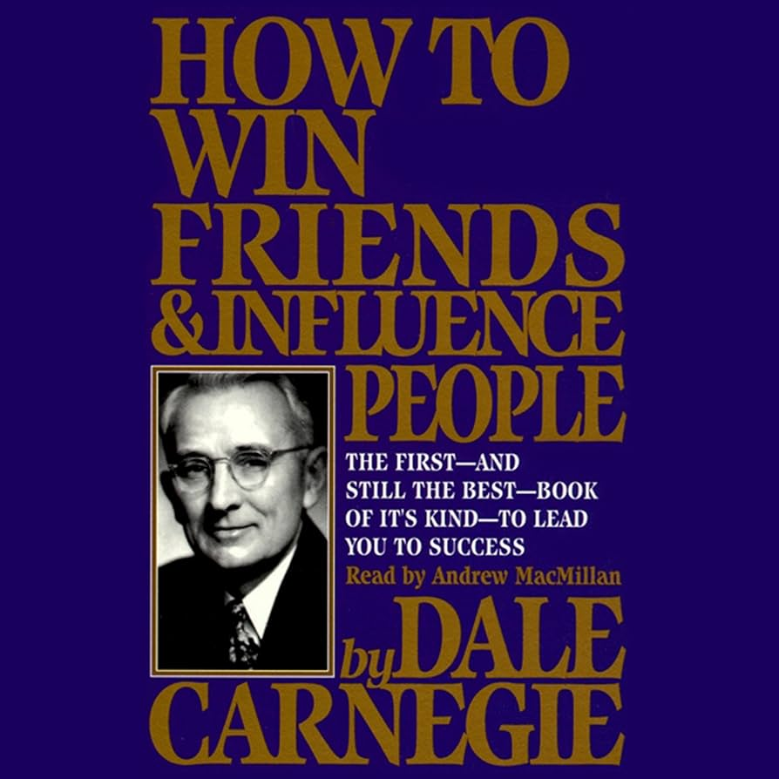
“How to win friends and influence people” - What Dale Carnegie taught me
By Omar Maaouane Veiga

Slide 2
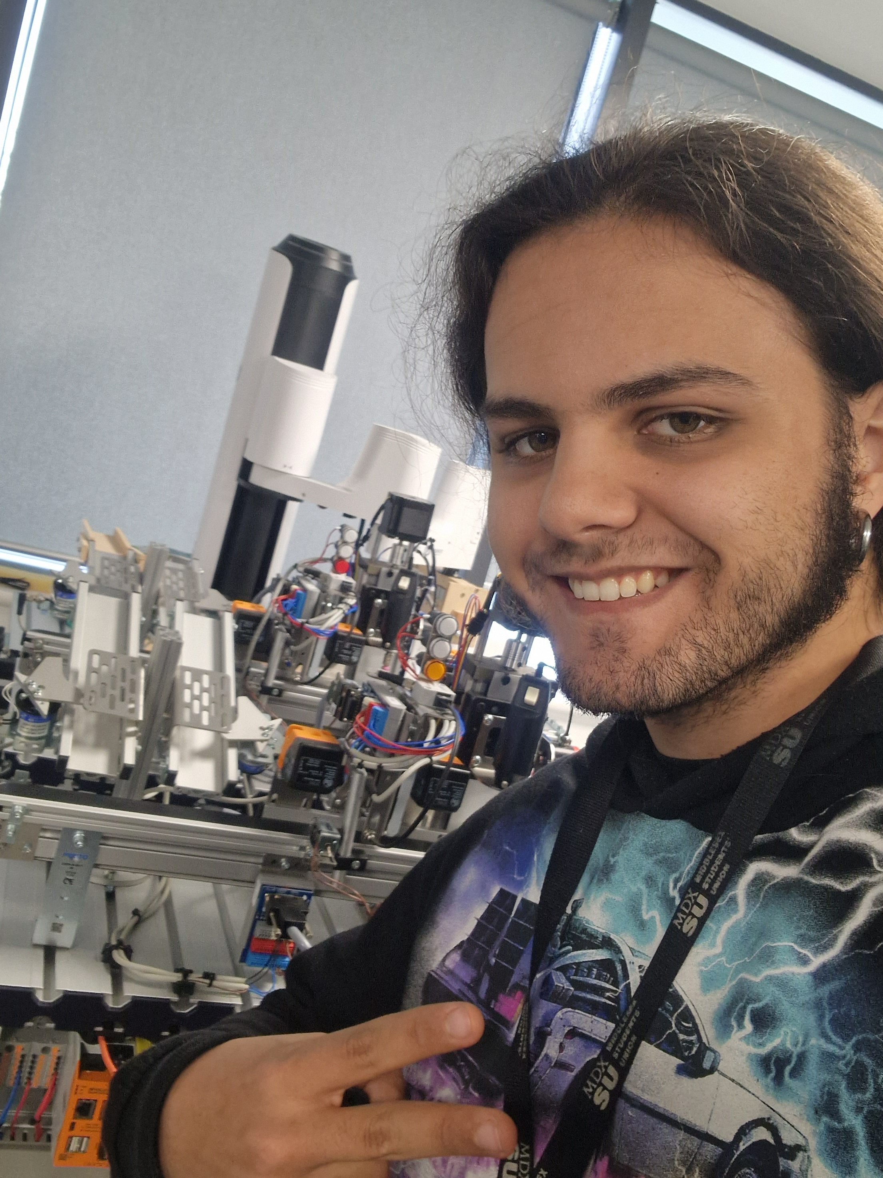
Introduction
Before I started uni I was alone when it came to my interest. I was the only person I knew who liked Robotics, and I didn’t have much experience making friends nor influencing people within my profession at all.
That’s when I bought a book called “How to win friends and Influence people”.

Slide 3

What’ we’ll cover
In this presentation I’ll share with you the essence of what I learned from the book
I’ll also share examples of how putting those lessons in practice helped me greatly succeed in my journey so far (and hopefully succeed in the future).

Slide 4

What lessons I learned
If there’s one thing this book will drill into your head across all it’s lessons, is how beneficial making friends is in the long run. This is shown through plenty of examples through the book. Among the most important lessons were:
-No one wins an argument
-If you’re wrong, admit it
-A drop of honey is better than a barrel of tar

Slide 5

Those lessons in practice
During one course project, we were in a group project were one of our peers was often unavailable and didn’t perform as expected. Instead of mandating him to do better I actively communicated with him, asked what was wrong, empathised and never so much as commanded him to “get to work”.
In the end he himself was the one eager to collaborate and quickly picked up his slack.
The group project turned out far better that we could’ve imagined/
Notes:
NOTES: During my first year if uni, I was very closed off from my peers and deeply ingrained in the “one-man band” mindset I had followed up to that point.
After reading the book and learning about the benefits of making friends and how those relationships correlate with success, I gradually became more open to collaborating, making friends, and learning from others.
Next slide has some of the examples of how I applied those principles and what benefits they brought:

Slide 6

Those lessons in practice
From the book I also began to appreciate the power behind communicating with people effectively. I began actively going to networking events whereby I met other engineers who were later able to help me with professional advice and even obtained help for interviews I would’ve never obtained otherwise.

Slide 7

Those lessons in practice
During my final year project, I went to my supervisor fixated on a particular idea. Hearing his suggestions and actively admitting I was wrong at times allowed me to grow, progress and make friends on top of excelling at my project beyond what I could’ve ever imagined.

Slide 8

Conclusion
‘How to make friends and influence people’ has been an amazing book. It singlehandedly taught me how to make wiser decisions in my life that pan out better for everyone in the long run.
Without it, I probably wouldn’t have gotten here giving this presentation to you!

