Slide 1

SOAR
Sub-orbital Amateur Radio

Slide 2
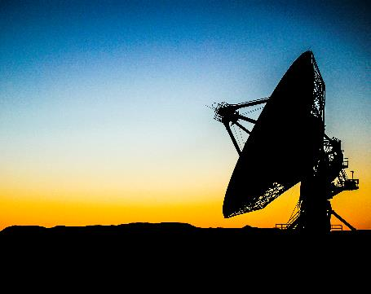


Introduction
Sub-orbital rocket launches provide opportunities for space environment payload testing and experimentation at a fraction of the complexity and cost of typical Low Earth Orbit missions. The Sub-orbital Amateur Radio (SOAR) project’s goals are to perform engineering and science experiments utilizing Amateur Radio, as well as increasing the Technology Readiness Level of Amateur Radio space flight systems.
This project is sponsored by the Open Research Institute.

Slide 3
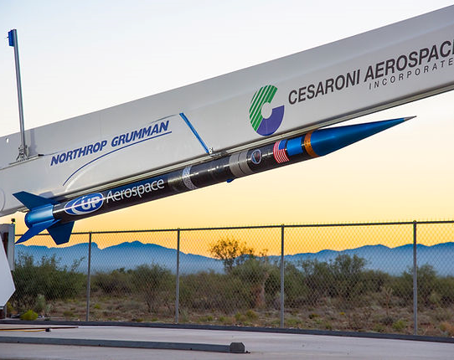
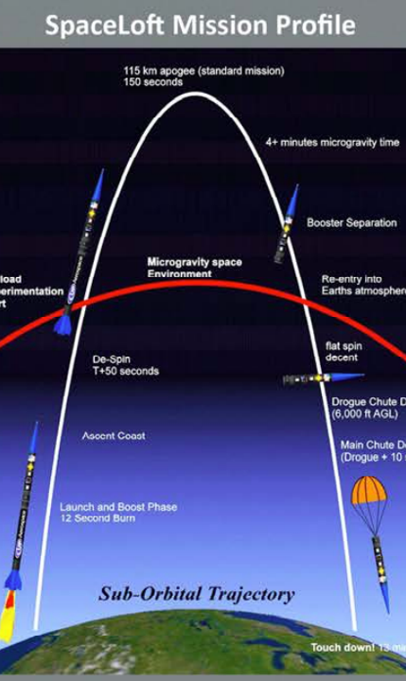
Typical Mission: UP Aerospace SpaceLoft
Sub-orbital launches using vehicles such as UP Aerospace’s SpaceLoft follow the mission profile shown at the left. Launch and boost phase lasts 12.5 seconds during which the payloads will experience axial loads up to 16 g and radial loads up to 18.5 g. The vehicle will coast for 42.5 seconds and then reduce its spin rate to a few degrees per second. At this point, the vehicle enters the microgravity space environment for just over 4 minutes, reaching an apogee of over 100 km. The vehicle re-enters the atmosphere, deploys drogue and main chutes, and touches down at approximately 13 minutes after launch.
Top image photo credit: NASA
Bottom image credit: UP Aerospace Payload Users Guide

Slide 4
SOAR
ASCENT
SPACE
RE-ENTRY
Payload will experience both axial (direction of travel) and radial (due to vehicle spin stabilization) high acceleration loading
Frequencies will be altered via doppler shift as well as component drift due to acceleration and temperature changes
More difficult to track with directional ground station antennas due to the velocity of launch
Shortest portion of the mission
Least dynamic environment of the mission
Vehicle orientation may block antenna radiation (vehicle is slowly rotating)
Best opportunity for longer range 3rd party reception
Very dynamic vehicle motions prior to drogue and main chute deployments
Highest temperatures of the mission
Additional opportunities for 3rd party reception

Slide 5
SOAR-1 Mission
VEHICLE PAYLOAD
GROUND STATION
A low-cost radio transceiver (Semtech SX1276) will be evaluated for use in space applications
Modulation via LoRa, CW, and FM voice will be performed in the 70cm amateur band (430-435 MHz)
Maximum output power of 1W or 100mW (TBD) into a 0dBi omnidirectional antenna
Test pattern data will be transmitted from the payload using different LoRa modes cycled in a predictable pattern
A Software Defined Radio Receiver (e.g. AirSpy R2) will be used to record the radio spectrum required to demodulate the various transmitted modes (+/- doppler and some margin for drift)
A single station with an azimuth/elevation tracking antenna, or multiple stations with fixed antennas covering the flight trajectory will be used (TBD)

Slide 6
SOAR-1 Timeline
September 2022
Payload hardware design complete
Prototype payload ready for lab use
October 2022
Testing of prototype payload
Ground station options evaluation
Ground station software prototype
Initial pass of firmware complete
November 2022
January 2023
Payload hardware re-spin if required
Finalize payload firmware
Finalize Ground station hardware and software
Launch
March 2023
Payload hardware delivered to UP Aerospace

Slide 7




References
Open Research Institute https://www.openresearch.institute/
UP Aerospace Inc.
https://www.upaerospace.com/
Semtech SX1276
https://www.semtech.com/products/wireless-rf/lora-core/sx1276

Slide 8

Contact
Jay Francis, KA1PQK
ka1pqk@arrl.net
https://github.com/robojay/SOAR

