Slide 1
Bin Packing Using
Search Methods
Robert Jackson
Applications
Current State of the Art
Shapes
Bins
Rotations
Search Methods
Heuristics

Slide 2
Overview
Bin Packing optimization deals with the problem of fitting objects of various shapes and sizes into a bin of length l and width w.
Search algorithms (DFS, A*) can be used to traverse the possibility tree to find a configuration that leaves no holes.

Slide 3
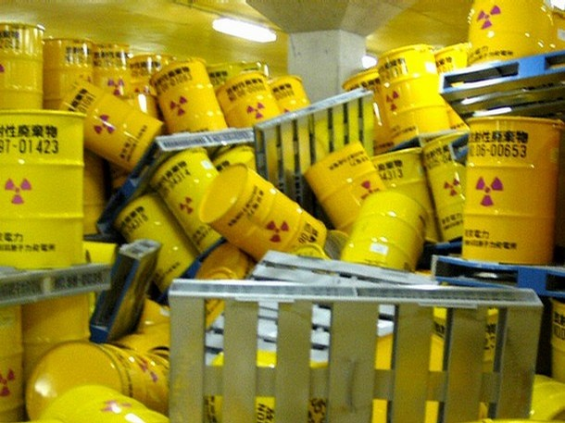
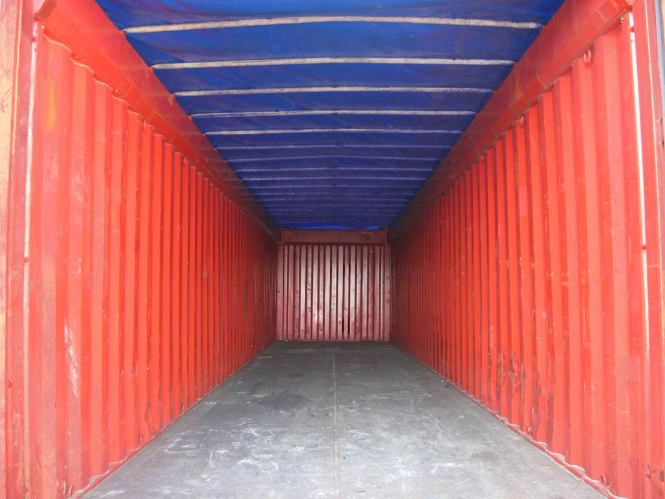
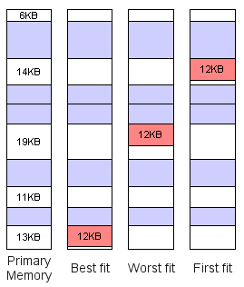

The Problem – Why?
Storage of Radioactive
Waste
Memory Allocation
Shipping of Goods
Of various size/shapes

Slide 4
The Present Situation
Give a summary of the current situation
Packing for:
      Storage – optimize space, time
      Transport – inertia, center of mass, space
Applications
      Memory Management (Paging)
      Shipping
      Storage
      Art
Commercial Application Suites
      optimal packing of various bins
      shipping containers
      pallets
      radioactive waste storage/transport

Slide 5
Development up to present
Development made up to the current situation
Important background information
Original forecasts which turned out to be wrong
Original forecasts which turned out to be true

Slide 6
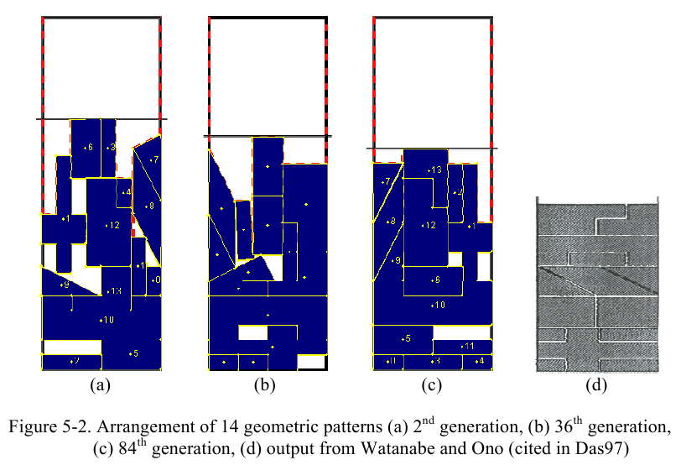
Potential Alternatives
State the alternative strategies
    Genetic Algorithm (GA)
      Pros: good for large tree,
      Cons: slow, not optimal,
    Constraint Satisfaction Problem (CSP)
      Pros: fast
      Cons: not easily modified
    Packing homogeneous shapes/sizes
      Pros: greatly reduces permutations
      Cons: not possible in most instances
List the pros and cons of each strategy
Give a forecast of costs

Slide 7
Genetic Algorithm by Arfath Pasha

Slide 8
Bin Packing Methods
Overview
Long-term goal
The Present Situation
Development up to present
Potential Alternatives
Recommendation

Slide 9
My Project – Tetromino Bin Packer
Algorithms Implemented
    A* (NumberOfTilesLeft and NumberOfHoles Heuristics)
    DSF
    Greedy Best First Search
    Hill Climbing
    Simulated Annealing

Slide 10
Long-term goal
Given a set of tetrominos T, and a bin of length l and width w, place each element of T at location x,y and rotation r.
numTetrominos*4 <= l*w
numTetrominos*4 + numHoles <= l*w

Slide 11
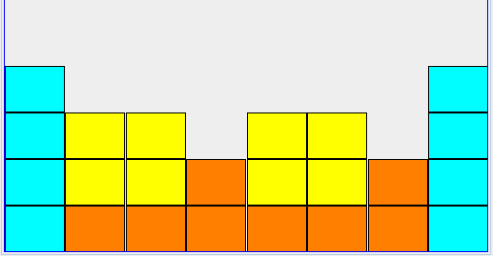
Building the Tree – 1
class TetrisPieceActionsFunction {
public Set<Action> actions(Object state) {
...
for (int j = 0; j < board.getRows(); j++) {
...
for (int i = 0; i < board.getColumns(); i++) {
addActionsToSet(pool, i, j, board, actions);
}
}

Slide 12
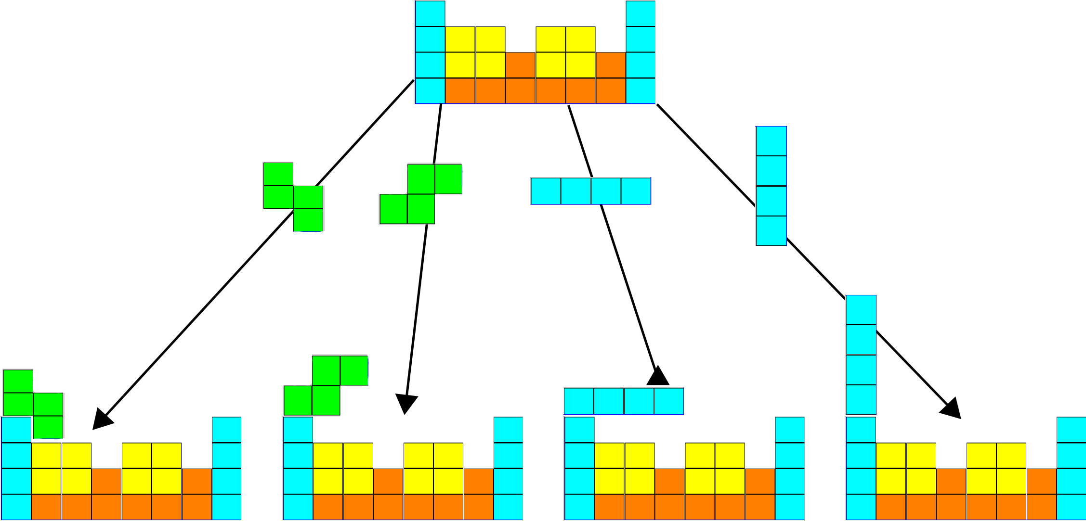
Building the Tree – 2
void addActionsToSet(...) {
. . .
addSActionsToSet(board, location, actions);
addIActionsToSet(board, location, actions);
. . .

Slide 13
Building the Tree – 3
addSActionsToSet(TetrisBoard board, XYLocation loc, Set<Action> actions) {
TetrisPiece piece = TetrisPiece.S_PIECE;
if (board.willFit(piece, loc)
&& !BadMoveTest.isBadMove(board, piece, loc)) {
actions.add(TetrisPieceAction.PLACE_S, loc);
}
// try rotate and place S piece
piece.rotateClockwise();
if (board.willFit(piece, loc)
&& !BadMoveTest.isBadMove(board, piece, loc)) {
actions.add(TetrisPieceAction.ROTATE_AND_PLACE_S, loc);
}
}

Slide 14
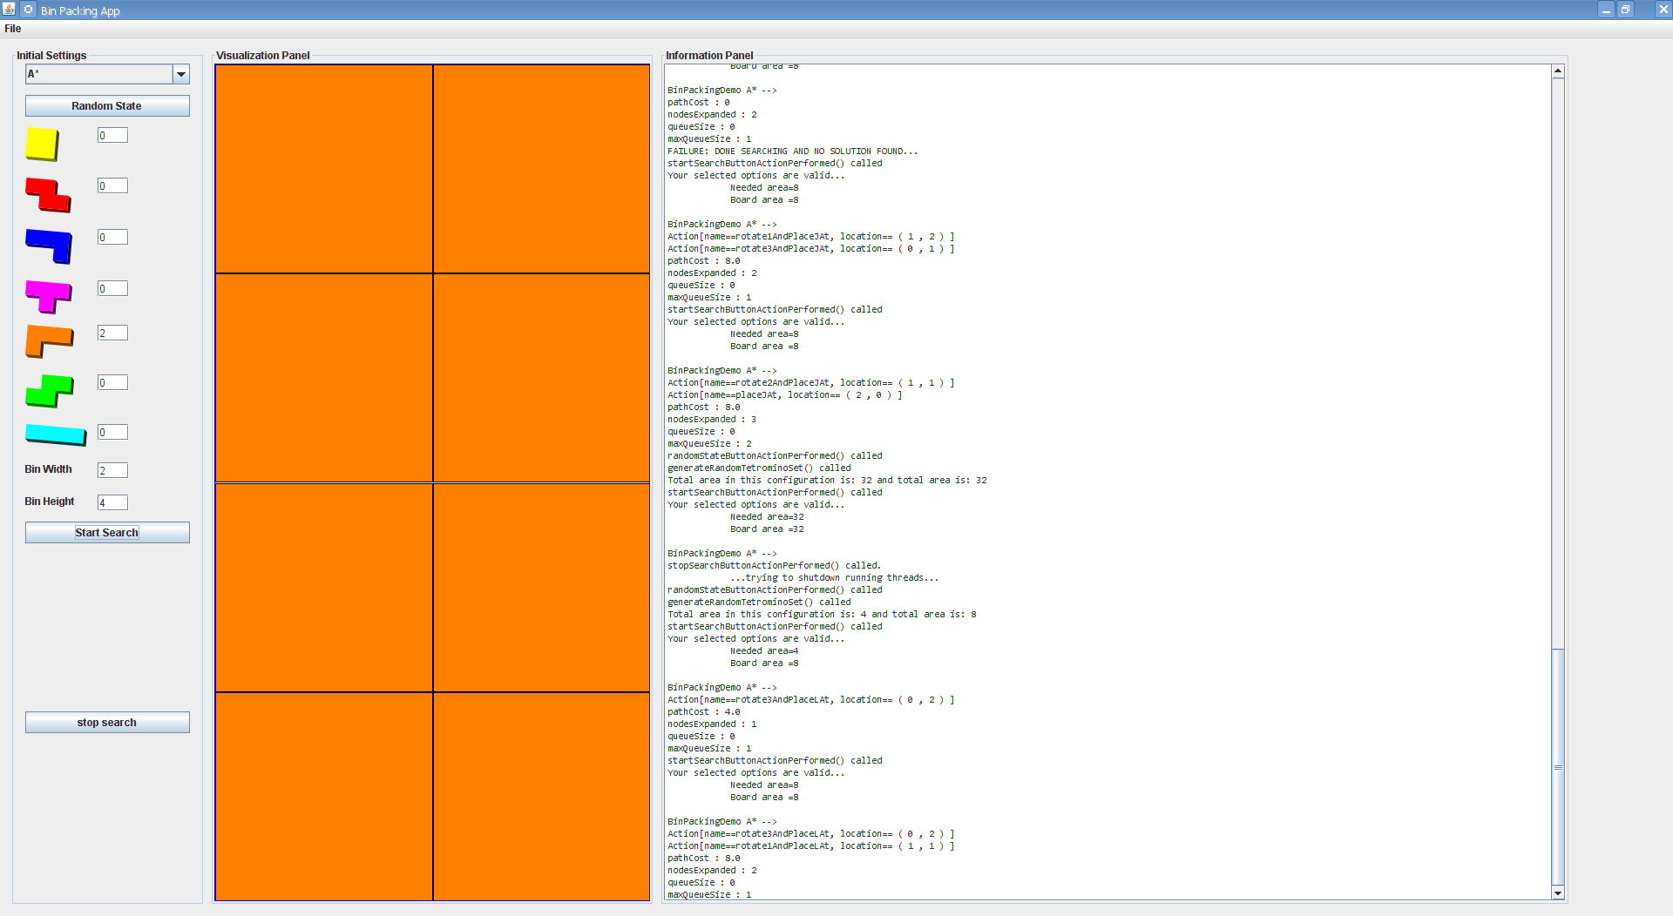
Screen Shot #1 – 2x4

Slide 15
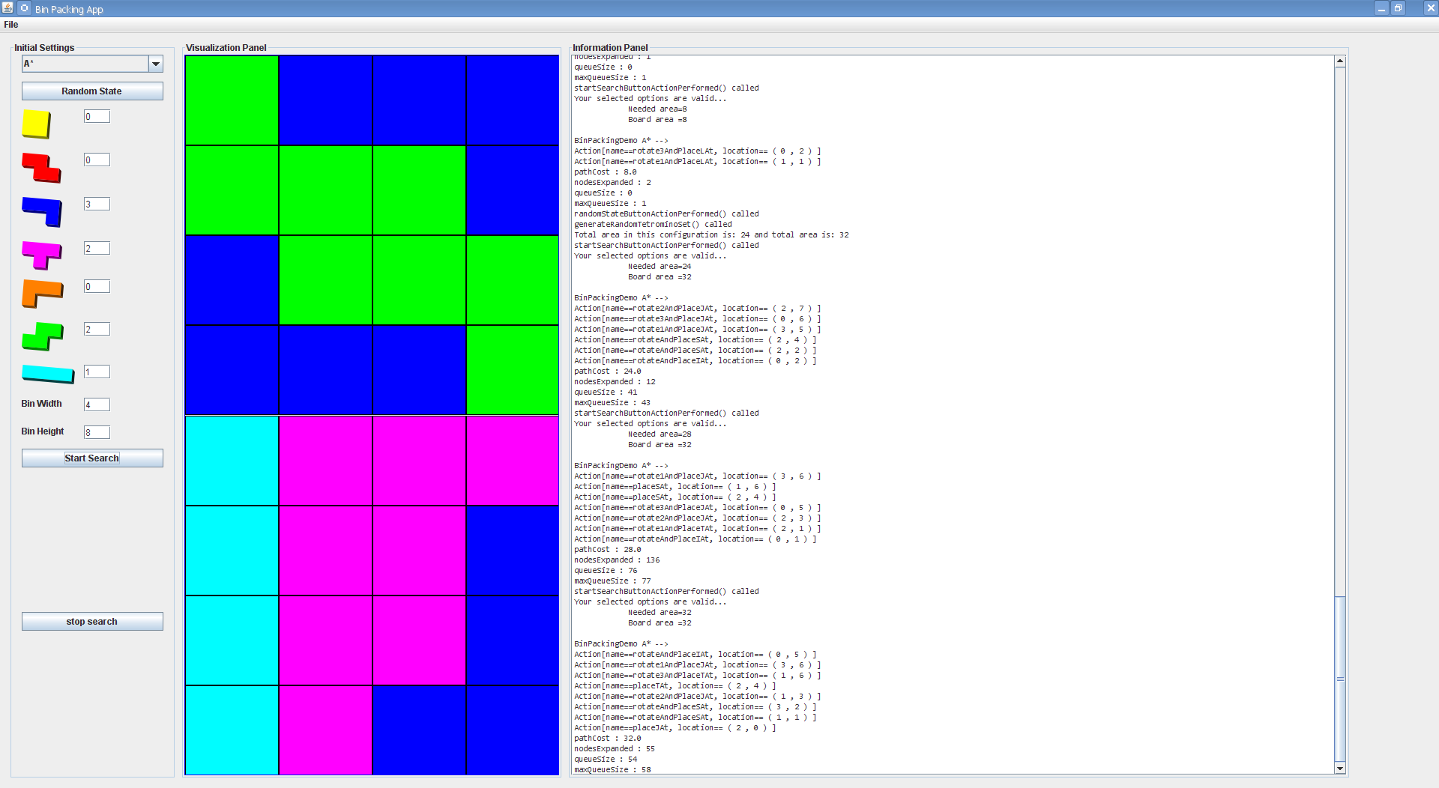
Screen Shot #1 – 4x8

Slide 16
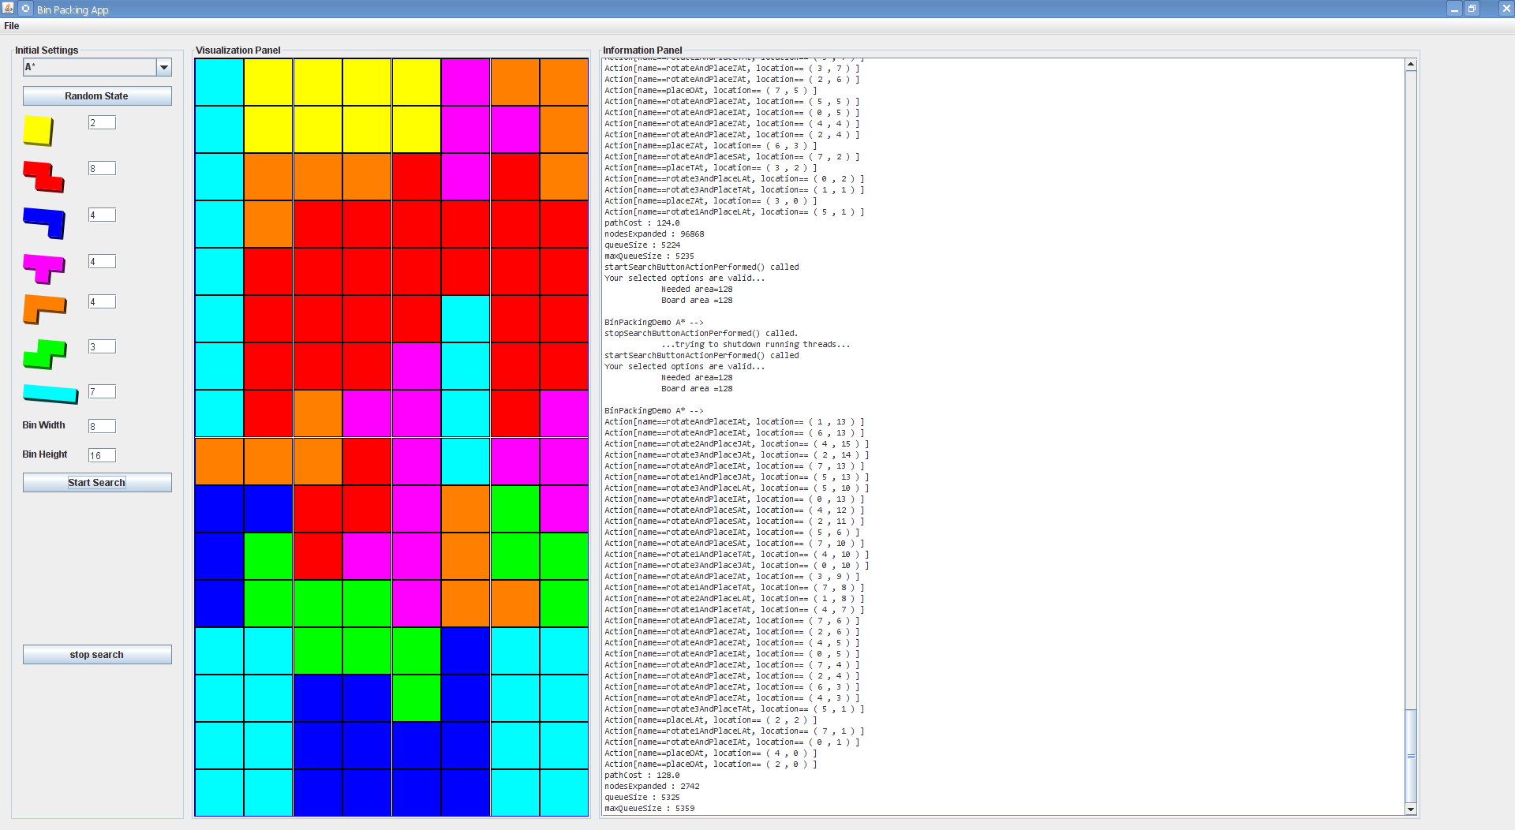
Screen Shot #1 – 8x16

Slide 17
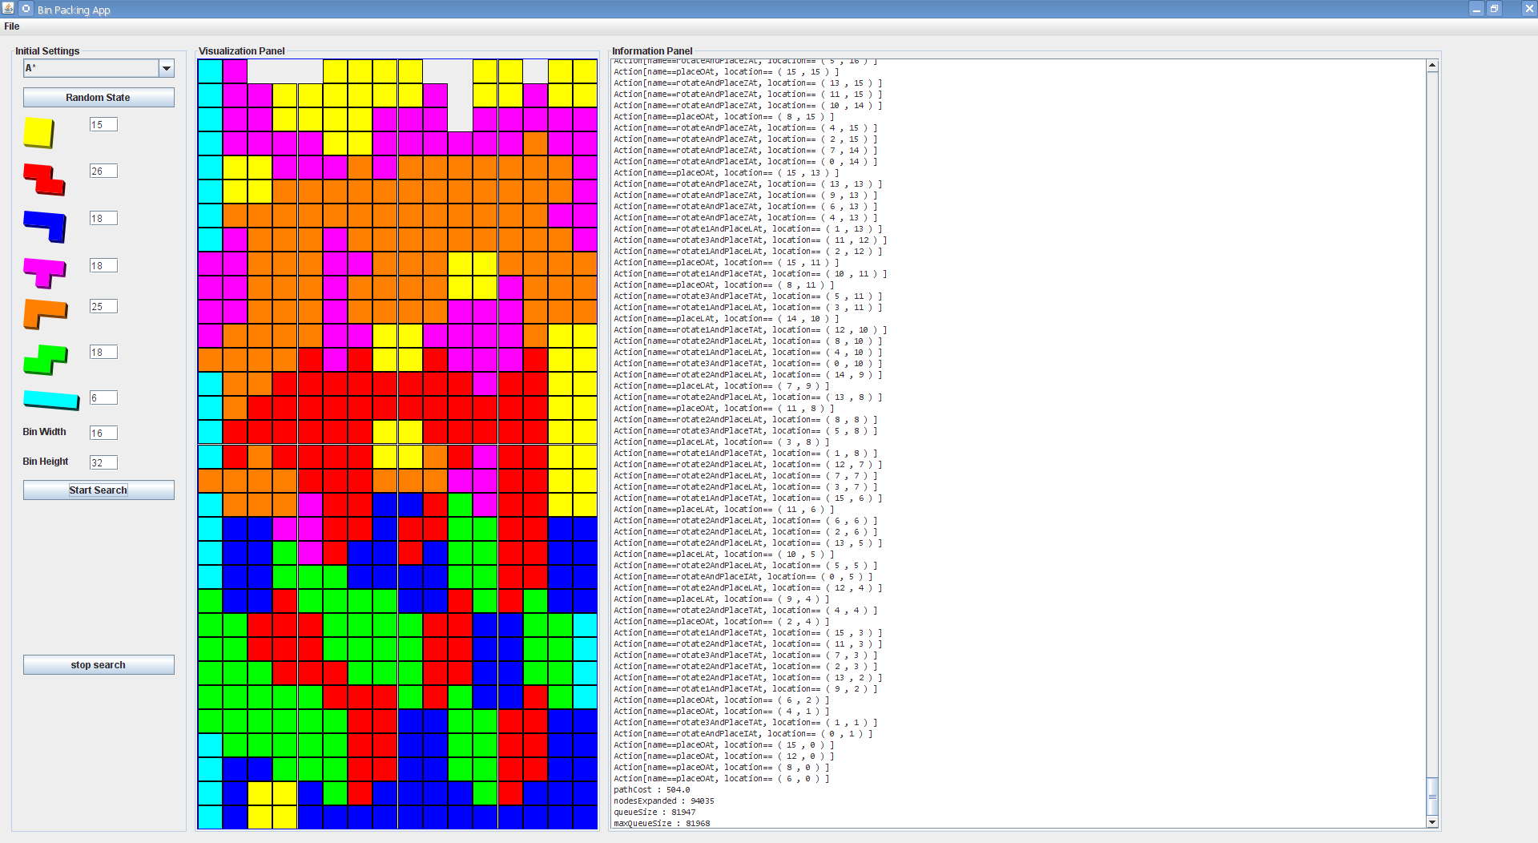
Screen Shot #1 – 16x32

Slide 18
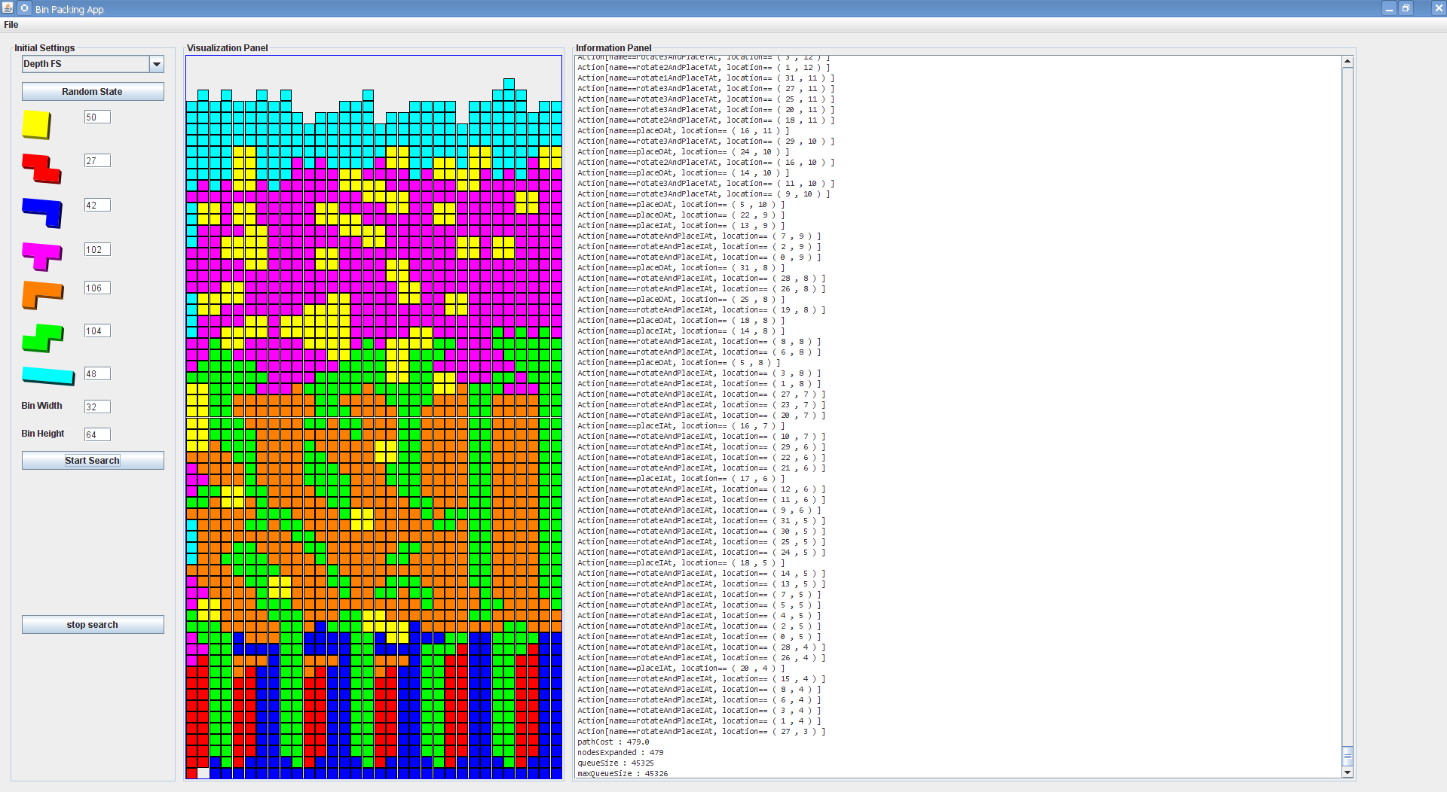
Screen Shot #1 – 32x64

Slide 19
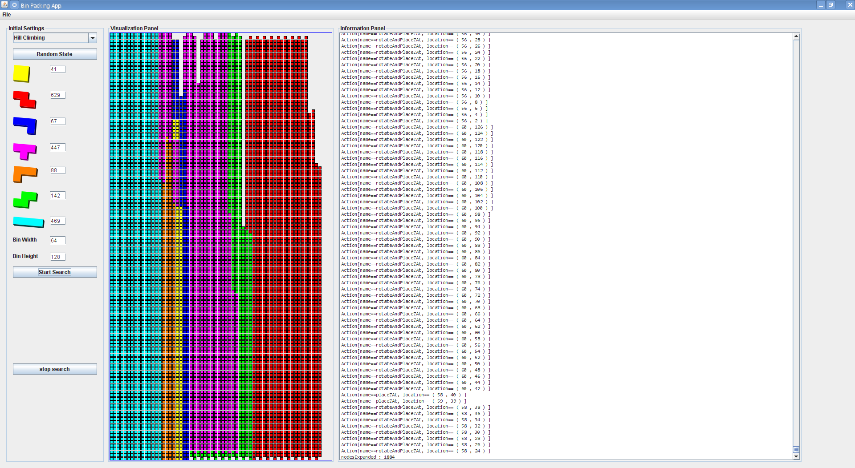
Screen Shot #1 – 64x128

Slide 20
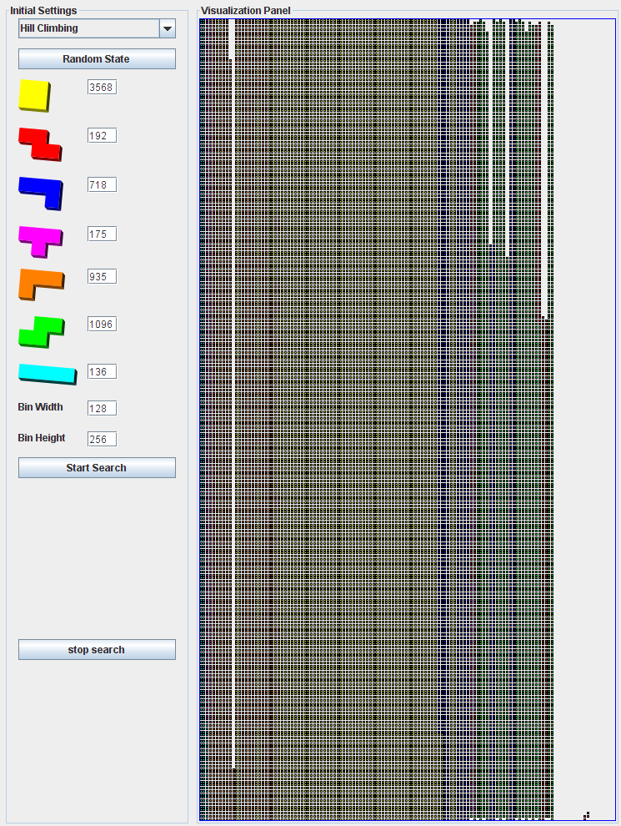
Screen Shot #1 – 100x200

Slide 22

Question Time

