Slide 1
INTERACTIVE VOICE RESPONSE SYSTEM FOR COLLEGE AUTOMATION
BY
N.S.RAGHAVAN
VIKRAM
VIJAY SAKTHI
FINAL YEAR ECE , JCET.

Slide 2
OBJECTIVE
Main aim of this project is to automate the retrieval of marks by students of the college by using an interactive voice response system.
For this a 40 pin AT89S52 controller is used to convert the dtmf code into decimal and send it serially to the computer.
A software is used to find the relevant data from the database and read it in voice.

Slide 3
Area of this project
Embedded systems
Microcontrollers
Database management
Text to voice response

Slide 4
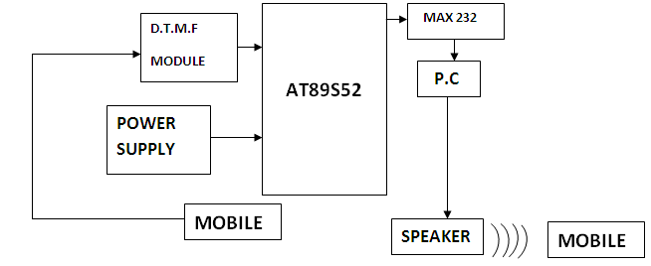
Block diagram

Slide 5
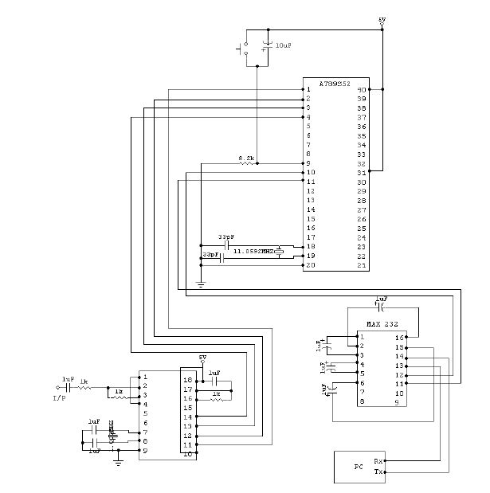
CIRCUIT DIAGRAM

Slide 6
COMPONENTS USED
Hardware :
ATMEL AT89S52 Microcontroller
HT9170B DTMF Decoder
MAX 232 UART
Power supply
USB to COM port connector
Software
Visual Studio 10
Keil uVision 4
Proteus 7

Slide 7
AT89S52 Microcontroller
• 8K Bytes of In-System Programmable (ISP) Flash Memory
– Endurance: 1000 Write/Erase Cycles
• 4.0V to 5.5V Operating Range
• Fully Static Operation: 0 Hz to 33 MHz
• Three-level Program Memory Lock
• 256 x 8-bit Internal RAM
• 32 Programmable I/O Lines

Slide 8
• Three 16-bit Timer/Counters
• Eight Interrupt Sources
• Full Duplex UART Serial Channel
• Low-power Idle and Power-down Modes
• Interrupt Recovery from Power-down Mode
• Watchdog Timer
• Dual Data Pointer

Slide 9
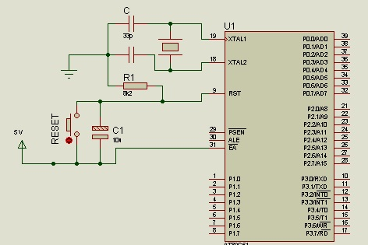
AT89S52 Pin Diagram

Slide 10
HT9170B DTMF DECODER
When the user calls the phone at the college side attends it automatically and the student at the other end should type his register number.
The DTMF code is received by the DTMF Decoder HT9170B via tone input and the corresponding 4 bit output is available at pins 11 to 14 (D0 to D3).
This is connected to the Ports P1.0 to P1.3 of AT89S52 microcontroller.

Slide 11
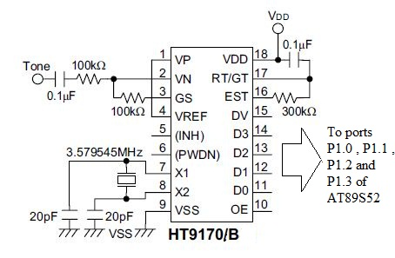
DTMF Decoder Circuit Diagram

Slide 12
MAX 232 UART
The MAX232 IC is used to connect the AT89S52 microcontroller and the computer serially via a RS232 cable.
The number given by the DTMF decoder is sent serially to the computer via this IC.
Only the transmit mode is used as the output of the project is from the computer speaker.

Slide 13
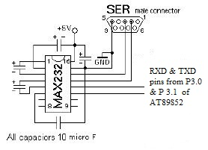
UART Circuit Diagram

Slide 14
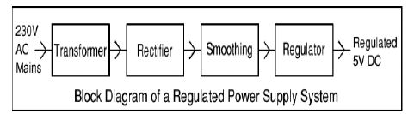
Power supply
The power supply circuit consists of the following components
A transformer to step down 230V to 12V AC.
A rectifier to convert AC to DC
A filter to remove any ripples
A voltage regulator U17805 to get 5V output

Slide 15
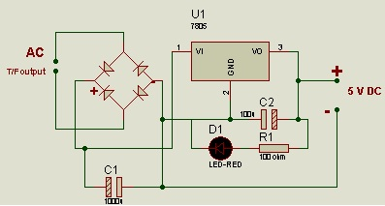
Power Supply Circuit Diagram

Slide 16
Hardware Code
#include<reg52.h>
void baud()
{
TMOD=0x20;
SCON=0x50;
TH1=0xfd;
TR1=1;
}
// Used to set baud rate to the serial port

Slide 17
void tx(unsigned char x)
{
while(TI==0);
SBUF=x;
TI=0;
}
/* tx function will be used to transmit the bits in the transmit mode of MAX232 IC, the register number will be transmitted by using this function */

Slide 18
void main()
{
baud();
while(1)
{
if(P1==0x01)
tx('1');
else if(P1==0x02)
tx('2');
else if(P1==0x03)
tx('3');
else if(P1==0x04)
tx('4');
else if(P1==0x05)
tx('5');

Slide 19
else if(P1==0x06)
tx('6');
else if(P1==0x07)
tx('7');
else if(P1==0x08)
tx('8');
else if(P1==0x09)
tx('9');
}
}
/* now the corresponding code is transmitted to the software in the computer */

Slide 20
SOFTWARE CODE
using System;
using System.Collections.Generic;
using System.ComponentModel;
using System.Data;
using System.Drawing;
using System.Linq;
using System.Text;
using System.Windows.Forms;
using System.Data.Sql;
using System.Data.SqlClient;
using SpeechLib;
using System.IO;
using System.IO.Ports;
namespace ivrs
{
public partial class Form1 : Form
{
int read;
string con = @"Data Source=rags-PC\SQLEXPRESS;Initial Catalog=stud;Integrated Security=True";
SqlConnection co;
SqlCommand cmd;
SqlDataReader dr;

Slide 21
public Form1()
{
InitializeComponent();
}
private void button1_Click(object sender, EventArgs e)
{
// serial port setup
SerialPort myport = new SerialPort();
myport.PortName = "COM17";
myport.BaudRate = 9600;
myport.DataBits = 8;
myport.Parity = Parity.None;
myport.StopBits = StopBits.One;
myport.Open();
SpVoice objspeech = new SpVoice();
objspeech.Rate = -3;
objspeech.Speak("WELCOME TO COLL BASE VERSION 1.0", SpeechVoiceSpeakFlags.SVSFlagsAsync);
objspeech.WaitUntilDone(msTimeout: 10000); //WELCOME
objspeech.Speak("ENTER YOUR REGISTER NUMBER AFTER THE BEEP“;
SpeechVoiceSpeakFlags.SVSFlagsAsync);
objspeech.WaitUntilDone(msTimeout: 10000);

Slide 22
objspeech.Speak("BEEP", SpeechVoiceSpeakFlags.SVSFlagsAsync);
objspeech.WaitUntilDone(msTimeout: 10); //BEEP
System.Threading.Thread.Sleep(3000); //delay
read = myport.ReadChar();
read = Convert.ToInt32(read);
read = read - 48;
myport.Close();
label2.Text = read.ToString();
string query = "select * from Table1 where REGNO = '" + label2.Text + "'";
co = new SqlConnection(con);
co.Open();
cmd = new SqlCommand(query, co);
dr = cmd.ExecuteReader();
dr.Read();
if (dr.HasRows)
{
label4.Text = dr["NAME"].ToString();
label8.Text = dr["EC1101"].ToString();
label10.Text = dr["EC1102"].ToString();
label12.Text = dr["EC1103"].ToString();
label14.Text = dr["EC1104"].ToString();
label16.Text = dr["EC1105"].ToString();
label18.Text = dr["EC1106"].ToString();
}
co.Close();

Slide 23
System.Threading.Thread.Sleep(1000);
objspeech.Speak("YOUR NUMBER AND NAME IS", SpeechVoiceSpeakFlags.SVSFlagsAsync);
objspeech.WaitUntilDone(msTimeout: 10);
objspeech.Speak(label2.Text, SpeechVoiceSpeakFlags.SVSFlagsAsync);
objspeech.WaitUntilDone(msTimeout: 10);
objspeech.Speak(label4.Text, SpeechVoiceSpeakFlags.SVSFlagsAsync);
objspeech.WaitUntilDone(msTimeout: 10);
objspeech.Speak("YOUR MARKS IN THIS SUBJECT ARE", SpeechVoiceSpeakFlags.SVSFlagsAsync);
objspeech.WaitUntilDone(msTimeout: 10);
objspeech.Speak(label9.Text, SpeechVoiceSpeakFlags.SVSFlagsAsync);
objspeech.WaitUntilDone(msTimeout: 10);
objspeech.Speak(label8.Text, SpeechVoiceSpeakFlags.SVSFlagsAsync);
objspeech.WaitUntilDone(msTimeout: 10);
objspeech.Speak(label11.Text, SpeechVoiceSpeakFlags.SVSFlagsAsync);
objspeech.WaitUntilDone(msTimeout: 10);
objspeech.Speak(label10.Text, SpeechVoiceSpeakFlags.SVSFlagsAsync);
objspeech.WaitUntilDone(msTimeout: 10);
objspeech.Speak(label13.Text, SpeechVoiceSpeakFlags.SVSFlagsAsync);
objspeech.WaitUntilDone(msTimeout: 10);
objspeech.Speak(label12.Text, SpeechVoiceSpeakFlags.SVSFlagsAsync);
objspeech.WaitUntilDone(msTimeout: 10);

Slide 24
objspeech.Speak(label15.Text, SpeechVoiceSpeakFlags.SVSFlagsAsync);
objspeech.WaitUntilDone(msTimeout: 10);
objspeech.Speak(label14.Text, SpeechVoiceSpeakFlags.SVSFlagsAsync);
objspeech.WaitUntilDone(msTimeout: 10);
objspeech.Speak(label17.Text, SpeechVoiceSpeakFlags.SVSFlagsAsync);
objspeech.WaitUntilDone(msTimeout: 10);
objspeech.Speak(label16.Text, SpeechVoiceSpeakFlags.SVSFlagsAsync);
objspeech.WaitUntilDone(msTimeout: 10);
objspeech.Speak(label19.Text, SpeechVoiceSpeakFlags.SVSFlagsAsync);
objspeech.WaitUntilDone(msTimeout: 10);
objspeech.Speak(label18.Text, SpeechVoiceSpeakFlags.SVSFlagsAsync);
objspeech.WaitUntilDone(msTimeout: 10);
objspeech.Speak("Thank you for using COLL BASE VERSION 1.0 , have a nice day“,
SpeechVoiceSpeakFlags.SVSFlagsAsync);
objspeech.WaitUntilDone(msTimeout: 10);
}
private void button2_Click(object sender, EventArgs e)
{
Application.Exit();
}
}
}

Slide 25
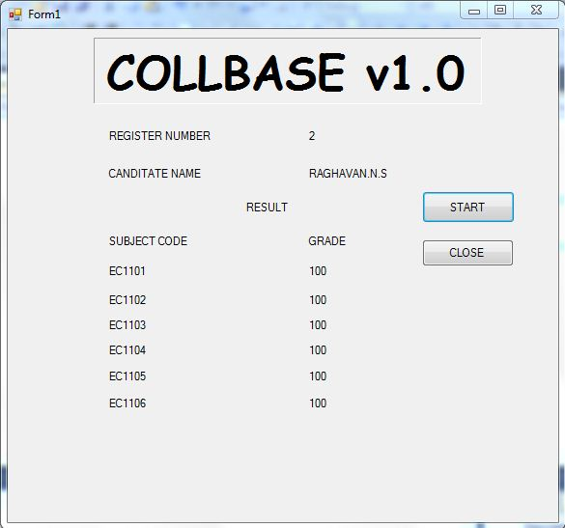
OUTPUT

Slide 26
APPLICATIONS
Used in colleges avoiding need of internet connection.
Used by companies to provide workers data services.
Used by mobile banking customers.

Slide 27
THANK YOU

