Slide 1
RFID BASED COLLISION-FREE INDOOR ROBOT LOCALIZATION
BY
N.S.RAGHAVAN
A.VIKRAM
R.VIJAY SAKTHI
M.BHARATH
FINAL YEAR ECE, JCET.
PROJECT GUIDE: MS.R.SILAMBARASI(M.E)
AP, ECE , JCET.

Slide 2
OBJECTIVE
Main aim of this project is to check whether the Robot is navigating in it’s respective path or not.
For this, Localisation of Robot is essential.
Localisation of the Robot can be done by using both RFID and sensor fusion.

Slide 3
EXISTING SYSTEM
The existing indoor localization uses GPS technology which is expensive.
The existing system performs localization using RFID tags but does not have object avoidance.
The exact position of the robot can not be found within the indoor environment.

Slide 4
PROPOSED SYSTEM
The proposed system uses RFID localization with infrared sensor fusion to avoid objects.
This method is much cheaper than GPS system.
Also the position of the robot could be relayed to the control center.

Slide 5
Block Diagram
RFID TAG
BUZZER
RFID READER
ROBOT
RF TRANSMITTER
RF RECEIVER
IR
SENS0R
SYSTEM

Slide 6
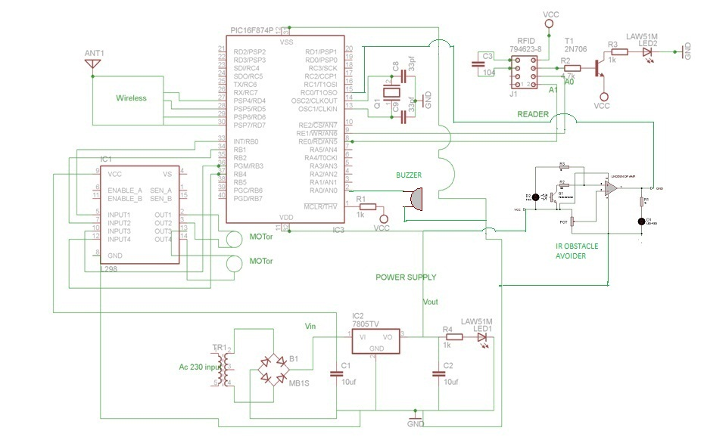
CIRCUIT DIAGRAM TRANSMITTER

Slide 7
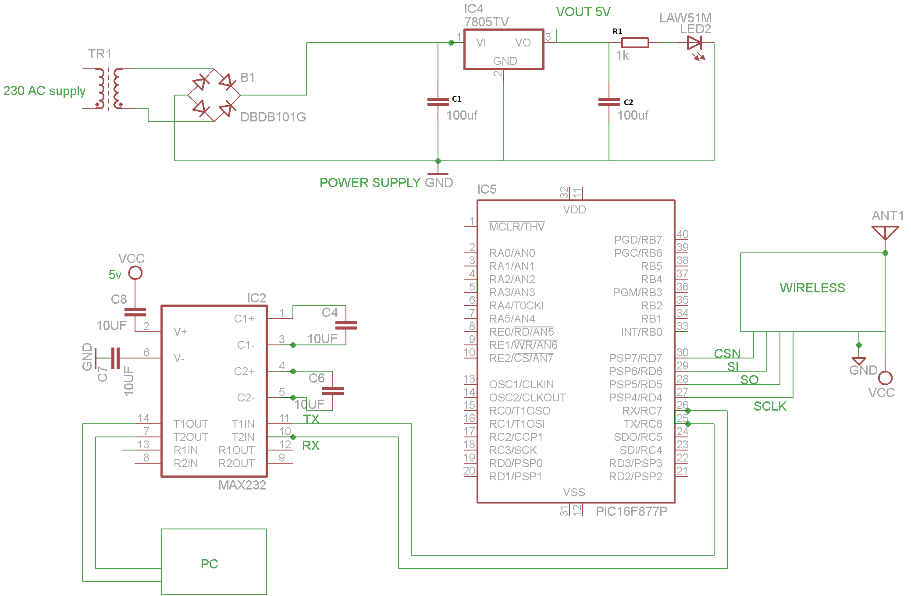
RECEIVER SIDE

Slide 8
COMPONENTS USED
PIC 16F877A Microcontroller
RFID reader and tag
TR 433 Transceiver
IR Sensor
DC Motor
Buzzer

Slide 9
PIC16F877A Microcontroller
It is based on Harvard Arhitecture.
High performance RISC CPU
35 single word instructions
8K x 14 words (flash pgm memory)
368x8 bytes (RAM)
256 x 8bytes EEPROM
Watchdog timer

Slide 10
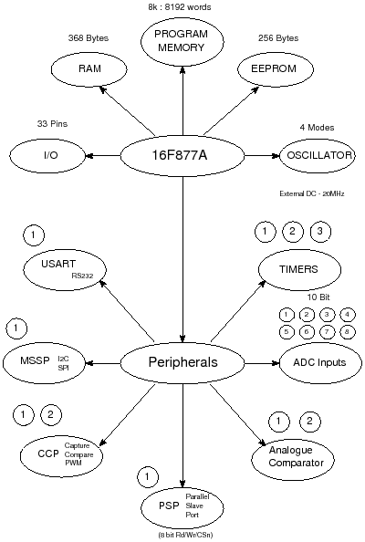
PIC contains 3 Timers
USART /SCI with 9 bit address detection
SSP with SPI and I2C (Master/slave)
PSP 8 bits wide, with external RD,WR and CS controls.

Slide 11
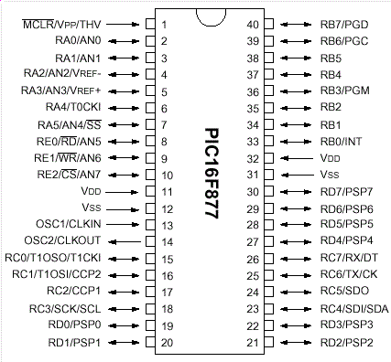
PIC pin diagram

Slide 12
RFID reader and tag
Main motto of the RFID is to carry data.
For this purpose mainly two things are used 1) tags 2)readers
Data within a tag provide identification
Identification or information will be read by the RFID reader.
Communication of data between tags and a reader is by wireless communication.

Slide 13
Data transfer and Bandwidth rate
Choosing carrier frequency is very important in determining data rates.
Higher the frequency higher data can be transferred.
In this project 2.4Ghz frequency is used.
Increasing bandwidth allows an increase noise level and a reduction in signal to noise ratio

Slide 14
RFID tags
RFID tags can be classified into 2 types
1)Passive tag 2 )active tag
An active tag has an on board battery that periodically transmits its ID signal
A passive tag is cheaper and smaller because it has no battery.Instead the tag uses radio energy transmitted by the reader as its energy source.

Slide 15
READER
Reader can differ quite considerably, depending upon the types of tags.
Reader performs following operations such as signal conditioning, parity error checking and correction.
Programmers are also generally designed to handle a single tag at a time.

Slide 16
TR 433 Transceiver
This is RF FSK Transceiver,which is designed using the chipcon IC(cc2500)
Based on PLL and 3 wire digital serial interface
Gives 100 metres range with provided external antenna.
Can be used on wireless security system.

Slide 17
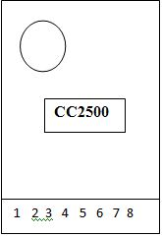
Pin details
Pin1: VCC
Pin2: GND
Pin3: SI
Pin4: SCLK
Pin5: SO
Pin6: GDO2
Pin7: GDO0
Pin8: CSn

Slide 18
IR SENSOR
IR sensor is used to detect objects
Passive IR used to sense the IR signals emitted by the objects
Active IR transmits the signals ,based on the reflections of those signals it will sense the objects.

Slide 19
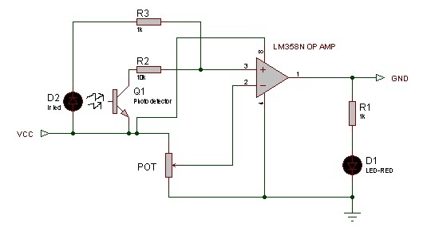
IR sensor circuit diagram

Slide 20
WORKING MODE
At first the part information is displayed at Hyperterminal of the computer.
When ever a tag is detected the buzzer sound is heard and the robot moves according to the tag information.
The corresponding point position is displayed in hyperterminal.

Slide 21
When obstacle is detected, the buzzer sound is heard and the robot stops moving.
The object detected message is displayed in the hyperterminal.
When the object is moved the robot starts moving in the direction.
This process continues and the robot is localized.

Slide 22
ADVANTAGES
Localization can be done using passive RFID tags which is cheaper.
Object can be avoided in an environment which will prevent collision.
The exact position of the robot can be obtained at the control center.

Slide 23
APPLICATIONS
Used in underground tunnels
Used in coal mines
Used in big industries for serving heavy materials
Used in airports for baggage transfer

Slide 24
FUTURE ENHANCEMENTS
Instead of infrared sensors that are affected by light, we can use ultrasonic sensors to avoid objects.
Object avoidance algorithm can be used to move around objects instead of stopping.
Cameras can be placed in the robot to monitor from the control center.

Slide 25
THANK YOU

