Slide 1
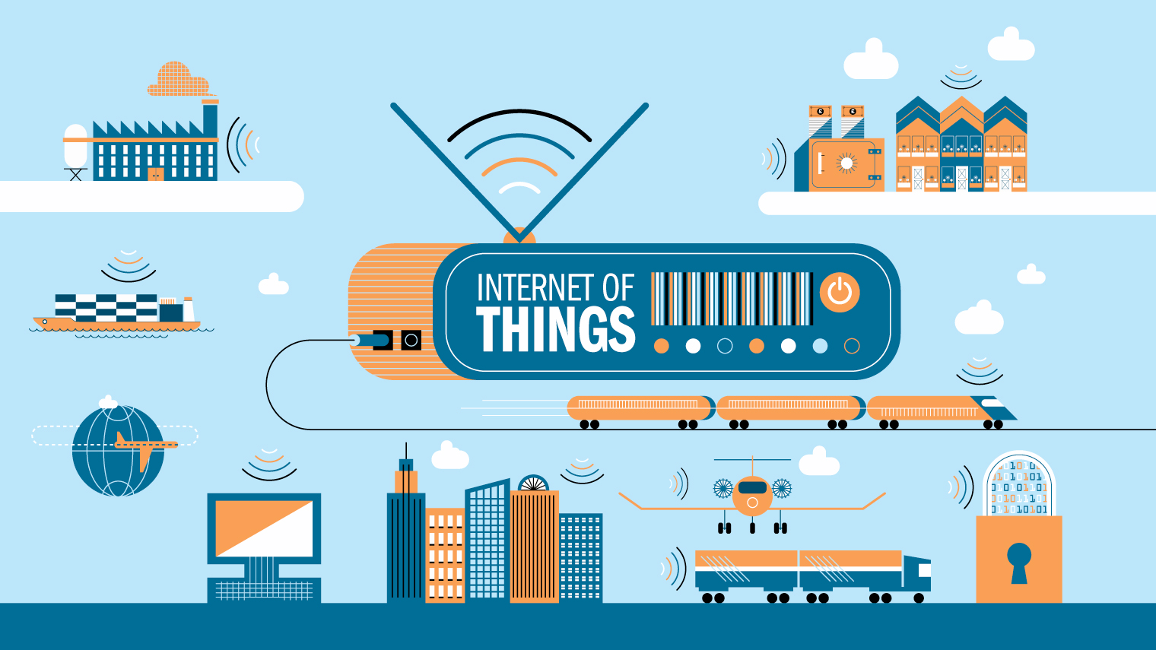
Remote I/O Sensor Bus- ll
Akash, Sarfraz, Raghavan | Dr. Mohamed El-Sharkawy | Indiana University – Purdue University Indianapolis

Slide 2
Akash Sunil Gaikwad, Mohammed Saifullah Sarfraz Sanaullah, Raghavan Naresh Sarangapani ECE-59500 – Design with Embedded Systems ECE Dept, Indiana University – Purdue University Indianapolis Year: Spring 2017
Group Members
Notes:
This is the question that your experiment answers

Slide 3
Introduction
Project overview
Hardware Design
Barebone PCB
PCB design
Manufacturing
Design challenges and solutions
Future Enhancements
Result & Conclusion
Project Demonstration
References
Introduction
Notes:
This is the question that your experiment answers

Slide 4

Hardware Design
EAGLE is a scriptable electronic design automation application with schematic capture, printed circuit board layout, auto-router and computer-aided manufacturing features.
We used EAGLE 8.1.1 Commercial License version.
In Free Eagle version, We can use up to only 80 cm*cm Area for Manufacturing purpose.
We have used 160 cm*cm area to design our PCB.
Notes:
Summarize your research in three to five points.

Slide 5
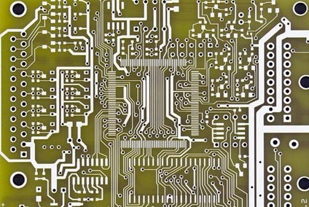
Hardware (PCB- Barebones)
"Bare Bones PCBs" is simple 2 layer PCBs that do not have Solder Mask.
Such PCBs is useful when you have simple applications for your PCB,
We can hand-solder simple devices on board.
Its like Zero PCB with Connection.
It is mainly used to Test the PCB Design
Our PCB is 2 layer Design.
Barebones PCB

Slide 6
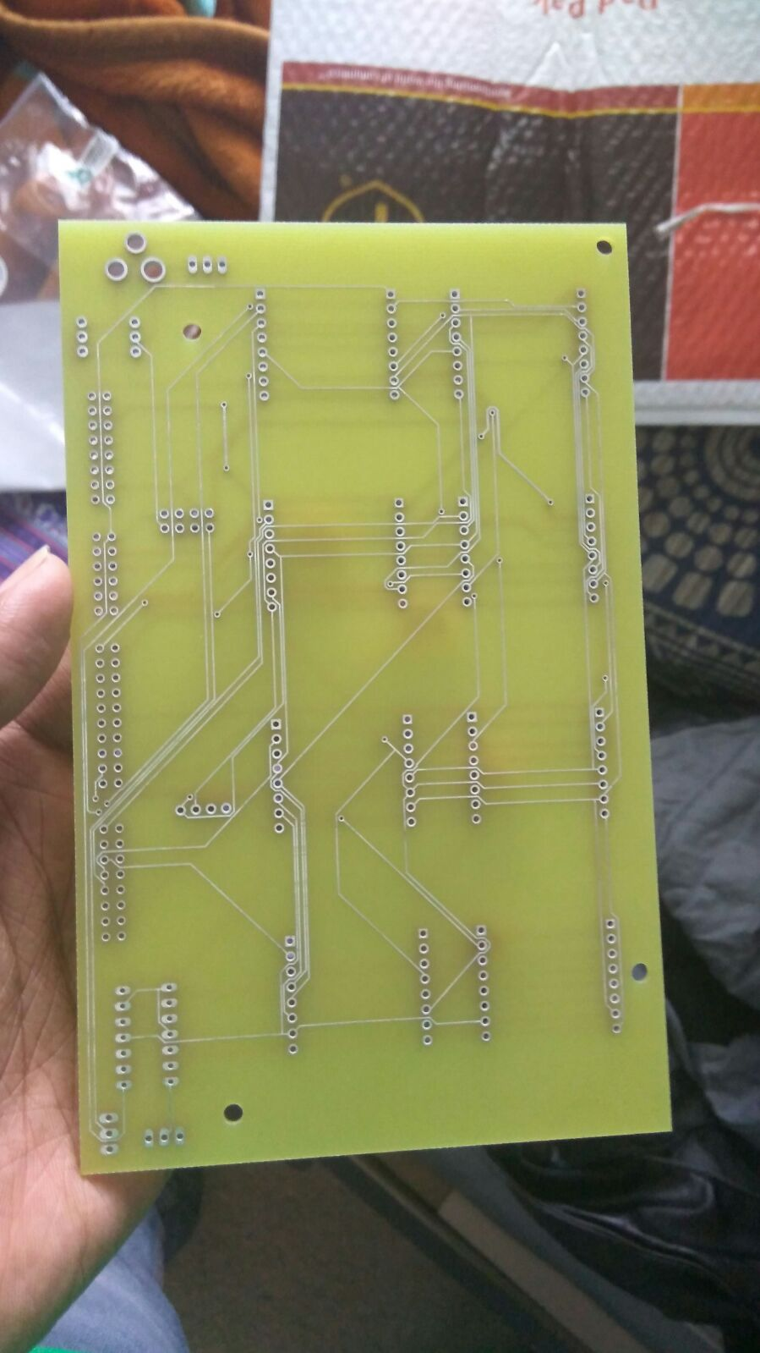
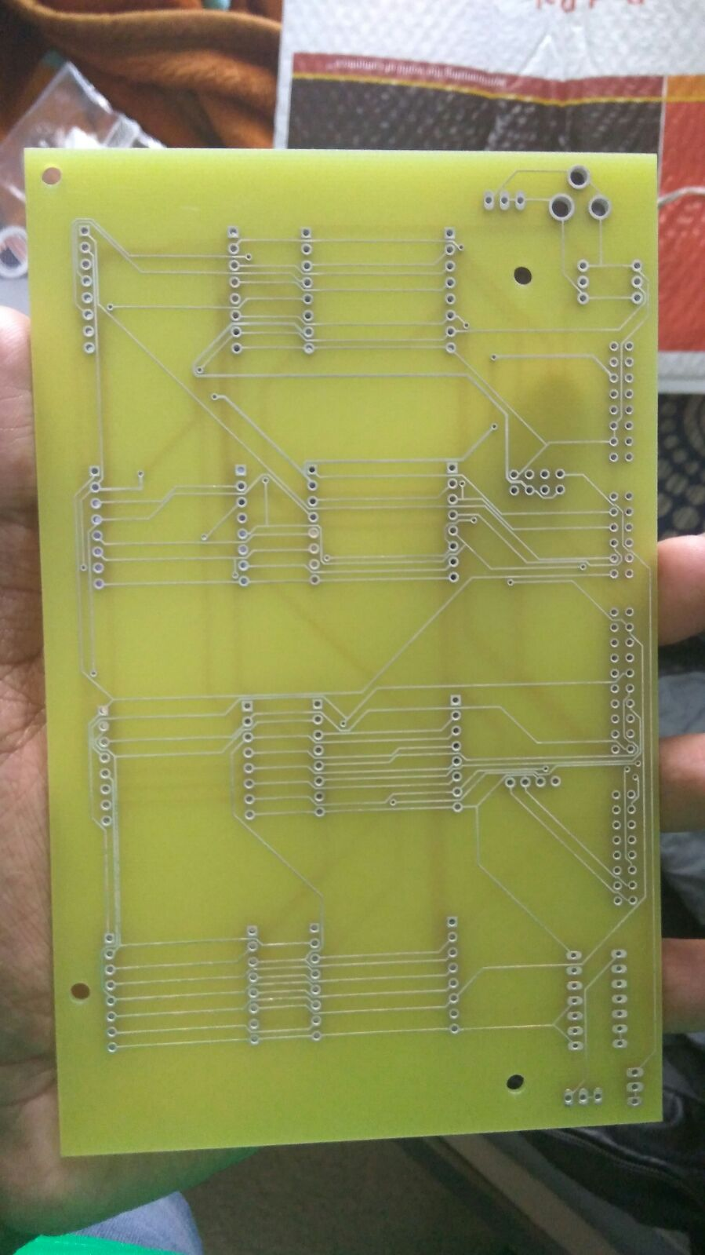
Hardware (PCB- Barebones)
Back Side
Front Side
Notes:
List all of the steps used in completing your experiment.
Remember to number your steps.

Slide 7
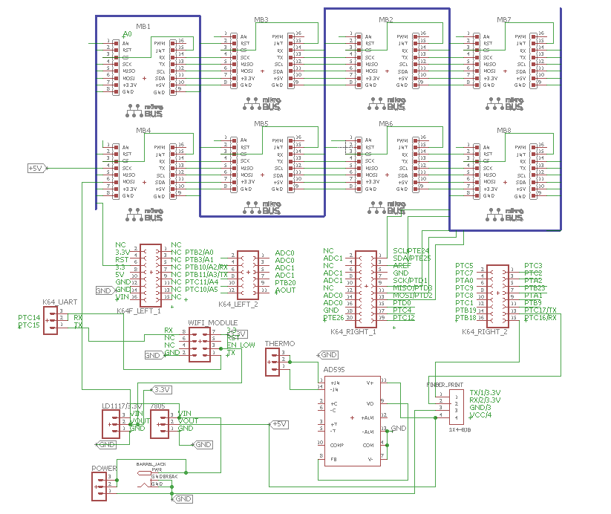
Hardware (PCB Design)
Schematic Diagram of PCB (.Sh File)
Notes:
List all of the steps used in completing your experiment.
Remember to number your steps.

Slide 8
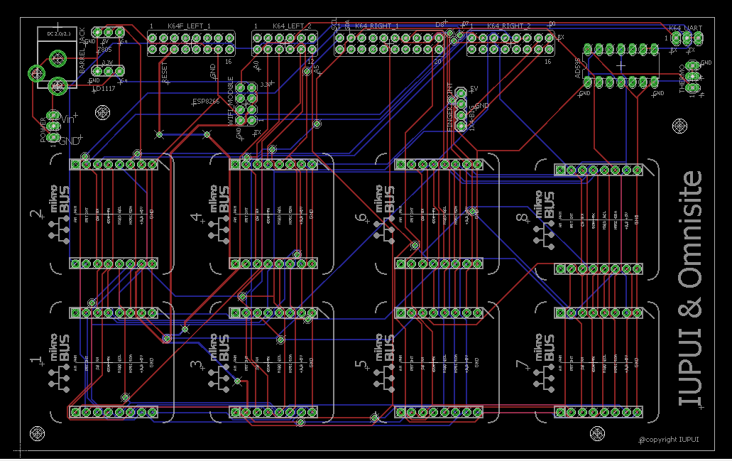
Hardware (PCB Design)
Actual Schematic of PCB (.brd File)
Notes:
List all of the steps used in completing your experiment.
Remember to number your steps.

Slide 9
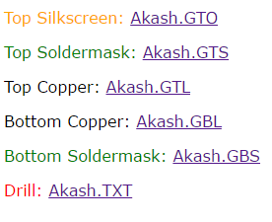
Manufacturing of PCB
To Manufacture any PCB, we have to provide Gerber Files to the manufacture.
The Gerber format is an open ASCII vector format for 2D binary images.
We used following Gerber files to manufacture the PCB.
Notes:
Summarize your research in three to five points.

Slide 10
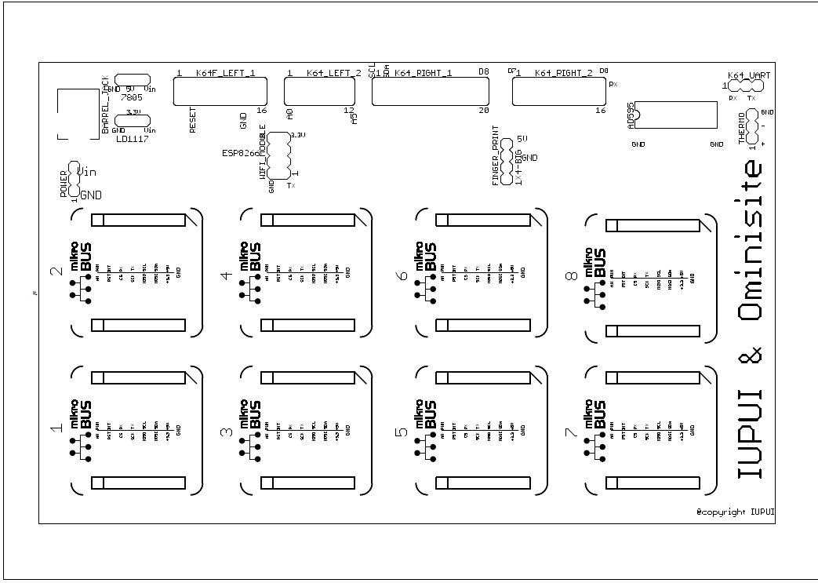
Hardware (PCB Design)
Top Silk Screen
Notes:
Summarize your research in three to five points.

Slide 11
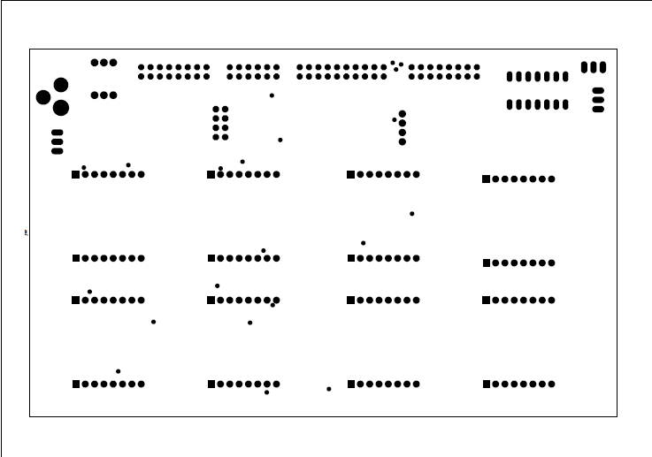
Hardware (PCB Design)
Top Solder Mask
Notes:
Summarize your research in three to five points.

Slide 12
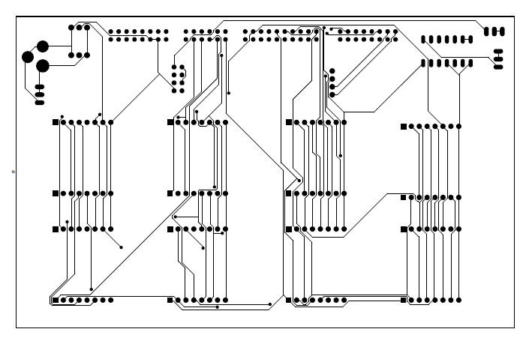
Hardware (PCB Design)
Top Copper Layer
Notes:
Summarize your research in three to five points.

Slide 13
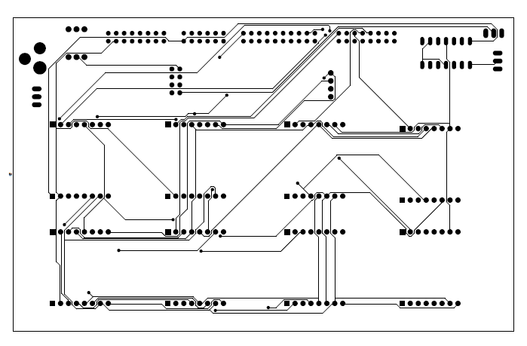
Hardware (PCB Design)
Bottom copper layer
Notes:
Summarize your research in three to five points.

Slide 14
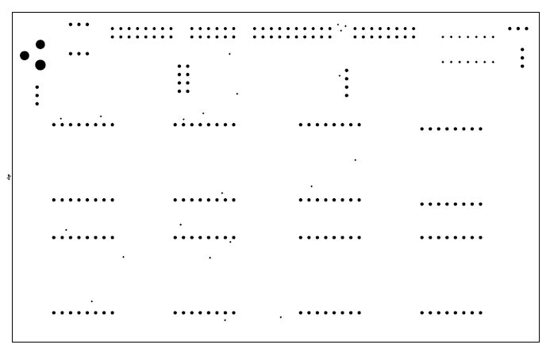
Hardware (PCB Design)
Drill File
Notes:
Summarize your research in three to five points.

Slide 15
Design challenges and solution:
Hexiwear Bootloader was in Base board.
Solution: Switching to FRDM K-64f with bootloader in the same board.
Using 4 UART’s from FRDM – 1 for Wifi Chip, 1 for Fingerprint, 1 for Serial debug and 1 for other clicks.
Solution: FRDM has 4 UART’s total . We used 3 , same UART for Fingerprint and Click BUS.
Planning UART, SPI and I2C protocols and Analog pins without overlap.
Solution: Planning protocol pins as common for the bus, assign specific lines for SPI Chip select.

Slide 16
Design challenges and solution:
Problems due to multiple through-via, more chances of failure.
Solution: Reduced via design to prevent this.
Planning for issues after PCB fab.
Solution: Revising design multiple times before sending PCB gerber files for production.
Expecting shipping delays.
Solution: Actual PCB got delayed in shipping, so we ordered another PCB (barebone) immediately.

Slide 17
Future Enhancements
Using separate UART for Bus design.
Using secure Wi-Fi chip.
Improving Bus design with MUX for more devices.
Reducing power consumption for devices.
Designing enclosure for sensors.
Edge programming to reduce data transfer load.
AWS, Azure, IBM Watson integration.

Slide 18
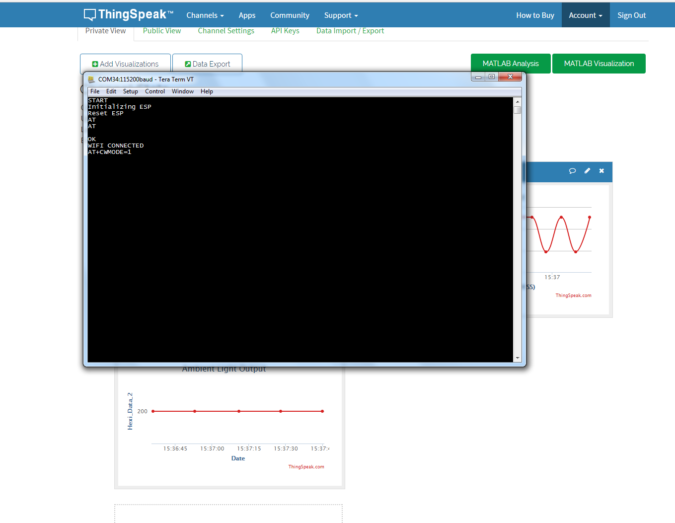
Results
WiFi Connection Established

Slide 19
Conclusion
The FRDM K64f was used to collect data from the Ammeter, Voltmeter, Ambient light, Thermocouple, Temperature, Humidity, Motion Module and Fingerprint sensors, and this data was sent to the cloud using the ESP 8266 Wi-Fi chip and Thingspeak server.
The cloud data was verified with the actual measurements.

Slide 20
Project Demonstration
Notes:
This is the question that your experiment answers

Slide 21
https://drive.google.com/open?id=0Bzt4TIgmpy40Vm5GcFQ5SVpwSlk
Notes:
This is the question that your experiment answers

Slide 22
References
https://thingspeak.com
https://www.mikroe.com/
https://en.wikipedia.org/wiki/Hexaware_Technologies
https://developer.mbed.org/compiler/#nav:/;
https://developer.mbed.org/cookbook/Homepage

Slide 23
Thank You.
Any Questions ???

