Slide 1
Deep Field
Workshop
Exploiting (supervised) learning-based detectors for on-board, real time localization and target tracking
Eric Price

Slide 2
Agenda
Who am I
Deep Learning based detectors
Bayesian tracking with DNN detectors

Slide 3
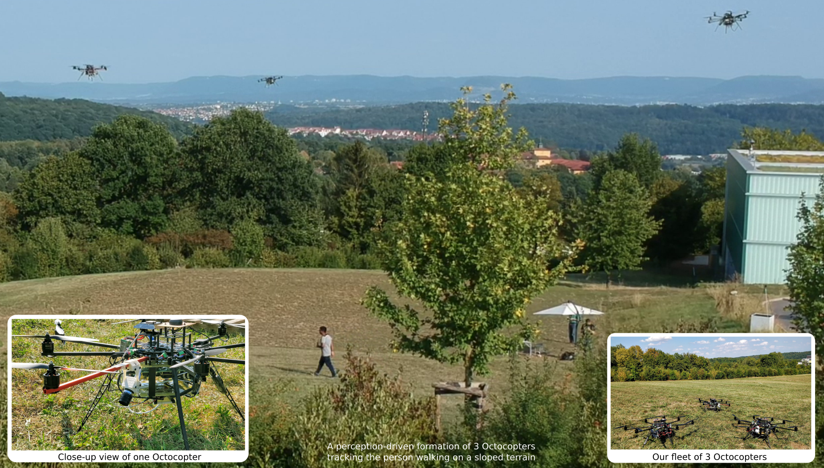
Presenter
Dipl. Inf. Eric Price <eric.price@ifr.uni-stuttgart.de>
https://www.ifr.uni-stuttgart.de/en/institute/team/Price/
  Post Doc Researcher, IFR FRPG Uni Stuttgart
  Up to now, PhD student, Max Planck Institute for Intelligent Systems
  Project AIRCAP (Aerial Outdoor Motion Capture)
  https://ps.is.tuebingen.mpg.de/research_projects/aircap

Slide 4
Deep Learning in Robotics
The beginning:
  2012 AlexNet owns the ImageNet classification challenge (ILSVRC)

Slide 5
Deep Learning in Robotics
The beginning:
  2012 AlexNet owns the ImageNet classification challenge (ILSVRC)
  2014 RCNN “solves” visual detection

Slide 6
Deep Learning in Robotics
The beginning:
  2012 AlexNet owns the ImageNet classification challenge (ILSVRC)
  2014 RCNN “solves” visual detection
  2016 SSD Multibox speeds visual detection up for robotic applications

Slide 7
2018
We exploit SSD in a Multi Vehicle Collaborative Detection and Tracking Framework

Slide 8
Performance Metric in Computer Vision
Detectors are compared based on
Mean average precision.
Using “Jaccard Overlap”
  Aka Intersection over Union
as the main metric.

Slide 9
Performance Metric in Robotics
For Bayesian Inference we like to have
  Mean Deviation (localization)
  (Co-)Variance

