Slide 1
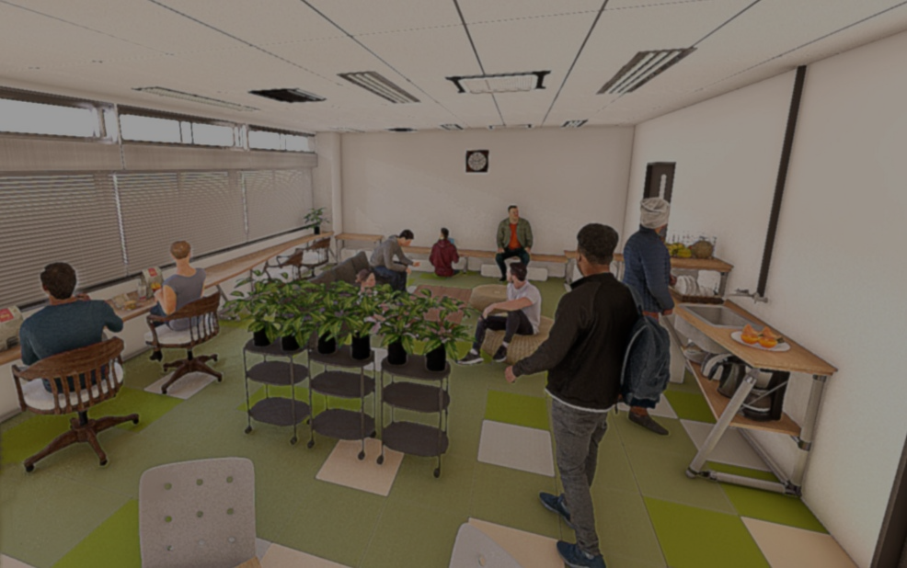
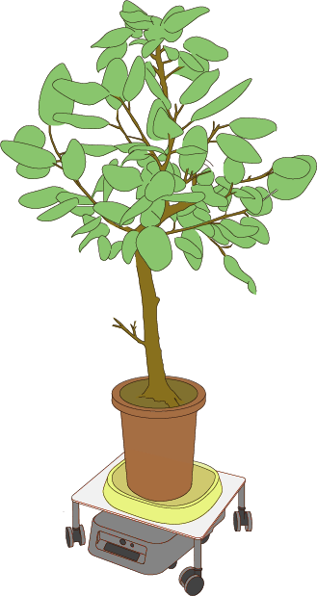
Human
Enhancement of humans’ health & comfort by plants
Prediction of human
emotions & comfort
Plant
Robot
Automatic maintenance of biophilic spaces
Space Design
Spatial designs suitable for plants & robots preserving humans’ comfort

Slide 2
Enhancement of humans’ health & comfort by plants
Prediction of human
emotions & comfort
Human
Plant
Robot
Automatic maintenance
of biophilic spaces
Space Design
Spatial designs suitable for plants & robots preserving humans’ comfort

