Slide 1


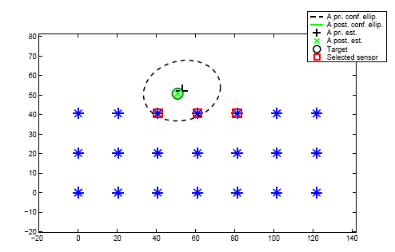
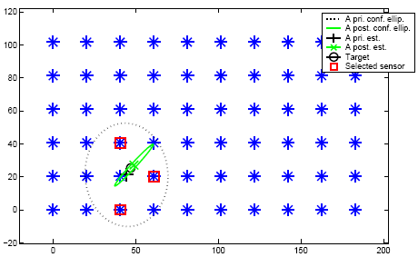
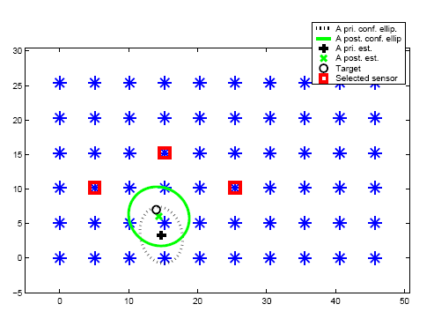
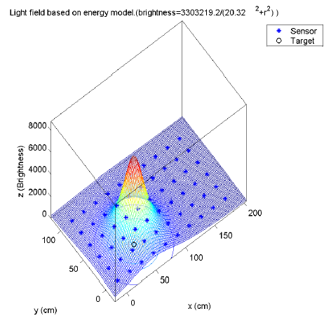
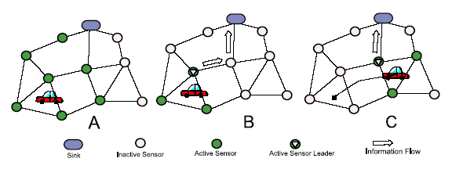
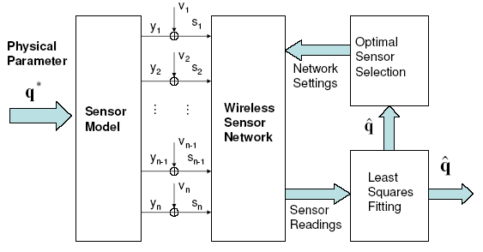
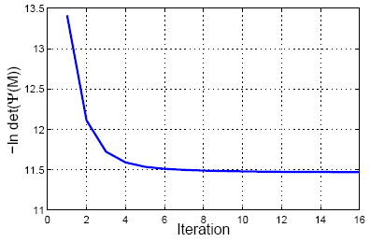
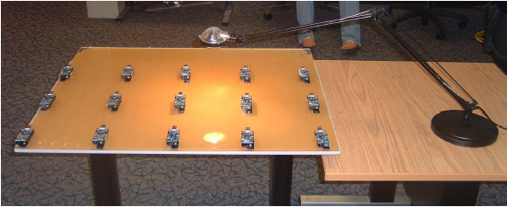
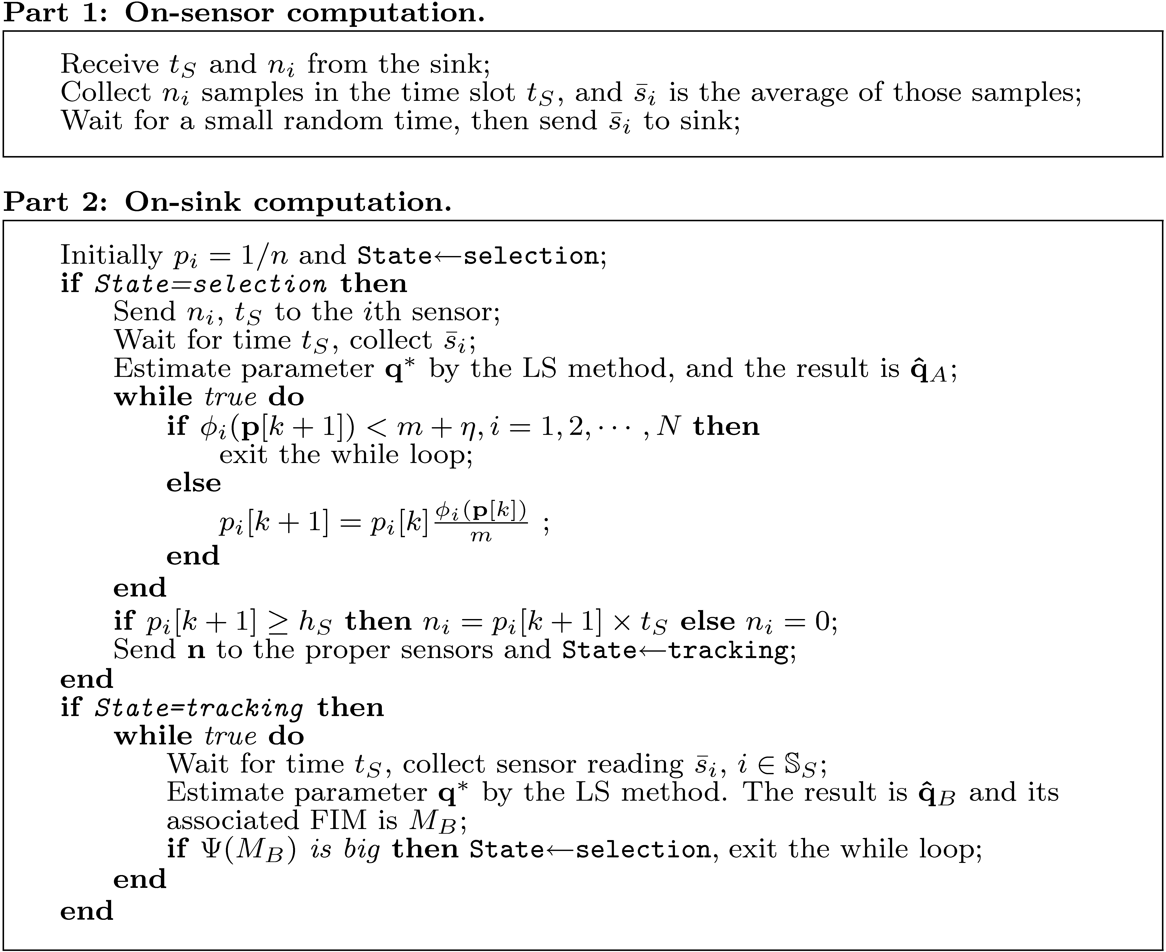
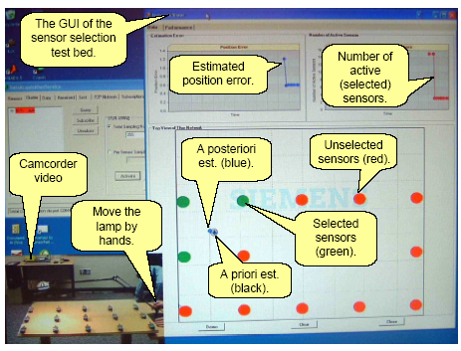
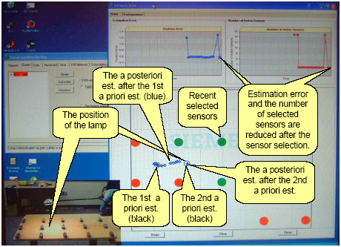
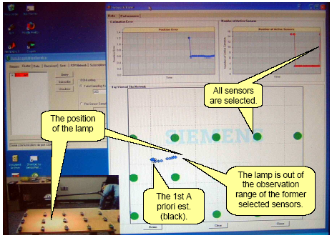
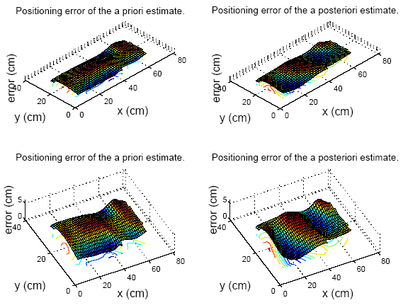
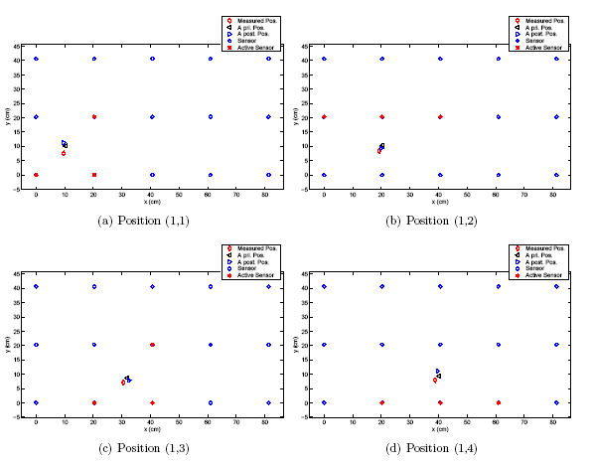
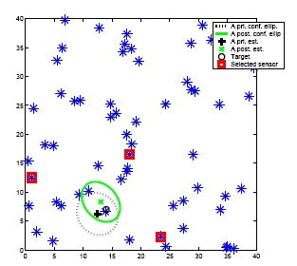
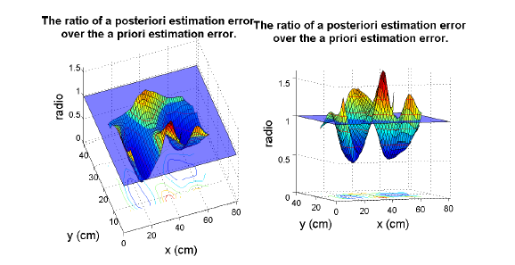
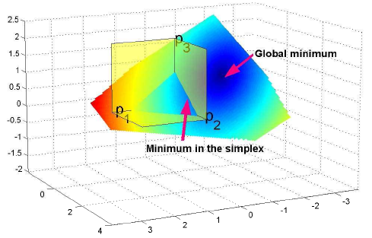
A Convex Optimal Sensor Selection Method for Wireless Sensor Networks
Zhen Song
Utah State University
Chellury Ram Sastry
Siemens Corporate Research
Nazif Cihan Tas
Siemens Corporate Research
UtahState
s
s
U N I V E R S I T Y
Simulations
Abstract: In wireless sensor networks (WSNs) based applications, a key requirement is the need to design sensor operations that would conserve precious onboard battery energy and yet satisfy application quality-of-service (QoS) requirements. Sensor operations include sensor-to-sink communication, onboard processing/filtering of sensor measurements etc, while application QoS could be the maximum event position estimation error allowable in a remote event monitoring application. An obvious strategy to reduce the overall consumption of battery energy would be to select only a small subset of the total number of deployed sensors to satisfy application requirements. However, it is a challenging task to determine which subset of the sensor deployment will suffice, if at all. In this paper, we consider a remote monitoring application where it is required to estimate the location of an event with optimal precision using minimum number of sensors. Based on some reasonable approximations, we formulate the sensor selection problem as a convex optimization problem. We then come up with a solution to this optimization problem which we refer to as the convex optimal sensor selection (COSS) algorithm to select only a proper subset of the sensor deployment required to observe the event and accurately estimate the location of the event. Finally, the proposed COSS algorithm has been tested through extensive simulations and hardware experiments under realistic conditions.
The a posteriori estimates are normally much more precise than the a priori estimates.
It takes about 8 ms for a Pentium IV 3Ghz PC to select the proper sensors out of a network with 60 sensors. The memory requirement is 2mn+m² double variables, where m is the number of parameters and n is the number of sensors.
The sensors close the to the target or with high illumination values may not be selected.
The proposed sensor selection method is applicable to both regular and irregular sensor deployments.
The algorithm converges fast.
Sensor selection by COSS with the target out of the coverage area.
Sensor selection for a network of 60 sensors by COSS.
Motivation, Application Scenario and the System Architecture
Convergence speed of the COSS algorithm.
Applying the COSS algorithm to densely deployed sensors.
Light field.
Future application scenario.
Hardware Experiments
Motivation: observe events with the optimal precision using the minimum number of sensors.
Application scenario: target tracking.
Features
  The event location estimation error is approximately equal to the minimal estimation error as predicted by the Cramer-Rao lower bound (CRLB).
  The number of selected sensors is no more than that allowed by the Caratheodory’s theorem as applied to our formulation.
System Architecture
The hardware implementation is more challenging due to the following reasons:
  Imperfect communications introduce packet drops.
  Disturbances from the ambient light.
  The light bulb is not a perfect point light source. In fact, the size of the light bulb is about 3 cm, which is comparable to the tracking error of our testbed.
  The light reflector behind the light bulb is not perfect and the reflection is not very smooth. That is, the distribution on the light field is not perfect.
  The sensor noise is not an ideal Gaussian noise.
The hardware experiments indicate that the COSS algorithm is applicable to realistic conditions.
  Normally, 3 sensors are selected.
  The a posteriori estimates are more precise than that of the a priori estimates, statistically.
  An implicit sensor selection method such that the number of selected sensors is not explicitly presented in the cost function of the optimization.
  The algorithm is simple, fast, and memory efficient, due to the existence of the gradient of the cost function.
Sensor model
Problem Formulation
Solution: the COSS algorithm
The computations are distributed on the sensor nodes and the sink.
The D-optimization problem can be solved by non-linear optimization algorithms, such as the multiplicative method in the following pseudo-code.
The algorithm returns the estimated positions, as well as the estimation error bound, i.e., the confidence ellipsoid.
A photo on our sensor selection testbed.
Fisher information matrix (FIM)
Algorithm outline
A screen shoot of our sensor selection testbed: The GUI.
A screen shoot of our sensor selection testbed: Tracking the lamp.
A screen shoot of our sensor selection testbed: The track.
Observation
method
The real target should be within the confidence ellipsoid.
Network
model
Physics
model
FIM
Example scenarios for hardware tracking error testing.
OED
CVX
The selected sensors may not be the closest.
Estimation errors of our sensor selection testbed.
Other Opt.
An example of applying the COSS algorithm to randomly placed sensors.
Conclusions
Introduced approximations
FIM is a hub between observations and designs.
Theoretical Background
The proposed COSS algorithm selects the minimum number of sensors allowed by the Caratheodory’s theorem and its estimate error approximates the Cramer-Rao lower bound (CRLB).
The algorithm is simple, fast, and memory efficient.
The algorithm has been tested extensively by simulations and hardware experiments under realistic conditions.
More experiment results, including movies on the hardware experiments, are available at http://cc.usu.edu/~zhensong/sensorselection/
A “before-and-after” comparison of our sensor selection testbed: ratio of the a posteriori estimation error (after sensor selection) over the a priori (before sensor selection) estimation error.
Contacts:
Kevin Moore, CSOIS Director, Control Systems, 435-797-2924, moorek@ece.usu.edu
Bob Gunderson, Program Development, 435-797-0148, rwgunde@ibm.net
Nick Flann, Path and Mission Planning, 435-797-2432, flann@nick.cs.usu.edu
Carl Wood, Mechanical, 435-797-7112, carl@ece.usu.edu
Matthew Berkemeier, ECE Robotics and Computer Eng., 435-797-2873, matthewb@ece.usu.edu

