Slide 1






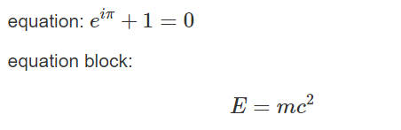




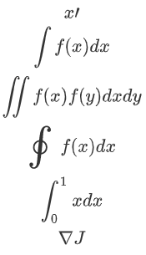











Mathematics in R Markdown: : CHEAT SHEET
Basics
Arrows
Trigonometric
Log
Operator
\rightarrow
\leftarrow
\leftrightarrow
\Rightarrow
\Leftarrow
\Leftrightarrow
\pm
\mp
\times
\div
\ast
\star
\mid
\nmid
\circ
\bullet
\cdot
\wr
\diamond
\Diamond
\triangle
\bigtriangleup
\bigtriangledown
\triangleleft
\triangleright
\lhd
\rhd
\unlhd
\unrhd
\circ
\bigcirc
\odot
\bigodot
\oslash
\ominus
\otimes
\bigotimes
\oplus
\bigoplus
\dagger
\ddagger
\amalg
Thank you for reading the new cheatsheets about mathematics for R! These cheatsheets have an important job:
\uparrow
\downarrow
\updownarrow
\Uparrow
\Downarrow
\Updownarrow
\sin
\cos
\tan
\cot
\sec
\csc
\bot
\angle
45^\circ
\ln{a + b}
Others
\log_{a}{b}
\aleph
\hbar
\imath
\jmath
\ell
\wp
\Re
\Im
\mho
\surd
\top
\bot
\flat
\natural
\sharp
\backslash
\Box
\clubsuit
\diamondsuit
\heartsuit
\spadesuit
equation: $e^{i\pi} + 1 = 0$
equation block:
$$E = mc^{2}$$
\lg{a + b}
\longrightarrow
\longleftarrow
\longleftrightarrow
\Longrightarrow
\Longleftarrow
\Longleftrightarrow
\mapsto
\longmapsto
\hookleftarrow
\hookrightarrow
\rightharpoonup
\leftharpoondown
\rightleftharpoons
\leftharpoonup
\rightharpoondown
\leadsto
\nearrow
\searrow
\swarrow
\nwarrow
Space
Set
Relation
Vector
Mod
a\! b
\emptyset
\varnothing
\in
\ni
\notin
\subset
\supset
\not\subset
\subseteq
\subsetneq
\supseteq
\cup
\bigcup
\cap
\bigcap
\uplus
\biguplus
\sqsubset
\sqsupset
\sqcap
\sqsubseteq
\sqsupseteq
\vee
\wedge
\setminus
\neg
\leq
\geq
\equiv
\models
\prec
\succ
\sim
\perp
\preceq
\succeq
\simeq
\mid
\ll
\gg
\asymp
\parallel
\approx
\cong
\neq
\doteq
\propto
\bowtie
\Join
\smile
\frown
\vdash
\dashv
\vec{a}
a \equiv b \pmod n
ab
f(\mathbf{x})
a\, b
Calculus
a\: b
x\prime
a\; b
\int f(x) dx
\iint f(x)f(y)dxdy
a\quad b
\oint f(x) dx
Sum &
Prod
a\qquad\ b
\int_0^1 x dx
\sum_{i = 0}^{n}x_i
\nabla J
Logistics
\frac{\part f}{\part x}
\prod_{i = 0}^{n}x_i
Limit
\because \therefore \forall \exist
\lim_{n\rightarrow+\infty} a_n
\vee \wedge \bigvee \bigwedge
Sqrt
\sqrt{a + b}
\sqrt[n]{a + b}
YOUR LOGO
(optional)
RStudio® is a trademark of RStudio, Inc. • CC BY SA Your Name • your@email.com • 844-448-1212 • your.website.com • Learn more at webpage or vignette • package version 0.5.0 • Updated: 2017-01

Slide 2



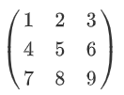

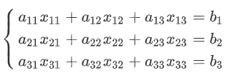
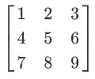

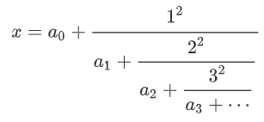
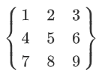

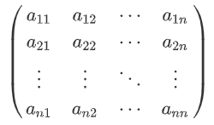

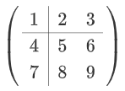
Mathematics in R Markdown: : CHEAT SHEET
Multiple lines
Matrix
Parenthese
Greek
y =
\begin{cases}
-x, \quad x\leq 0 \\
x, \quad x > 0
\end{cases}
\begin{matrix}
1 & 2 & 3 \\
4 & 5 & 6 \\
7 & 8 & 9
\end{matrix}
(\frac{1}{x}) [\frac{1}{x}] \left(\frac{1}{x} \right) \left[\frac{1}{x} \right] \lang , \rang \lvert, \rvert \lVert, \rVert \lbrace, \rbrace
\Alpha
\Beta
\Gamma
\Delta
\Epsilon
\Zeta
\Eta
\Theta
\Iota
\Kappa
\Lambda
\Mu
\Nu
\Xi
\Omicron
\Pi
\Rho
\Sigma
\Tau
\Upsilon
\Phi
\Chi
\Psi
\Omega
\alpha
\beta
\gamma
\delta
\epsilon
\varepsilon
\zeta
\eta
\theta
\iota
\kappa
\lambda
\mu
\nu
\xi
\omicron
\pi
\rho
\sigma
\tau
\upsilon
\phi
\varphi
\Chi
\Psi
\Omega
\left\{
\begin{array}{c}
a_{11}x_{11} +a_{12}x_{12} +a_{13}x_{13} = b_1 \\
a_{21}x_{21} +a_{22}x_{22} +a_{23}x_{23} = b_2 \\
a_{31}x_{31} +a_{32}x_{32} +a_{33}x_{33} = b_3
\end{array}
\right.
\left(
\begin{matrix}
1 & 2 & 3 \\
4 & 5 & 6 \\
7 & 8 & 9
\end{matrix}
\right)
\Bigg(\bigg(\Big(\big((x)\big)\Big)\bigg)\Bigg)
Frac
\left[
\begin{matrix}
1 & 2 & 3 \\
4 & 5 & 6 \\
7 & 8 & 9
\end{matrix}
\right]
\frac{a}{b}
x = a_0 + \cfrac{1^2}{a_1 + \cfrac{2^2}{a_2 + \cfrac{3^2}{a_3 + \cdots}}}
\left\{
\begin{aligned}
2x+3y&=34\\
x+4y&=25
\end{aligned}
\right.
\left\{
\begin{matrix}
1 & 2 & 3 \\
4 & 5 & 6 \\
7 & 8 & 9
\end{matrix}
\right\}
\boxed{a^2+b^2 = c^2}
Matrix
Superscribe Subscribe
a_{i}
a^{i}
\bar{a}
\acute{a}
\breve{a}
\grave{a}
\dot{a}
\ddot{a}
\dot {\dot x}
\hat{a}
\widehat{xy}
\check{a}
\breve{a}
\tilde{a}
\vec{a} \overrightarrow{x}
\overline{x+y}
\underline{x+y}
\overbrace{x+y}
\underbrace{x+y}
{\underset {x\in S\subseteq X}{\operatorname {arg\,max} }}\,
f(x):=\{x\mid x\in S\wedge \forall y\in S:f(y)\leq f(x)\}.
\left(
\begin{array}{c|cc}
1 & 2 & 3 \\ \hline
4 & 5 & 6 \\
7 & 8 & 9
\end{array}
\right)
\left(
\begin{matrix}
a_{11} & a_{12} & \cdots & a_{1n}\\
a_{21} & a_{22} & \cdots & a_{2n}\\
\vdots & \vdots & \ddots & \vdots \\
a_{n1} & a_{n2} & \cdots & a_{nn}\\
\end{matrix}
\right)
YOUR LOGO
(optional)
RStudio® is a trademark of RStudio, Inc. • CC BY SA Your Name • your@email.com • 844-448-1212 • your.website.com • Learn more at webpage or vignette • package version 0.5.0 • Updated: 2017-01

