Slide 1
Forecasting Floats in Turbulence Challenge Competitors’ Day
Mr. John Waterston
Ocean of Things Program Manager
DARPA, STO
FFTchallenge@darpa.mil
Presentation will begin at 2:05pm ET
7 October 2021

Slide 2
Welcome to Competitors Day!
1. Why are we holding the Forecasting Floats in Turbulence Challenge?
2. Getting to know the Spotter
3. Conduct of the Challenge
4. Challenge Schedule
5. Challenge Scoring
6. How to Register
7. Q&A

Slide 3
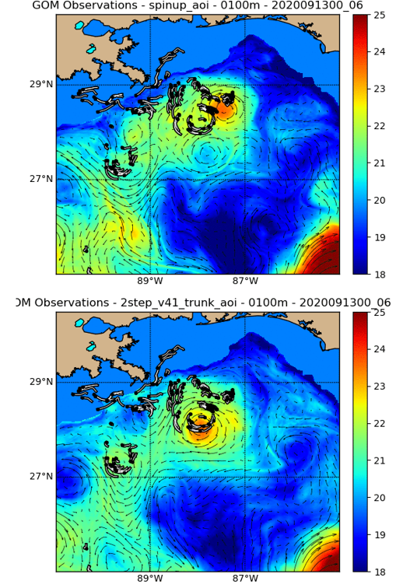
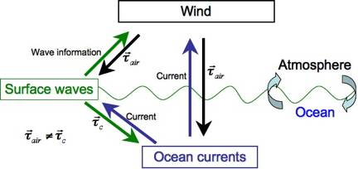
Interactions at the Ocean-Air Interface
Complex interactions at the Ocean-Air interface are difficult to predict with reasonable accuracy
Submesoscale features go unpredicted
Mesoscale features are often out of place

Slide 4
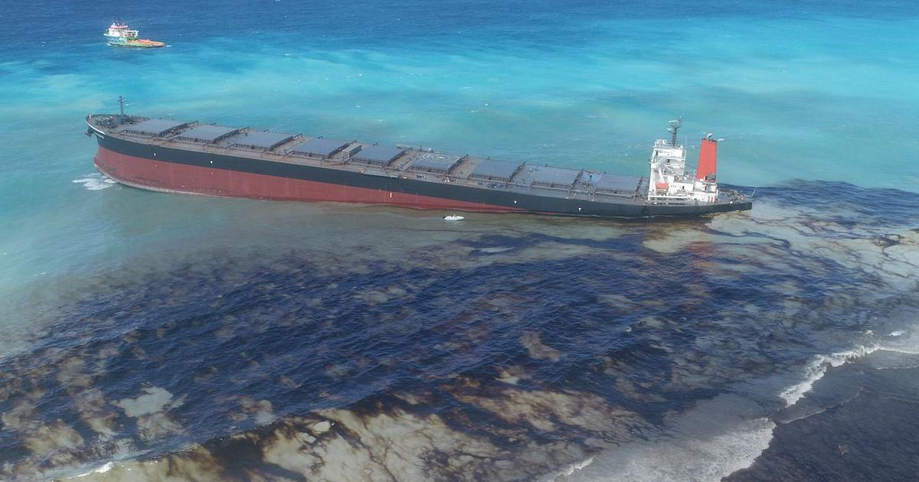
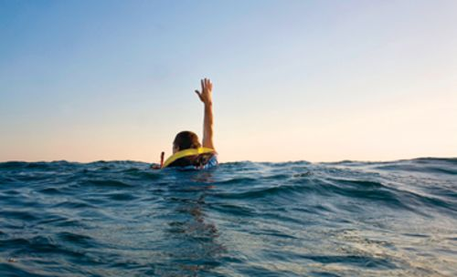
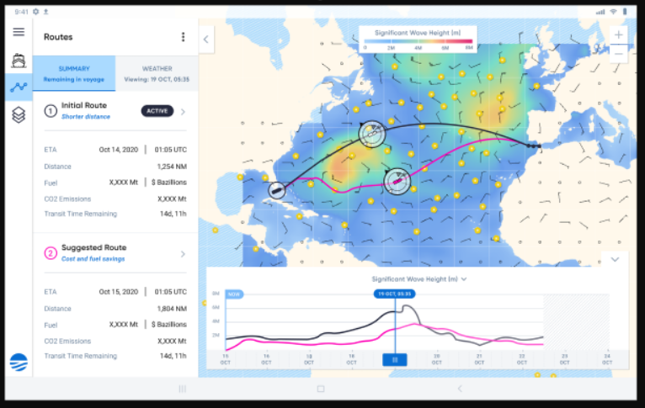
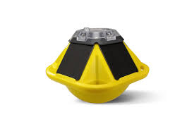
Advantages of In-Situ Drifters
Man overboard and oil spill response
Improved route planning

Slide 5
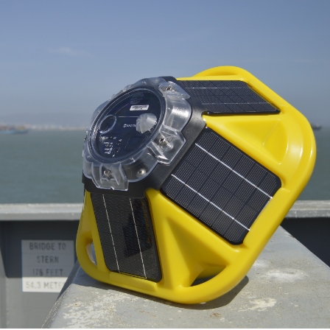
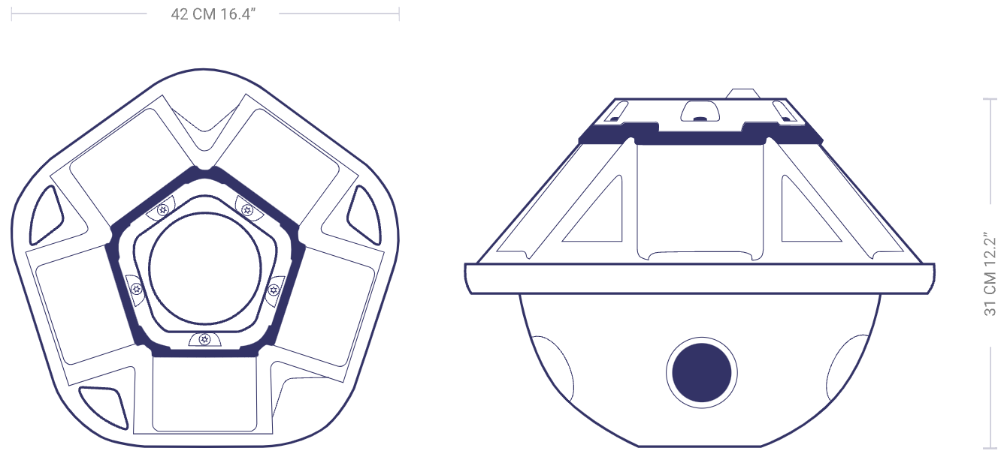
The Spotter by Sofar Ocean
20 days of drift data provided: your tools for success
Significant Wave Height (m)
Peak Period (s)
Mean Period (s)
Peak Direction (longitude spanning (0, 360) degrees)
Peak Directional Spread (degrees)
Mean Direction (longitude spanning degrees)
Mean Directional Spread (degrees)
Timestamp (UTC)
Latitude (5 decimals)
Longitude (5 decimals)
Epoch (s)
SpotterID
More info at: https://www.sofarocean.com/products/spotter

Slide 6
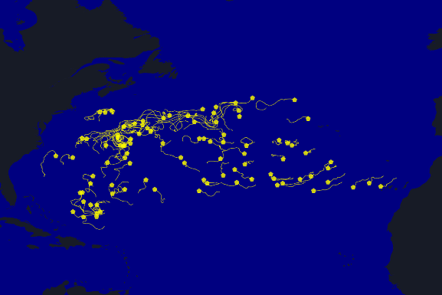
Our Challenge
DARPA does not presuppose any methodology for accomplishment!
Given 20 days of data, forecast the location of 90 drifters in the Atlantic for 10 days

Slide 7
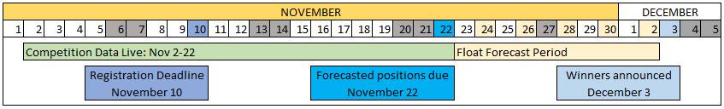
Challenge Schedule
Event | Date
Competitors Day Registration Ends | October 1, 2021
Competitors Day | October 7, 2021
Competition Data Goes Live | November 2, 2021
Competition Registration Ends | November 10, 2021
Qualification Deadline | November 17, 2021
End of Competition Data | November 22, 2021
Forecasted Positions Due | November 22, 2021
Winners Announced | December 3, 2021
Challenge Data will be provided on the Ocean of Things website:
https://oceanofthings.darpa.mil/data
Sample data available now includes data from ~90 Spotters, from May 30-Jun 21, 2021
Sample submission for two spotters over the 10 day forecast period

Slide 8

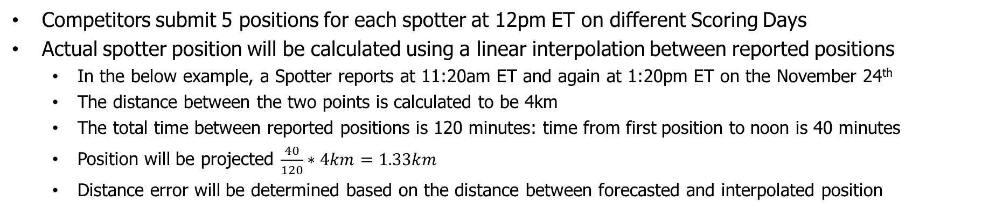
Forecast period: Determining Error
Competitors submit 5 positions for each spotter at 12pm ET on different Scoring Days
Actual spotter position will be calculated using a linear interpolation between reported positions
In the below example, a Spotter reports at 11:20am ET and again at 1:20pm ET on the November 24th
The distance between the two points is calculated to be 4km
The total time between reported positions is 120 minutes: time from first position to noon is 40 minutes
Position will be projected $\frac{40}{120}∗4km=1.33km$
Distance error will be determined based on the distance between forecasted and interpolated position
Actual trajectory
12:00pm ET
Interpolated
11:20am ET
Reported
Distance error
1:20pm ET
Reported
12:00pm ET
Competitor Forecasted

Slide 9
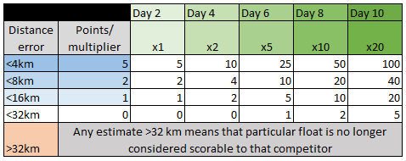
Challenge Scoring
Scoring is on a points system calculated using Great Circle distance between the Spotter’s actual calculated position and the team’s forecasted position
More points are awarded for higher accuracy
More points are awarded as time goes on
Error >32km represents an unsatisfactory trajectory, and a competitor may no longer receive points for that particular float

Slide 10
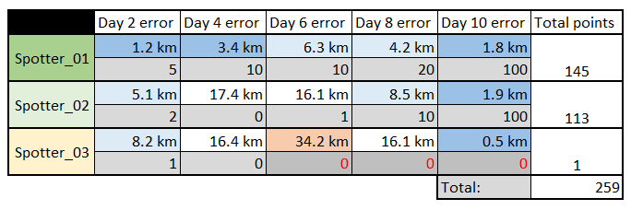
Scoring Examples
Spotter_01
On day 2, error <4km is awarded 5 points.
On day 4, error <4km is awarded 10 points.
On day 6, error <8km is awarded 10 points.
On day 8, error <8km is awarded 20 points.
On day 10, error <4km is awarded 100 points.
Overall, this float scored very highly for error that never exceeded 8km, with very low error on day 10.

Slide 11
Scoring Examples
Spotter_02
On day 2, error <8km is awarded 2 points.
On day 4, error <32km is awarded 0 points.
On day 6, error <32km is awarded 1 point. Maintaining trajectory within a submesoscale feature after 5 days will earn some points.
On day 8, error <16km is awarded 10 points.
On day 10, error <4km is awarded 100 points.
Overall, this float scored well for staying within a 32km feature, with very low error on day 10.

Slide 12
Scoring Examples
Spotter_03
On day 2, error <16km is awarded 1 point.
On day 4, error <32km is awarded 0 points.
On day 6, error >32km means the trajectory calculated for this float is too high to continue scoring. This team will no longer receive points from Spotter_03. Despite the extremely low error on day 10, the trajectory is too far off to receive points. The team receives only 1 point for this spotter.

Slide 13
How to Register
Follow the Qualification Guide to submit registration information to FFTChallenge@darpa.mil
Part 1: Team Information • Team Name • Team Organization(s) • Team Point-of-Contact (name, email, phone number) • Team Roster, i.e., list of all team members and their affiliations • Team Email Distribution List
Part 2: Brief Technical Approach (1,000 words max)
Participants are welcome to attach a document with any diagrams, video clips, or images to support your narrative
In your technical approach, please specify your data and model sources
Technical approach descriptions should provide sufficient detail to differentiate your approach
DARPA may choose to arrange a follow-up teleconference to discuss your submission
All qualification determinations will be made within 5 business days of the registration deadline

Slide 14
Questions?
Please enter your questions in chat

