Slide 1
MOVIES STREAMING AND RECOMMENDATION SYSTEM
Research Evaluation 2022-24
Presented by
NITYA GOPAL JENA 2205260015
SAGAR MAJHI 2205260018
USHA TIRKEY 2205260032
Under the guidance of
Prof. BIBHUDENDU PANDA
HOD, MCA
RIMS, Rourkela

Slide 2
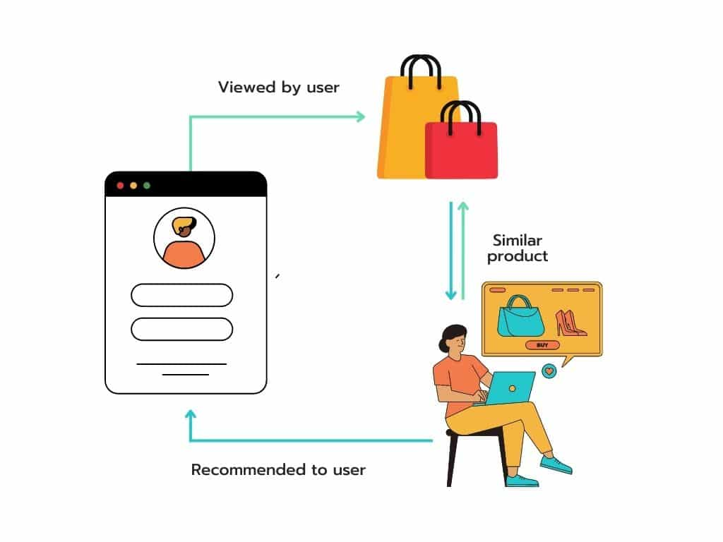
Why Do We Need Recommendation Systems?

Slide 3
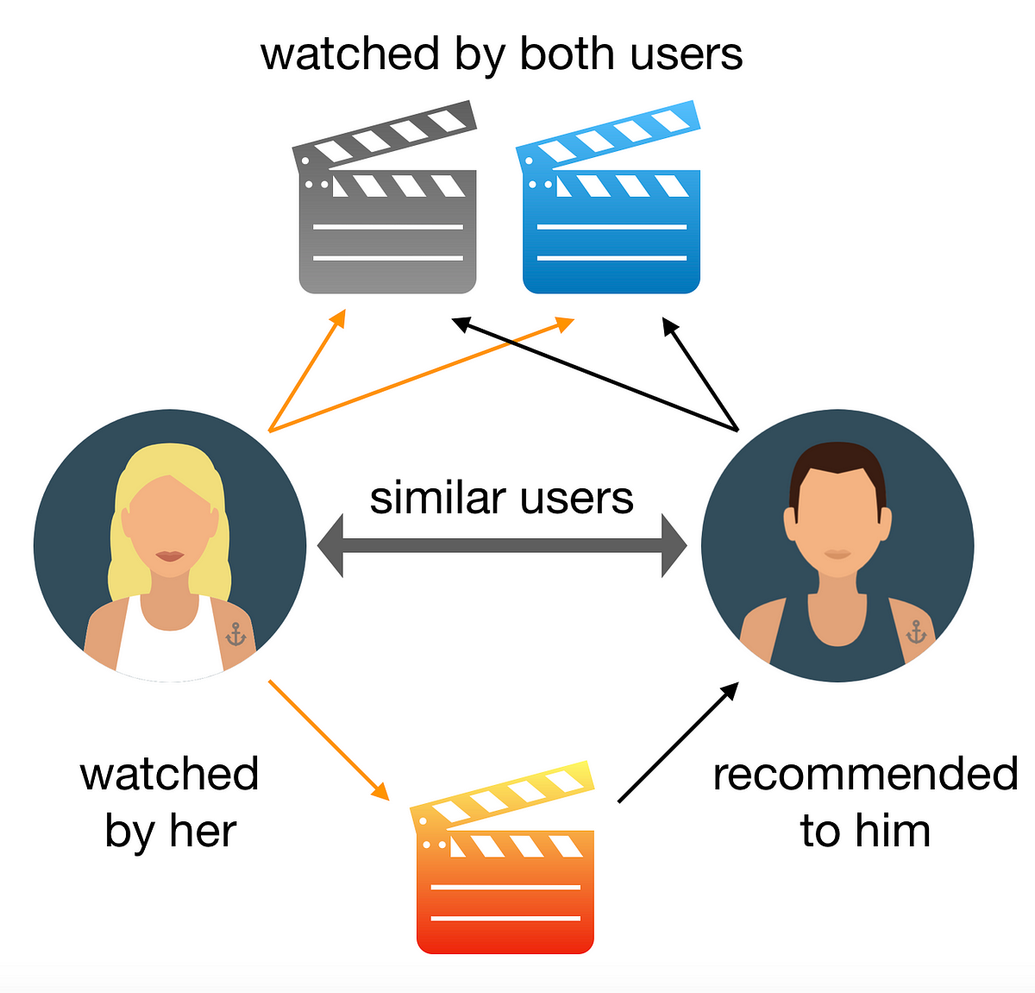
Introduction
Recommendation System

Slide 4
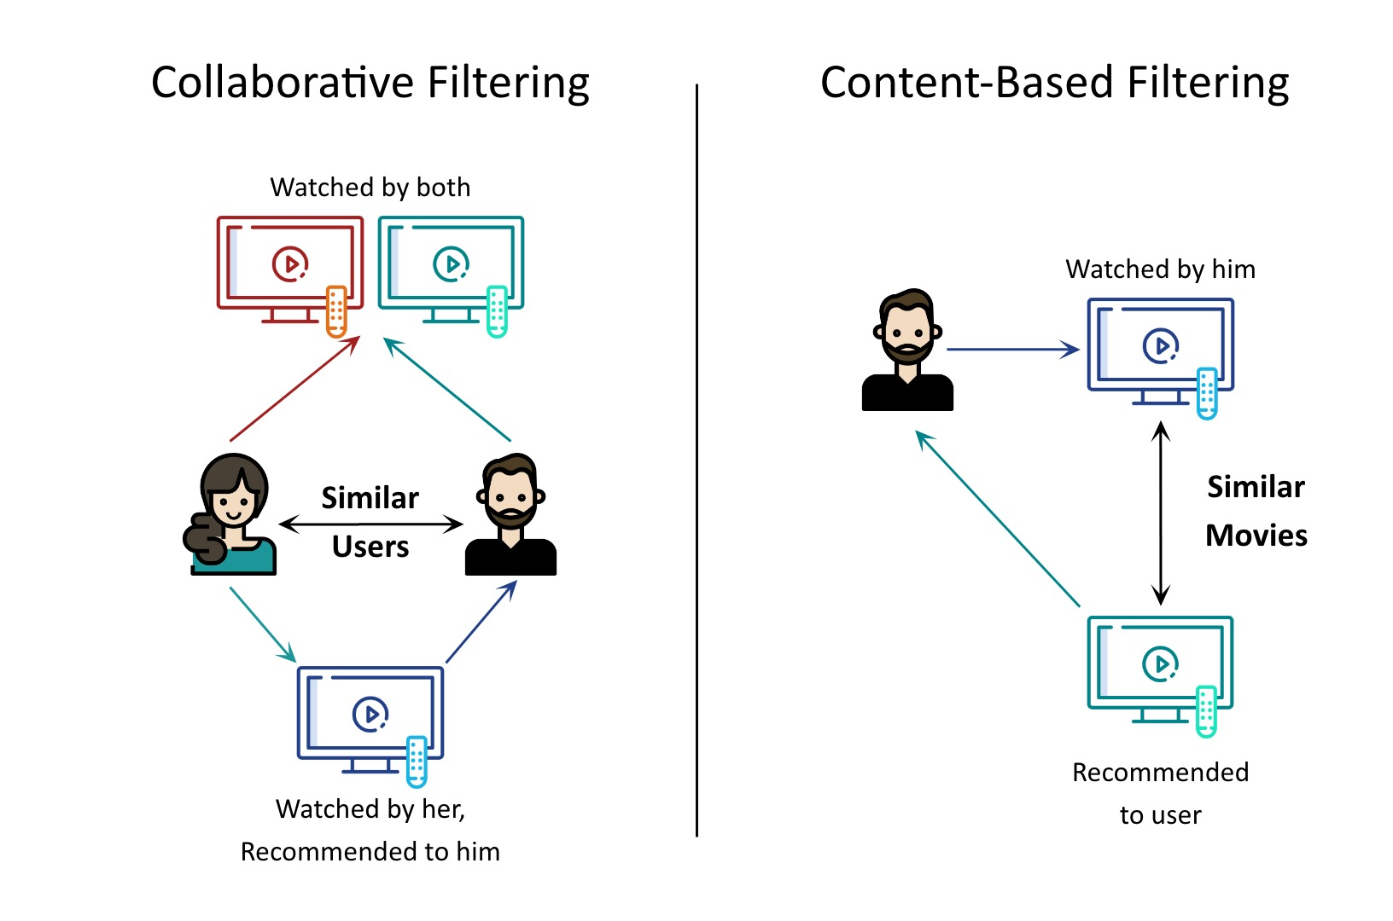
Types of Recommendation system

Slide 5
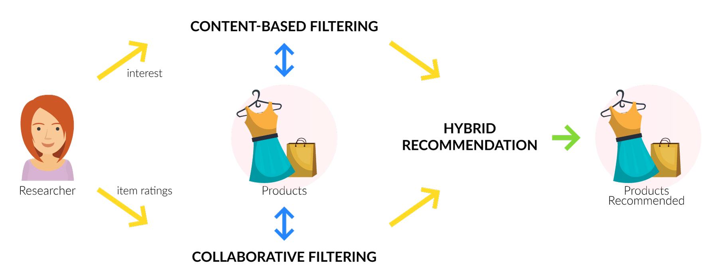

Slide 6
Recommendation Systems work based on the similarity between either the content or the users who access the content.
There are several ways to measure the similarity between two items. The recommendation systems use this similarity matrix to recommend the next most similar product to the user.
In this project, we will build a machine learning algorithm that would recommend movies based on a movie the user likes. This Machine Learning model is based on Cosine Similarity.

Slide 7
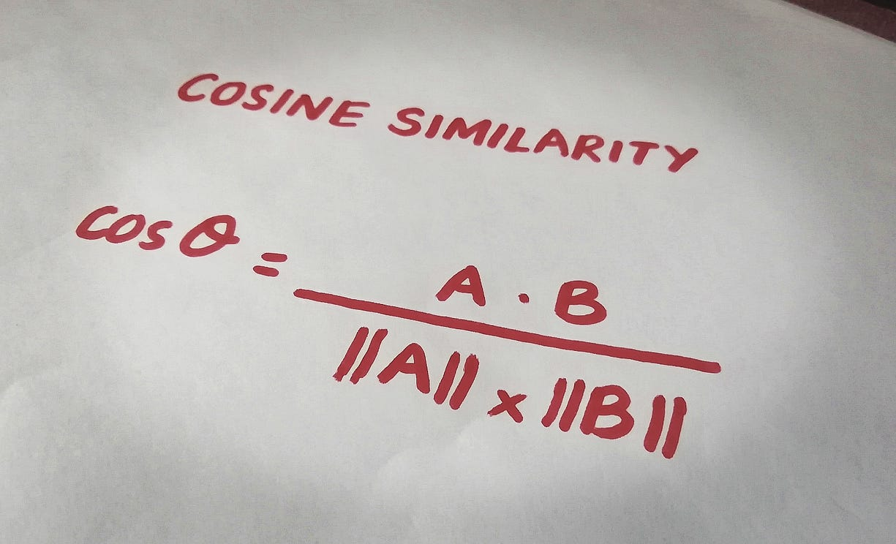
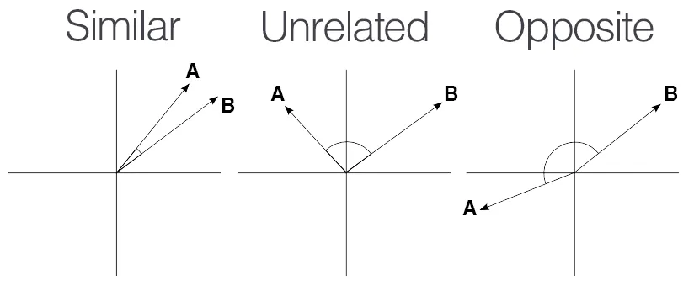
Cosine Similarity
Cosine similarity is a metric used to measure how similar two items are.
Mathematically, it measures the cosine of the angle between two vectors projected in a multi-dimensional space.
The output value ranges from 0–1.
0 means no similarity, where as 1 means that both the items are 100% similar.

Slide 8
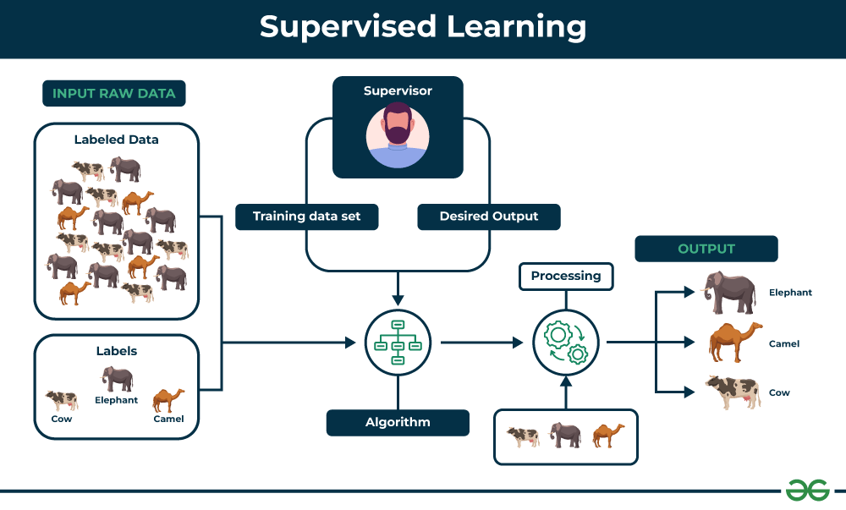

Slide 9
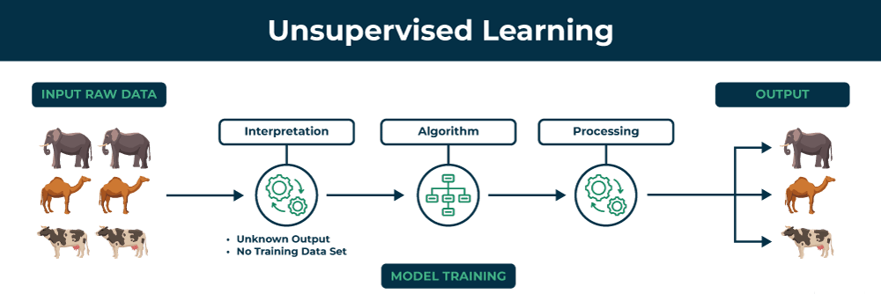

Slide 10

Pre-requisite for ReactJS:
NodeJS and NPM
React and React DOM
Webpack
Babel

Slide 11



Slide 12
Dataset
The first step to build a movie recommendation system is getting the appropriate data.
Our JSON file contains a total of 200 movies with the following fields: index, budget, genres, homepage, id, keywords, original_language, original_title, overview, popularity, production_companies, production_countries, release_date, revenue, runtime, spoken_languages, status, tagline, title, vote_average, vote_count, cast, crew, and director. This JSON file was scraped from Netflix.
A user who likes a horror movie will most probably like another horror movie. Some users may like seeing their favourite actors in the cast of the movie. Others may love movies directed by a particular person. Combining all of these aspects, our shortlisted 4 features are sufficient to train our recommendation algorithm.

Slide 13
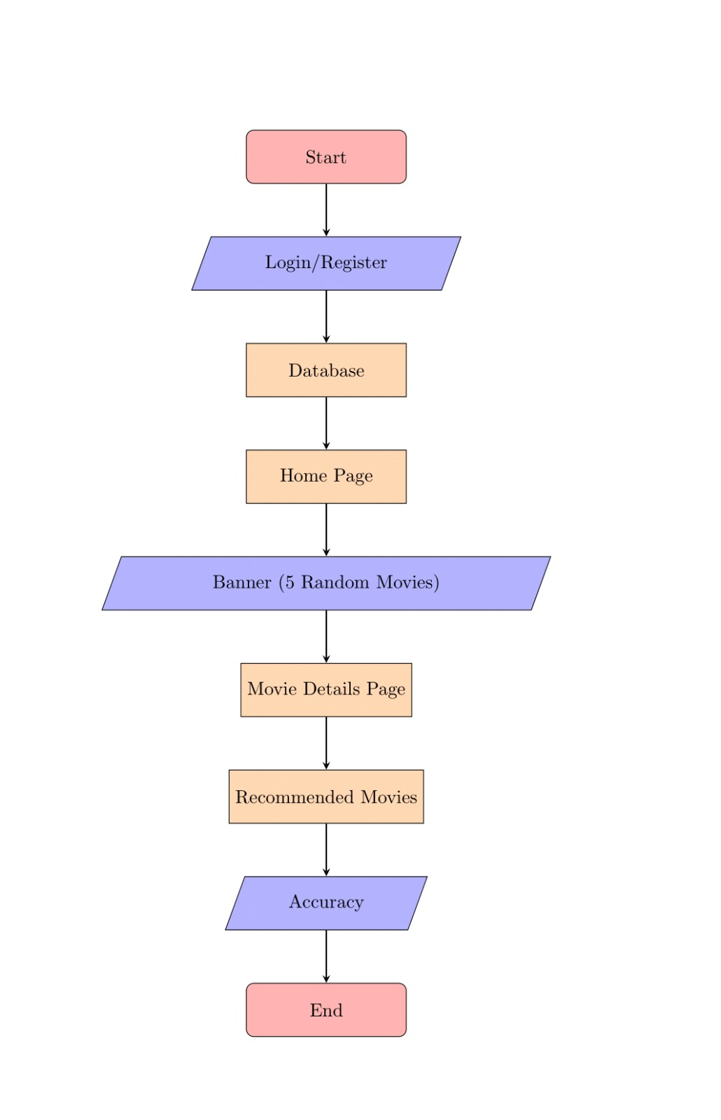

Slide 14
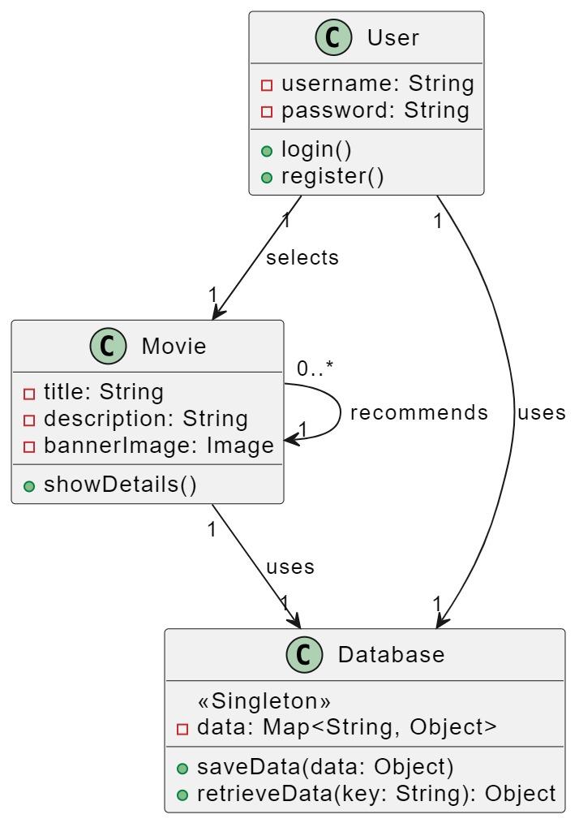
CLASS DIAGRAM

Slide 15
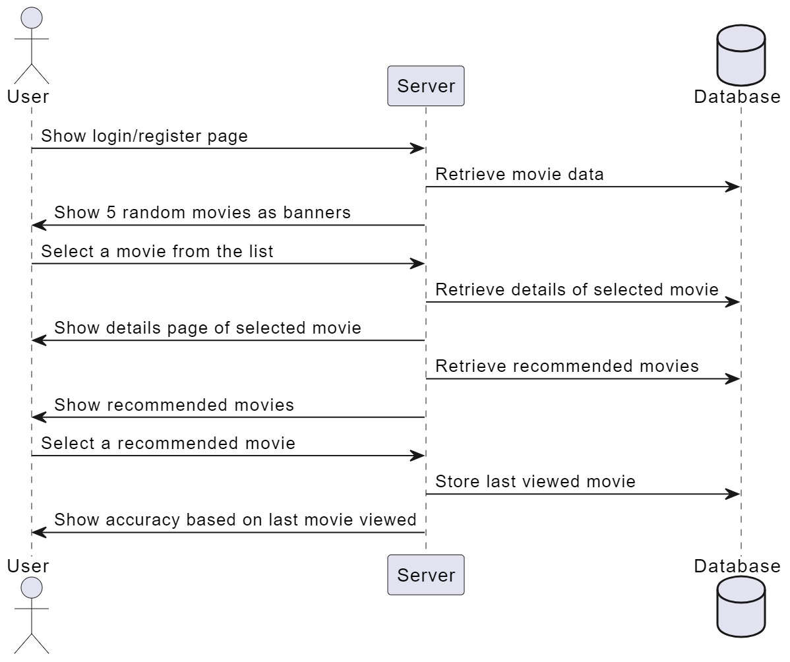
SEQUENCE DIAGRAM

Slide 16
CODING STEPS
index.html
index.js
index.css
app.css
app.js
Components:
Carousel.jsx
ImageSlider.jsx
Movies.jsx
Slide.jsx
Carouser.css
ImageSlider.css
recommender.py

Slide 17
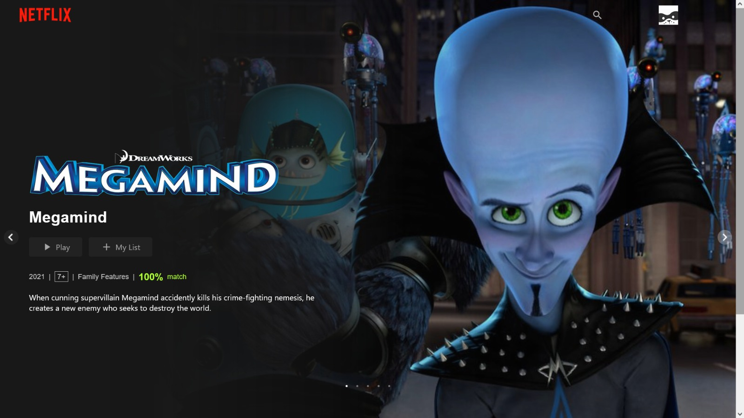
OUTPUT

Slide 18
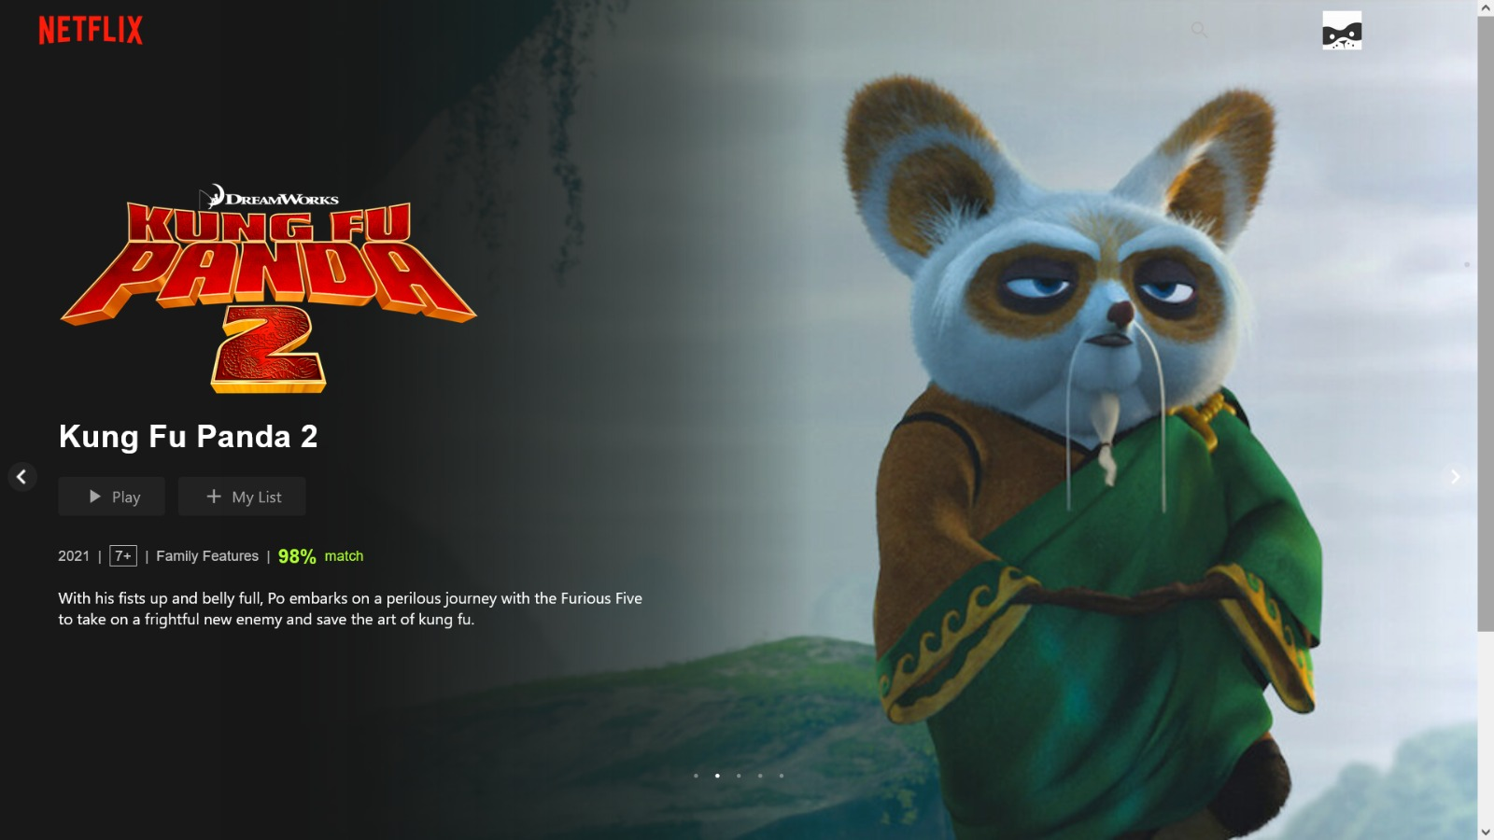
OUTPUT

Slide 19
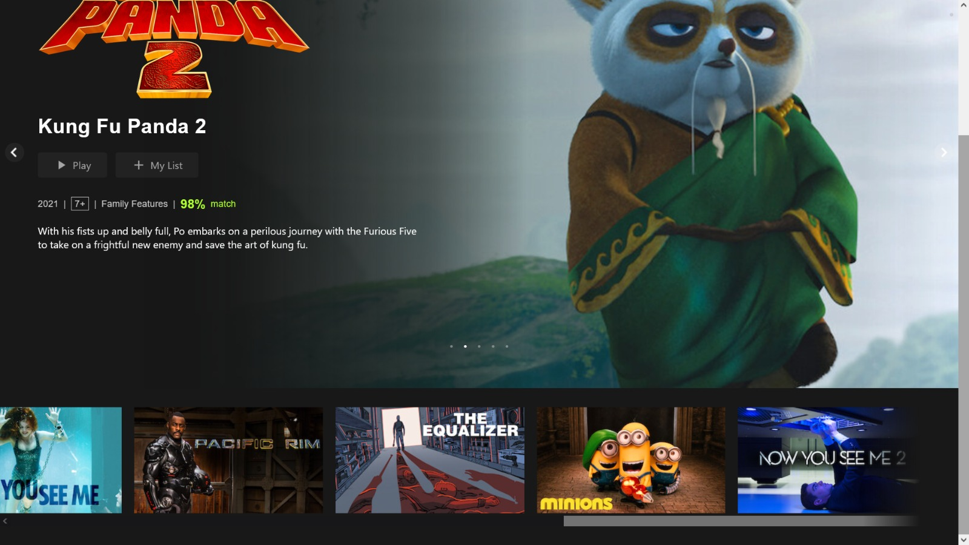
OUTPUT

Slide 20
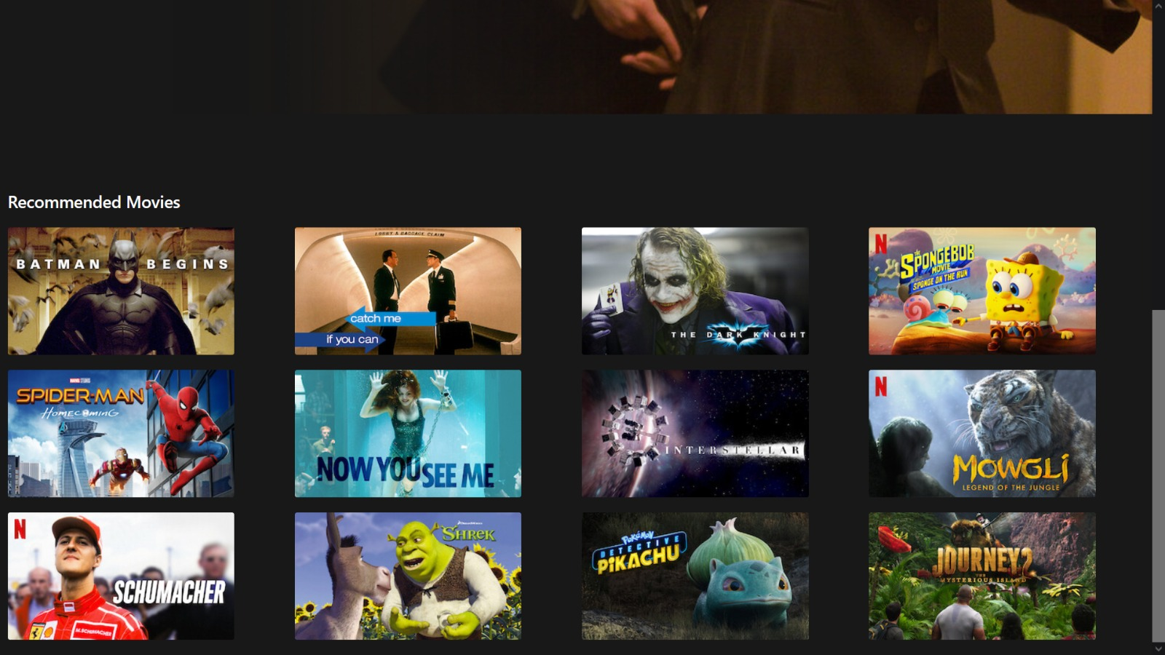
OUTPUT

Slide 21
Conclusion
In summary, the movie recommendation system project has demonstrated the power and potential of machine learning in enhancing user experience in the digital entertainment industry. The system effectively utilized collaborative filtering and content-based filtering methods, providing personalized movie recommendations based on user preferences and viewing history.

Slide 22
FUTURE ENHANCEMENT
Enhanced Recommendation Algorithm
Dynamic Banner Content
Interactive Homepage Features
Social Integration
Cross-Platform Compatibility
Personalized Content Discovery
Integration with External APIs
User Feedback and Iterative Improvement
Monetization Strategies
By incorporating these enhancements and continually iterating on your movie recommendation system, we can create a compelling and personalized entertainment platform that delights users and keeps them engaged for the long term.

Slide 23
Thank you

