Slide 1

Group 15 In-class Presentation
CLASSIFICATION BY LOGISTIC REGRESSION

Slide 2
Bias-Variance Tradeoff
/01
Mathematical Interpretation.
Graphical illustration.
Tradeoff in terms of model complexity

Slide 3
Mathematical Interpretation
For the regression problem, we can define and decompose it bias and variance components.
$ERROR= σ^{2}+𝔼_{D}\left({\left(h\left(x\right)−𝔼_{D}\left(h\left(x\right)\right)\right)}^{2}\right)+$ ${\left(𝔼_{D}\left(h\left(x\right)\right)−f(x)\right)}^{2}$
Var
Bias^2

Slide 4
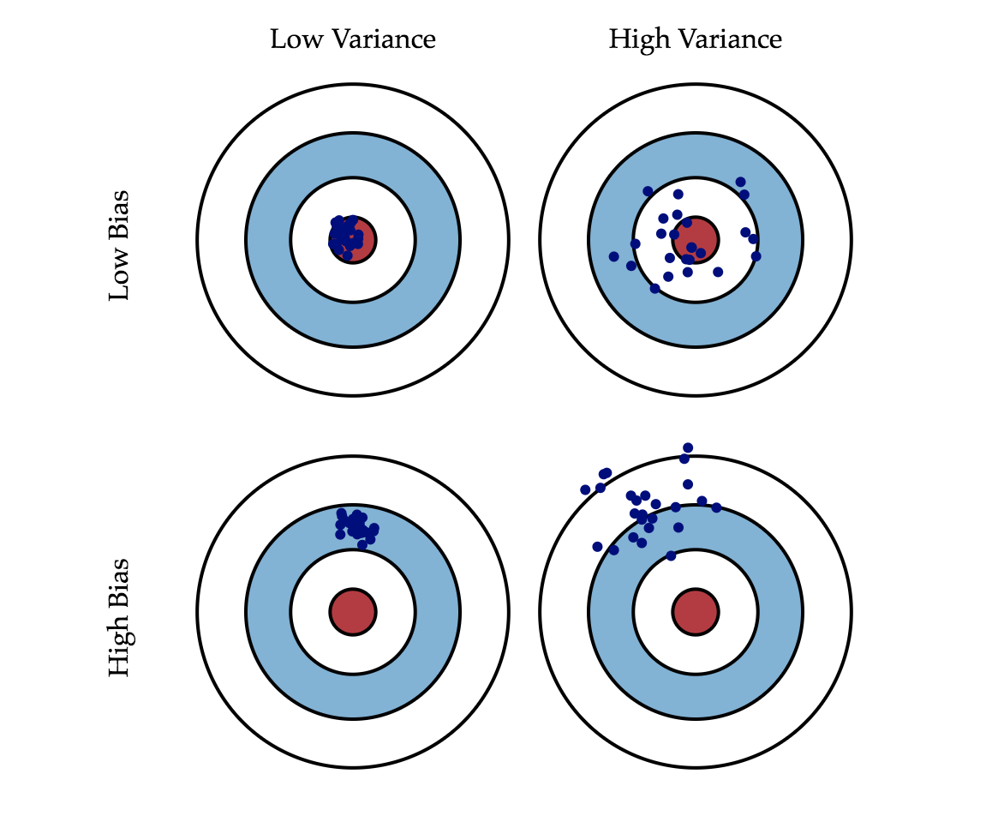
Graphical illustration
A graphical visualization of bias and variance
using a bulls-eye diagram
Each hit represents an individual realization of
our model
The center of the target is a model that perfectly predicts the correct values
Top left case: perfect but impossible to realize
due to imperfect models and finite data
In real world: tradeoff between minimizing bias and minimizing variance

Slide 5
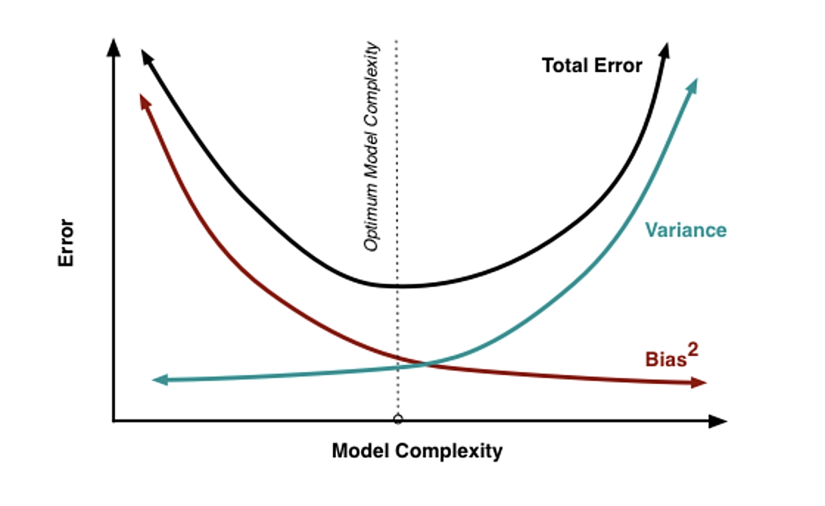
Tradeoff in terms of model complexity
Bias is reduced and variance is increased in relation to model complexity.
Need to tradeoff bias and variance to achieve expected goals.
In this case, choose optimum model complexity point to minimize the error.

Slide 6
Overview of Dataset
/02

Slide 7
Overview of Dataset
Numeric
Categorical
Age
Job
Cons.conf.
idx
Cons.price.
idx
Nr.
Including 41188 samples
20 features
Duration
employed
Day_
of_
week
Education
Martial
Campaign
Housing
Euribir3m
Pdays
Loan
Previous
Emp_var_
rate
month
Default
Contract
Predictor: Has the client subscribed a term deposit?
Poutcome

Slide 8
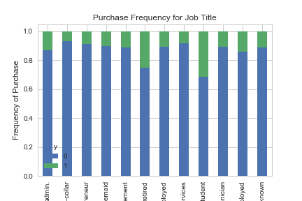
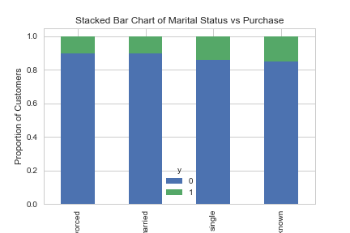
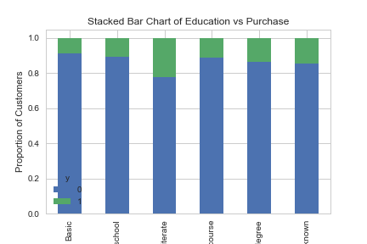
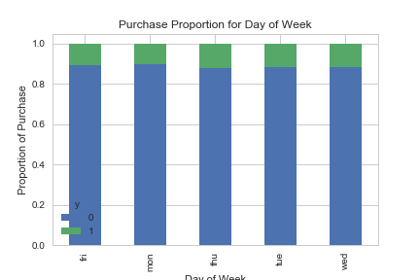
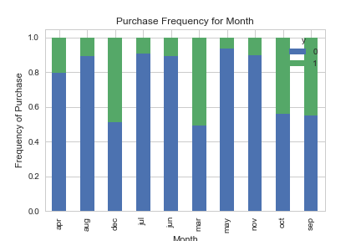
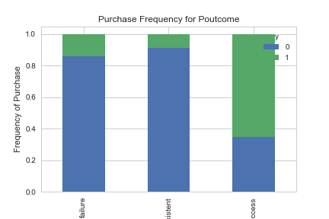
Data Visualization

Slide 9
Data Preprocessing
/03

Slide 10
General Idea
Recursive Feature Elimination
Over-sampling using SMOTE
Convert categorical into dummy variables
3
2
1

Slide 11
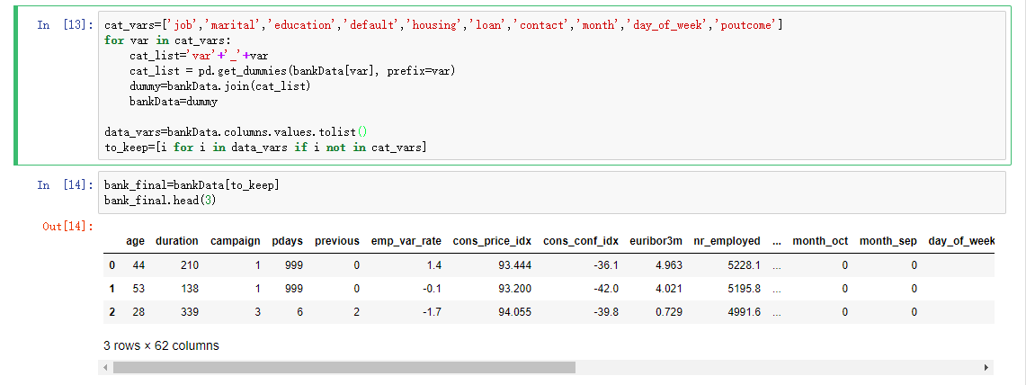
Convert categorical into dummy variables
Use get_dummies from pandas

Slide 12
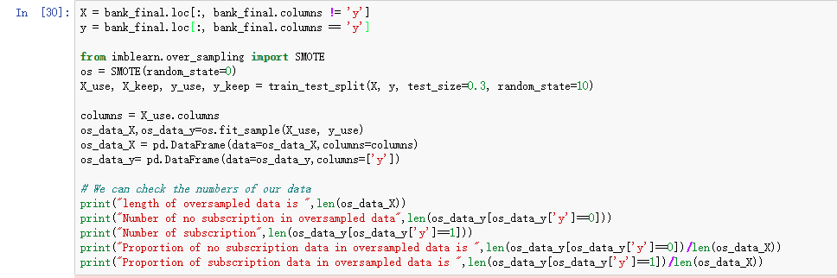
Over-sampling using SMOTE
Works by creating synthetic samples from the minor class (no-subscription) instead of creating copies.
Randomly choosing one of the k-nearest-neighbors and using it to create a similar, but randomly tweaked, new observations.

Slide 13
Over-sampling using SMOTE
The output is:
Now we have a perfect balanced data!

Slide 14
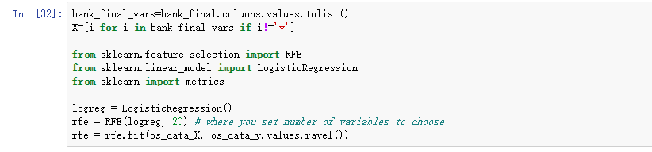
Recursive Feature Elimination
Recursive Feature Elimination (RFE) is based on the idea to repeatedly construct a model and choose either the best or worst performing feature, setting the feature aside and then repeating the process with the rest of the features. This process is applied until all features in the dataset are exhausted.
The goal of RFE is to select features by recursively considering smaller and smaller sets of features.

Slide 15
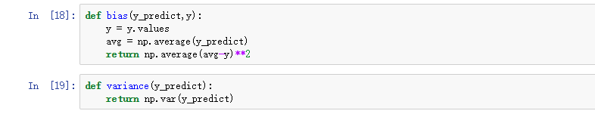
Bias and Variance
Bias: use predict labels and ground truth labels to compute bias
Variance: directly compute the variance of predict labels

Slide 16
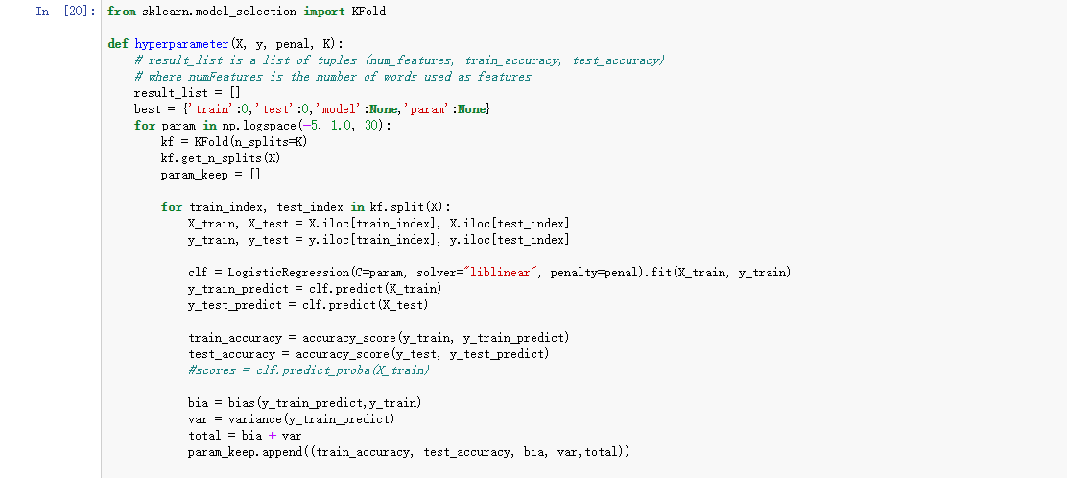
Hyperparameter Tuning
Use grid search to tune inverse weight of L1 regularization
Split data into K=4 folds for cross validation
Calculate bias and variance

Slide 17
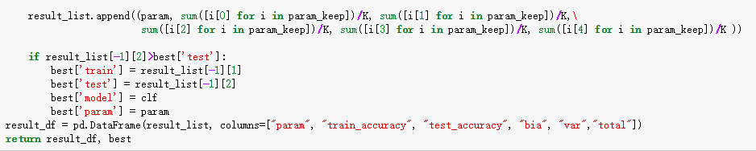
Tuning Hyperparameter
Store the model with the highest test accuracy

Slide 18
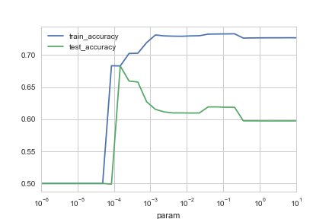
Relationship between accuracy and L1 regulation
x-axis is inverse weight of L1 regularization, indicates how "strong" L1 regularization

Slide 19
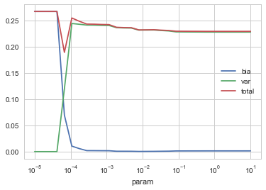
Bias and Variance Tradeoff
Bias grow when we try to reduce variance and the same case for variance.
Can not achieve low bias and low variance at the same time
Need to tradeoff bias and variance in real model to improve the performance

Slide 20
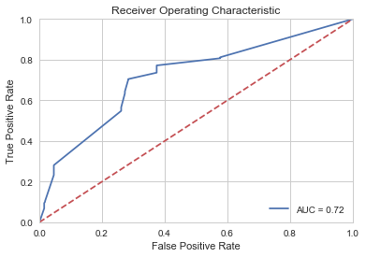
ROC plot and corresponding AUC
Precision Score:
66.620%
Recall Score:
73.806%
F1 Score:
70.029%

Slide 21
Bias-variance Tradeoff in TensorFlow
/ADDITION

Slide 22
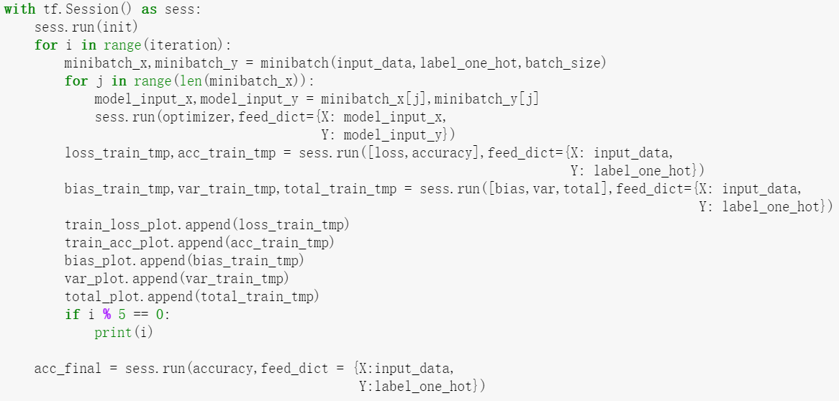
Code in TensorFlow

Slide 23
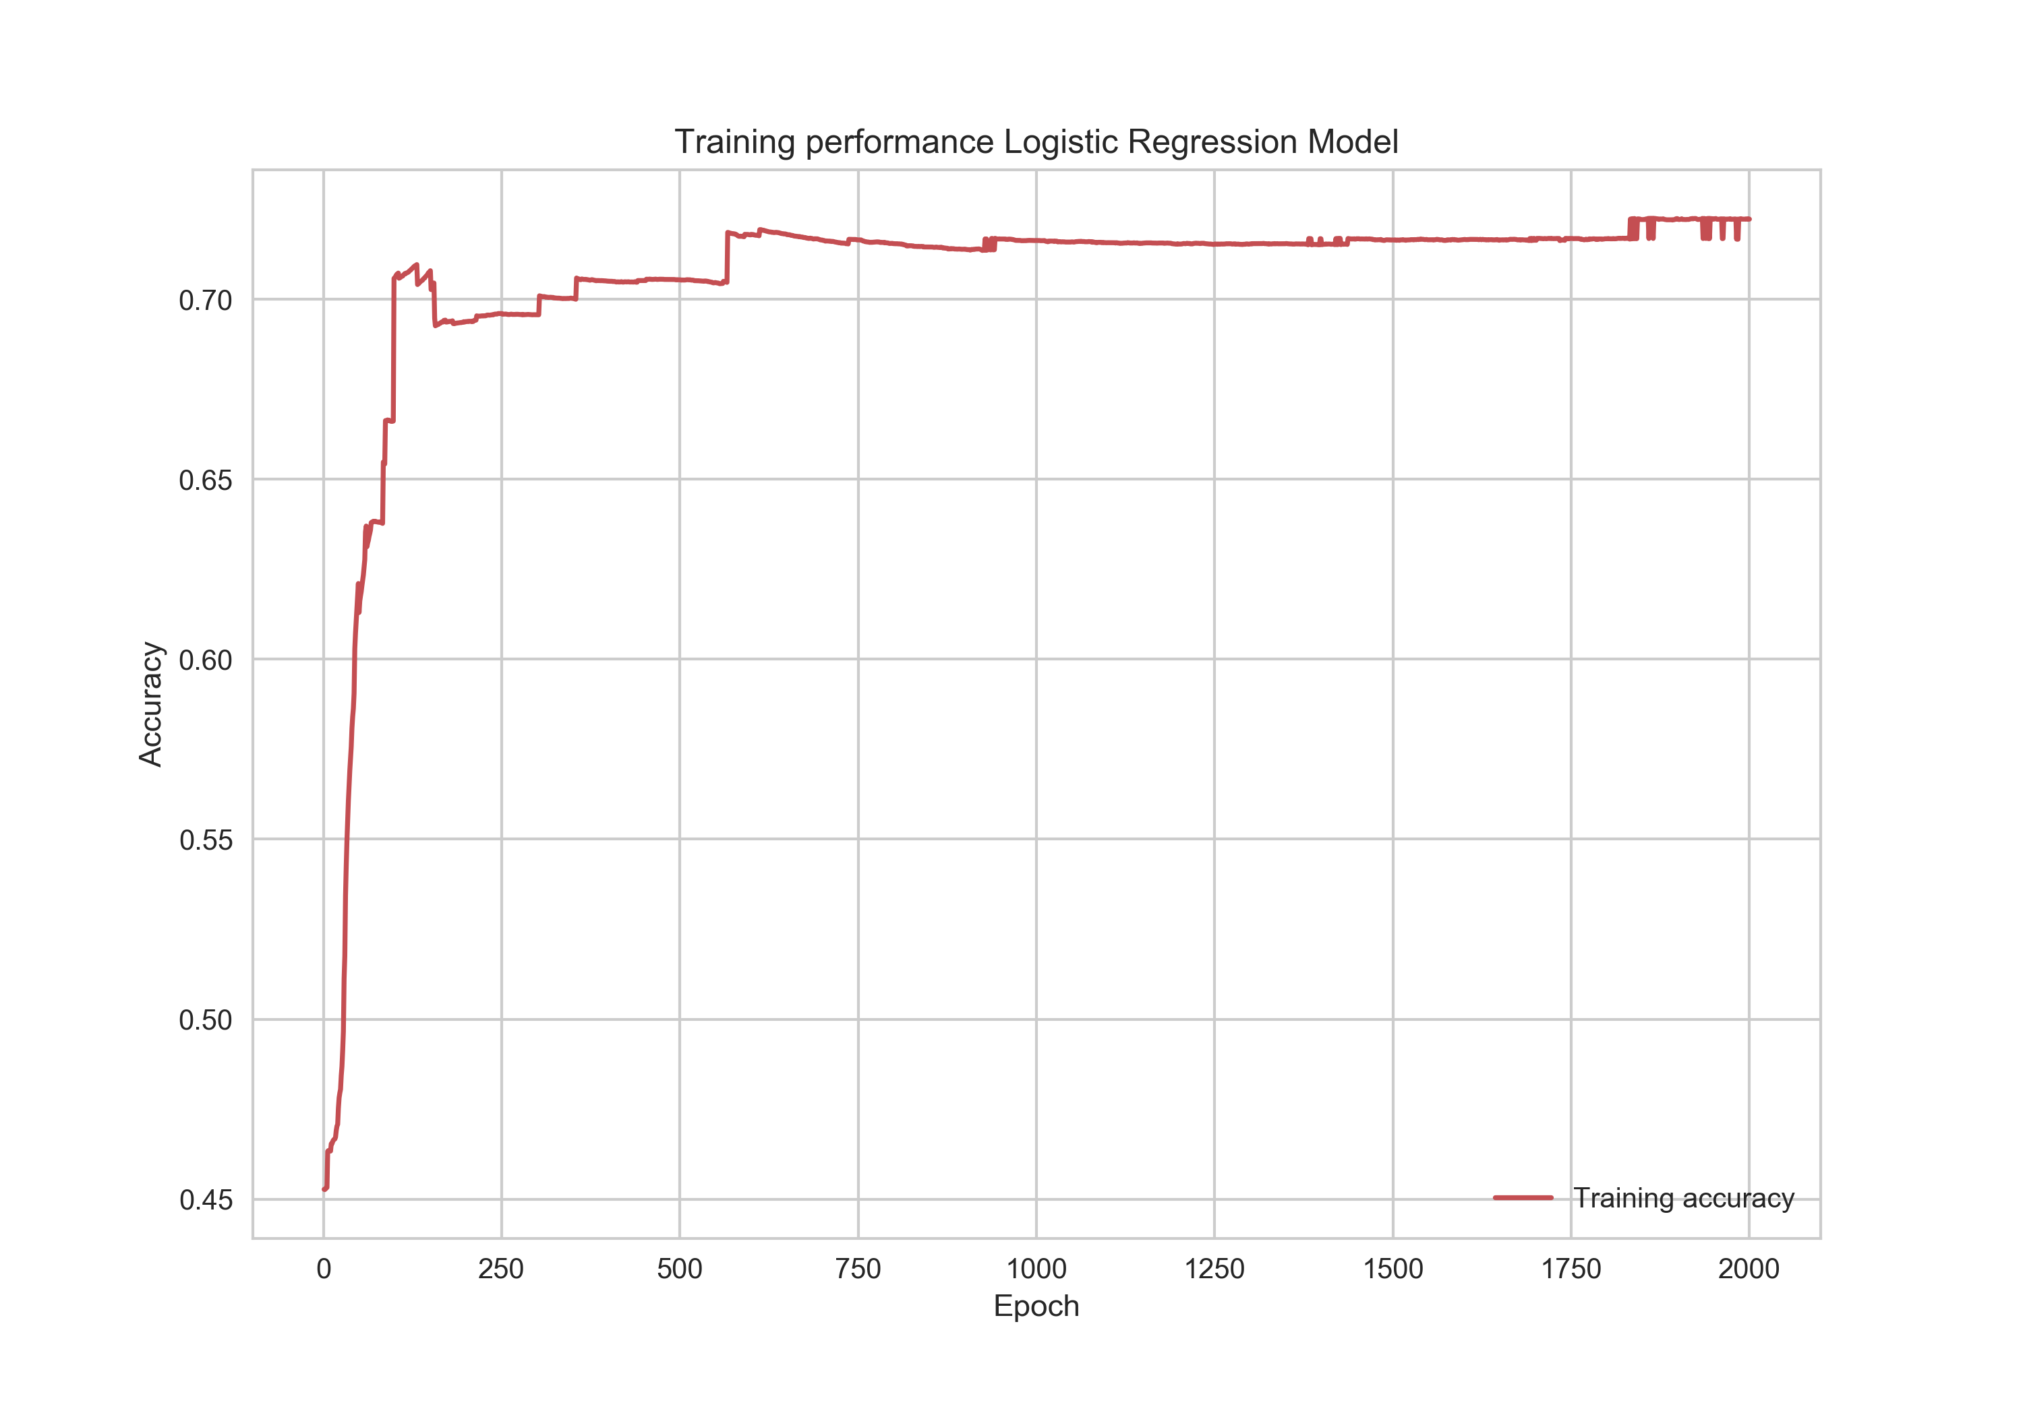
Result in TensorFlow

Slide 24
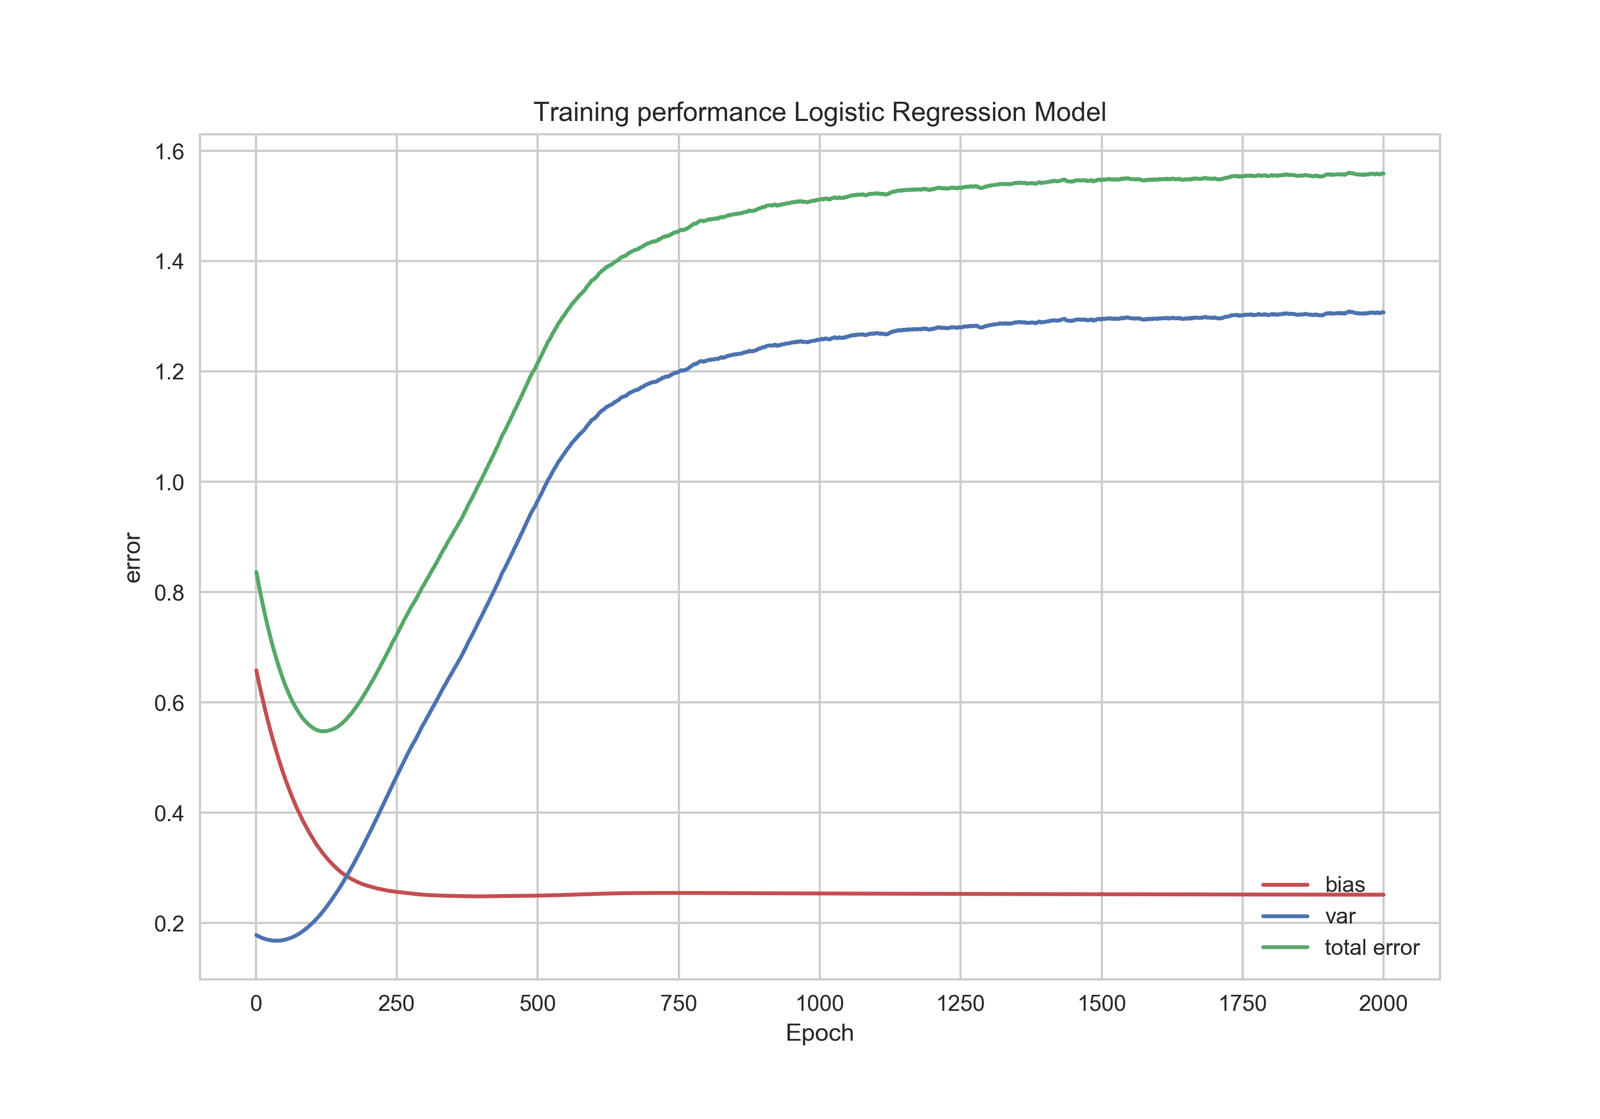
Result in TensorFlow

Slide 25
Group 15

