Slide 1
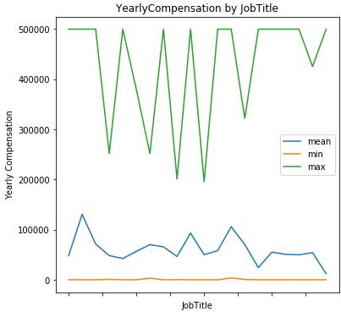
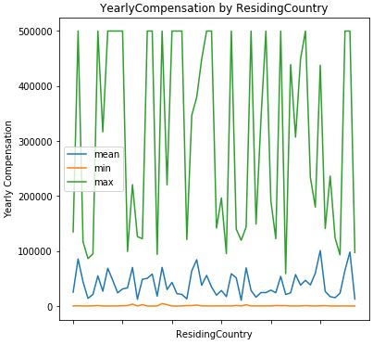
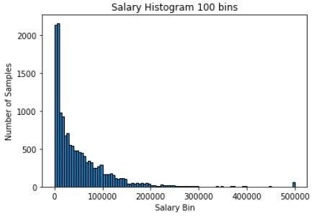
/01
Exploratory Data Analysis
The left two figures respectively show the relationships of JobTitle vs YearlyCompensation, Residing Country vs YearlyCompensation. The mean and maximum YearlyCompensation vary with these two variables. Comparatively, the minimum YearlyCompensation are almost the same.
The primary concern for further regression task is existence of outliers in our dataset. The histogram on the left shows the distribution of yearly compensation. From 0 to 300,000 the number of persons keeps dropping. But it's weird that there is a minor peak at 500,000. We have reason to doubt the authentication of these data records. Therefore, for future regression task, we will set a threshold to eliminate the outliers.

Slide 2
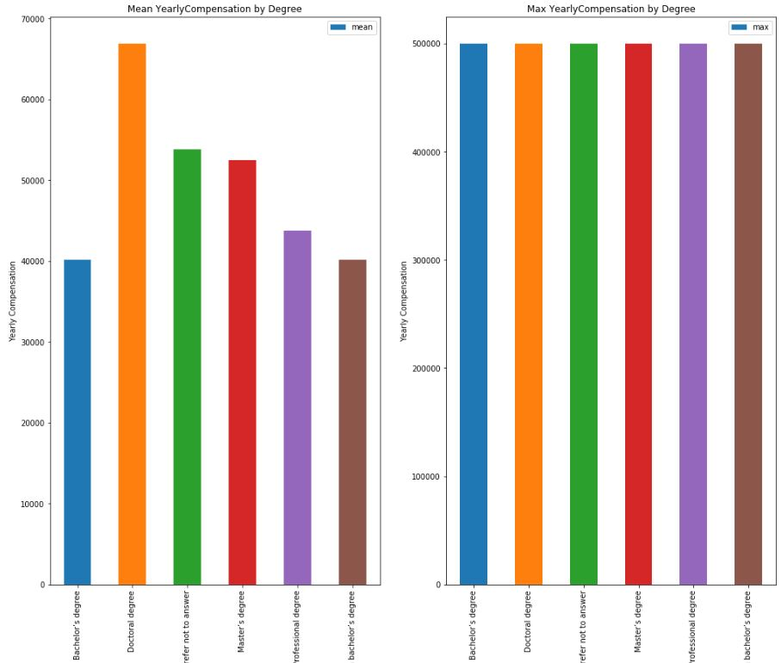
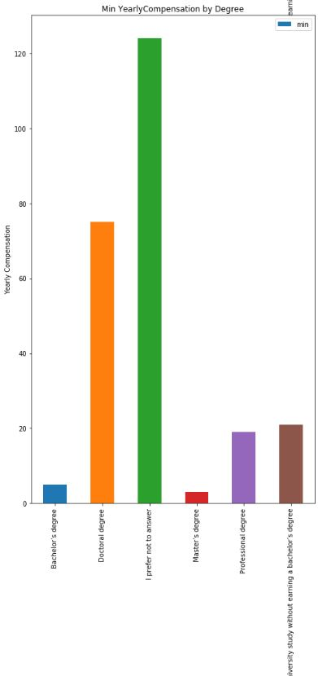
Above figures show mean, max and min Yearly Compensation of people with different degrees. According to mean value, people with higher degree are more likely to earn more salary. People with different degrees all have chance to earn salary as high as 500,000. From the min Yearly Compensation, we notice a weird phenomenon that some people earn as less as 100. These values are likely to be fake and unreliable since respondents may take this survey slightly and give false values. We will set a threshold to delete records less than the threshold in the further deployment.

Slide 3
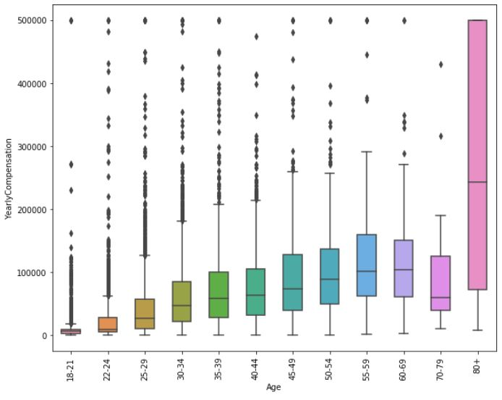
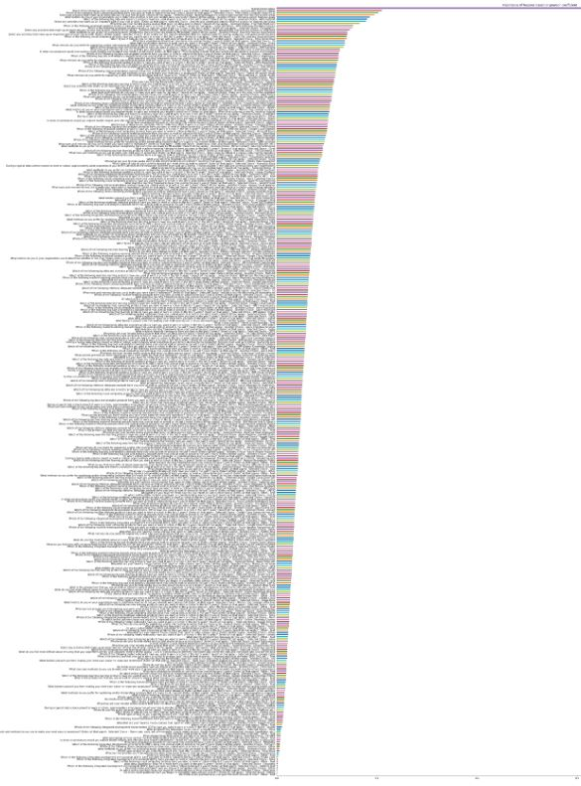
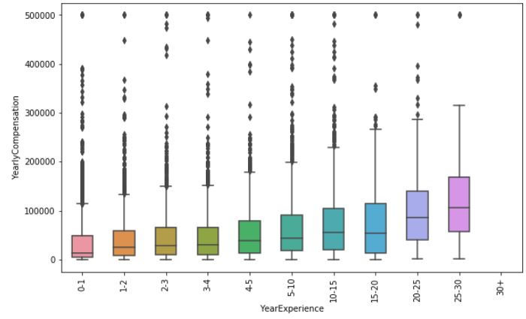
In the left two figures, we dig into the relationship between Yearly Compensation and length of work, so we respectively show the relationships of Age vs Yearly Compensation, Year Experience vs Yearly Compensation. We can see that older people or those who have longer work experience are more likely to have a higher yearly compensation. Therefore we can normalize these features with with mean value to keep numerical order.
In the right figure, we rank the features according to their pearson correlation with yearly compensation.
The top 3 most important features are:
1. Used AWS in the past or not
2. Used EC2 in the past or not
3. Built prototypes to explore applying machine learning to new areas in work or not
The top 3 less important features are
1. Used Udemy as online platform to take data science courses or not
2. Used DataCamp as online platform to take data science courses or not
3. Use Other online platform to take data science courses or not
Feature Importance Ranking

Slide 4
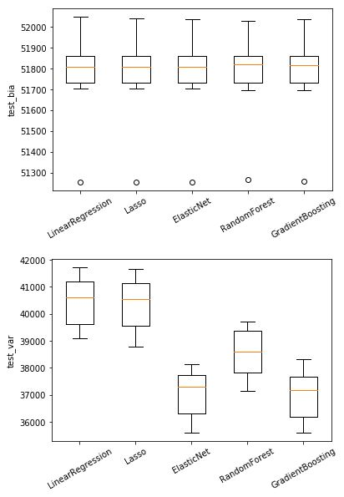
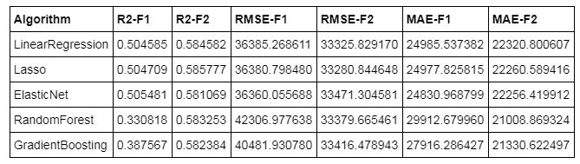

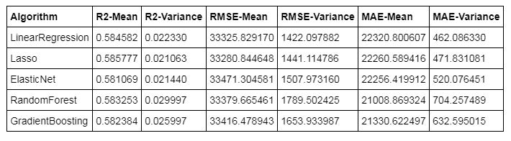
/02
Feature Selection and Model Implementation
After cleaning data and featurization, we implemented two kinds of feature selection methods “Principal Component Analysis(PCA)” denoted by ‘F1’ and “SelectFromModel-Lasso” denoted by ‘F2’. Then we implemented five machine learning methods, which are "Linear Regression", "Lasso", "ElasticNet", "Random Forest", "Gradient Boosting“ to do regression task.
In table above, to choose better feature bunch, we compute the R-Square(R2)/Root Mean Square Error (RMSE)/Mean Absolute Error(MAE) scores on testing set. Note that during the training, we do 10-fold cross-validation and the testing scores are the mean of 10 folds. From the test performance, we can see that F2 is better than F1 from every measurement. Therefore, in the following steps, we discard F1 and only develop on F2 bunch (“SelectFromModel-Lasso”).
Above we plotted the bias and variance of five algorithms cross 10-fold. The bias are almost the same, but the variance are quite different. LinearRegression and Lasso have the larger variance, while ElasticNet and GradientBoosting have lower variance. Considering that GradientBoosting performs better than ElasticNet in accuracy, we choose GradientBoosting as our best model.
To compare the models performance on chosen feature bunch, we use R2/RMSE/MAE to measure the accuracy. R2 value and RMSE score are almost the same across different algorithms. The MAE score of Random Forest is the lowest but it has high variance.

Slide 5
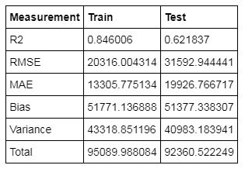
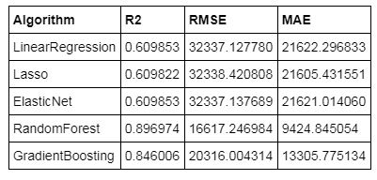
/03
Model Tuning, Testing and Conclusion
We use GridSearch Cross-Validation to tune the hyperparameters.
1. For each algorithm, we define the hyperparameter space beforehand.
2. With every candidate hyperparameter, GridSearchCV will first split the data into K folds, train the model on K-1 folds and then score on test data. We choose to use R2 as performance measure score. R2 measures how well the regression line approximates the real data points, it also portrays percent of variance in the data explained by regression model. GridSearchCV will give the best hyperparameters based on the average R2 score cross K times training.
We used our optimal model to make predictions on the training and test set. The results are listed above. From every perspective, the performance on training set is better than that on testing set.
Our model is overfitting. First we can see the R2 score is much higher for training than testing, which means that the model fits training set so well that it has captured the noise of the data. The variance difference between training set and testing set is much higher than bias difference, and the variance in training stage is a little higher. Therefore we can conclude that the model is overfitting.
To improve the testing performance, we can fit multiple models and use validation or cross-validation to compare their predictive accuracies on test data. In the case of GradientBoosting, the maximum tree depth also plays a huge role in determining the fit, so we can decrease the max depth to significantly reduces overfitting.
Based on the hyperparameter tuning, we obtained the best models of each algorithm and we listed their performance on the whole training set in the above table. According to above table, the models that perform better are RandomForest and GradientBoosting. RandomForest seems to be the best. However, from our analysis in last step, GradientBoosting has much lower variance than RandomForest and the bias are almost the same. So we choose GradientBoosting as our best model. The best hyper-parameter are {'max_depth': 7, 'min_samples_leaf': 2, 'n_estimators': 110}.

