Slide 1


Robot Framework
Dos and Don'ts
© Copyright Pekka Klärck <peke@eliga.fi>
Creative Commons Attribution 3.0 License

Slide 2
Introduction
This presentation demonstrates general guidelines how to create good Robot Framework test cases
Good practices and antipatterns

Slide 3
Most important goals
Easy to understand
Easy to maintain
Fast to execute

Slide 4
Naming
Very important to name well test cases, test suites, keywords, variables, libraries, resource files, ...
Good name is explicit and easy to understand
Consistency
Namespaces
Name should tell “what”, not “how”

Slide 5
Documentation
Test suites often benefit from documentation explaining background etc.
Well named tests with well named keywords should not need extra documentation
Reusable keywords must be documented
  Good keyword and argument names help

Slide 6
Example categorization
DO: A very good and generally recommended practice.
DON'T: An antipattern, should not be used.
TRY: A practice that works in many contexts.
AVOID: A practice that typically should be avoided but may sometimes be necessary.

Slide 7
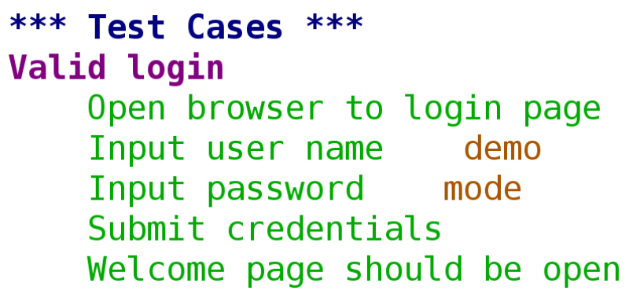
DO: Appropriate abstraction level
Notes:
- easy with user keywords
- dsl
- slap
- no unnecessary details
- phases

Slide 8
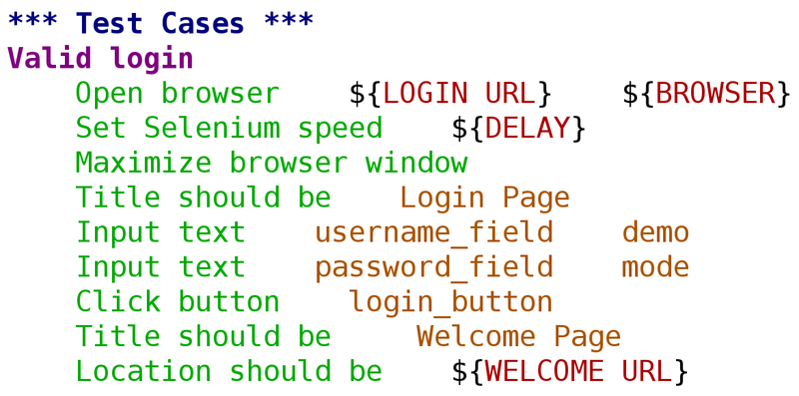
DON'T: Too low abstraction level

Slide 9
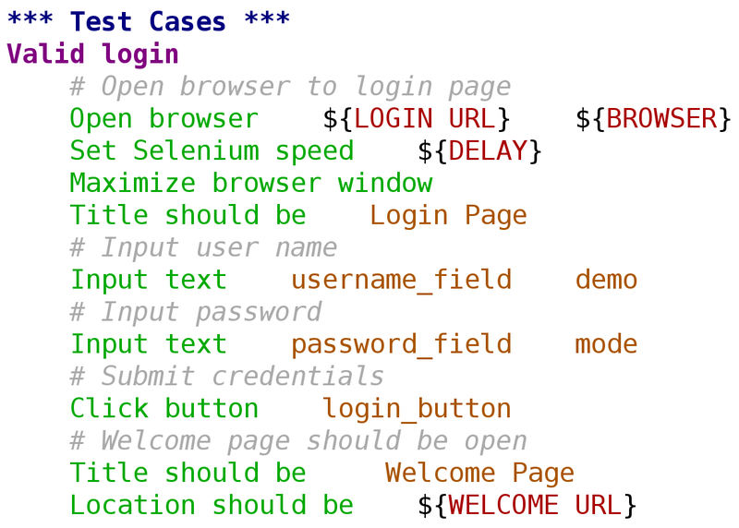
DON'T: Comments instead of abstraction

Slide 10
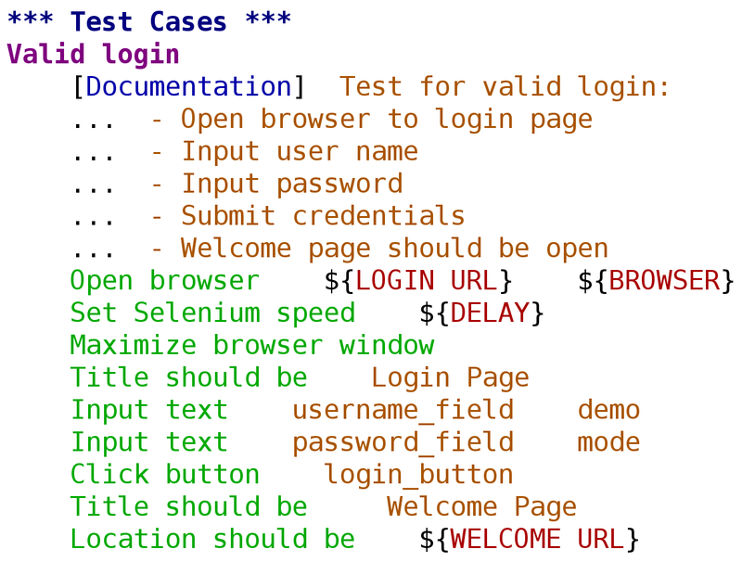
DON'T: Documentation instead of abstraction

Slide 11
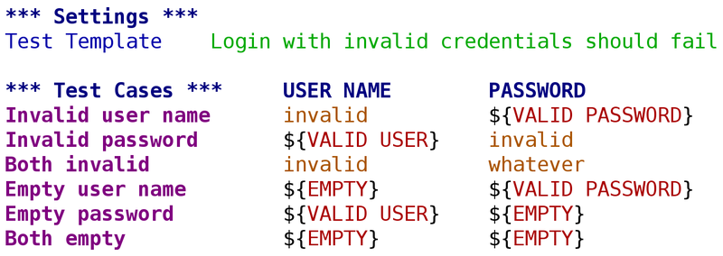
DO: Use data-driven style to avoid repeating same test workflow

Slide 12
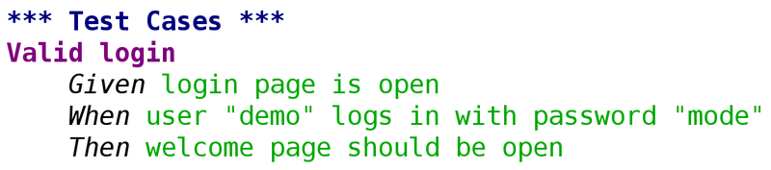
TRY: Gherkin style (ATDD/BDD)

Slide 13
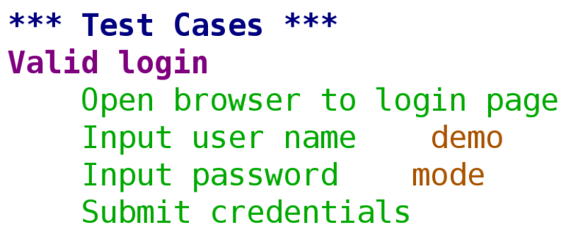
DON'T: Tests without assertions

Slide 14
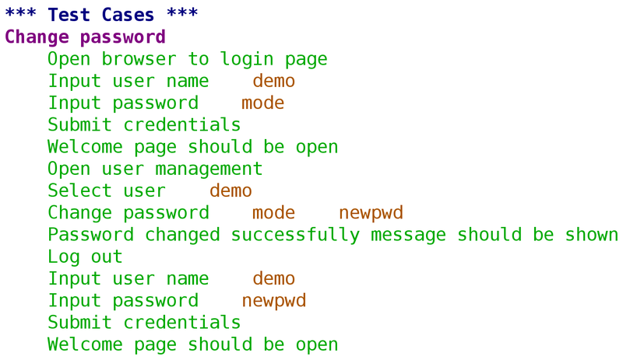
AVOID: Tests with unrelated asserts
Notes:
- one test should test one thing
- things can be big (end to end) or small (part of a feature)
-

Slide 15
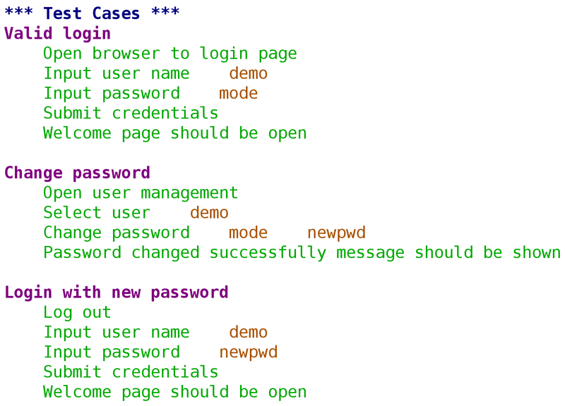
AVOID: Dependencies between tests

Slide 16
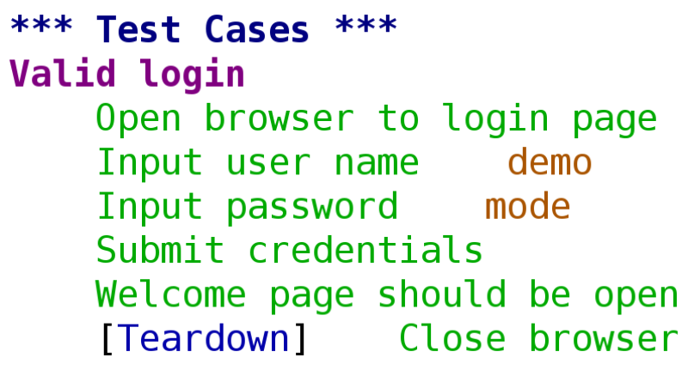
DO: Use teardowns for cleanup

Slide 17
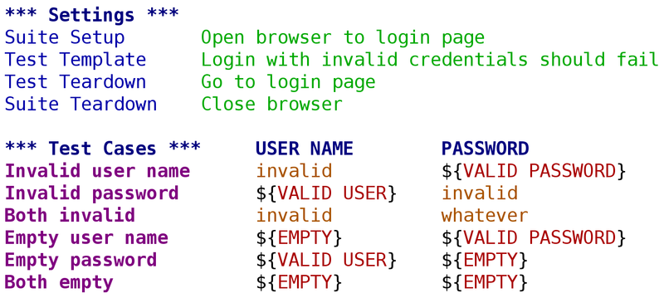
DO: Use suite setup/teardown to speed up execution

Slide 18

TRY: Move suite setup/teardown to directory level initialization files

Slide 19
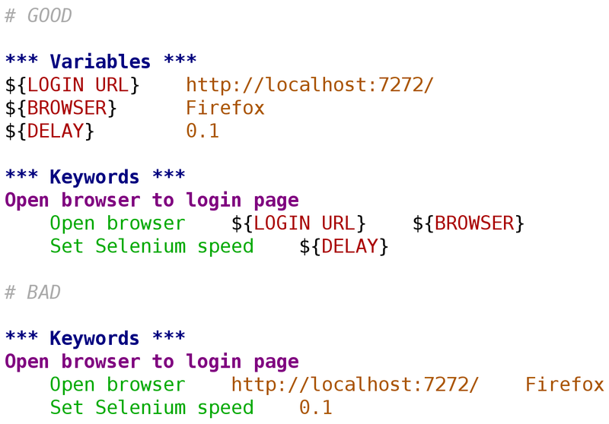
DO: Use variables to avoid hard coding

Slide 20
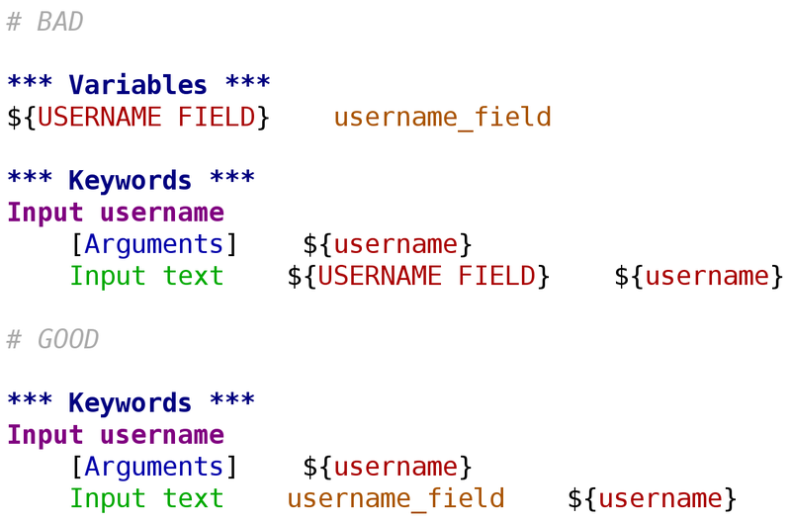
DON'T: Overuse variables

Slide 21
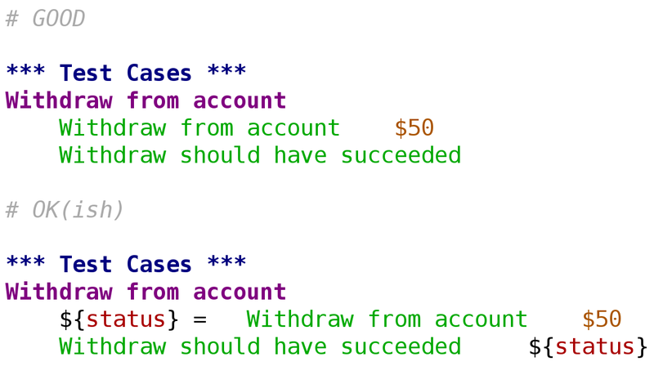
AVOID: Variable assignment on test case level
Notes:
- can be implemented either with a library having state or using Set Test Variable keyword
- no for loops in test level either

Slide 22
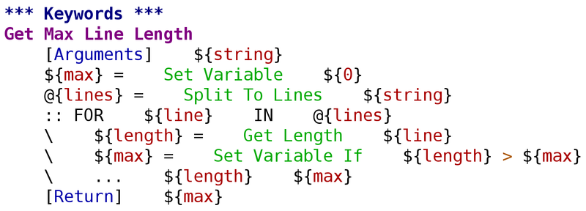
AVOID: Complex logic in test data

Slide 23
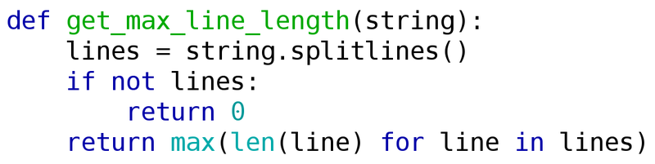
DO: Move logic to libraries when possible

Slide 24
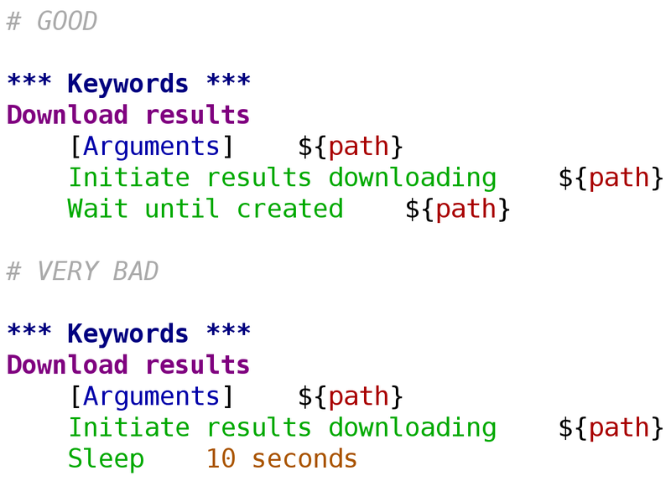
DO: Use polling to synchronize
DON'T: Use sleeping to synchronize

