Slide 1
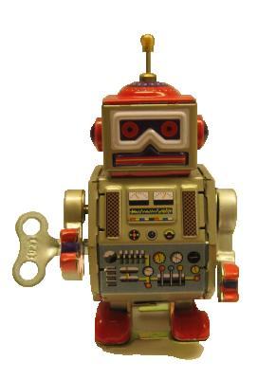
An introduction to
Robot Framework http://robotframework.org
© Copyright Nokia Siemens Networks
Creative Commons Attribution 3.0 License

Slide 2
Fast facts
Generic test automation framework
  Utilizes the keyword-driven testing approach
  Suitable for both “normal” test automation and ATDD
Implemented with Python
  Runs also on Jython (JVM) and IronPython (.NET)
  Can be extended natively using Python or Java
  Other languages supported via a remote interface
Open source
  Hosted on GitHub, Apache 2 license
  Sponsored by Nokia Networks
  Rich ecosystem and very active community

Slide 3
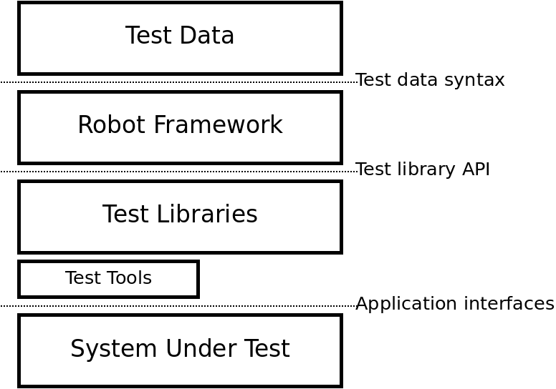
High level architecture

Slide 4
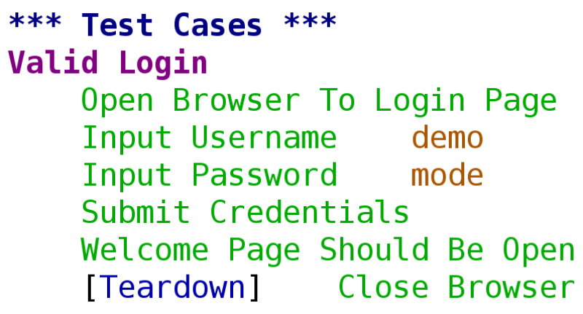
Simple keyword-driven syntax

Slide 5
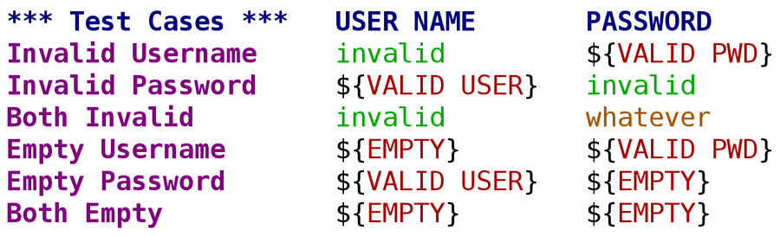
Data-driven tests

Slide 6
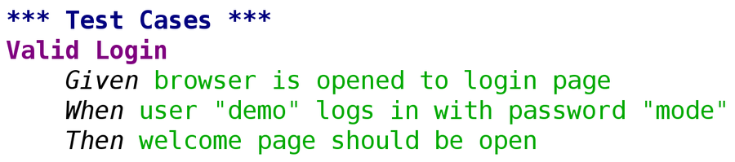
Gherkin syntax

Slide 7
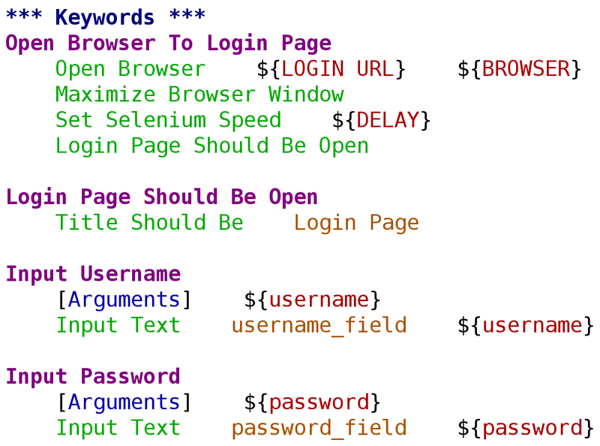
Higher level keywords

Slide 8
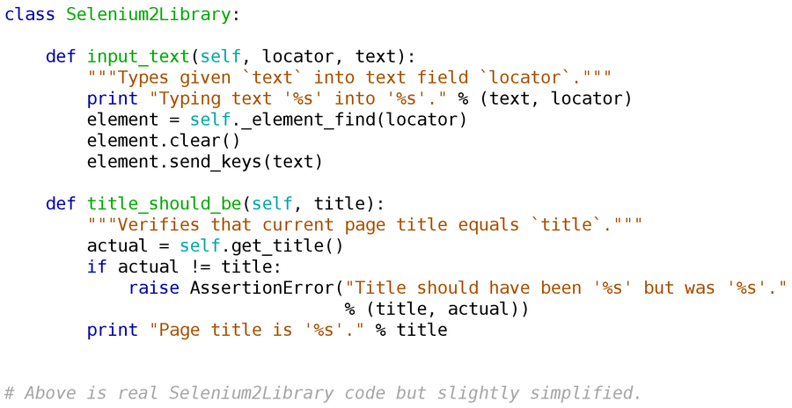
Simple test library API

Slide 9
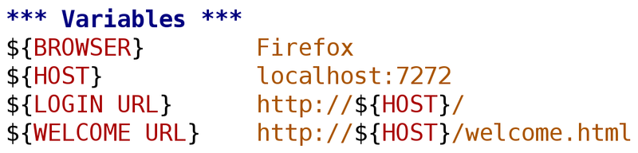
Variables
Easy to create:
Override from the command line:
--variable BROWSER:IE

Slide 10
Tagging
Free metadata to categorize test cases
Statistics by tags collected automatically
Select test cases to be executed
Specify which test cases are considered critical

Slide 11
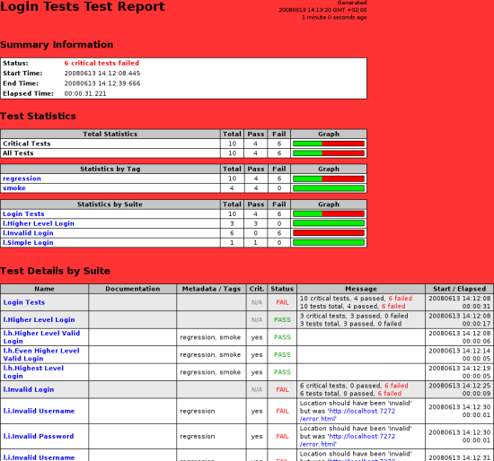
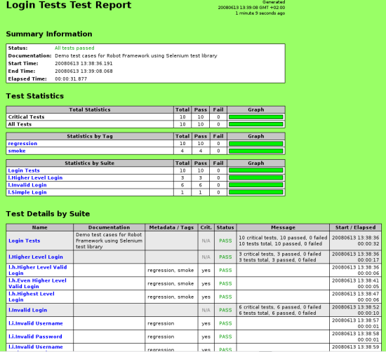
Clear reports

Slide 12
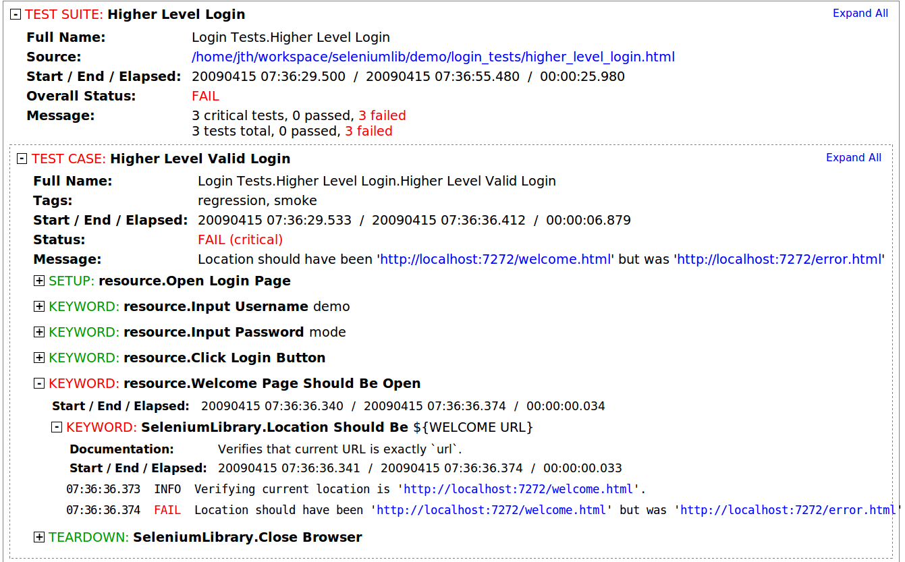
Detailed logs

Slide 13
Different test libraries
Standard libraries
  Included in normal installation
  OperatingSystem, Screenshot, String, Telnet, XML, …
External libraries
  Must be installed separately
  Selenium2Library, SwingLibrary, DatabaseLibrary, AutoItLibrary, SSHLibrary, HTTPLibrary, …
Project and team specific libraries

Slide 14
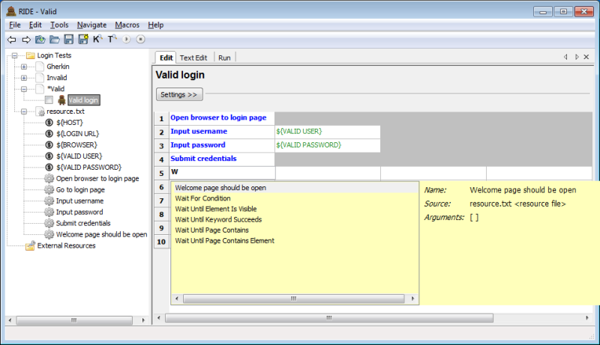
Editor support
RIDE
Plugins for Eclipse, IntelliJ/PyCharm, SubLime, TextMate, Vim, Emacs, Brackets, Atom, ...

Slide 15
Easy integration
Test suites are created from files and directories
  Trivial to store into any version control system
Simple command line interface
  Easy to start test execution by external tools
Output also in XML format
  All information in machine readable format
  Outputs from different test runs can be combined
Plugins for common CI and build tools
  Jenkins, Ant, Maven

Slide 16
For more information
Ecosystem front page
  http://robotframework.org
Project pages
  https://github.com/robotframework/robotframework
Quick Start Guide
  http://code.google.com/p/robotframework/wiki/QuickStartGuide
User Guide
  http://robotframework.org/robotframework/#user-guide
Demo projects
  http://robotframework.org/#documentation

