Slide 1
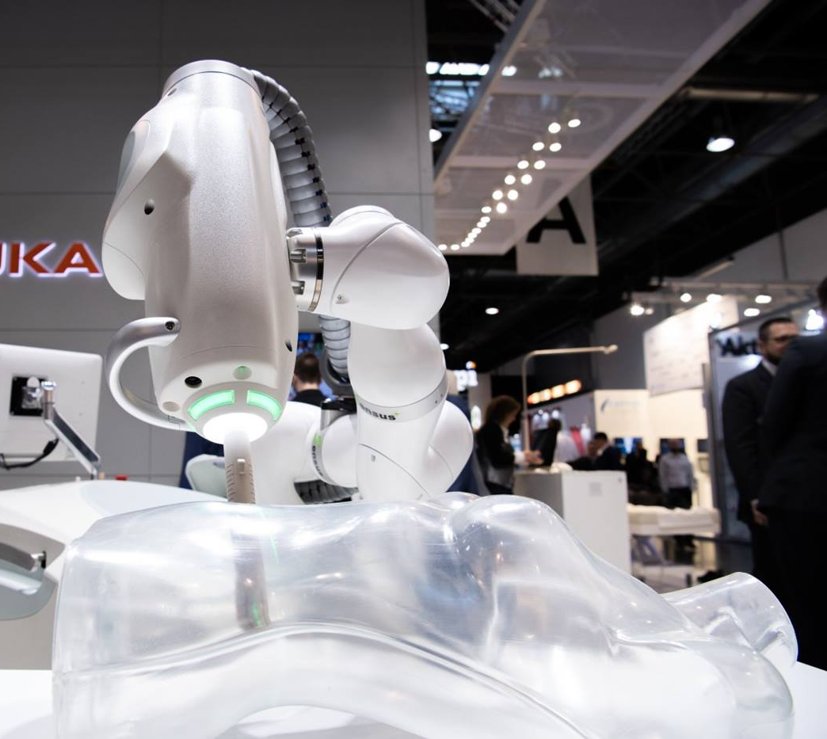

Introduction to Robot Modeling Project 2
Cyberknife
A non-invasive approach in modern radiosurgery
Bharadwaj Chukkala | 118341705
Bhargav Kumar Soothram | 117041088
Joseph Pranadeer Reddy Katakam | 117517958

Slide 2
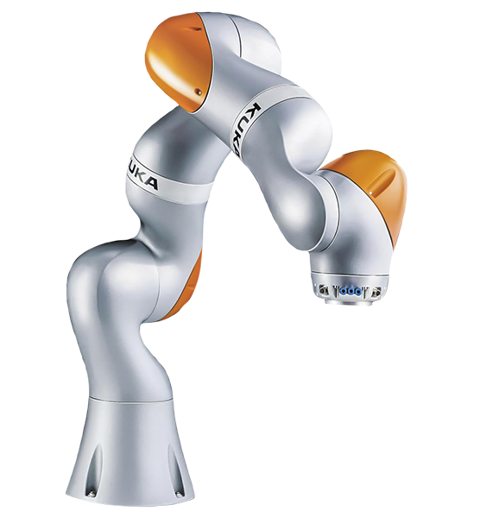
Introduction
Cyberknife is 6DOF robotic arm manipulator coupled with a 4MeV linear accelerator as the end effector.
It is a frameless, image-guided robotic technology used to deliver stereotactic radiosurgery and radiotherapy anywhere in the body where it is clinically indicated.
The target pose is localized into a common reference frame using a combination of image registration algorithms and precisely calibrated coordinate transformations.
The Manipulator with its 6DOF can traverse easily in its widespread workspace without creating a singularity and deliver accuracy and precision in the surgical process.

Slide 3
Motivation
Radiosurgery is a precision-based technique that doesn’t involve actual surgery, but highly focused beams of radiation are used to treat cancerous tissues (tumours) without surgical incision.
Treating tumours is often a very tough task that involves very precise focusing of beams, we have collimators to narrow the beam, but accurately pointing the beam at the cancerous tumour and not healthy tissue is what will be needed.
There have been many incidents where the radio beam has done more harm than good.
The clinic of Zaragoza radiotherapy accident, overexposure to radiation.
In the year 2018, there was a bizarre accident that happened when performing surgery using a gamma knife, which is another radiosurgery method.
This adds on to prove that the need of the hour is a precise machine that can perform the surgery with minimum to no errors.
A Robotic surgical method here would prove to eliminate the possibility of such accidents tremendously.

Slide 4
Process Pipeline
Basic Research about Cyberknife system
Choosing KUKA LBR iiwa R800 robot as the base for the system.
CAD Model in Solidworks
Exporting URDF and assigning joint angle limits
Test Spawning model in Gazebo
Calculating FK, IK using programmed algorithm
Adding Transmission blocks for independent joint control
Configuring the joint controllers and assigning PID values
Launching the prepared model in gazebo
Performing TeleOP to check the DOF of the manipulator.
Programming the Publisher and Subscriber nodes for drawing a circle.
Using rosrun to launch the nodes and perform desired action.

Slide 5
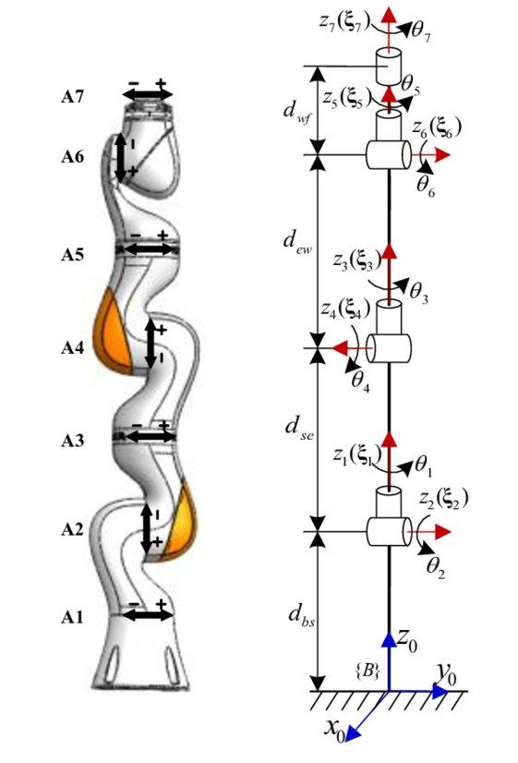
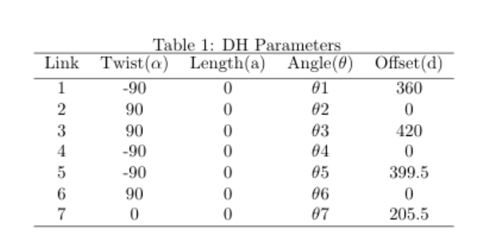
DH parameters and the Coordinate frames

Slide 6
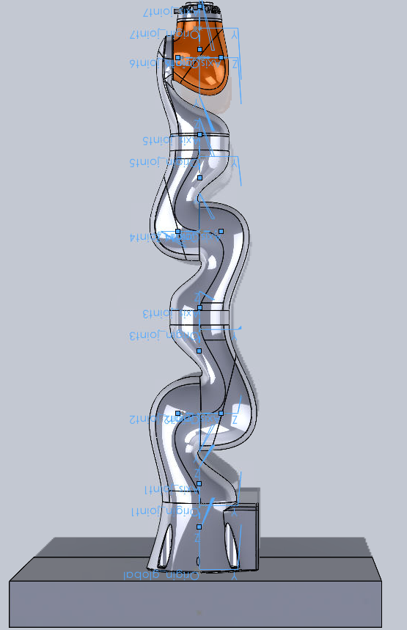
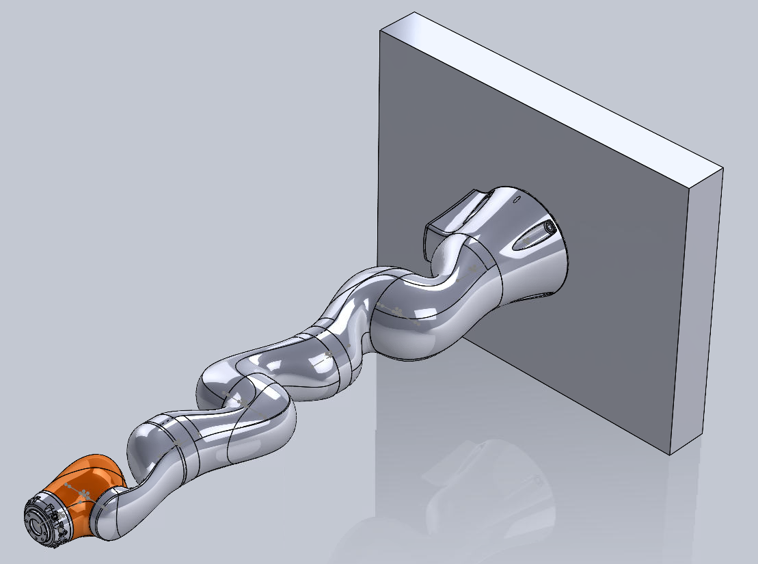
CAD Model
Front View
Isometric View

Slide 7

Forward Kinematics
Step 1: Calculated the Transformation matrices for all the joints using the formula
Step 2: Selected a desired pose to place the end effector on the plane of action.
Step 3: Substituted the joint angles and other DH parameters in the transformation matrices to move the robot into the desired pose.
q= [0,30,-45,0,75,0]
d1 = 360
d3 = 420
d5 = 399.5
d7 = 205.5

Slide 8

Inverse Kinematics
We will need an inverse Jacobian here to calculate the joint velocities from the planar velocities.
In this case we calculate the planar velocity by taking the position of end effector’s initial pose in cylindrical coordinates.
Calculating the Jacobian using the second (differentiation) method.
To do that we need to calculate the Zs by singling out the third column from the individual transformation matrices.
Calculation Formula for Jacobian (second method) ----->>>
PS: The calculations can be referred from our algorithm programmed in python3
x_dot = -100.0 * (2*pi/5)* sin(th[i])
z_dot = 100.0 * (2*pi/5)* cos(th[i])
V = [x_dot,0.0, z_dot, 0.0, 0.0, 0.0])

Slide 9
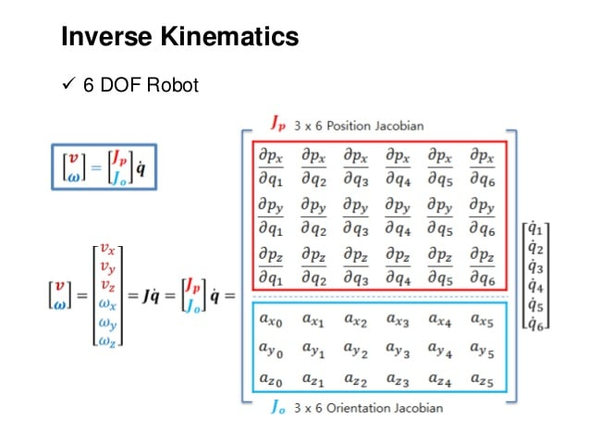

Slide 10
Snippet of the code (for ref.)
import matplotlib.pyplot as plt
figure, ax = plt.subplots()
ax.set(xlim=(0, 800), ylim = (0,1000))
for i in range(0,N):
x_dot = -100.0 * (2*pi/5)* sin(th[i])
z_dot = 100.0 * (2*pi/5)* cos(th[i])
V = Matrix([x_dot,0.0, z_dot, 0.0, 0.0, 0.0])
J_inv = J.evalf(3, subs={theta1:theta_joint[0],theta2:theta_joint[1],theta4:theta_joint[2],theta5:theta_joint[3],theta6:theta_joint[4],theta7:theta_joint[5]}).inv()
theta_dot = J_inv*V
theta_joint = theta_joint + (theta_dot*(5/N))
T = A.evalf(3, subs={theta1:theta_joint[0],theta2:theta_joint[1],theta4:theta_joint[2],theta5:theta_joint[3],theta6:theta_joint[4],theta7:theta_joint[5]})

Slide 11
Problems faced during the project:
Conversion of STL files to Solidworks part files*
Coordinate system assignment to joints of the robot manipulator**
Spawning the robot in the Gazebo environment where the robot was completely dismantled due to issues with physics engine ***
Assigning the right controllers to each joint **
Joint control using publisher and subscriber ****
Constrained angular freedom in the workspace due to moment restriction *
Managing the gravity acting on robot which topples the spawned robot **
Setting the correct PID values **
Simple problems *
Relatively difficult **
Very Difficult ***
Extremely difficult ****

Slide 12
Result: Simulation of the Robot in Gazebo
Link to video
https://drive.google.com/file/d/1k4bVFm9eszw6IDoCDINYM6II19aMtiYY/view?usp=sharing

Slide 13
Validation
The plotting of the circle can be validated by running the Inverse Kinematics algorithm that we have written in python3
Link to the algorithm
https://drive.google.com/file/d/1vCGxHU7xu-xTIHHwyvNXMDOt0xAXsHNZ/view?usp=sharing

Slide 14
Learnings:
Detailed Description will be given in the final report.

Slide 15
Ambitious Goals
Building a medical surgery room world in a gazebo to exactly demonstrate the process.
Optimizing the robot to move along the desired trajectory with an enhanced speed.
Simulation of the tumor cells getting destroyed by using the KUKA LBR with an inbuilt linear accelerator as end effector module.
Automating the simulation process.

Slide 16
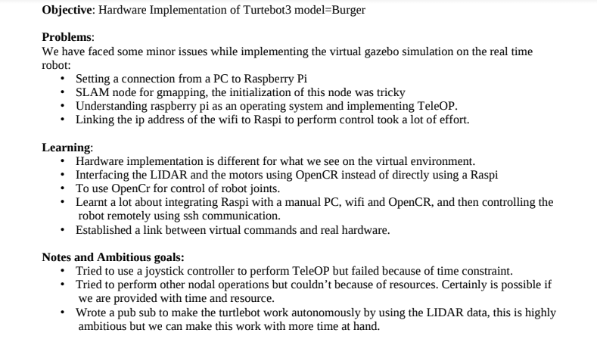
Hardware implementation

Slide 17
Final slide
J- Joseph
B1- Bhargav
B2- Bharadwaj
Contribution:
Project ideation: B2,B1, J
Solidworks model – B2, J, B1
URDF Exporting – B1 and B2
Gazebo test Launch- B1, B2, J
Transmission block and controller assignment- B1 and J
TeleOP – B1
Publisher and Subscriber - J and B2
Hardware Implementation – J, B2, B1
Acknowledgment: We would like to thank Professor Reza for the opportunity to work on this project. Our hearty gratitude is extended to the Professor for being immensely kind and cooperative. We would like to thank our TAs Ajinkya and Karan for lending a hand to help us in the end and the start of our project, respectively.

Slide 18

THANK YOU

