Slide 1


Aristotle University of Thessaloniki Polytechnic School Department of Electrical and Computer Engineering Intelligent Systems and Software Engineering Labgroup
Continuous implicit authentication of smartphone users by navigational and behavioral data
Christos Emmanouil
Professor Supervisor: Andreas Symeonidis
PhD Supervisor: Thomas Karanikiotis

Slide 2
Contents
Introduction
Results
Future Work
Methodology
Conclusions
Notes:
In this presentation, I will refer to the motivation and objectives of the work. I will talk about important parts of the design process by showing some results, and finally I will talk about the conclusions I reached as well as some ideas for future research.

Slide 3

Introduction
Motivation
Constantly increasing number of smartphone users
Storage of personal and business data
Need to seccure the data stored on these devices.
Concerns about the adequacy of existing authentication methods.
Need to implement new authentication methodologies.
Notes:
Today, most of us, if not all, use a smartphone and we tend to store on it photos, documents and in general information that would be dangerous to find in the hands of a cunning person. It is therefore important that we use ways to keep this data safe. A PIN or a Pattern PIN offer a level of security, however research has shown that these methods do not meet all the needs of users, mainly because after unlocking the device there is no additional control and also because the control requires continuous actions from the user. Therefore, there is a need to develop new, safer and more discreet ways of authentication.

Slide 4
Introduction
Continuous – Implicit Authentication
Advantages :
Enhanced security system
Better user experience
Ability to use behavioral characteristics
Easy adjustment
Low implementation cost
Development prospects
Problems :
High sampling rates
High power consumption
Secondary devices (wearables)
Insufficient evaluation
Small amount of data
'lab' data
'Wrong ' metrics
Insufficient data during execution
Notes:
In this direction, several researches have shown interest in the development of continuous and implicit authentication methodologies. That is, systems that provide continuous control even after unlocking the screen, while at the same time not interfering with the way the user interacts with the device.
These systems have the potential to constitute a supplementary level of control ( MFA ) and thus:
They enhance the security level
And at the same time they do not burden the user
In addition, they can take advantage of behavioral characteristics ( such as how someone holds the device or operates the screen ) and therefore can be easily adapted to smartphones , as most already have the necessary hardware.
However, the problems arising from the various studies concern functionality and the balance between security and transparency to the user. For example:
Systems with high sampling rates reduce device performance
Systems that rely solely on a sensor can actually underperform.
The use of wearables is not desirable in some cases.
And furthermore the lack of qualitative data or metrics does not help to generalize the conclusions.

Slide 5
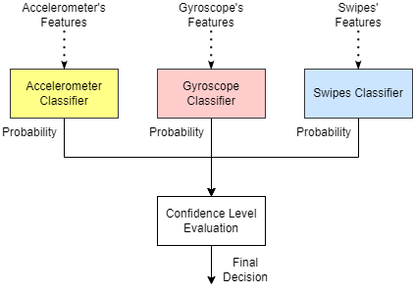
Introduction
Main idea
Objective :
Satisfactory levels of security and transparency
Use of data generated by the smartphone
Tolerant of errors and/or missing data
Questions :
Data set
Feature extraction and preprocessing
Structure of classifiers
Trust subsystem structure
Objective evaluation
Notes:
Our idea is based on the development of a system consisting of 3 independent classifiers communicating with a trust system. The figure shows that the system takes advantage of accelerometer, gyroscope and swipes data . The respective classifiers generate the probability that the measurement they accept is from the owner of the device, and the trust subsystem locks the device when necessary.
In this way, we want to achieve:
Satisfactory levels of security and transparency
Easy implementation and customization
Tolerance to sensors errors
But to achieve these, we must first answer the following:
What dataset will we use?
What is the best way to use the data?
What will be the structure of the classifiers?
How will the trust system work?
How will we objectively evaluate the system?

Slide 6
Methodology
Dataset
BrainRun :
Set of behavioral data
Motion and gesture sensor data
Data collection application ( android & iOS )
5 different games, with different levels of difficulty
Characteristics :
2218 users
60% male, 26% female, 14% unknown
90% Android , 10% iOS
Games & Final Sets
( after applying selection criteria ) :
Games | Data type | Number of Training Users | Number of Evaluation Users
Mathis | Acc, Gyr, Swp | 15 | 24
Focus | Acc, Gyr, Swp | 15 | 30
Reacton | Acc, Gyr, Swp, Tap | 15 | 45
Memory | Acc, Gyr, Tap | 15 | 44
Speedy | Acc, Gyr, Tap | 15 | 45
Acc: Accelerometer, Gyr: Gyroscope, Swp: Swipe
Notes:
BrainRun dataset was chosen. A large set of behavioral data from various users, which stands out because its collection was not done under laboratory conditions and thus there is the possibility of generalizing the conclusions. More specifically, for the collection of the data, an application for smartphones was implemented that includes 5 different games, which examine different behaviors and focus on the collection of different data.
Although the set is quite large, using all the data for the design, optimization and evaluation of the system was impossible (lack of resources). Thus, after recording the requirements and performing tests, some selection criteria were formulated and suitable sets of users were created to train and evaluate the final system.
The table shows the number of users for each set, in each game separately.

Slide 7
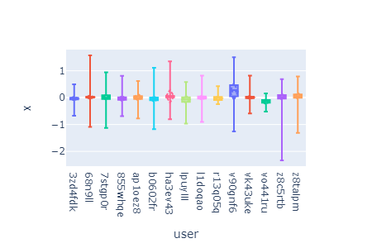
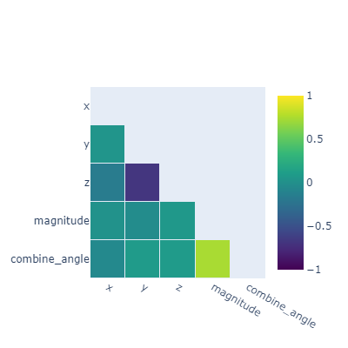
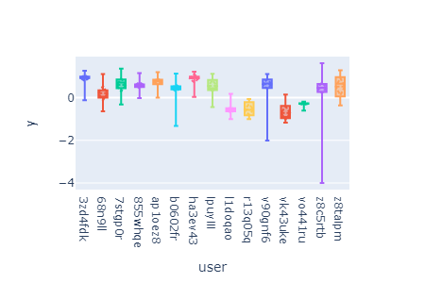
Methodology
Extract Features
Accelerometer, Gyroscope (1)
Selected: x, y and magnitude
Notes:
After the selection of the set, it is time to select the right features. The accelerometer and gyroscope measure the acceleration and rotation values in the 3 axes, respectively. The selection of all 3 values can lead to undesirable results and so for the selection of the appropriate features, some boxplots and some correlation tables were created, which as you can see also contain some additional features. (Boxplots helped to understand user variation, while correlation matrices visualized the correlations of all traits.)
These diagrams are for the accelerometer in the Mathisis game, but identical diagrams were created for both sensors for each game.
Utilizing the above information and performing various experiments the x, y and magnitude features were selected for both sensors.

Slide 8
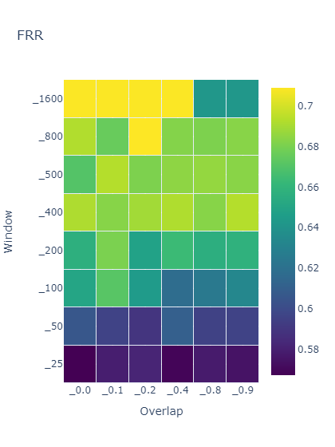
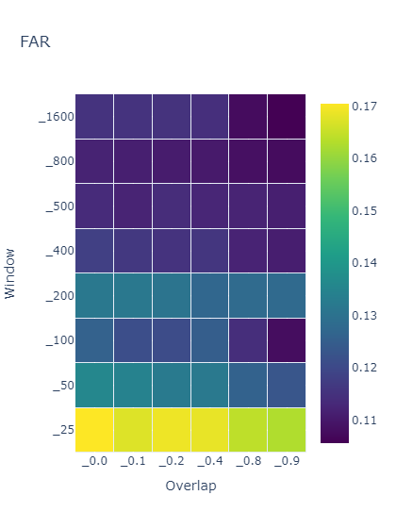
Methodology
Extract Features
Accelerometer, Gyroscope (2)
Selected: Window Size: 50 samples Overlap: 60%
Notes:
However, these measurements are produced based on a specific frequency (for example 50 Hz ) and may contain errors. To address this problem, a rolling window partitioning technique was used. In essence, this technique creates sequences of values for each feature selected in the previous step and thus the calculation of features that will constitute the input of the classifiers is then achieved.
For the implementation of the technique, the size of the sequences is required, as well as the overlap percentage of the consecutive sequences. For this reason grid searches were performed for various values of the two parameters and the transparency ( FRR ) and safety metrics ( FAR ) were calculated, using an early system and training user set. The above tables show the metrics for the accelerometer in the Mathisis game, and as you can see the two metrics behave inversely. (Smaller window sizes yield better usability but less security, and the opposite for larger window sizes.) Running searches for both sensors and for each game, the sequences were chosen to consist of at most 50 measurements and have 60% overlap. (However, it is noted that during the operation of the system these sizes can be changed to some extent so that sequences can be created in cases where there are fewer or more measurements.)

Slide 9
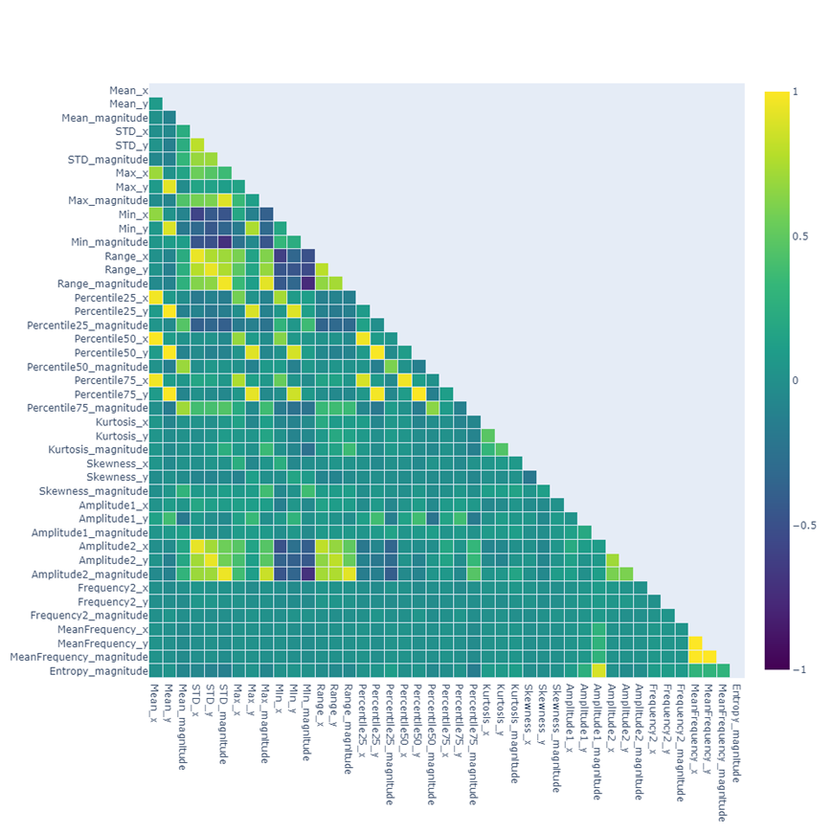
Methodology
Extract Features
Accelerometer, Gyroscope (3)
Sensos
Features L0
Features L1
Accelerometer
Gyroscope
Notes:
To select the final features, a large number of features were first calculated and then correlation tables were used and various experiments were performed. The finally selected features are presented in the table.

Slide 10
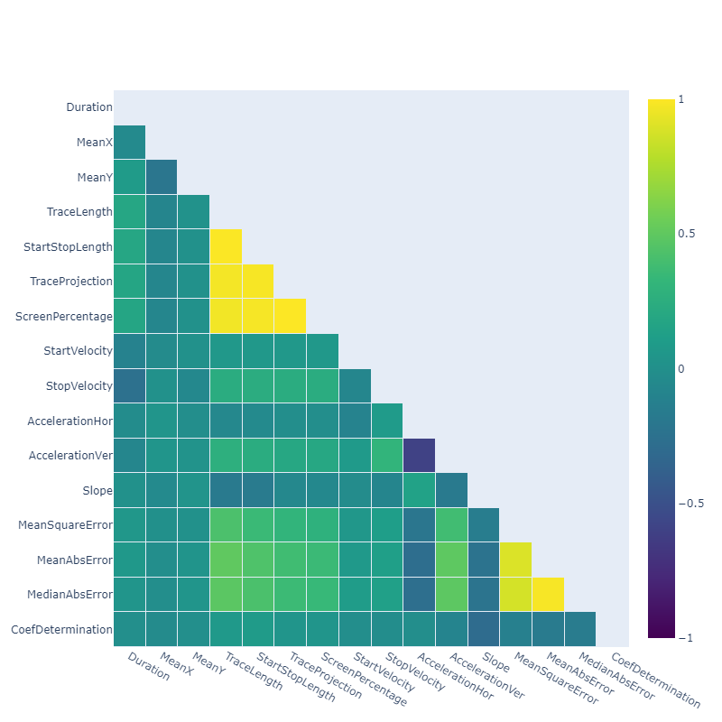
Methodology
Extract Features
Gestures
Features Final
Notes:
When it comes to swipes, the process of extracting and selecting features was simpler. Each gesture in the BrainRun is stored as a feature set. Using these features, more features were calculated. As before, several characteristics were initially calculated, but then with correlation tables the ones shown in the table on the right were selected.
It is noted that the table also shows the taps which have a unique characteristic. Research was conducted only on swipes , however to examine the behavior of the system in games that also contain taps , an additional classifier based on this unique feature was constructed.

Slide 11
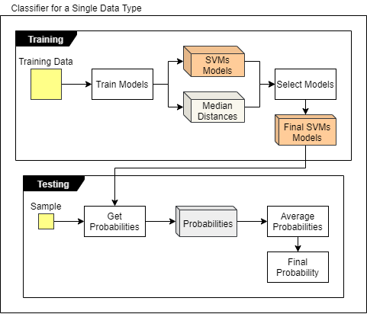
Methodology
Classifiers
What do we know?
Single class classification problem
Solving with RBF-OCSVM
Impossible to use one model per classifier
The parameters ( nu, gamma) affect the RBF-OCSVMs
What do we recommend?
Using multiple RBF-OCSVMs , per classifier
Use a range of values for the parameters
Collective final decision
Questions :
Range of parameters
Number of deciding models
Notes:
Classifiers should be able to accept features and then extract the probability that the sample is from the owner or not. In the literature, One Class SVM algorithms with RBF kernel have been shown to be effective in one-class classification problems and thus were chosen for our system. Briefly, what they do is use the training data to define a region of observations and then derive the probability for each new sample by calculating the sample's distance from that region.
However, in our case the final system should have a high generalizability. Every user is different and thus it is impossible to achieve the goals using a unique OCSVM for each classifier. A solution is to use multiple OCSVMs with different parameters ( nu and gamma ) for each classifier. The training data will be used to train all models, and the final probability will be averaged.
But the questions that need an answer in this case are:
What will be the range of parameters, for each data type?
How many final models will be making the final decision, for each type of data?

Slide 12
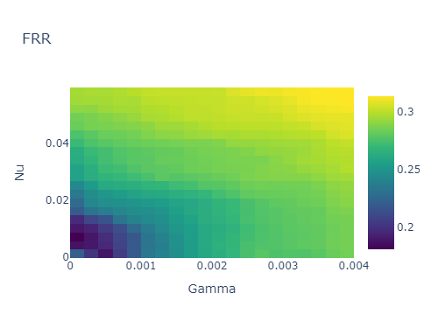
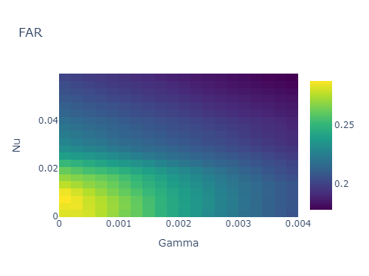
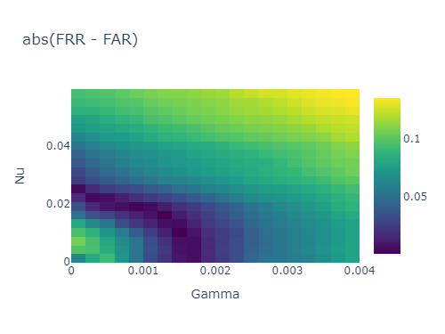
Methodology
Classifiers
Parameters Range
Type
Start Value
End Value
Step
Start Value
End Value
Step
Accelerometer
Gyroscope
Notes:
In RBF-OCSVMs the main parameters are nu and gamma. (The gamma defines the influence that a training sample has on the partition function , while nu defines the percentage of outliers in the data and thus the hardness of the hyperplane around the data.) To select an appropriate range grid searches were again performed for each data type and for every game.
The figures above are for the accelerometer for the Mathisis game. From left to right, first we see the change in the FRR metric which shows us the percentage of times the owner was locked out, then the change in the FAR metric which shows us the percentage of times a malicious user went unnoticed, and finally the absolute difference of the first two. As can be seen here too, the metrics change in the opposite direction. The selection of the range was made by selecting those areas where the FRR and FAR metrics have the smallest difference. In this way, the values shown in the table were obtained.

Slide 13
Methodology
Classifiers
Number of Models
Data Type
Optimal Number
Accelerometer
Gyroscope
Notes:
A similar procedure was used to select the number of models. Experiments were run for different populations of models and the same metrics were recorded, creating bar graphs. The final numbers are presented in the table.

Slide 14
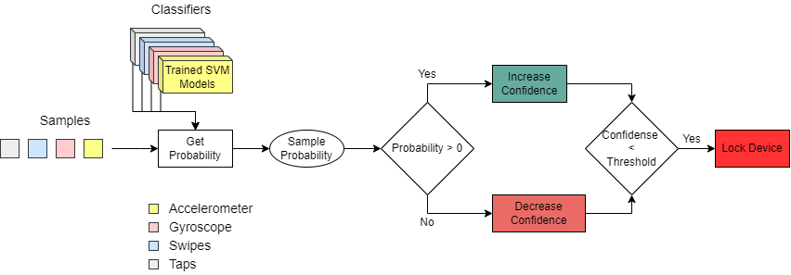
Methodology
Confidence Subsystem
Notes:
The trust subsystem takes some chances and decides to lock the device. More specifically, the trust system defines an initial trust level and a threshold. As shown in the figure, each classifier returns the probability that a sample belongs to the owner's class or not, in the interval [-1, 1]. Then, from the equation, it can be seen that this probability is multiplied by a constant, proportional to the game and a number that expresses the confidence of the system in each classifier. The final number obtained is added to the trust level and if it falls below the threshold then the device is locked. The initial confidence value, the threshold as well as the increment and decrement steps were chosen after several experiments and are presented in the table below. On the contrary, the weights related to the type of data are automatically defined by the system, based on metrics obtained during the training of the classifiers.

Slide 15
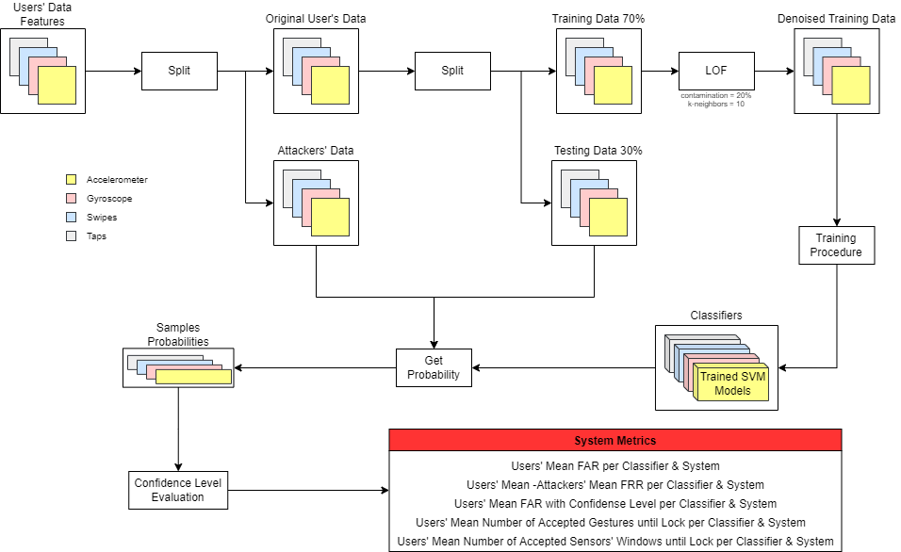
Methodology
System Summary – Structure of Final Experiments
Notes:
Connecting all the above elements results in the final system. The figure above shows the final layout incorporating the final system and examining its effectiveness.
Points that need attention are:
The separation of each user's data into training and evaluation sets, with percentages of 70 – 30 respectively.
The training data goes through a pre-processing stage before being fed to the classifiers. Specifically, a Local Outlier Factor algorithm is applied , in order to remove extreme samples. Its integration into the final system was decided after experiments, the results of which we will see below.
Finally, it is noted that, after the integration of the trust system, it is necessary to calculate new, more representative, metrics. So together with the FRR and FAR metrics, 3 additional metrics are calculated that describe the final performance of the system. These metrics express the percentage that the device locked while there was interaction from the owner, as well as the number of gestures and the number of measurement packets from sensors that the system needed to detect the presence of an unauthorized user.

Slide 16
Results
Trust System – Multiple RBF-OCSVMs
Notes:
In this slide we see 4 experiments performed on the training user set. On the left bar graph are the metrics expressed as a percentage, while on the right are the metrics expressed as a number of samples.
So looking at the bar graphs we see:
The effect that the trust system has. On the left, we notice that the gray bars are much smaller than the blue ones.
In the right figure, in the first two experiments it appears that using multiple SVMs can provide better security.

Slide 17
Results
LOF – Nu-Gamma
Notes:
Here we see experiments performed on the set of completely unknown users. The bar graphs show its metrics after the trust subsystem.
From these figures it can be made more clearly:
The importance of LOF in preprocessing. Between the first two experiments, we see that the second one applying LOF presents significantly better security metrics.
The importance of nu-gamma in the final result. Experiments 2, 3 and 4 were performed in exactly the same way but with different nu-gamma ranges. Experiment 2 aimed at ª balanced system, while Experiments 3 and 4 aimed at systems with greater transparency and security respectively.

Slide 18
Results
Per Game
Notes:
In this slide, we see the results of the 2nd ^{experiment} of the previous slide per game.
We observe:
Satisfactory results for Mathisis games and Focus.
That the games Reacton , Memoria and Speedy have a high number of gestures, which is justified by the existence of taps .

Slide 19
Results
Comparisons (1)
Notes:
This slide shows the results for the Mathisis game in more detail, comparing it to systems based on one data type. The 3 figures correspond to the 3 metrics, while the different systems are expressed with colors. Our system shows better and more stable results, as it has smaller average and extreme values but also less variance. Similar behavior exists in other games.

Slide 20
Results
Comparisons (2)
Sensor Pack Size: 500 counts
Sensor Packet Size: ~50 counts
Notes:
These tables summarize the results for each game, compared to previous works that used the same data set.
First, in relation to the sensor system, it is noted that the sensor system does not use a trust subsystem and therefore the comparison is not absolute. For FRR we see that they are better in the main interest games and similar in the rest. While for the safety metrics what is worth noting is that in the sensor system the FAR values presented are achieved with windows of 500 samples while in the present system the window contains at most 50 samples. So, assuming for example a sampling frequency of 50 Hz, the sensor system needs at least 10 seconds to make a check, as opposed to the present system which needs only about 5 seconds to recognize the user in each game.
In relation to the gesture system, what we can comment on is that they show similar results in the games of main interest and that the system we propose shows a smoother behavior in the rest of the games as well.
However, what is noted is that the system we propose, unlike both other systems, is based on a variety of data and can cope with cases where there are errors or lack of measurements.

Slide 21
Conclusions
Methodology & Techniques
Using multiple RBF- OCSVMs serves system security.
The trust system helps form an easy-to-use system.
Denoising the training data with LOF improves security.
The nu and gamma parameters of RBF- OCSVMs play a decisive role in ensuring a balance between security and usability.
System
Robust to measurement errors.
Satisfactory security and transparency metrics.
Quick check
Objective evaluation
Notes:
Summarizing:
Using multiple SVMs and denoising the training data helps to achieve better security.
The trust system adds a lot of functionality to the final system.
The parameters nu and gamma play a decisive role in the final result.
The system that was finally formed:
It presents satisfactory results, even using a wide range of qualitative data.
It can perform fast and fault-tolerant checks.

Slide 22

Future Work
Ideas
Dynamic weights in classifiers
Option to select nu-gamma ranges
Combination with context-aware techniques
Ability to adapt to changes in owner behavior
Notes:
Improvements that could be made are:
The configuration of better weights to the classifiers when making the decision.
The creation of an environment where the user will be able to choose for himself the nu-gamma areas that meet his needs.
Apply screen content awareness techniques.
Ability to evolve and adapt to user behavior.

Slide 23
Thanks!
Notes:
Thank you. Any questions?

Slide 24
Anomaly Detection – One Class Classification
Detection of Extreme Samples ( Outlier Detection ):
Unsupervised
Detection of Areas of High Sample Density
Data Denoising
Isolation Forest, Elliptic Envelope, Local Outlier Factor
Detection of Unusual Samples ( Novelty Detection ):
Semi-Supervised
Delimitation of the Total Education Area
Denoised Training Sets
One Class Support Vector Machine
Notes:
The problem we have to solve in this particular case is whether a new measurement from the sensors comes from the real user of the device. More general problems that consider whether an observation belongs to some set of initial observations belong to the category of anomaly detection. In this case, it is assumed that the training data belongs to a single class and the algorithm must be able to distinguish whether a new observation belongs to it or not, and for this reason the specific problem is also referred to as single-class classification.
However, two different approaches can be applied to such problems.
The first approach, known as Outlier Detection, is based on unsupervised learning algorithms which attempt to detect areas of high sample density and then exclude those not in them. They are often used for denoising datasets and some of them are isolation forest, elliptic envelope and the local outlier factor .
In the second approach, known as Novelty Detection, are semi-supervised algorithms that use the training set to delineate some regions. Only when a new observation is found outside these areas can it be considered unusual. The most common mechanisms that are called upon to solve such problems are One Class Support Vector Machine .

Slide 25
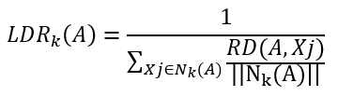

Local Outlier Factor (LOF)
Notes:
LOF algorithm characterizes a sample as an outlier by considering the density of its neighborhood and therefore performs well when the density of observations is not the same throughout the dataset. It is based on concepts such as k-distance, Reachability Distance, Local Reachability Density whose equations are written on the transparency.
Generally, if LOF>1, the point is considered an outlier, however sometimes its LOF value needs to be compared with the maximum LOF value of all points.
An important advantage is the ability to identify local outliers. It can detect outliers that are very close to a cluster of points when other approaches fail.

Slide 26
One Class Support Vector Machine (OCSVM)
Notes:
Classical 2- class SVM algorithms try to find a decision boundary that separates the observations of the two classes and are characterized by the property of generating non-linear decision boundaries by projecting the data into higher dimensions with the help of kernel functions or otherwise Kernel .
For one-class problems, the logic is similar with the difference that the algorithm tries to find a bound on the observations of the one class. In this logic, the two most basic approaches are the creation of a hyperplane that separates the regions that do not contain data and the creation of a hypersphere that encloses almost all the data of the positive class ( Tax, SVDD ).

Slide 27
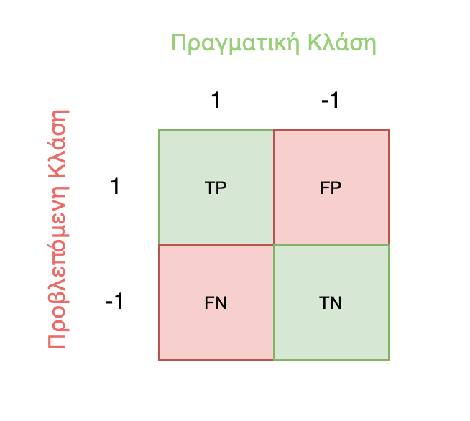


Evaluation Metrics
False Rejection Rate =$\frac{FN}{TP+FN}$
False Acceptance Rate =$\frac{FP}{TN+FP}$
Notes:
Choosing the right evaluation metrics is also an important part.
In authentication problems, common metrics are the False Acceptance Rate ( FAR ), that is, the percentage of times the system granted access to an unauthorized person, and the False Rejection Rate ( FRR ), that is, the percentage of times the system did not grant access to an authorized person.
FN =$Αριθμός μη αποδεκτών ενεργεΩων πραγματικού χρηστη$
TP + FN =$Συνολικός αριθμός ενεργειών πραγματικού χρηστη$
FP = $Αριθμός αποδεκτών ενεργειων κακόβουλου χρηστη$
TN + FP = S$υνολικός αριθμός ενεργειών κακόβουλου χρηστη$

