Slide 1
Modern C++
Control flow

Slide 2
Agenda
01
Conditions
If and Switch case

Slide 3
Agenda
01
02
Conditions
If and Switch case
For loops

Slide 4
Agenda
01
02
03
Conditions
If and Switch case
For loops
While loops

Slide 5
Agenda
01
02
03
04
Conditions
If and Switch case
For loops
While loops
Do while loops

Slide 6
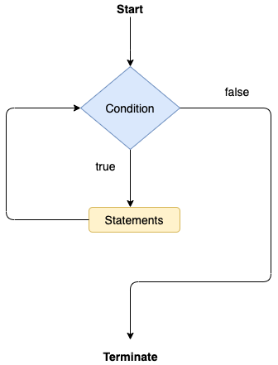
Understanding Control Flow:
Sequential Execution:
Default mode of operation.
Code is executed line by line, from top to bottom.
Conditionals:
If-Else Statements: Execute different blocks of code based on certain conditions.
Visual Cue: Flowchart symbol for conditionals.
Loops:
For Loops: Repeat a block of code a fixed number of times.
While Loops: Repeat a block of code as long as a condition is true.
Example
int num = 10; if (num > 0) { std::cout << “The number is positive.\n”; } else { std::cout << “The number is positive non-positive .\n”; }

Slide 7
Understanding Control Flow:
Example
int num = 10; if (num > 0) { std::cout << “The number is positive.\n”; } else { std::cout << “The number is positive non-positive .\n”; }

Slide 8
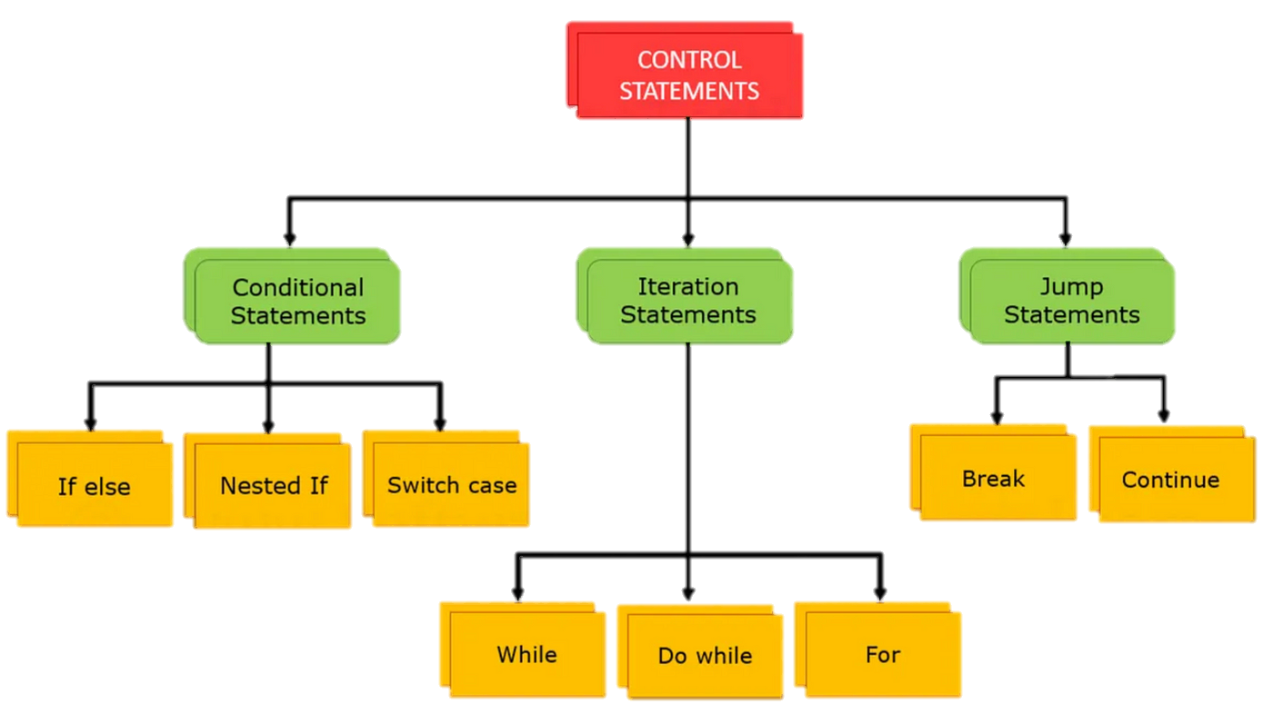
Understanding Control Flow:

Slide 9
Conditional statements: if, if...else and Nested if...else
In computer programming, we use the if...else statement to run one block of code under certain conditions and another block of code under different conditions.
For example, assigning grades (A, B, C) based on marks obtained by a student.
if the percentage is above 90, assign grade A
if the percentage is above 75, assign grade B
if the percentage is above 65, assign grade C
deg
if
Output

Slide 10
Conditional statements: if, if...else and Nested if...else
In computer programming, we use the if...else statement to run one block of code under certain conditions and another block of code under different conditions.
For example, assigning grades (A, B, C) based on marks obtained by a student.
if the percentage is above 90, assign grade A
if the percentage is above 75, assign grade B
if the percentage is above 65, assign grade C
deg
if
If (P >= 90)
Output

Slide 11
Conditional statements: if, if...else and Nested if...else
In computer programming, we use the if...else statement to run one block of code under certain conditions and another block of code under different conditions.
For example, assigning grades (A, B, C) based on marks obtained by a student.
if the percentage is above 90, assign grade A
if the percentage is above 75, assign grade B
if the percentage is above 65, assign grade C
deg
if
If (P >= 90)
A
std::cout << “A”;

Slide 12
Conditional statements: if, if...else and Nested if...else
In computer programming, we use the if...else statement to run one block of code under certain conditions and another block of code under different conditions.
For example, assigning grades (A, B, C) based on marks obtained by a student.
if the percentage is above 90, assign grade A
if the percentage is above 75, assign grade B
if the percentage is above 65, assign grade C
deg
if
If (P >= 75)
B
std::cout << “B”;

Slide 13
Conditional statements: if, if...else and Nested if...else
In computer programming, we use the if...else statement to run one block of code under certain conditions and another block of code under different conditions.
For example, assigning grades (A, B, C) based on marks obtained by a student.
if the percentage is above 90, assign grade A
if the percentage is above 75, assign grade B
if the percentage is above 65, assign grade C
deg
if
If (P >= 65)
There are three forms of if...else statements in C++.
if statement
if...else statement
if...else if...else statement
C
std::cout << “C”;

Slide 14
Lab 1
Task: Ticket Pricing
You are developing a program for a movie ticket booking system. The ticket pricing depends on the following conditions:
Age of the customer.
Time of the movie (matinee or evening).
Whether the customer is a student (students get a discount).
Write a program that takes the customer's age, the time of the movie, and whether the customer is a student as input and calculates the ticket price accordingly.
Here are the pricing rules:
For customers under 12 or over 65, there's a senior/child discount, and the base price is $8.
For customers between 12 and 64:
Matinee (before 5:00 PM): $10
Evening (5:00 PM or later): $12
Students (regardless of age) get a $2 discount.

Slide 15
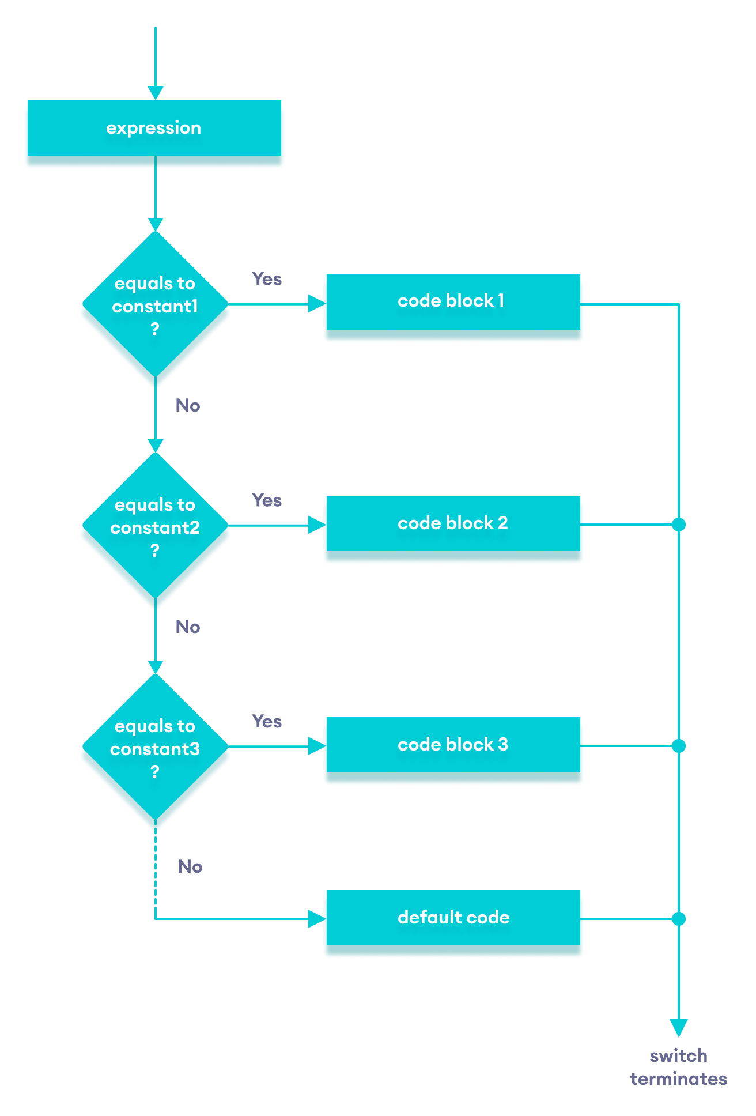
Switch case:
Syntax
The switch statement allows us to execute a block of code among many alternatives.
You can do the same thing with the if...else statement. However, the syntax of the switch statement is much easier to read and write.
switch (expression) {
case constant1:
// code to be executed if
// expression is equal to constant1;
break;
case constant2:
// code to be executed if
// expression is equal to constant2;
break;
.
.
.
default:
// code to be executed if
// expression doesn't match any constant
}

Slide 16
Switch case:
Syntax
The switch statement allows us to execute a block of code among many alternatives.
You can do the same thing with the if...else statement. However, the syntax of the switch statement is much easier to read and write.
switch (expression) {
case constant1:
// code to be executed if
// expression is equal to constant1;
break;
case constant2:
// code to be executed if
// expression is equal to constant2;
break;
.
.
.
default:
// code to be executed if
// expression doesn't match any constant
}

Slide 17
Switch case:
// Program to build a simple calculator using switch Statement
#include <iostream>
using namespace std;
int main() {
char oper;
float num1, num2;
cout << "Enter an operator (+, -, *, /): ";
cin >> oper;
cout << "Enter two numbers: " << endl;
cin >> num1 >> num2;
switch (oper) {
case '+':
cout << num1 << " + " << num2 << " = " << num1 + num2;
break;
case '-':
cout << num1 << " - " << num2 << " = " << num1 - num2;
break;
case '*':
cout << num1 << " * " << num2 << " = " << num1 * num2;
break;
case '/':
cout << num1 << " / " << num2 << " = " << num1 / num2;
break;
default:
// operator is doesn't match any case constant (+, -, *, /)
cout << "Error! The operator is not correct";
break;
}
return 0;
}

Slide 18
for Loop:
In computer programming, loops are used to repeat a block of code.
For example, let's say we want to show a message 100 times. Then instead of writing the print statement 100 times, we can use a loop.
That was just a simple example; we can achieve much more efficiency and sophistication in our programs by making effective use of loops.
There are 3 types of loops in C++.
for loop
while loop
do...while loop

Slide 19
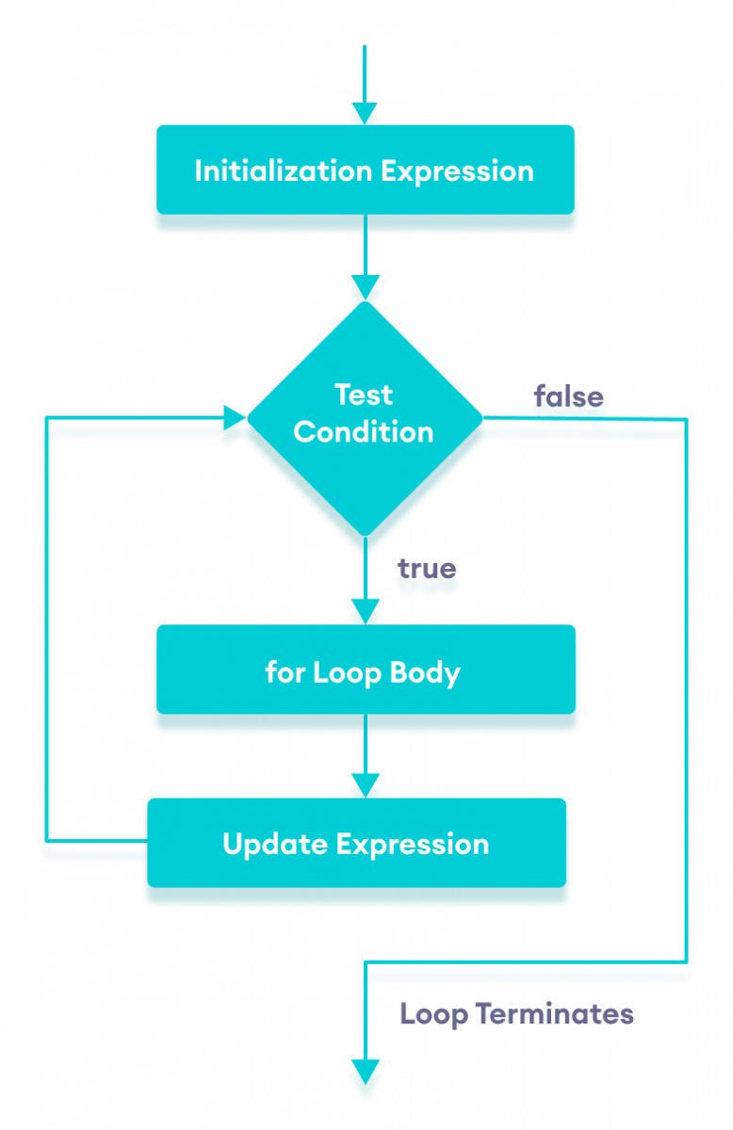
for Loop:
The syntax of for-loop is
for (initialization; condition; update) {
// body of-loop
}
Here,
initialization - initializes variables and is executed only once
condition - if true, the body of the for loop is executed
if false, the for loop is terminated
update - updates the value of initialized variables and again checks the condition

Slide 20
Example:
Printing Numbers From 1 to 5
#include <iostream>
using namespace std;
int main() {
for (int i = 1; i <= 5; ++i) {
cout << i << " ";
}
return 0;
}
Run code
1 2 3 4 5

Slide 21
Task:
Display a text 5 times
Find the sum of the first n Natural Numbers
positive integers such as 1,2,3,...n are known as natural numbers
The program checks if the number Entered by the user is Even or Odd

Slide 22
problem:
The user wants to create a program that creates a pyramid of stars depending on the user inputs:
*
***
*****
To solve this problem you need to know the matrix.
for(int i = 0; i < 2; i++)
{
for(int j = 0; j < 2; j++)
{
std::cout << " ";
}
std::cout << std::endl;
}
j1
j2
Rows: i
Columns: j
i1
i2

Slide 23
explanation:
n-1 n n+1
if rows = 1 then columns = 1
if rows = 2 then columns = 3
if rows = 3 then columns = 5
if rows = 4 then columns = 7
*
***
*****
columns = 2 * rows - 1

Slide 24
Here is the program:
int rows;
std::cout << "Please, Enter Number of rows you want : ";
std::cin >> rows;
for(int i = 1; i <= rows; i++)
{
for(int j = 1; j <= 2 * rows - 1; j++)
{
if(j >= rows-(i-1) && j <= rows+(i-1))
{
std::cout << "*";
}
else
{
std::cout << " ";
}
}
std::cout << "\n";
}

Slide 25
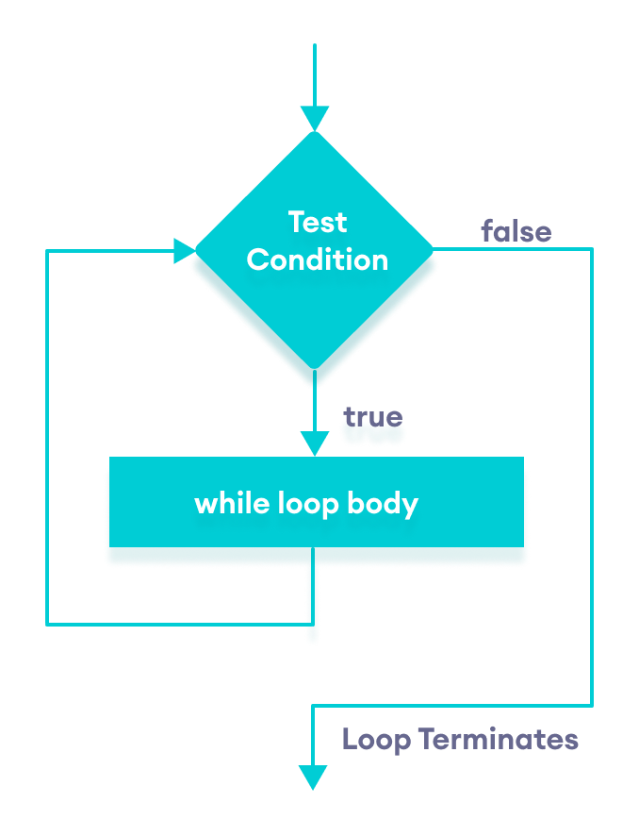
while and do...while Loop
While Loop: in C++ is used in situations where we do not know the exact number of iterations of the loop beforehand. The loop execution is terminated based on the test condition. Loops in C++ come into use when we need to repeatedly execute a block of statements.

Slide 26
while and do...while Loop
While Loop: in C++ is used in situations where we do not know the exact number of iterations of the loop beforehand. The loop execution is terminated based on the test condition. Loops in C++ come into use when we need to repeatedly execute a block of statements.

Slide 27
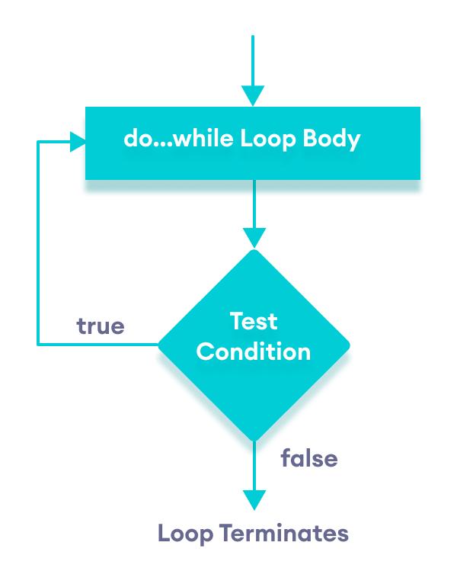
while and do...while Loop
While Loop: in C++ is used in situations where we do not know the exact number of iterations of the loop beforehand. The loop execution is terminated based on the test condition. Loops in C++ come into use when we need to repeatedly execute a block of statements.
do...while Loop: The do...while loop is a variant of the while loop with one important difference: the body of the do...while loop is executed once before the condition is checked.

Slide 28
Assignment: Banking System
Create a basic banking system program that allows users to perform the following actions:
Account Creation
Account Balance Inquiry
Withdrawal
Deposit
Interest Calculation
Menu System
Additional Considerations:
Use appropriate control flow structures based on the requirements of each task.
Implement error handling to handle unexpected input.
Ensure the program keeps running until the user chooses to exit.

