Slide 1

VS CODE and gcc compiler
Software engineering

Slide 2
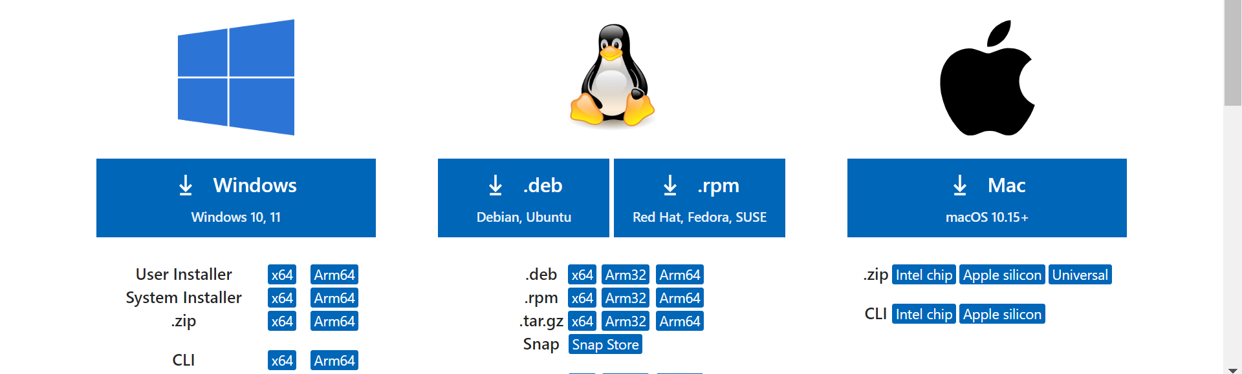
Download Visual Studio Code (Linux/Windows/Mac)
https://code.visualstudio.com/download

Slide 3
Download MYSYS (Windows)
https://www.msys2.org/

Slide 4
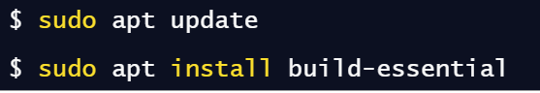
Download gCC/G++ (Linux)
https://linuxhint.com/install-and-use-g-on-ubuntu/

Slide 5
Download gcc (Mac)
https://cs.millersville.edu/~gzoppetti/InstallingGccMac.html

Slide 6
YouTube
Download VSCODE with mysys compiler (Windows): https://www.youtube.com/watch?v=DMWD7wfhgNY
Download VSCODE with mysys compiler (Linux): https://www.youtube.com/watch?v=oQ9E_LFoo9U
Download VSCODE with gcc compiler (Mac): https://youtu.be/wY24ehH6mC0?si=ZuwQKPdLwIZF0Y6t
https://youtu.be/RSXwLOPHKVQ?si=SY1n4x0x3T5JJC5J

