Slide 1

Dijkstra’s Algorithm

Slide 2
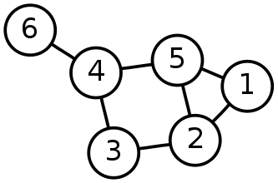
Single-Source Shortest Path Problem
Single-Source Shortest Path Problem - The problem of finding shortest paths from a source vertex v to all other vertices in the graph.

Slide 3
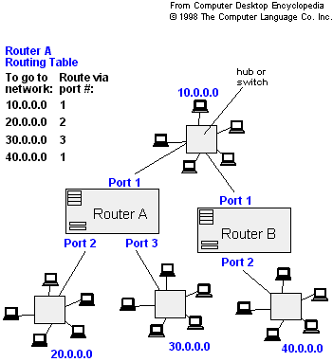
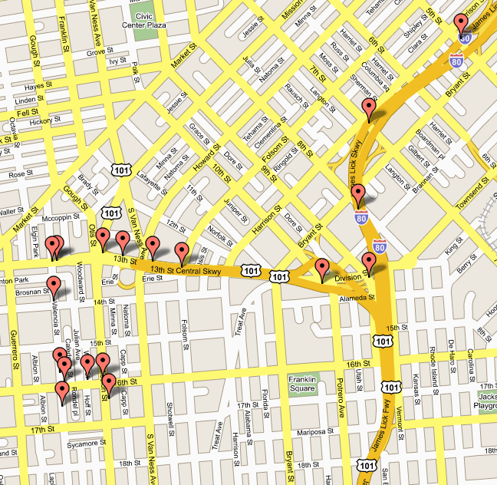
Applications
- Maps (Map Quest, Google Maps)
- Routing Systems

Slide 4
Dijkstra's algorithm
Dijkstra's algorithm - is a solution to the single-source shortest path problem in graph theory.
Works on both directed and undirected graphs. However, all edges must have nonnegative weights.
Input: Weighted graph G={E,V} and source vertex v∈V, such that all edge weights are nonnegative
Output: Lengths of shortest paths (or the shortest paths themselves) from a given source vertex v∈V to all other vertices

Slide 5
Approach
The algorithm computes for each vertex u the distance to u from the start vertex v, that is, the weight of a shortest path between v and u.
the algorithm keeps track of the set of vertices for which the distance has been computed, called the cloud C
Every vertex has a label D associated with it. For any vertex u, D[u] stores an approximation of the distance between v and u. The algorithm will update a D[u] value when it finds a shorter path from v to u.
When a vertex u is added to the cloud, its label D[u] is equal to the actual (final) distance between the starting vertex v and vertex u.

Slide 6
Dijkstra pseudocode
Dijkstra(v1, v2):
for each vertex v: // Initialization
v's distance := infinity.
v's previous := none.
v1's distance := 0.
List := {all vertices}.
while List is not empty:
v := remove List vertex with minimum distance.
mark v as known.
for each unknown neighbor n of v:
dist := v's distance + edge (v, n)'s weight.
if dist is smaller than n's distance:
n's distance := dist.
n's previous := v.
reconstruct path from v2 back to v1,
following previous pointers.

Slide 7
Example: Initialization
Distance(source) = 0
0
∞
Distance (all vertices but source) = ∞
A
2
B
4
1
3
10
∞
C
2
D
2
E
∞
5
8
∞
4
6
F
1
G
∞
∞
Pick vertex in List with minimum distance.

Slide 8
Example: Update neighbors' distance
0
2
A
2
B
4
1
3
10
∞
C
2
D
2
E
∞
5
8
1
4
6
Distance(B) = 2
F
1
G
Distance(D) = 1
∞
∞

Slide 9
Example: Remove vertex with minimum distance
0
2
A
2
B
4
1
3
10
∞
C
2
D
2
E
∞
5
8
1
4
6
F
1
G
∞
∞
Pick vertex in List with minimum distance, i.e., D

Slide 10
Example: Update neighbors
0
2
A
2
B
4
1
3
10
3
C
2
D
2
E
3
5
8
1
4
6
Distance(C) = 1 + 2 = 3 Distance(E) = 1 + 2 = 3 Distance(F) = 1 + 8 = 9 Distance(G) = 1 + 4 = 5
F
1
G
9
5

Slide 11
Example: Continued...
Pick vertex in List with minimum distance (B) and update neighbors
0
2
A
2
B
4
1
3
10
3
C
2
D
2
E
3
5
8
1
4
6
Note : distance(D) not updated since D is already known and distance(E) not updated since it is larger than previously computed
F
1
G
9
5

Slide 12
Example: Continued...
Pick vertex List with minimum distance (E) and update neighbors
0
2
A
2
B
4
1
3
10
3
C
2
D
2
E
3
5
8
1
4
6
F
1
G
No updating
9
5

Slide 13
Example: Continued...
Pick vertex List with minimum distance (C) and update neighbors
0
2
A
2
B
4
1
3
10
3
C
2
D
2
E
3
5
8
1
4
6
Distance(F) = 3 + 5 = 8
F
1
G
8
5

Slide 14
Example: Continued...
Pick vertex List with minimum distance (G) and update neighbors
0
2
A
2
B
4
1
3
10
3
C
2
D
2
E
3
5
8
1
4
6
F
1
G
Previous distance
6
5
Distance(F) = min (8, 5+1) = 6

Slide 15
Example (end)
0
2
A
2
B
4
1
3
10
3
C
2
D
2
E
3
5
8
1
4
6
F
1
G
6
5
Pick vertex not in S with lowest cost (F) and update neighbors

Slide 16
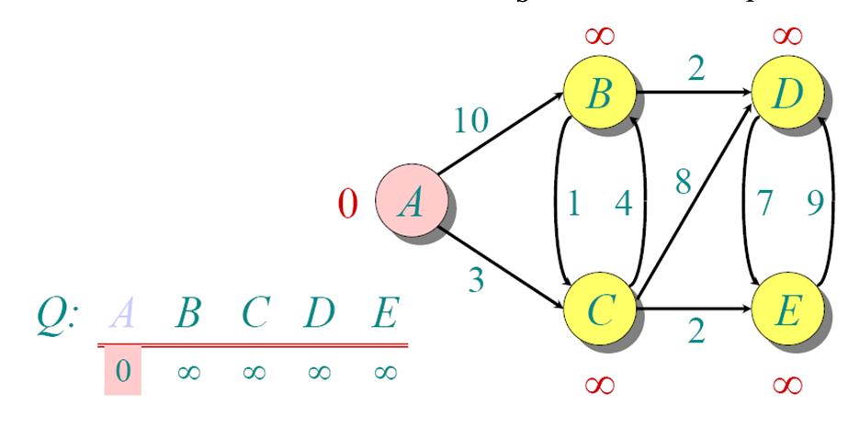
Another Example

Slide 17
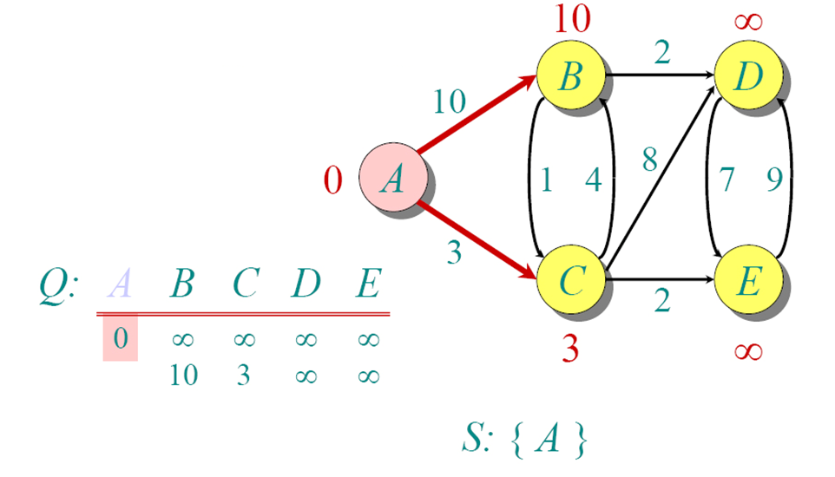
Another Example

Slide 18
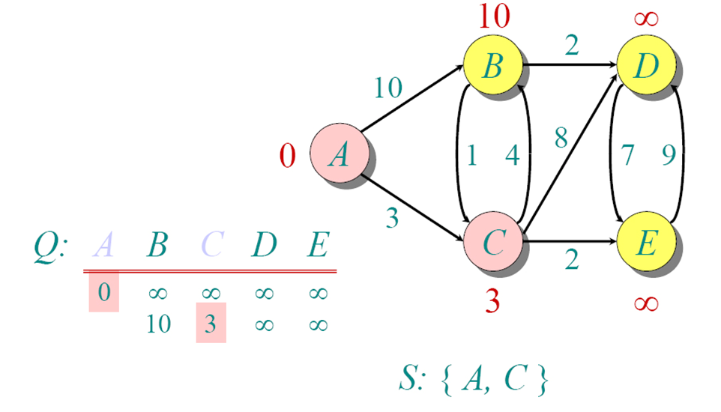
Another Example

Slide 19
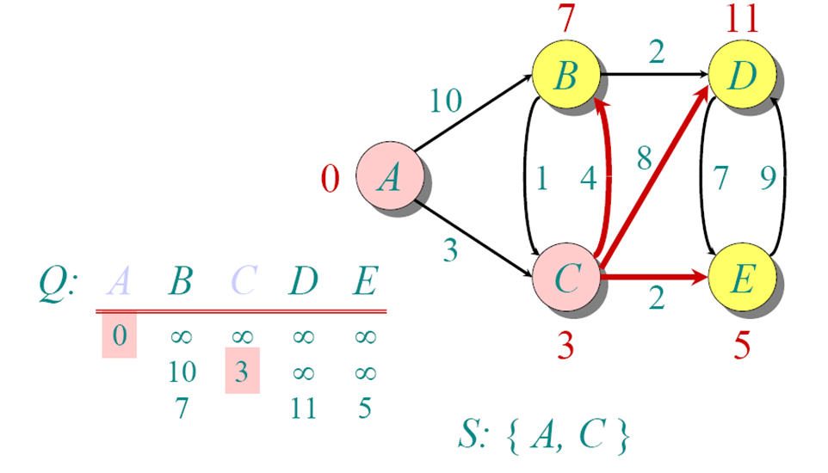
Another Example

Slide 20
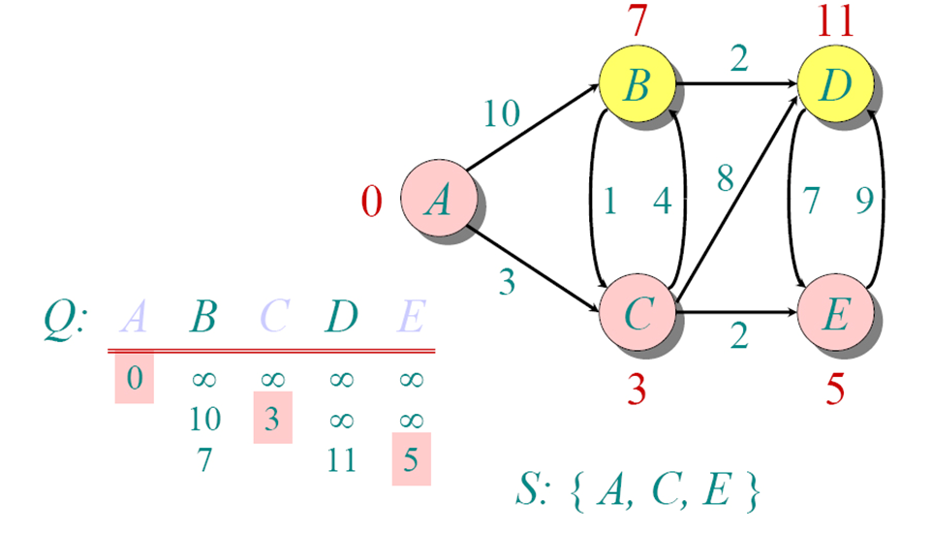
Another Example

Slide 21
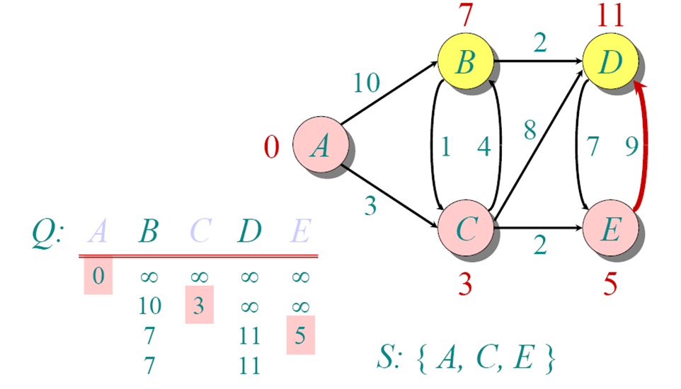
Another Example

Slide 22
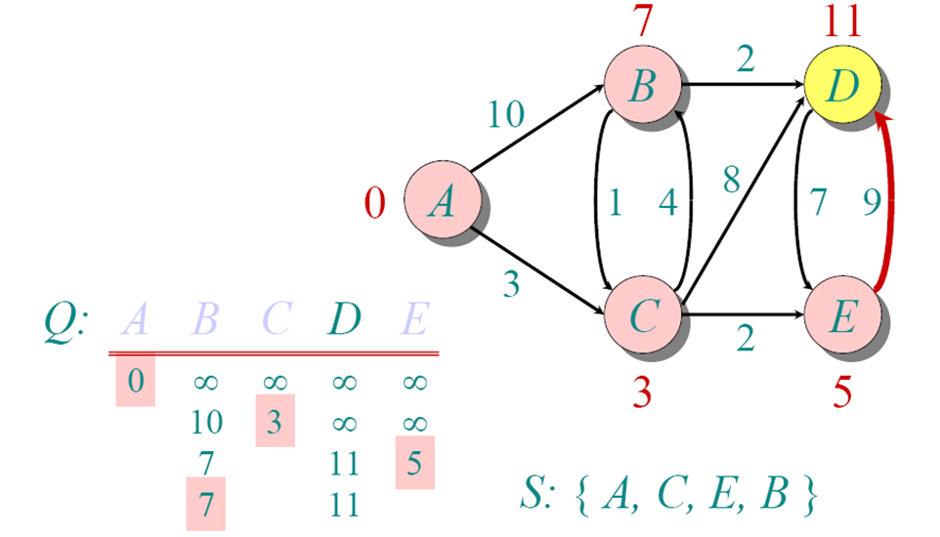
Another Example

Slide 23
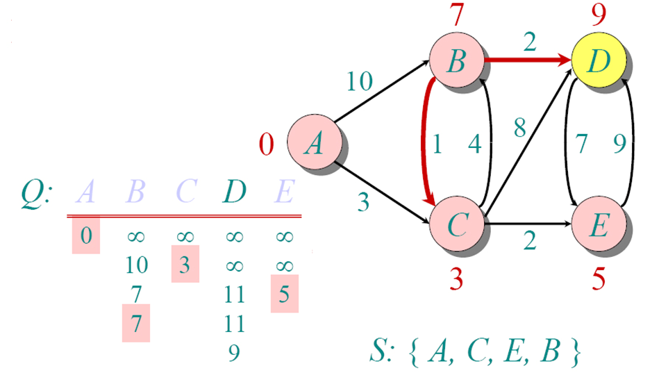
Another Example

Slide 24
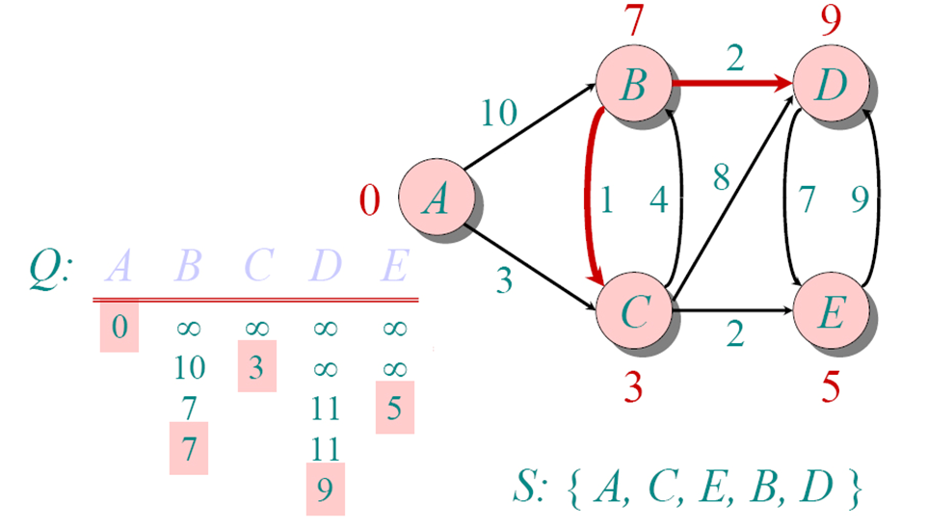
Another Example

Slide 25

Correctness :“Cloudy” Proof
When a vertex is added to the cloud, it has shortest distance to source.
Least cost node
P: Next shortest path from inside the known cloud
v
THE KNOWN
CLOUD
competitor
v'
Source
If the path to v is the next shortest path, the path to v' must be at least as long. Therefore, any path through v' to v cannot be shorter!

Slide 26
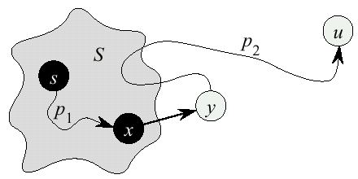
Dijkstra’s Correctness
We will prove that whenever u is added to S, d[u] = δ(s,u), i.e., that d[u] is minimum, and that equality is maintained thereafter
Proof
Note that φορ αλλ v, d[v] ≥ δ(s,v)
Let u be the first vertex picked such that there is a shorter path than d[u], i.e., that d[u] > δ(s,u)
We will show that this assumption leads to a contradiction

Slide 27
Dijkstra Correctness (2)
Let y be the first vertex ιν V – S on the actual shortest path from s to u, then it must be that d[y] = δ(s,y) because
d[x] is set correctly for y's predecessor x ιν S on the shortest path (by choice of u as the first vertex for which d is set incorrectly)
when the algorithm inserted x into S, it relaxed the edge (x,y), assigning d[y] the correct value

Slide 28
Dijkstra Correctness (3)
But if d[u] > d[y], the algorithm would have chosen y (from the Q) to process next, not u −− Contradiction
Thus d[u] = δ(s,u) at time of insertion of u into S, and Dijkstra's algorithm is correct

Slide 29
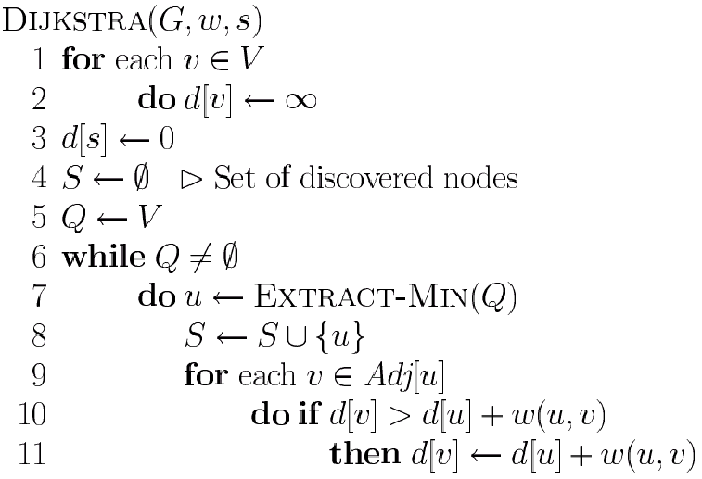
Dijkstra’s Pseudo Code
Graph G, weight function w, root s
relaxing edges

Slide 30
Time Complexity: Using List
The simplest implementation of the Dijkstra's algorithm stores vertices in an ordinary linked list or array
Good for dense graphs (many edges)
|V| vertices and |E| edges
Initialization O(|V|)
While loop O(|V|)
Find and remove min distance vertices O(|V|)
Potentially |E| updates
Update costs O(1)
Total time O(|V²| + |E|) = O(|V²| )

Slide 31
Time Complexity: Priority Queue
For sparse graphs, (i.e. graphs with much less than |V²| edges) Dijkstra's implemented more efficiently by priority queue
Initialization O(|V|) using O(|V|) buildHeap
While loop O(|V|)
Find and remove min distance vertices O(log |V|) using O(log |V|) deleteMin
Potentially |E| updates
Update costs O(log |V|) using decreaseKey
Total time O(|V|log|V| + |E|log|V|) = O(|E|log|V|)
|V| = O(|E|) assuming a connected graph

Slide 32

Thank you

