Slide 1

Particle Filter/Monte Carlo Localization

Slide 2

Agenda
Problem Statement
Classical Approaches
Particle Filters
Theory
Algorithms
Applications

Slide 3
Problem Statement
Tracking the state of a system as it evolves over time
We have: Sequentially arriving (noisy or ambiguous) observations
We want to know: Best possible estimate of the hidden variables

Slide 4
Illustrative Example: Robot Localization
Prob
0
1
t=0
Sensory model: never more than 1 mistake
Motion model: may not execute action with small prob.

Slide 5
Illustrative Example: Robot Localization
Prob
0
1
t=1

Slide 6
Illustrative Example: Robot Localization
Prob
0
1
t=2

Slide 7
Illustrative Example: Robot Localization
Prob
0
1
t=3

Slide 8
Illustrative Example: Robot Localization
Prob
0
1
t=4

Slide 9
Illustrative Example: Robot Localization
Trajectory
1
2
3
4
Prob
0
1
t=5

Slide 10
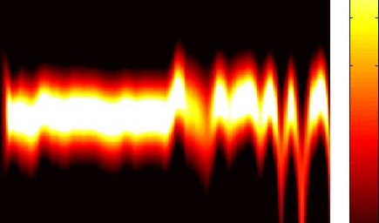
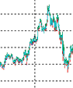
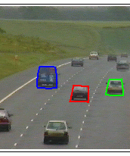
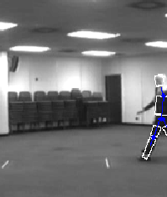
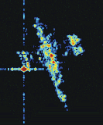
Applications
Tracking of aircraft positions from radar
Estimating communications signals from noisy measurements
Predicting economical data
Tracking of people or cars in surveillance videos

Slide 11
Bayesian Filtering / Tracking Problem
Unknown State Vector x_{0:t} = (x₀, …, x_{t})
Observation Vector z_{1:t}
Find PDF p(x_{0:t} | z_{1:t}) … posterior distribution
or p(x_{t} | z_{1:t}) … filtering distribution
Prior Information given:
p(x₀) … prior on state distribution
p(z_{t} | x_{t}) … sensor model
p(z_{t} | x_{t-1}) … Markovian state-space model
Notes:
complete solution: optimal estimate and measure of accuracy available
Sensor and state model are given as transition functions (dependent on some noise variable)

Slide 12
Sequential Update
Storing all incoming measurements is inconvenient
Recursive filtering:
Predict next state pdf from current estimate
Update the prediction using sequentially arriving new measurements
Optimal Bayesian solution: recursively calculating exact posterior density

Slide 13
Bayesian Update and Prediction
Prediction
Update
Notes:
update via Bayes‘ rule
usually infeasible to calculate analytically the exact posterior desity
only in restricted cases (Kalman filter, next section)

Slide 14
Agenda
Problem Statement
Classical Approaches
Particle Filters
Theory
Algorithms
Applications

Slide 15
Kalman Filter
Optimal solution for linear-Gaussian case
Assumptions:
State model is known linear function of last state and Gaussian noise signal
Sensory model is known linear function of state and Gaussian noise signal
Posterior density is Gaussian

Slide 16
Kalman Filter: Update Equations

Slide 17
Limitations of Kalman Filtering
Assumptions are too strong. We often find:
Non-linear Models
Non-Gaussian Noise or Posterior
Multi-modal Distributions
Skewed distributions
Extended Kalman Filter:
local linearization of non-linear models
still limited to Gaussian posterior
Notes:
No algorithm can do better in linear Gaussian environment

Slide 18
Grid-based Methods
Optimal for discrete and finite state space
Keep and update an estimate of posterior pdf for every single state
No constraints on posterior (discrete) density

Slide 19
Limitations of Grid-based Methods
Computationally expensive
Only for finite state sets
Approximate Grid-based Filter
divide continuous state space into finite number of cells
Hidden Markov Model Filter
Dimensionality increases computational costs dramatically

Slide 20
Agenda
Problem Statement
Classical Approaches
Particle Filters
Theory
Algorithms
Applications

Slide 21
Particle Filter
Definition:
Particle filter is a Bayesian based filter that samples the whole robot work space by a weight function derived from the belief distribution of previous stage.
Basic principle:
Set of state hypotheses (“particles”)
Survival-of-the-fittest particles (best fit to sensor data….)

Slide 22
Why Particle Filters
Represent belief by random samples
Estimation of non-Gaussian, nonlinear processes
Particle filtering ➔ non-parametric inference algorithm
- suited to track non-linear dynamics.
- efficiently represent non-Gaussian distributions

Slide 23
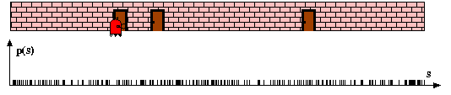
Particle Filters
Robot Pose particles drawn at random and uniformly over the entire pose space

Slide 24
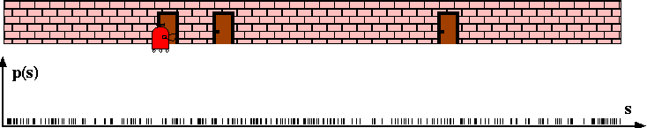
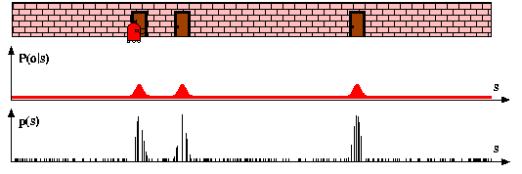
Sensor Information: Importance Sampling
After robot senses the door, Monte Carlo Localization Assigns importance factors to each particle

Slide 25
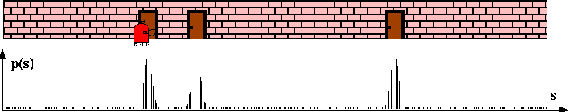
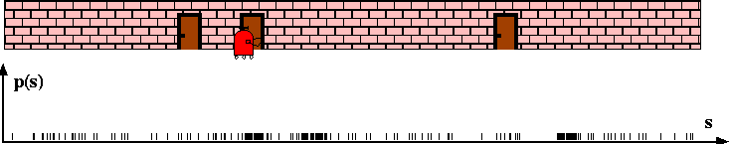
Robot Motion
After incorporating the robot motion and after resampling, leads to new particle set with uniform importance weights, but with an increased number of particles near the three likely places

Slide 26
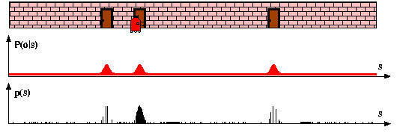
Sensor Information: Importance Sampling
New measurement assigns non-uniform importance weights to the particle sets, most of the cumulative probability mass is centered on the second door

Slide 27
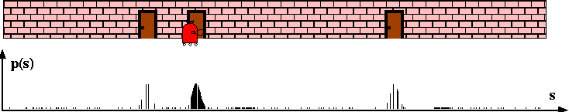
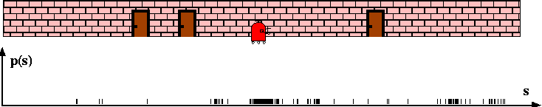
Robot Motion
Further motion leads to another re-sampling step, and a step in which a new particle set is generated according to the motion model

Slide 28
Mobile Robot Particle Filter Video

Slide 29
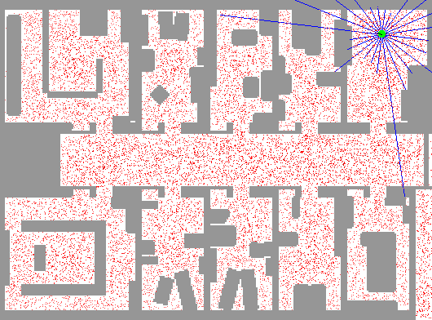
Sample-based Localization (sonar)

Slide 30
MCL in action
“Monte Carlo” Localization -- refers to the resampling of the distribution each time a new observation is integrated

Slide 31
Particle Filter Basics
Known map of the world (2D in our case). Location of objects of interest (i.e. obstacles, walls, beacons/cones) is also known
How can we localize ourselves given an arbitrary starting position?
Idea: populate the space with random samples of where we might be
See if the random samples are consistent with movement and sensor readings
Predict: Move all particles according to movement model with noise
Measure: Integrate sensor readings into a “weight” for each sample by making a prediction about the sensor readings likelihood given this particle’s location. Update weight on the particle accordingly
Sample: Randomly select M particles based on weights (same particle may be picked multiple times)
Prefer new samples that are consistent with sensor data over samples that are not consistent

Slide 32
Particle Filter Basics
Particle filters represent a distribution by a set of samples drawn from the posterior distribution.
The denser a sub-region of the state space is populated by samples, the more likely it is that true state falls into this region.
Such a representation is approximate, but it is nonparametric, and therefore can represent a much broader space of distributions than Gaussians.
Weight of particle are given through the measurement model.
Re-sampling allows to redistribute particles approximately according to the posterior .
The re-sampling step is a probabilistic implementation of the Darwinian idea of survival of the fittest: it refocuses the particle set to regions in state space with high posterior probability
By doing so, it focuses the computational resources of the filter algorithm to regions in the state space where they matter the most.

Slide 33
Properties of Particle Filters
Sampling Variance
Variation due to random sampling
The sampling variance decreases with the number of samples
Higher number of samples result in more accurate approximations with less variability
If enough samples are chosen, the observations made by a robot – sample based belief - “are close enough” to the true belief.

Slide 34
2-D Mobile Robot Particle Filter Algorithm
Define a map of the scene, with features that can be sensed by the robot (vision, range, ultrasound etc.)
Choose N random particle locations (X,Y,θ) to cover the scene
Place mobile robot in scene (unknown location)
Until robot is localized do:
Move robot according to known random motion model with noise.
Move each particle with similar motion using known motion model with noise.
Compare real sensor readings with simulated sensor readings from each particle, given:
We know each Particle’s location
We have a noise model of the sensor (e.g. ultrasound, laser, vision)
We have a known map with feature locations (walls/obstacles/beacons)
Use comparison in (3) above to generate an “importance weight” for each particle – how close it’s measurements are to the sampled measurement
Resample the particles (with replacement) according to the new weighted distribution above. Higher weights mean more agreement with the sensor measurement, and a more likely location for the robot.
Repeat steps 1-5 above with the newly sampled particle set until robot is localized – particles converge
After each movement update, particles that are close to the actual robot location will have their sensor measurements be consistent with the real readings, reinforcing these particles (their weights are higher)
Particles that were not close to the actual robot location after the movement update will not be consistent with sensor measurements, and will be less likely to survive during resampling (their weights are lower)

Slide 35
Particle Filter in Python
p=[]
for i in range(N): #p is initial particle array with random location of particle (X,Y,ϴ)
p.append(p[i].random_location(X,Y,ϴ))
p2=[]
myrobot=myrobot.move(dX,dY, dϴ) # move robot (randomly) to new position with noise
Z = sensor_readings() # sensor readings from robot at this new position
for i in range(N):
p2.append(p[i].move(dX,dY, dϴ)) #update particle position with same movement as robot (translation,rotation)
p = p2
w = []
for i in range(N): #w is importance weight for each particle. P(Z |p[i]) how close sensor measurement
w.append(p[i].measurement_prob(Z)) # at particle location is to the actual sensor values (Z)
p3 = [] # now resample (with replacement) according to new importance weights
….insert resampling code here to get a new set of particles weighted by their importance
p = p3
# now do this again (starting with myrobot.move() )with the new particle set……

Slide 36
Importance Sampling Principle
After we update the particles with the sensor readings, we have a set of particles with new “importance weights”
We want to resample the particles (with replacements – duplicates) based on the new importance weightings.
Essentially: sample from an arbitrary prob. Distribution
Methods ( each with different efficiency/complexity)
Rejection sampling
Cumulative Distribution Function buckets
Importance sampling makes sure “good” particles survive

Slide 37
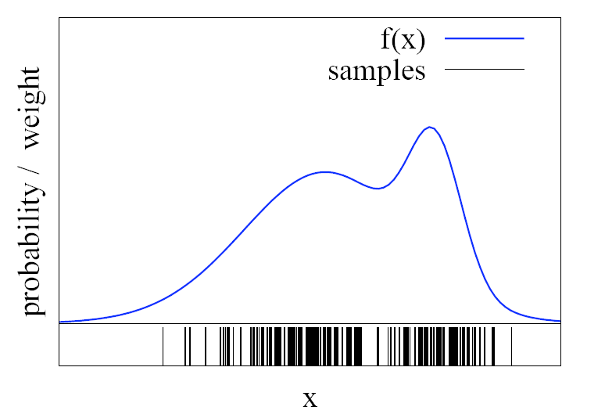
Rejection Sampling
Let us assume that f(x)<1 for all x
Sample x from a uniform distribution
Sample c from [0,1]
if f(x) > c keep the sample
otherwise reject the sample
Intuitively: Particles with high probability will have a good chance of being chosen as they will be larger than most random values of c =[0,1]
Particles with low probability will have a small chance of being chosen as they will be smaller than most random values of c = [0,1]

Slide 38
#rejection sampling
# pick a random particle from 1 to N. Then see if its weight (i.e. probability)
# is greater or less than a random probability from [0,1].
# if it is greater, then accept this particle, otherwise reject
import math
import random
N=5 #number of particles
w=[.1,.1,.6,.1,.1] #probability of each particle
print 'initial particle probabilities',w
freq=[0,0,0,0,0] #resampling frequency (histogram buckets)
accepted=0
iteration=0
while (accepted<1000):
iteration=iteration+1
index = int(random.random() * N)
c=random.random() * 1
if w[index]>=c:
freq[index]=freq[index]+1
accepted=accepted+1
print '# of iterations', iteration, ' # accepted', accepted
print 'resampled frequencies are', freq
Test execution to generate 1000 new particles:
initial particle probabilities [0.1, 0.1, 0.6, 0.1, 0.1]
# of iterations 4900 # accepted 1000
resampled frequencies are [92, 105, 598, 98, 107]
initial particle probabilities [0.1, 0.1, 0.6, 0.1, 0.1]
# of iterations 5266 # accepted 1000
resampled frequencies are [88, 103, 592, 118, 99]
initial particle probabilities [0.2, 0.2, 0.2, 0.2, 0.2]
# of iterations 4892 # accepted 1000
resampled frequencies are [195, 209, 185, 198, 213]
initial particle probabilities [0.47, 0.02, 0.02, 0.02, 0.47]
# of iterations 5009 # accepted 1000
resampled frequencies are [464, 20, 17, 25, 474]

Slide 39
Importance Sampling using a Cumulative Dist. Function (CDF)
Particle # | weight | Cumulative weight
3 | 0.1 | 0.1
5 | 0.1 | 0.2
1 | 0.2 | 0.4
4 | 0.2 | 0.6
2 | 0.4 | 1
Choose random number [0,…,1]
Find which bin in the CDF the number falls into
Choose that particle
Binary Search on the Cumulative Weight to find the right bin – Log N complexity
For N samples, overall complexity is N Log N

Slide 40
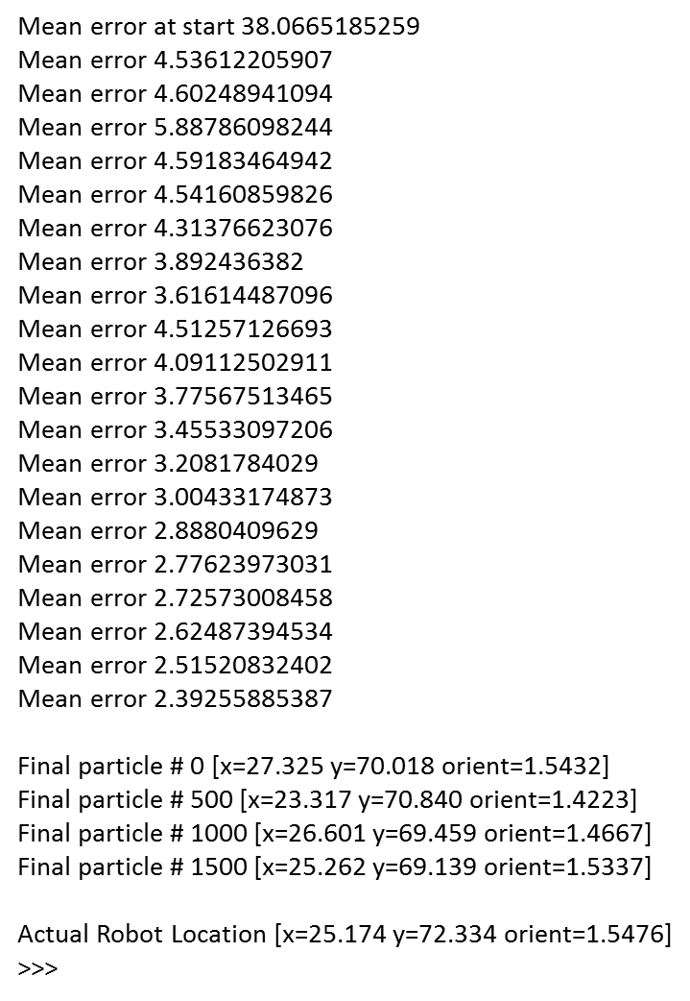
Simple Particle Filter (click)

Slide 41
Advantages of Particle Filters:
can deal with non-linearities, continuous spaces
can deal with non-Gaussian noise
easy to implement
PFs focus adaptively on probable regions of state-space
Parallel implementation possible
Can deal with kidnapped robot problem

Slide 42
Drawbacks
In order to explore a significant part of the state space, the number of particles should be very large which induces complexity problems not adapted to a real-time implementation.
Notes:
More particles ) Better approximation (and more
expensive), but there’s no formula for the “right amount

Slide 43
Summary
Particle filters are an implementation of recursive Bayesian filtering
They represent the posterior by a set of weighted samples.
In the context of localization, the particles are propagated according to the motion model.
They are then weighted according to the likelihood of their observations being the same as the real robot observations
In a re-sampling step, new particles are drawn with a probability proportional to the particle’s likelihood of the real observation.

Slide 44
References
Dieter Fox, Wolfram Burgard, Frank Dellaert, Sebastian Thrun, “Monte Carlo Localization: Efficient Position Estimation for Mobile Robots”, Proc. 16th National Conference on Artificial Intelligence, AAAI’99, July 1999
Dieter Fox, Wolfram Burgard, Sebastian Thrun, “Markov Localization for Mobile Robots in Dynamic Environments”, J. of Artificial Intelligence Research 11 (1999) 391-427
Sebastian Thrun, “Probabilistic Algorithms in Robotics”, Technical Report CMU-CS-00-126, School of Computer Science, Carnegie Mellon University, Pittsburgh, USA, 2000

