Slide 1

Grid Maps

Slide 2

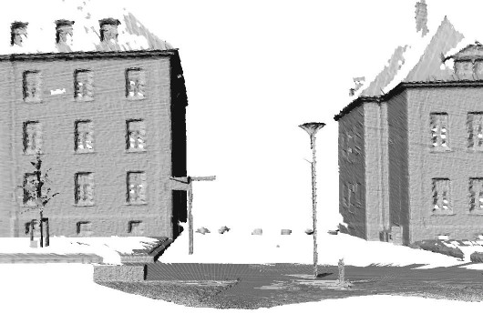
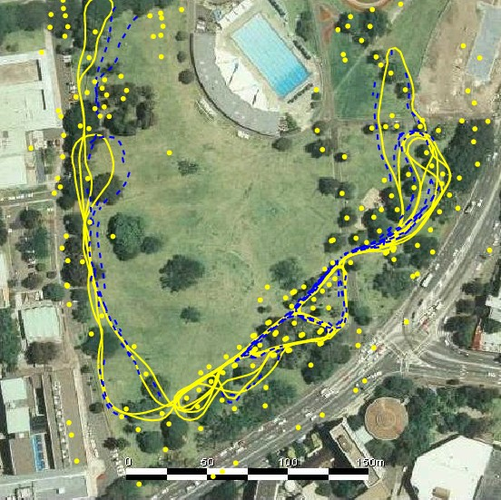
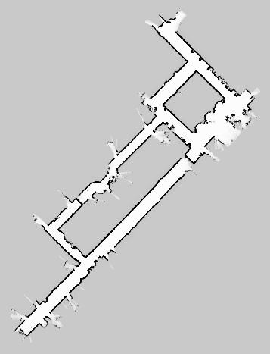
Features vs. Volumetric Maps
Courtesy by E. Nebot
2

Slide 3
Features
So far, we only used feature maps
Natural choice for Kalman filter-based SLAM systems
Compact representation
Multiple feature observations improve the landmark position estimate (EKF)
2

Slide 4
Grid Maps
Discretize the world into cells
Grid structure is rigid
Each cell is assumed to be occupied or free space
Non-parametric model
Large maps require substantial memory resources
Do not rely on a feature detector
3

Slide 5
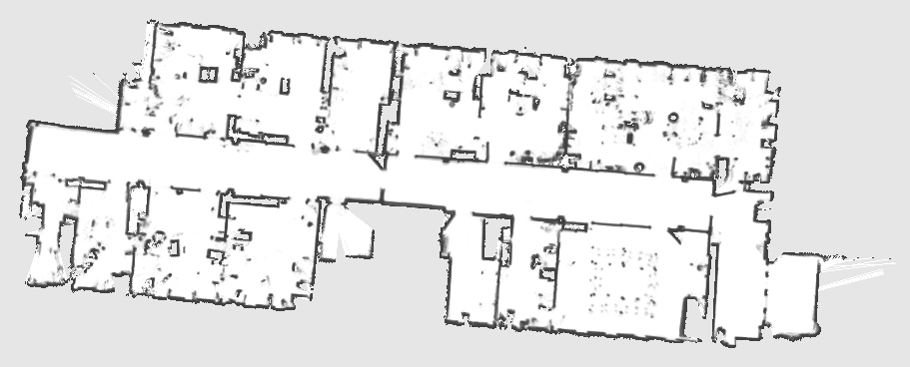

Example
4

Slide 6


Assumption 1
The area that corresponds to a cell is either completely free or occupied
occupied space
free space
5

Slide 7


Representation
Each cell is a binary random variable that models the occupancy
6

Slide 8



Occupancy Probability
Each cell is a binary random variable that models the occupancy
Cell is occupied:
Cell is not occupied:
No knowledge:
7

Slide 9


Assumption 2
The world is static (most mapping systems make this assumption)
always occupied always free space
8

Slide 10


Assumption 3
The cells (the random variables) are
independent of each other
no dependency between the cells

Slide 11
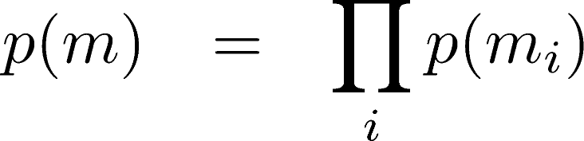


Representation
The probability distribution of the map is given by the product over the cells
map
cell

Slide 12

Representation
The probability distribution of the map is given by the product over the cells
example map (4-dim state)
4 individual cells

Slide 13


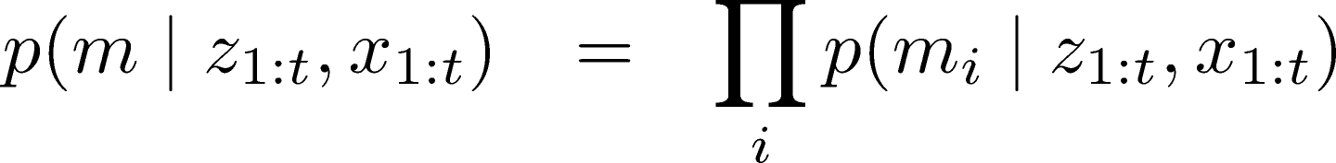

Estimating a Map From Data
Given sensor data and the poses of the sensor, estimate the map
binary random variable
Binary Bayes filter (for a static state)

Slide 14
Static State Binary Bayes Filter

Slide 15
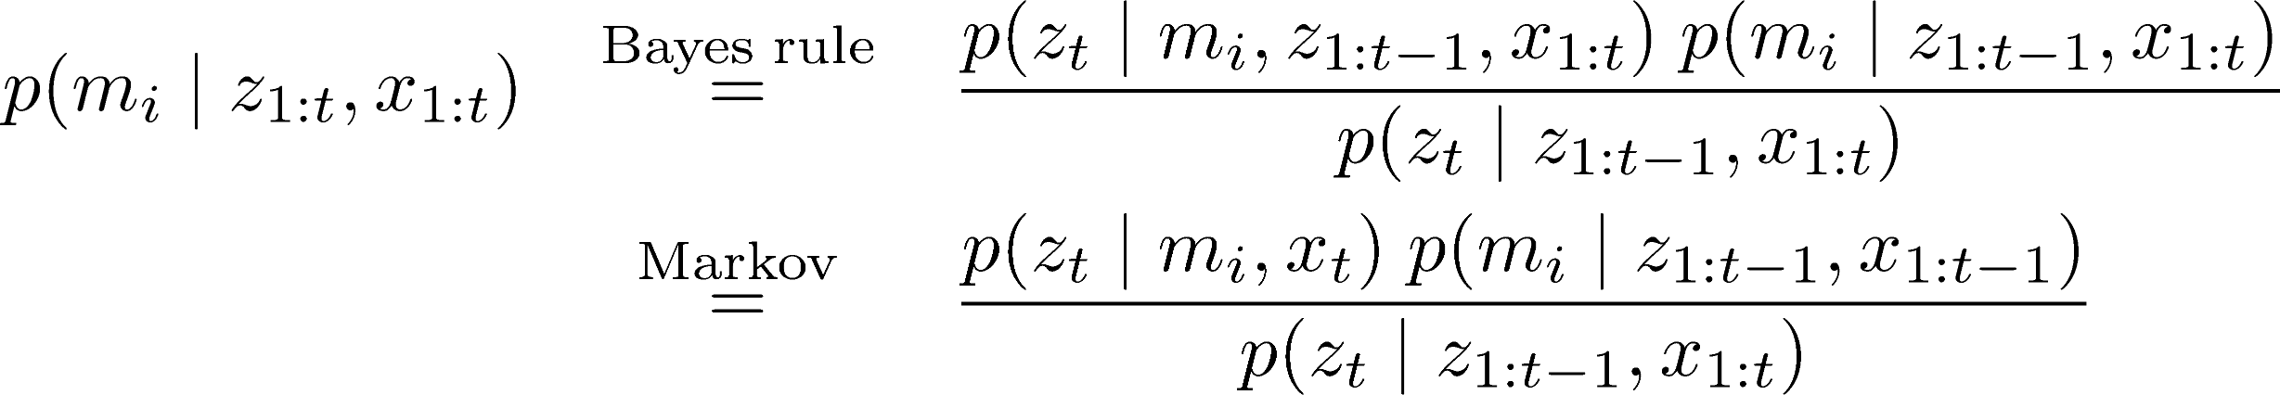


Static State Binary Bayes Filter

Slide 16


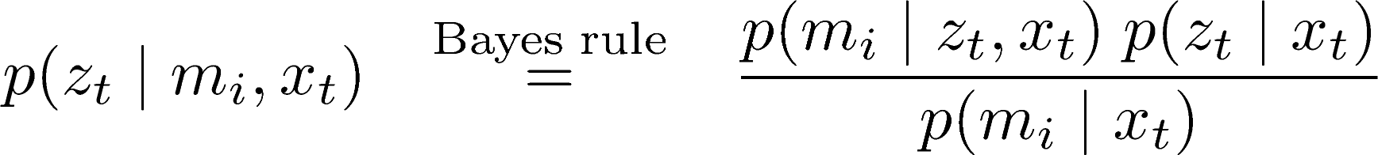
Static State Binary Bayes Filter

Slide 17
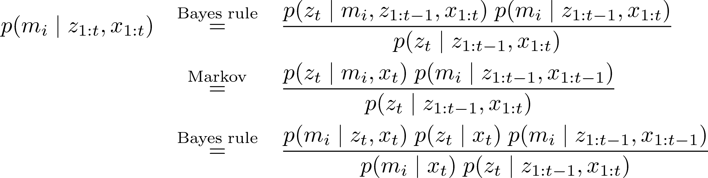
Static State Binary Bayes Filter

Slide 18
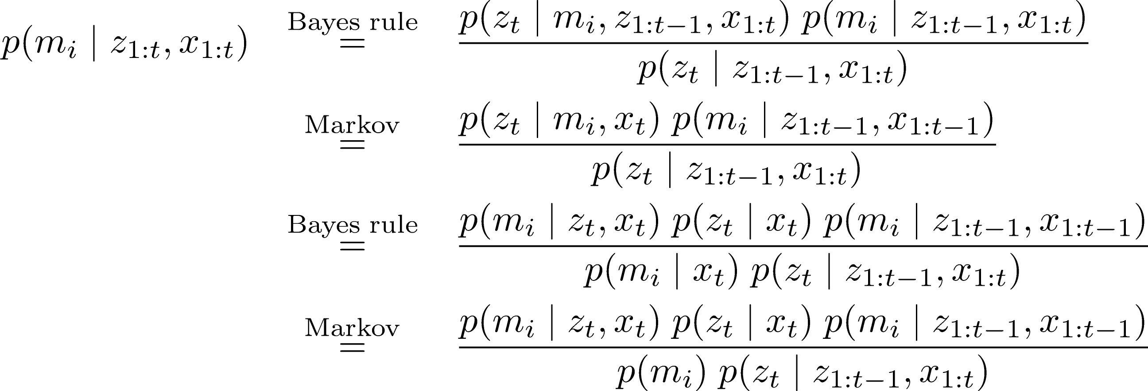

Static State Binary Bayes Filter

Slide 19
Static State Binary Bayes Filter
Do exactly the same for the opposite event:

Slide 20
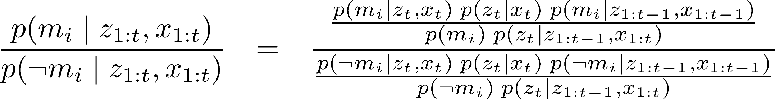
Static State Binary Bayes Filter
By computing the ratio of both probabilities, we obtain:

Slide 21
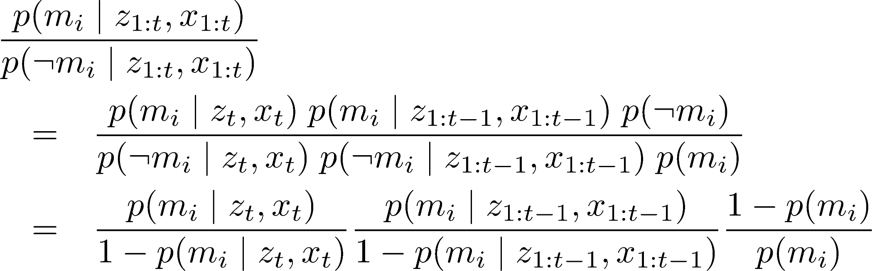
Static State Binary Bayes Filter
By computing the ratio of both probabilities, we obtain:

Slide 22
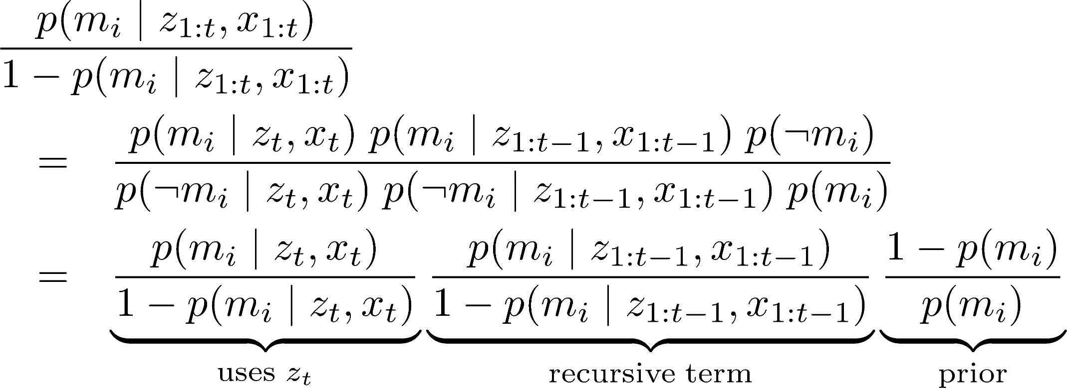
Static State Binary Bayes Filter
By computing the ratio of both probabilities, we obtain:

Slide 23
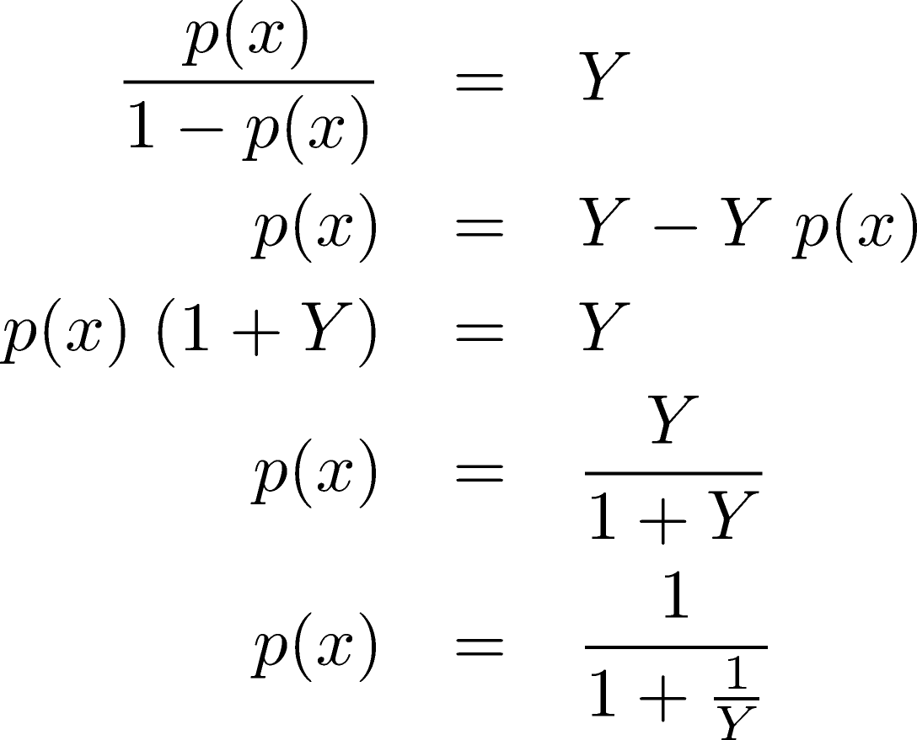
From Ratio to Probability
We can easily turn the ratio into the probability

Slide 24
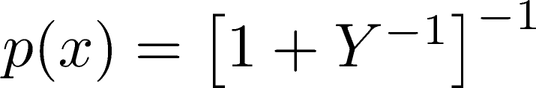
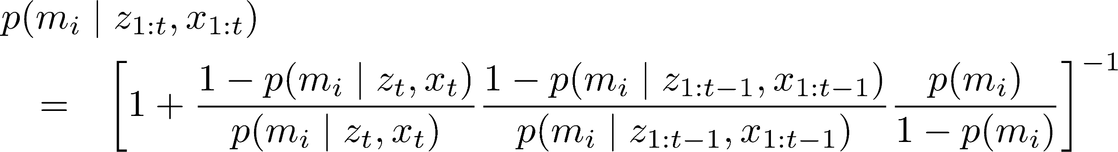
From Ratio to Probability
Using directly leads to
For reasons of efficiency, one performs the calculations in the log odds notation

Slide 25
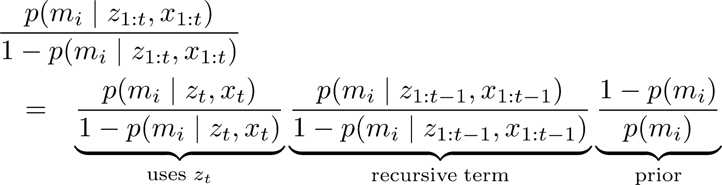
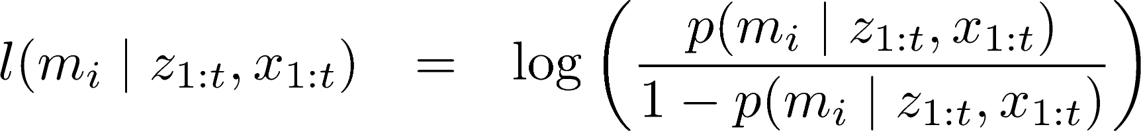
Log Odds Notation
The log odds notation computes the logarithm of the ratio of probabilities

Slide 26
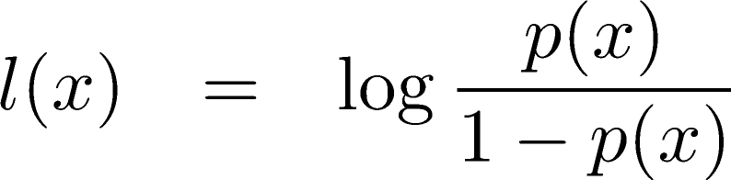

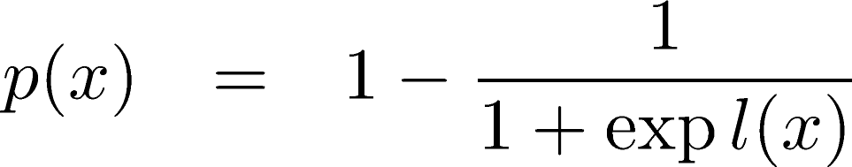
Log Odds Notation
Log odds ratio is defined as
and with the ability to retrieve

Slide 27
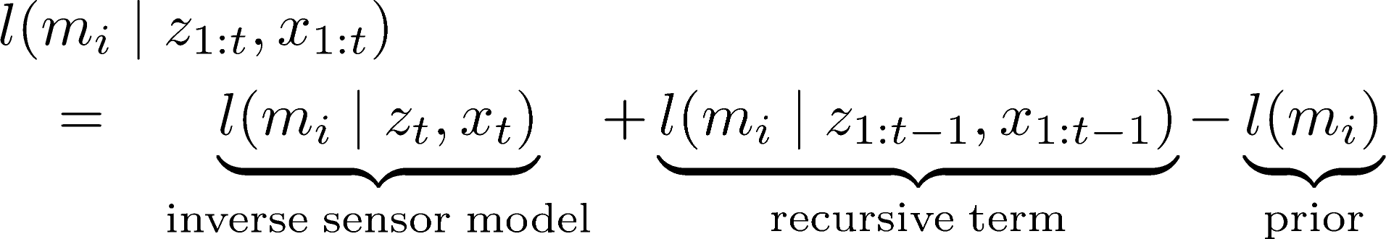
Occupancy Mapping in Log Odds Form
The product turns into a sum
or in short

Slide 28
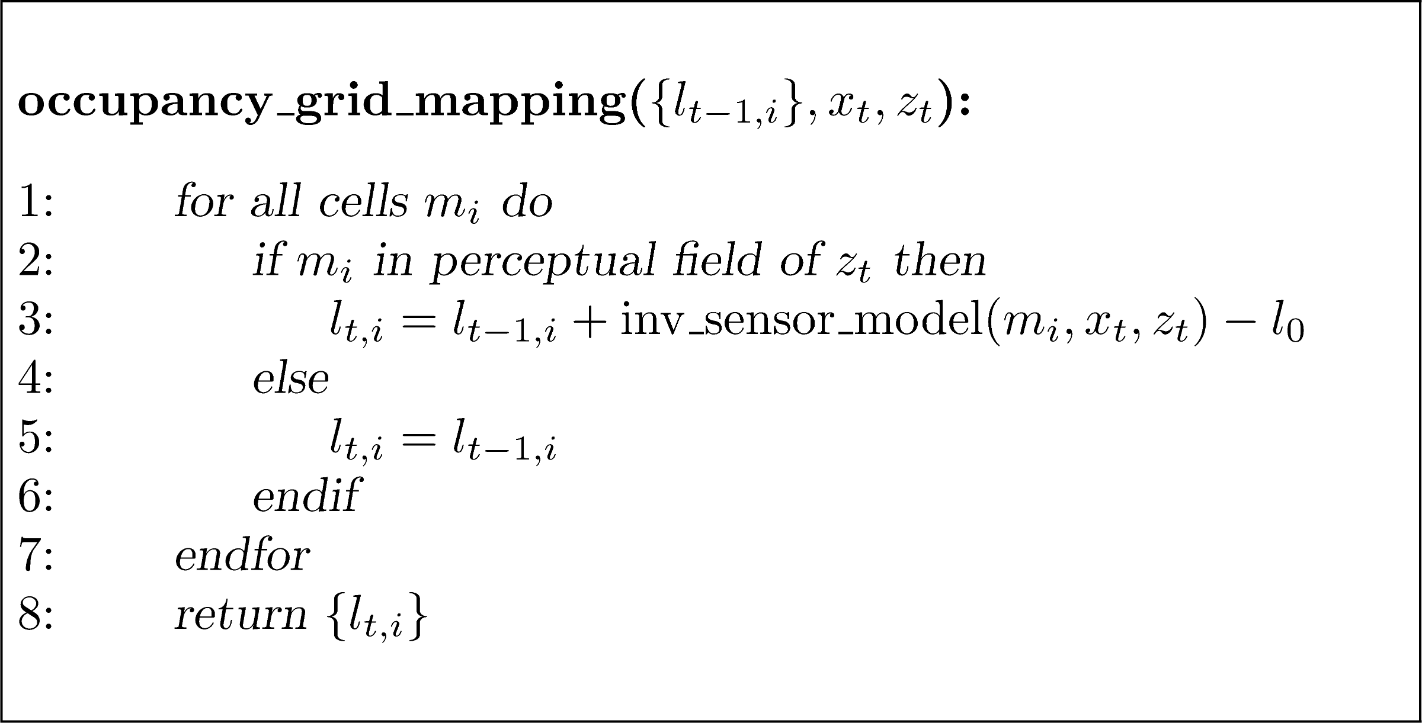


Occupancy Mapping Algorithm
highly efficient, we only have to compute sums

Slide 29
Occupancy Grid Mapping
Moravec and Elfes proposed occupancy grid mapping in the mid 80’ies
Developed for noisy sonar sensors
Also called “mapping with know poses”

Slide 30
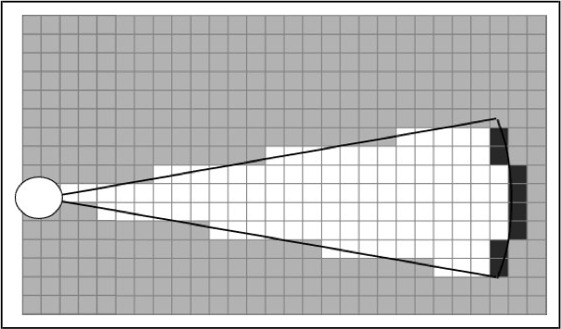
Inverse Sensor Model for Sonar Range Sensors
In the following, consider the cells along the optical axis (red line)
30

Slide 31
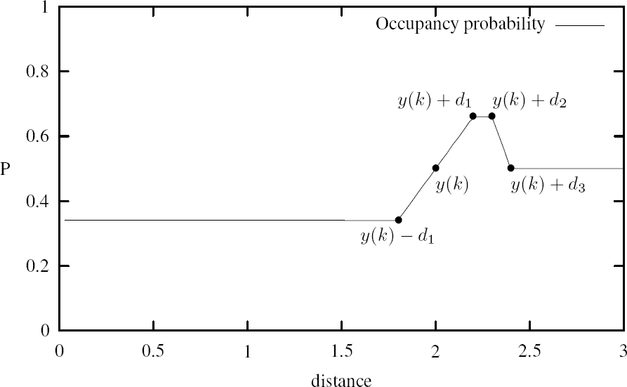
Occupancy Value Depending on the Measured Distance
z+d₁
z+d₂
prior
z
z+d₃
z-d₁
measured dist.
distance between the cell and the sensor

Slide 32
Occupancy Value Depending on the Measured Distance
z+d₁
z+d₂
prior
“free”
z
z+d₃
z-d₁
measured dist.
distance between the cell and the sensor

Slide 33
Occupancy Value Depending on the Measured Distance
“occ”
z+d₁
z+d₂
prior
z
z+d₃
z-d₁
measured dist.
distance between the cell and the sensor

Slide 34
Occupancy Value Depending on the Measured Distance
z+d₁
z+d₂
“no info”
prior
z
z+d₃
z-d₁
measured dist.
distance between the cell and the sensor

Slide 35
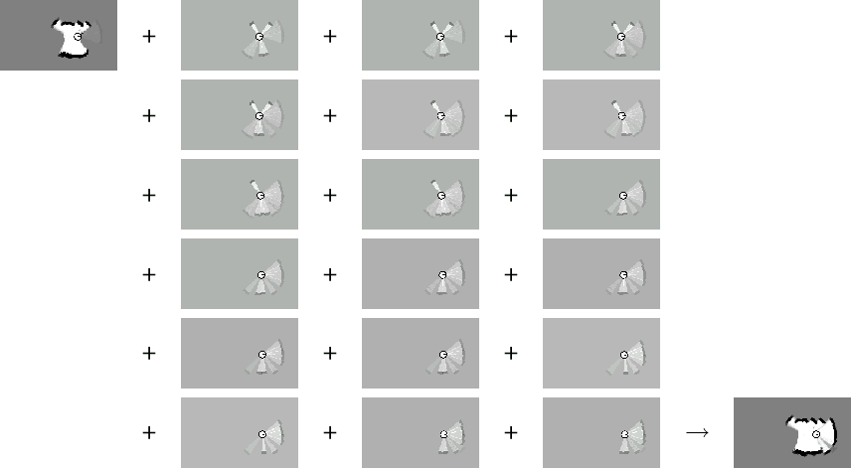
Example: Incremental Updating of Occupancy Grids

Slide 36
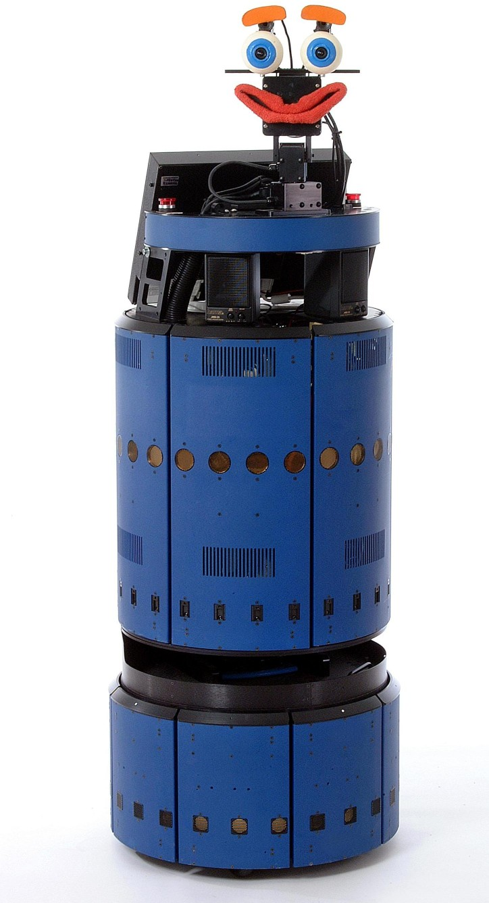

Resulting Map Obtained with 24 Sonar Range Sensors

Slide 37

Resulting Occupancy and Maximum Likelihood Map
The maximum likelihood map is obtained by rounding the probability for each cell to 0 or 1.

Slide 38
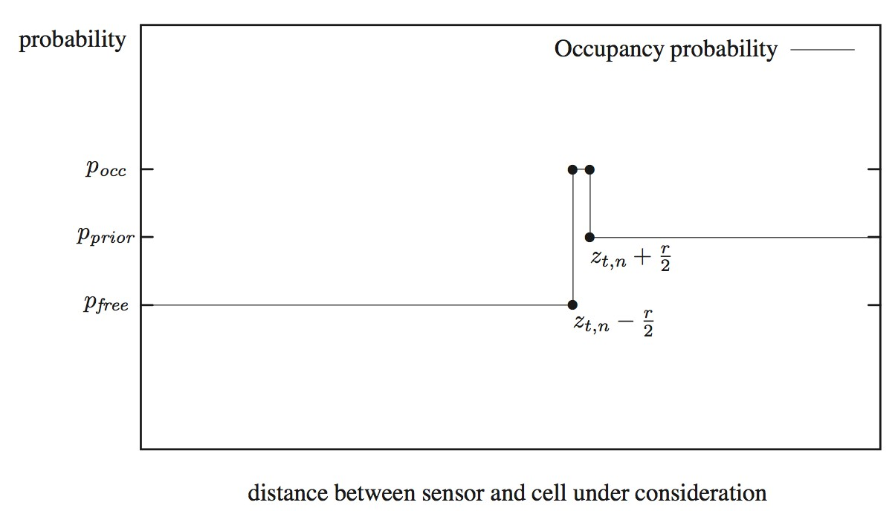
Inverse Sensor Model for Laser Range Finders

Slide 39
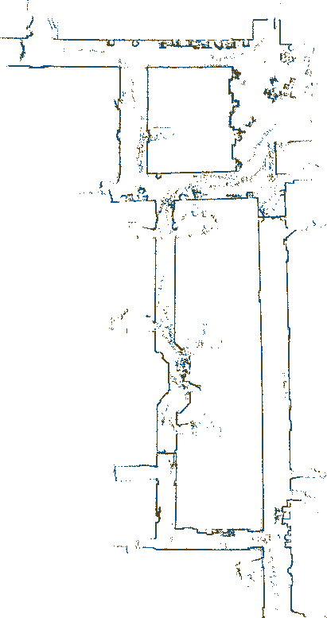
Occupancy Grids
From Laser Scans to Maps

Slide 40
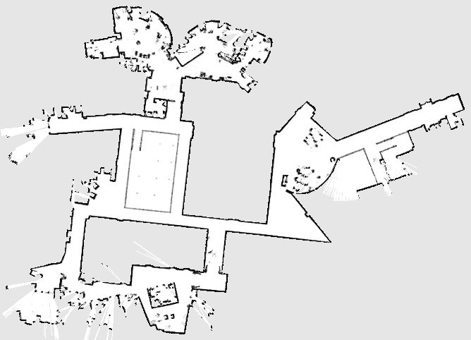

Slide 41
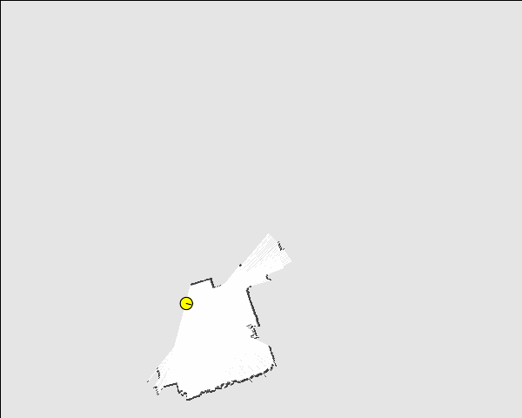

Slide 42
Occupancy Grid Map Summary
Occupancy grid maps discretize the space into independent cells
Each cell is a binary random variable estimating if the cell is occupied
Static state binary Bayes filter per cell
Mapping with known poses is easy
Log odds model is fast to compute
No need for predefined features

Slide 43
Grid Mapping Meets Reality…

Slide 44
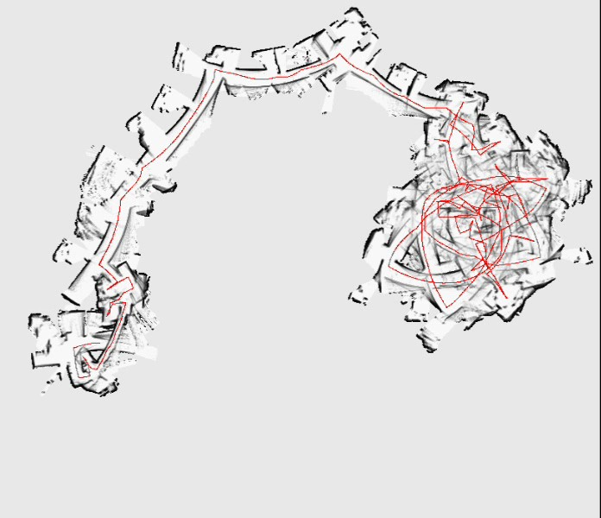
Mapping With Raw Odometry
Courtesy by D. Hähnel

Slide 45
Literature
Static state binary Bayes filter
Thrun et al.: “Probabilistic Robotics”, Chapter 4.2
Occupancy Grid Mapping
Thrun et al.: “Probabilistic Robotics”, Chapter 9.1+9.2

