Slide 1

A brief Introduction to Particle Filters

Slide 2
Many different names…
Particle Filters
(Sequential) Monte Carlo filters
Bootstrap filters
Condensation
Interacting Particle Approximations
Survival of the fittest
…

Slide 3
Sample-based PDF Representation
Monte Carlo characterization of pdf:
Represent posterior density by a set of random i.i.d. samples (particles) from the pdf p(x_{0:t}|z_{1:t})
For larger number N of particles equivalent to functional description of pdf
For N approaches optimal Bayesian estimate

Slide 4
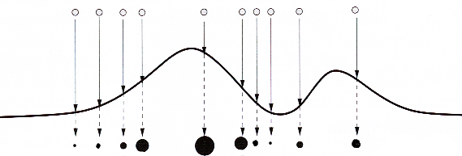
Sample-based PDF Representation
Regions of high density
Many particles
Large weight of particles
Uneven partitioning
Discrete approximation for continuous pdf

Slide 5
Importance Sampling
Draw N samples x_{0:t}^{(i)} from Importance sampling distribution (x_{0:t}|z_{1:t})
Importance weight
Estimation of arbitrary functions f_{t}:
Notes:
Usually impossible to draw efficiently from p ➔ importancr sampling

Slide 6
Sequential Importance Sampling (SIS)
Augmenting the samples
Weight update
Notes:
factoring importance density
Markov assumption; not necessary to keep all former states in memory

Slide 7
Degeneracy Problem
After a few iterations, all but one particle will have negligible weight
Measure for degeneracy: Effective sample size
Small N_{eff} indicates severe degeneracy
Brute force solution: Use very large N
w_{t}* ... true weights at time t
Notes:
Updating these particles means a lot of computational effort, for particles whose contribution to the approximation of p(x|t) is almost zero

Slide 8
Choosing Importance Density
Choose π to minimize variance of weights
Optimal solution:
Practical solution
importance density = prior
Notes:
drawbacks of optimal solution: sampling from complicated distribution, evaluation of integral over new state for weight estimation
restricted cases where optimal case is possible: finite state set,Gaussian transition model

Slide 9
Resampling
Eliminate particles with small importance weights
Concentrate on particles with large weights
Sample N times with replacement from the set of particles x_{t}^{(i)} according to importance weights w_{t}^{(i)}
„Survival of the fittest“
Notes:
resample whenever effective sample size falls below certain threshold
resulting particles have uniform weight

Slide 10
Sampling Importance Resample Filter: Basic Algorithm
1. INIT, t=0
for i=1,..., N: sample x₀^{(i)}~p(x₀); t:=1;
2. IMPORTANCE SAMPLING
for i=1,..., N: sample x_{t}^{(i)} ~ p(x_{t}|x_{t-1}^{(i)})
x_{0:t}^{(i)} := (x_{0:t-1}^{(i)}, x_{t}^{(i)})
for i=1,..., N: evaluate importance weights w_{t}^{(i)}=p(z_{t}|x_{t}^{(i}))
Normalize the importance weights
3. SELECTION / RESAMPLING
resample with replacement N particles x_{0:t}^{(i)} according to the importance weights
Set t:=t+1 and go to step 2

Slide 11
Variations
Auxiliary Particle Filter:
resample at time t-1 with one-step lookahead (re-evaluate with new sensory information)
Regularisation:
resample from continuous approximation of posterior p(x_{t}|z_{1:t})

Slide 12
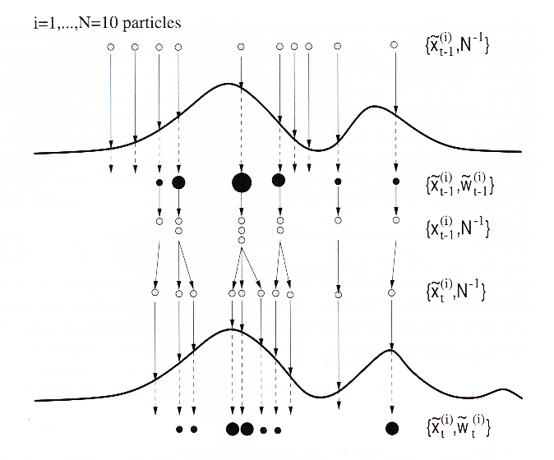
Visualization of Particle Filter
unweighted measure
compute importance weights ⇒ p(x_{t-1}|z_{1:t-1})
resampling
move particles
predict p(x_{t}|z_{1:t-1})

Slide 13
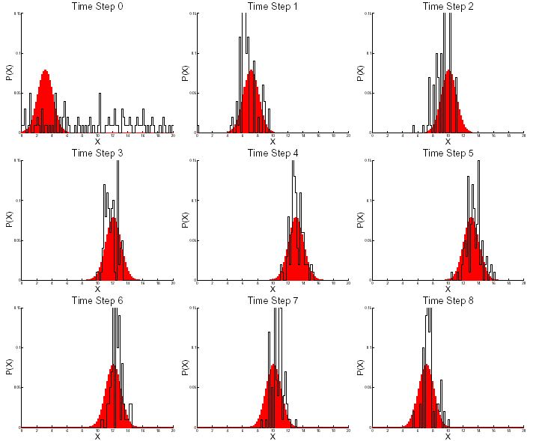
Particle Filter Demo 1
moving Gaussian + uniform, N=100 particles

Slide 14
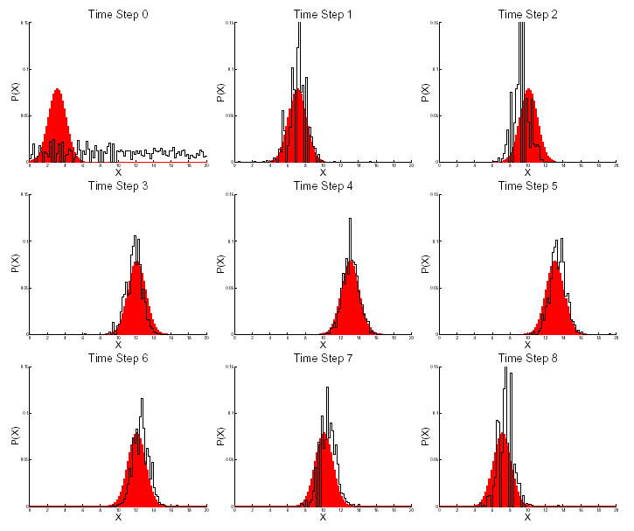
Particle Filter Demo 2
moving Gaussian + uniform, N=1000 particles

Slide 15
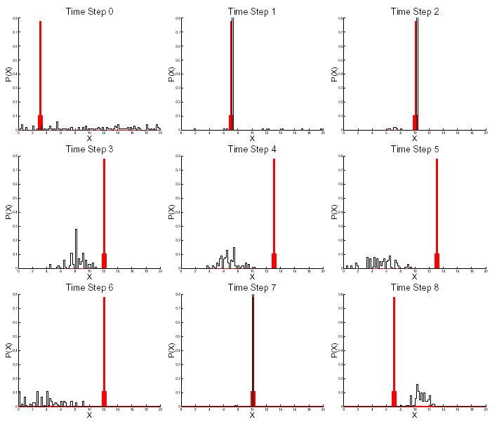
Particle Filter Demo 3
moving (sharp) Gaussian + uniform, N=100 particles

Slide 16
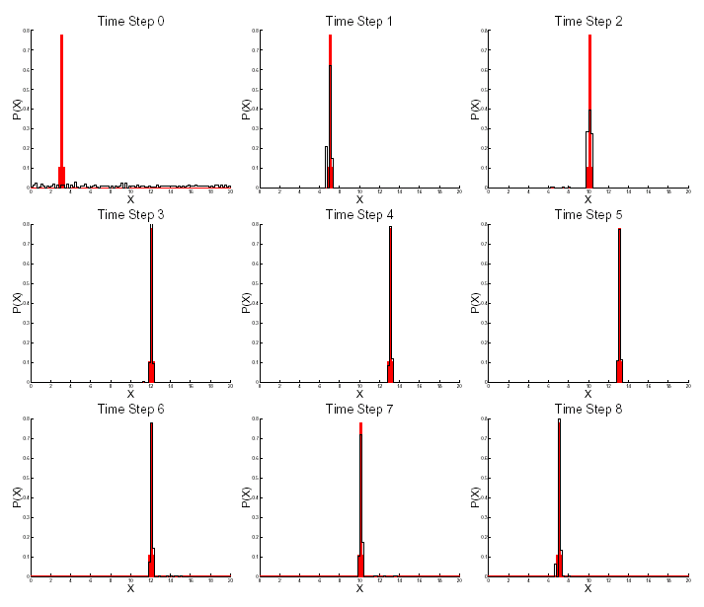
Particle Filter Demo 4
moving (sharp) Gaussian + uniform, N=1000 particles

Slide 17
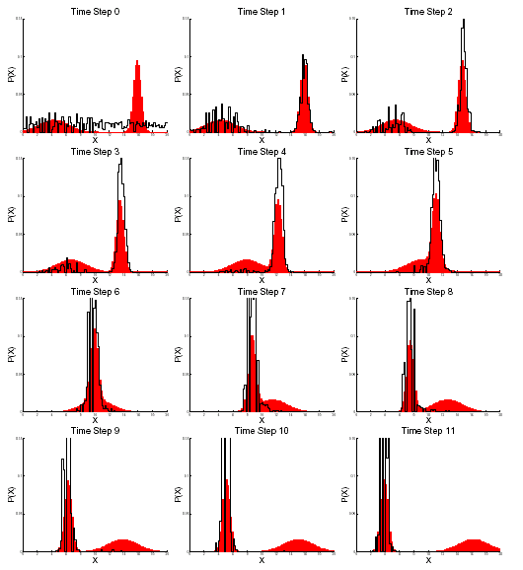
Particle Filter Demo 5
mixture of two Gaussians,
filter loses track of smaller and less pronounced peaks

Slide 18
Obtaining state estimates from particles
Any estimate of a function f(x_{t}) can be calculated by discrete PDF-approximation
Mean:
MAP-estimate: particle with largest weight
Robust mean: mean within window around MAP-estimate

Slide 19
Pros and Cons of Particle Filters
Estimation of full PDFs
Non-Gaussian distributions
e.g. multi-modal
Non-linear state and observation model
Parallelizable
Degeneracy problem
High number of particles needed
Computationally expensive
Linear-Gaussian assumption is often sufficient

Slide 20
Agenda
Problem Statement
Classical Approaches
Particle Filters
Theory
Algorithms
Applications

Slide 21
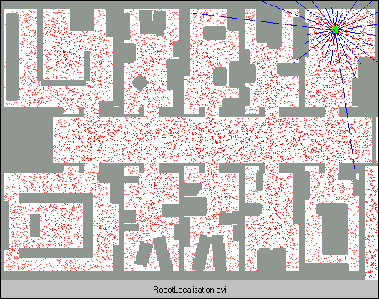
Mobile Robot Localization
Animation by Sebastian Thrun, Stanford
http://robots.stanford.edu

Slide 22
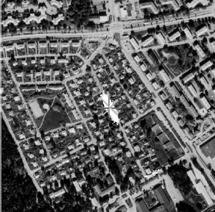
Positioning Systems¹
Track car position in given road map
Track car position from radio frequency measurements
Track aircraft position from estimated terrain elevation
Collision Avoidance (Prediction)
Replacement for GPS
1: Gustafsson, et.al.: Particle Filters for Positioning, Navigation and Tracking. IEEE Transactions on Signal Processing Vol. 50, 2002

Slide 23
Model Estimation
Tracking with multiple motion-models
Discrete hidden variable indicates active model (manoever)
Recovery of signal from noisy measurements
even if signal may be absent (e.g. synaptic currents)
mixture model of several hypotheses
Neural Network model selection [de Freitas]¹
estimate parameters and architecture of RBF network from input-output pairs
on-line classification (time-varying classes)
1: de Freitas, et.al.: Sequential Monte Carlo Methods for Neural Networks. in: Doucet, et.al.: Sequential Monte Carlo Methods in Practice, Springer Verlag, 2001

Slide 24
Other Applications
Visual Tracking
e.g. human motion (body parts)
Prediction of (financial) time series
e.g. mapping gold price → stock price
Quality control in semiconductor industry
Military applications
Target recognition from single or multiple images
Guidance of missiles

Slide 25
Possible Uses for our Group
Reinforcement Learning
POMDPs
Estimating Opponent States
RoboCup: Multi-robot localization and tracking
Representation of PDFs
Prediction Tasks
Preprocessing of Visual Input
Identifying Neural Network Layouts or other Hidden System Parameters
Applications in Computational Neuroscience (?)
Other suggestions?

Slide 26
References
Doucet, de Freitas, Gordon: Sequential Monte Carlo Methods in Practice, Springer Verlag, 2001
Arulampalam, Maskell, Gordon, Clapp: A Tutorial on Particle Filters for on-line Non-linear / Non-Gaussian Bayesian Tracking, IEEE Transactions on Signal Processing, Vol. 50, 2002

Slide 27

Thank you!

