Slide 1
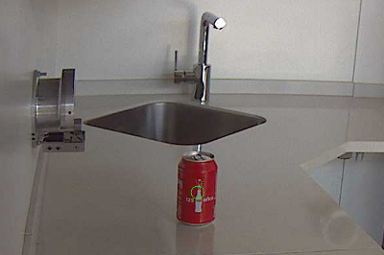
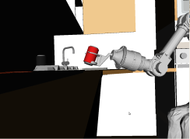
Device: remote_controlboard
Local: /local Remote: /ravebot
Device: controlboard
Name: /ravebot
/ravebot/x/rpc:o
/ravebot/x/rpc:i
findRedCan
grabRedCan
test_kdl
/redCan:o
/redCan:i

Slide 2
findRedCan
grabRedCan
test_kdl

