Slide 1

LEARN PROGRAMMING WITH
KELVIN
kelvindsmn@gmail.com

Slide 2
MATERIAL
In this course we will learn about the following concepts :
Conditional

Slide 3
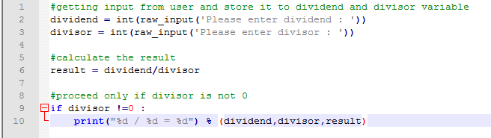
IF CONDITIONAL

Slide 4
CONDITIONAL STRUCTURE
if condition:
block
if condition:
Block
else:
Block
if condition:
Block
elif:
Block

Slide 5
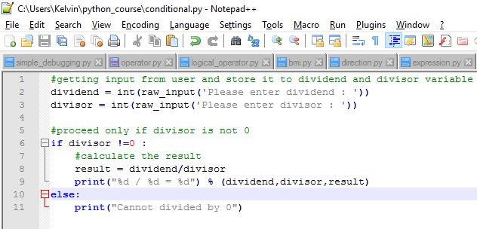
IF ELSE CONDITIONAL

Slide 6
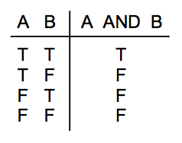
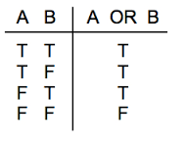
COMPOUND BOOLEAN EXPRESSION

Slide 7
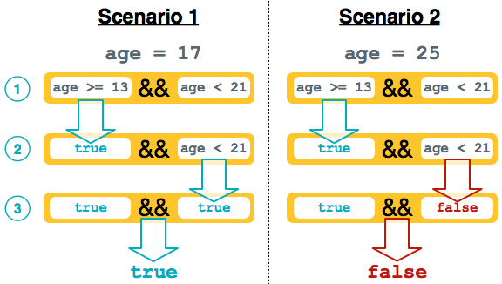
&& is same as AND
|| is same as OR
! is same as NOT

Slide 8
EXERCISE
Create a program that accept input as age and determine which category that their belongs infant, toddler, kids, teenager, adult and elder
CATEGORIES | RANGE
infant | 0 – 1 years old
Toddler | 1 – 6 years
Kids | 6 – 13 years
Teenager | 13 – 19 years
Adult | 19 – 50
Elder | > 50

