Slide 1
Sound Localization Using Microphone Arrays
Anish Chandak
achandak@cs.unc.edu
10/12/2006
COMP 790-072 Presentation
Notes:
Hello. Good Morning. I am Anish Chandak. Continuing on the series on how robots can use audible to do various tasks. Nikunj just talked about 1) What are the cues used by humans to localize sound. Apparently we can do much more than just localizing sound using our ears. We will see that in the end of the talk. 2) And we know some basics on how to build a robot which has two ears just like us. We want them to walk like us, see like and no wonder even hear like us.
Before I move on to having more than 2 years let us see what ppl have been able to do using binaural hearing techniques.

Slide 2
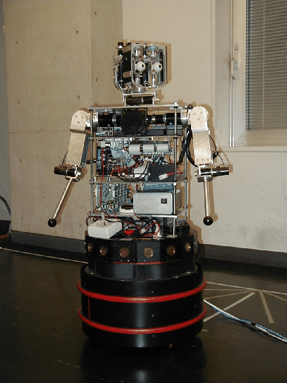
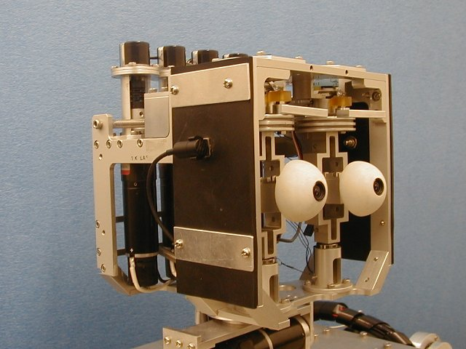
Robot ROBITA
Real World Oriented Bi-Modal Talking Agent (1998)
Uses two microphones to follow conversation between two people.
Notes:
The first in this series in Robot ROBITA. It uses two microphones and can follow conversations between two people. It has some basic capabilities of taking its turn to speak in the conversation but they are very limited.

Slide 3
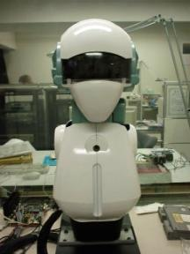
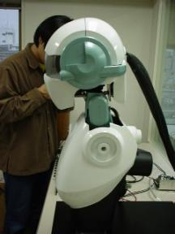
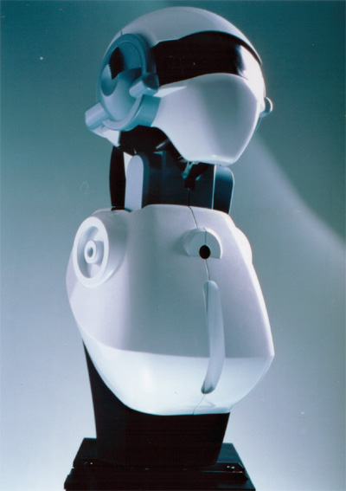
Humanoid SIG
(2002)
Notes:
This is robot Humanoid SIG. It can also localize listeners.

Slide 4
Steerable Microphone Arrays vs Human Ears
Difficult to use only a pair of sensors to match the hearing capabilities of humans.
The human hearing sense takes into account the acoustic shadow created by the head and the reflections of the sound by the two ridges running along the edges of the outer ears.
http://www.ipam.ucla.edu/programs/es2005/
Not necessary to limit robots to human like auditory senses.
Use more microphones to compensate high level of complexity of human auditory senses.
Notes:
So robots can localize sound with two ears then why move on to multiple microphones. Will be referred as microphone arrays from now on. A lot of laboratory scenarios are pretty much controlled. In real scenes there is noise, reverberations which make it difficult to localize sound with two microphones. Human Ears are much complicated and how processing of sound happens once it reaches inside is still an active area of research.
So it is difficult to take entirely into account the complexity of human ears just by two microphones. Therefore, we compensate high level complexity with introducing more microphones.

Slide 5
Outline
Genre of sound localization algorithms
Steered beamformer based locators
TDOA based locators
Robust sound source localization algorithm using microphone arrays
Results
Advanced topics
Conclusion
Notes:
Here is the outline of the presentation. We will first look into genre of sound localization algorithms using microphone arrays. Look at two more pre-dominant techniques. And then discuss one paper which does “Robust Sound Source Localization” and look some results and much more things that human ear can do followed by conculsion.

Slide 6
Existing Sound Source Localization Strategies
Based on Maximizing Steered Response Power (SRP) of a beamformer.
Techniques adopting high-resolution spectral estimation concepts.
Approaches employing Time Difference of Arrival (TDOA) information.
Notes:
1) Are based on moving the microphone array in a direction such as to maximize its power. Robust systems but not real time. 2) are based on some sort of eigen decompostion of the signal and using them to locate sound source. 3) Based on TDOA and are real-time.

Slide 7
Steered Beamformer Based Locaters
Background: Ideas borrowed from antenna array design & processing for RADAR.
Microphone array processing considerably more difficult than antenna array processing:
  narrowband radio signals versus broadband audio signals
  far-field (plane wavefronts) versus near-field (spherical wavefronts)
  pure-delay environment versus multi-path environment.
Basic Idea is to sum up the contribution of each microphone after appropriate filtering and look for a direction which maximize this sum.
Classification:
  fixed beamforming: data-independent, fixed filters f_{m}[k]
  e.g. delay-and-sum, weighted-sum, filter-and-sum
  adaptive beamforming: data-dependent, adaptive filters f_{m}[k]
  e.g. LCMV-beamformer, Generalized Sidelobe Canceller

Slide 8
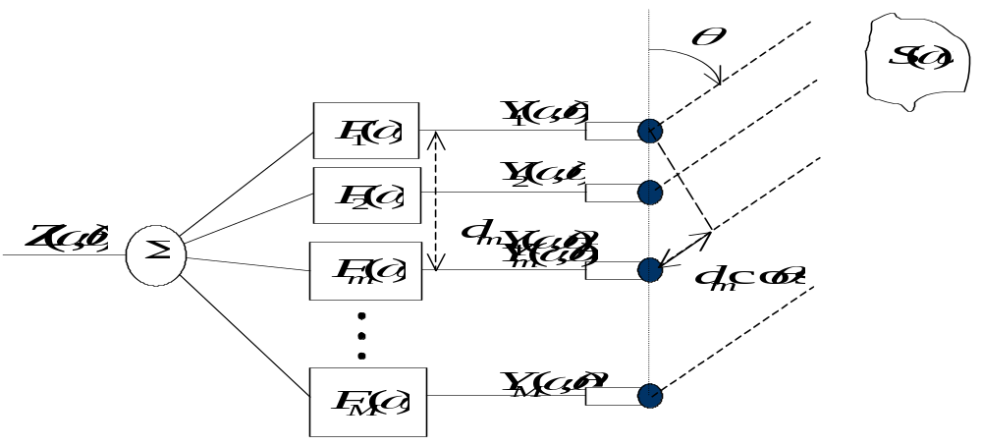
Beamforming Basics
Notes:
The ideas that will come through mostly spans signal processing and optimizations. I will work out some of the stuff on board and its pretty easy to follow. The basic idea is that since the microphones are at different spatial locations they receive different signal which help us get a directivity pattern.

Slide 9
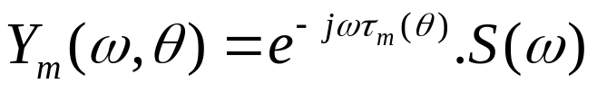
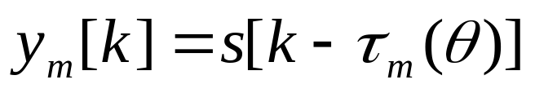
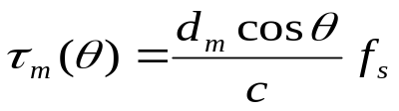


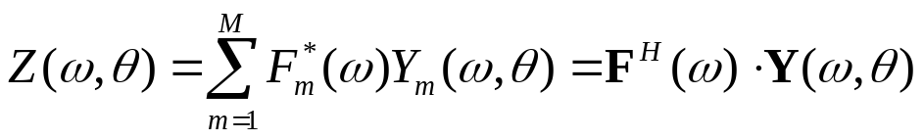
Beamforming Basics
Data model:
Microphone signals are delayed versions of S(ω)
Stack all microphone signals in a vector
d is `steering vector’
Output signal Z(ω,θ) is

Slide 10
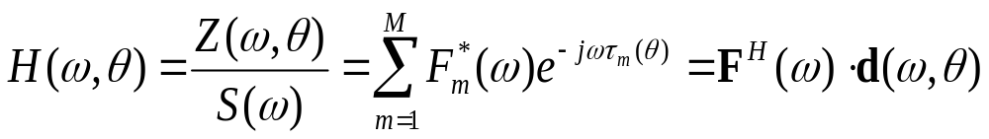
Beamforming Basics
Spatial directivity pattern: `transfer function’ for source at angle θ
Fixed Beamforming
  Delay-and-sum beamforming
  Weighted-sum beamforming
  Near-field beamforming
Notes:
I am putting down here only the equations for directivity pattern. Noise and other things are taken care by assuming some sort of noise model. The different kinds of beamformers differ in the kind of filters they apply to the signal at each microphone.

Slide 11
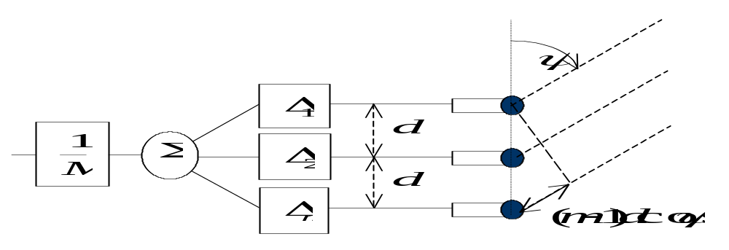
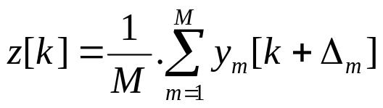
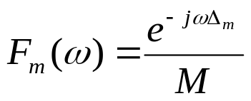
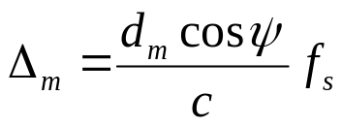
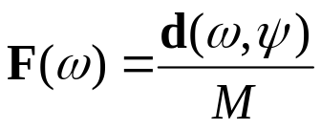



Delay-and-sum beamforming
Microphone signals are delayed and summed together
Array can be virtually steered to angle ψ
Angular selectivity is obtained, based on constructive
(for θ =ψ) and destructive (for θ !=ψ) interference
For θ =ψ, this is referred to as a `matched filter’ :
For uniform linear array :

Slide 12
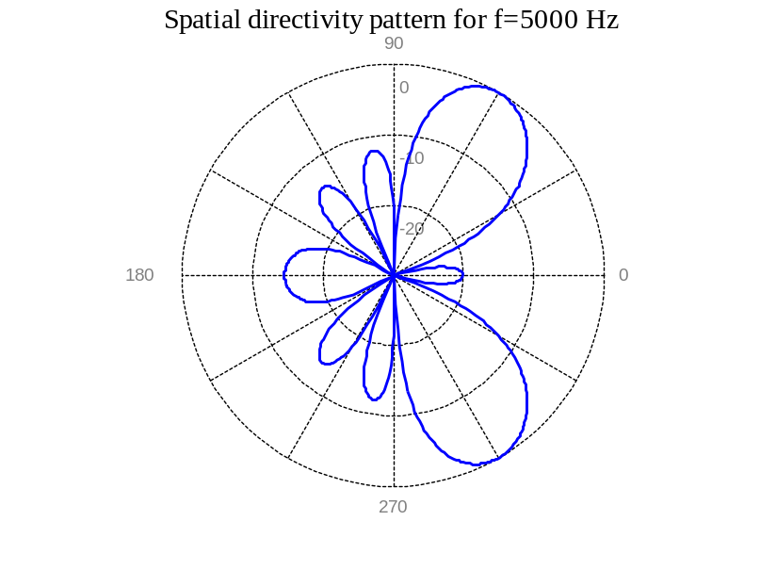
Delay-and-sum beamforming
M=5 microphones
d=3 cm inter-microphone distance
ψ=60° steering angle
fs=5 kHz sampling frequency

Slide 13
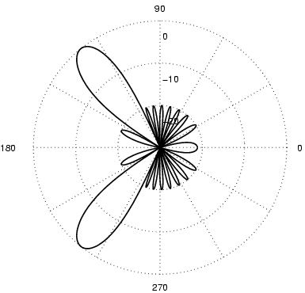
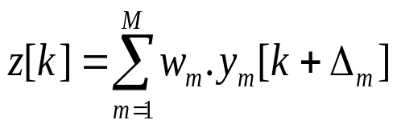
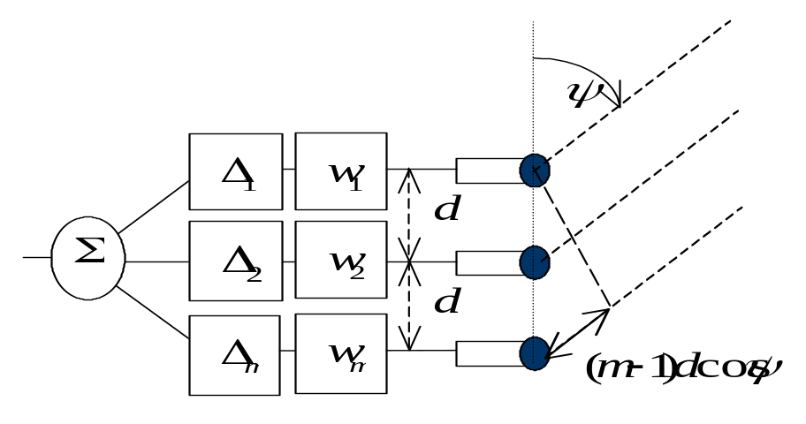
Weighted-Sum beamforming
Sensor-dependent complex weight + delay
Weights added to allow for better beam shaping
Notes:
Sensor dependent complex weights are introduced. Take into account individual microphone properties.

Slide 14

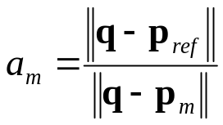
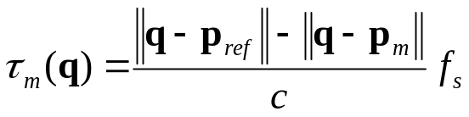
Near-field beamforming
Far-field assumptions not valid for sources close to microphone array
  spherical wavefronts instead of planar waveforms
  include attenuation of signals
  3 spherical coordinates θ,φ,r (=position q) instead of 1 coordinate θ
Different steering vector:
with q position of source
p_{ref} position of reference microphone
p_{m} position of m^{th} microphone
Notes:
The steering vector changes.

Slide 15
Advantages and Disadvantages
Can find the sound source location to very accurate positions.
Highly sensitive to initial position due to local maximas.
High computation requirements and is unsuitable for real time applications.
In presence of reverberant environments highly co-related signals therefore making estimation of noise infeasible.

Slide 16
TDOA Based Locators
Time Delay of Arrival based localization of sound sources.
Two-step method
  TDOA estimation of sound signals between two spatially separated microphones (TDE).
  Given array geometry and calculated TDOA estimate the 3D location of the source.
High Quality of TDE is crucial.
Notes:
We saw how ITD (Inter-Aural time difference) can be used to locate the source. TDOA based locaters use the same techniques. The time difference between two arrays is called TDE (time difference estimate). It is important to accurately calculate TDE.

Slide 17





Overview of TDOA technique
Multilateration or hyperbolic positioning
S
L
C
R
Q
Notes:
Consider a source S and four receivers.

Slide 18
Overview of TDOA technique
Multilateration or hyperbolic positioning
Three hyperboloids.
Intersection gives the source location.
Hyperbola = Locus of points where the difference in the distance to two fixed points is constant. (called Hyperboloid in 3D)

Slide 19
Perfect solution not possible
Accuracy depends on the following factors:
Geometry of receiver and transmitter.
Accuracy of the receiver system.
Uncertainties in the location of the receivers.
Synchronization of the receiver sites. Degrades with unknown propagation delays.
Bandwidth of the emitted pulses.
In general, N receivers, N-1 hyperboloids.
  Due to errors they won’t intersect.
  Need to perform some sort of optimization on minimizing the error.
Notes:
Assuming that we have the minimum possible errors due to geometry and other things estimating accurate TDE is the biggest concern.

Slide 20
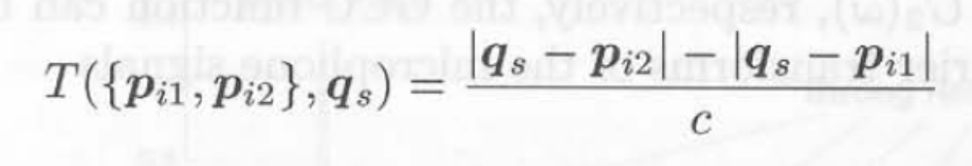
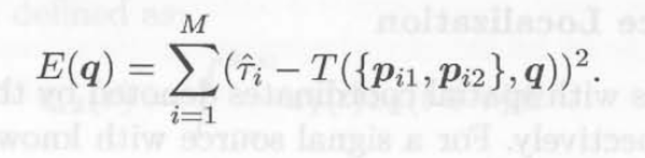
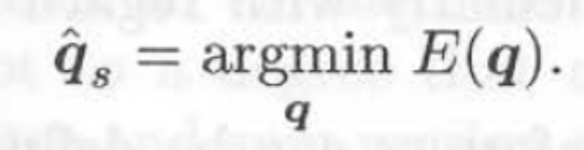
ML TDOA-Based Source Localization

Slide 21
Robust Sound Source Localization Algorithm using Microphone Arrays
A robust technique to do compute TDE.
Give a simple solution for far-field sound sources (which can be extended for near-field).
Some results.

Slide 22

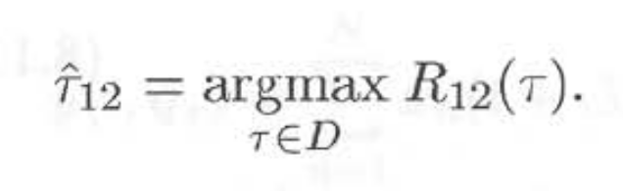
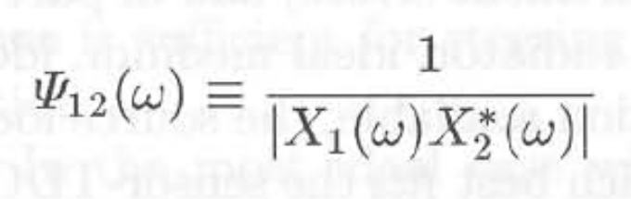
Calculating TDE
Generalized Cross Co-Relation
PHAT Weighting
Notes:
One way to find TDE is cross co-relation between the two signals received at receiver X1 and X2. Various weighting functions can be used. Most popularly used ones is PHAT weighting. Each frequency component has equal weight.

Slide 23
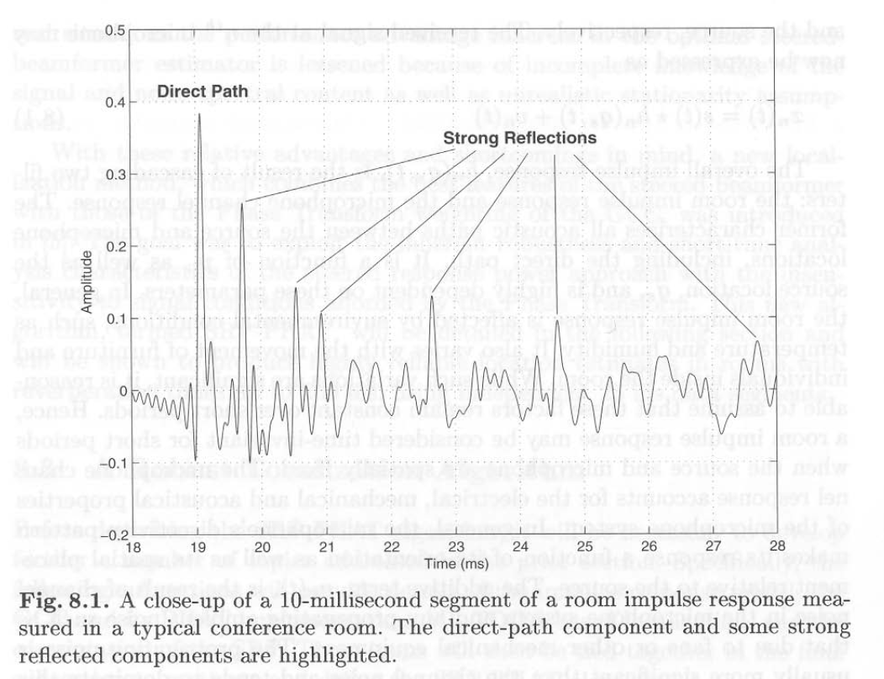
Co-Relation & Reverberations
Notes:
However in case of reverberations the reflected signals are highly co-related with the each other.

Slide 24
Robust technique to compute TDE
There are N(=8) microphones.
ΔT_{ij} = TDOA between microphone i and j.
Possible to compute N.(N-1)/2 cross-correlation of which N-1 are independent.
ΔT_{ij} = ΔT_{1j} – ΔT_{1i}
  Sources are valid only if the above equation holds. (7 independent, 21 constraint equations).
  Extract M highest peaks in each cross-correlation.
  In case more than one set of ΔT_{1i} respects all constraint pick the one with maximum CCR.

Slide 25
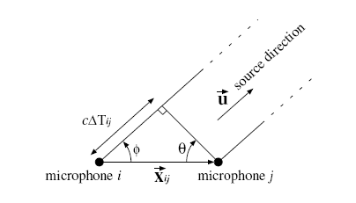
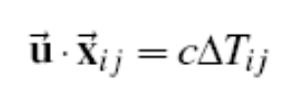
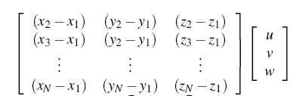
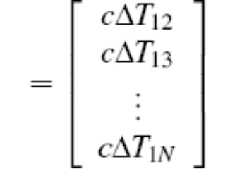
Position Estimation
Far-field sound source

Slide 26
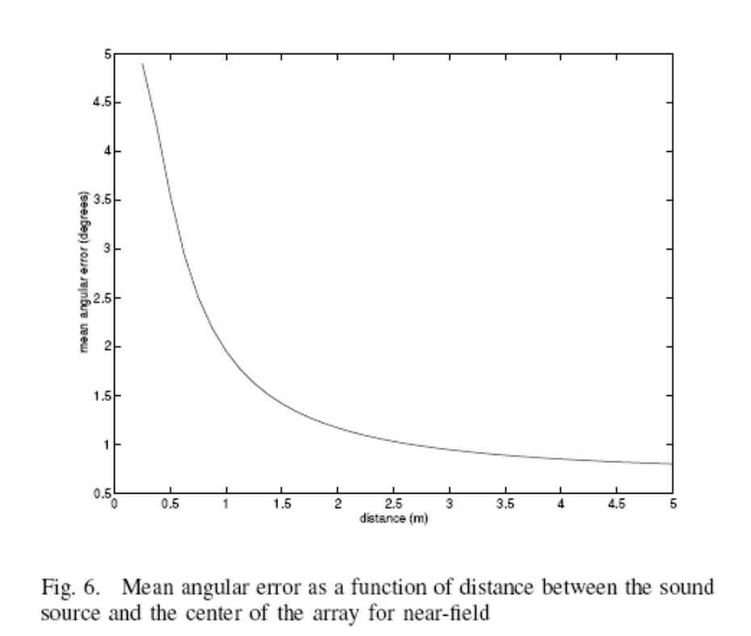
Results
Result showing mean angular error as a function of distance between sound source and the center of array.
Works in real time on a desktop computer.
Source is not a point source.
Large Bandwidth signals.

Slide 27
Advantages and Disadvantages
Computationally undemanding. Suitable for real time applications.
Works poorly in scenarios with
  multiple simultaneous talkers.
  excessive ambient noise.
  moderate reverberation levels.

Slide 28
Advanced Topics
Localization of Multiple Sound Sources.
Finding Distance of a Sound Source.
“Cocktail-party effect”
  How do we recognize what one person is saying when others are speaking at the same time.
  Such behavior is seen in human beings as shown in “Some Experiments on Recognition of Speech, with One and with Two Ears”, E. Colin Cherry, 1953.
Notes:
It makes use of the "Cocktail Party Effect", which means humans can listen to several audio streams simultaneously, and selectively focus on the one that is of interest, and tune the rest into the background.

Slide 29
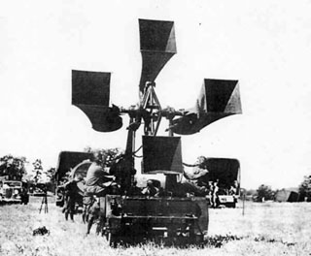
Passive Acoustic Locator
1935
Notes:
This huge systems were used during WW1 and between WW1 and WW2 for detection of aircrafts by picking up their noise. Scaled up version of ears?

Slide 30
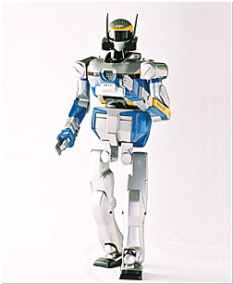
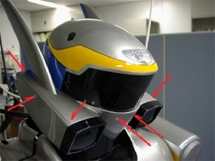
Humanoid Robot HRP-2
ICRA 2004
Notes:
This is humanoid Robot HRP-2. It was presented in ICRA 2004. Latest in series of humanoids. No videos on sound localization available though.

Slide 31
Conclusion
Use TDOA techniques for real time applications.
Use Steered-Beamformer strategies in critical applications where robustness is important.

Slide 32
Questions?

Slide 33
References
M. S. Brandstein, "A framework for speech source localization using sensor arrays," Ph.D. dissertation, Div. Eng., Brown Univ., Providence, RI, 1995.
Michael Brandstein (Editor), Darren Ward (Editor), “Microphone Arrays: Signal Processing Techniques and Applications”
E. C. Cherry, "Some experiments on the recognition of speech, with one and with two ears," Journal of Acoustic Society of America, vol. 25, pp. 975--979, 1953.
Wolfgang Herbordt (Author), “Sound Capture for Human / Machine Interfaces: Practical Aspects of Microphone Array Signal Processing”
Jean-Marc Valin, François Michaud, Jean Rouat, Dominic Létourneau, “Robust Sound Source Localization Using a Microphone Array on a Mobile Robot (2003)”, Proceedings International Conference on Intelligent Robots and Systems.

