Slide 1
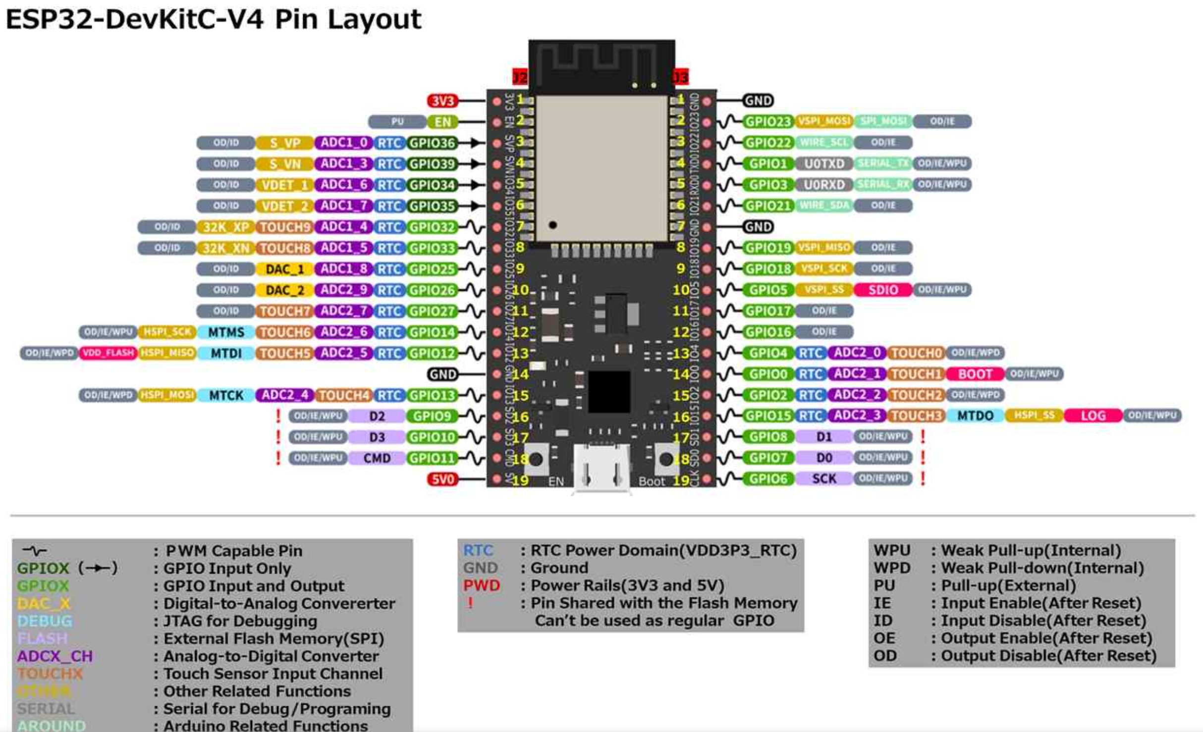
Multiplx[3]
Upper[0]
Multiplx[2]
Lower[0]
Serial
Upper[1]
Serial
Lower[1]
Multiplx[1]
Upper[2]
Lower[2]
Multiplx[0]
PWM for NeoPixel
PWM for audio
Upper[3]
Lower[6]
Lower[3]
Upper[6]
Upper[4]
Lower[5]
Lower[4]
Upper[5]

