Slide 1


Knowledge and Information Engineering
Assignment 2 Presentation by Team 4

Slide 2
Knowledge and Information Engineering
Team 4

Slide 3
Team Member
Winny
Junrong
Linus
James
Jordan Lim Jun Hong (8495816)

Slide 4
Part A

Slide 5

Why PowerBI?
User–Friendly Interface
Data visualizations capabilities
Supports a wide range of databases
Sharing and collaboration
Contains built-in data transformation tool
(Power Query)
Notes:
User–Friendly Interface
- drag and drop interface
- shallow learning curve as compared to others such as RStudio
- Excel like experience
Data visualization capabilities
- Built in visuals like bar charts, line graphs, scatter plot diagrams, pie charts etc
Supports a wide range of databases
- Able to connect to data sources such as csv, Excel workbook at the click of a button
Sharing and collaboration
- Dashboards and reports can be created to share and collaborate with people
Contains built-in data transformation tool
(Power Query)
- Extremely convenient and powerful when it comes to data preparation and cleaning which takes up a lot of time
- examples: changing data types, unpivoting/pivoting columns, combining data from multiple sources etc

Slide 6
Data Preparation/Cleaning

Slide 7
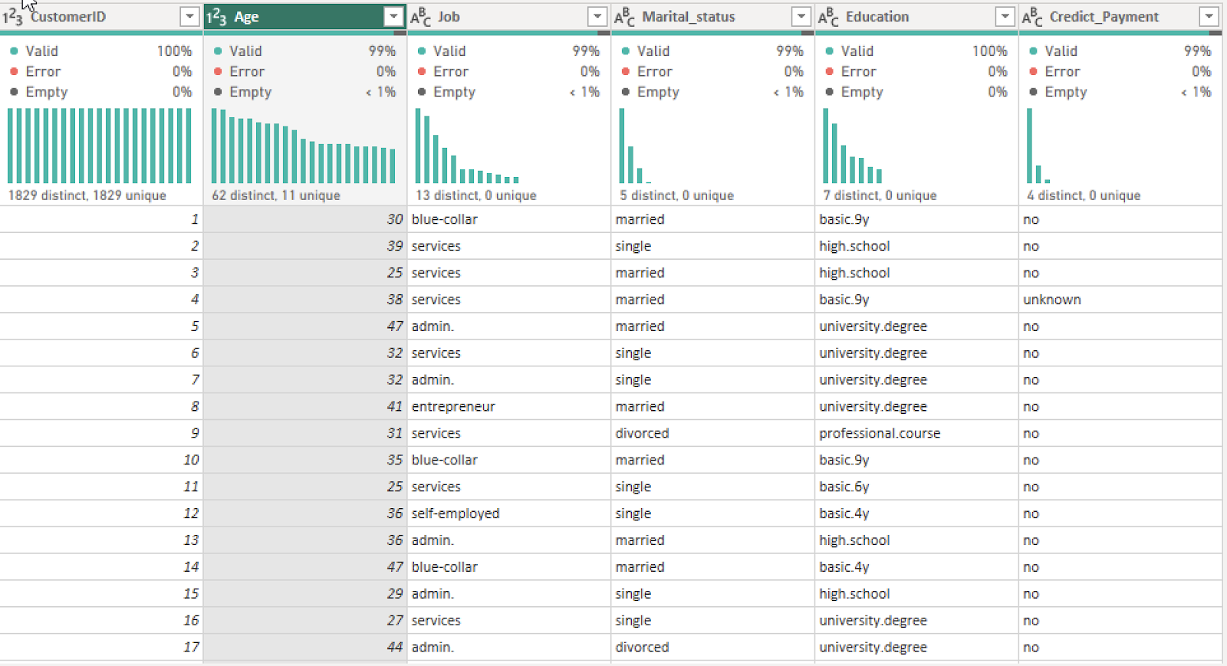
Profile
  Rows with empty values removed
  Invalid values e.g. Age:0 are also removed

Slide 8
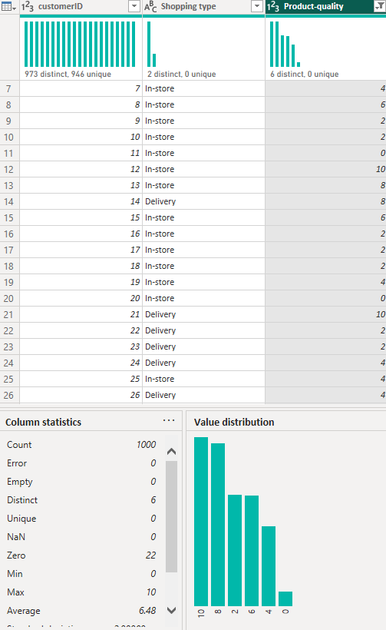
Survey (Product quality)
Rows with empty values removed
Invalid values such as 424823487 and 8218012 removed

Slide 9
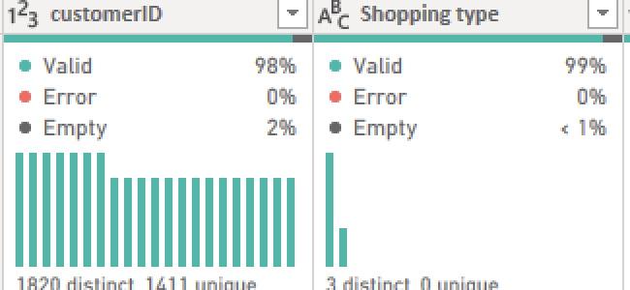
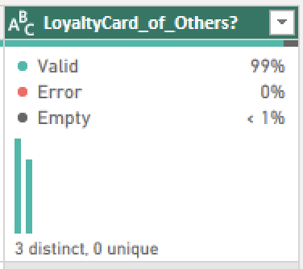
Survey(customerID, Shopping type and LoyaltyCard_of_Others?)
Rows with empty values removed

Slide 10
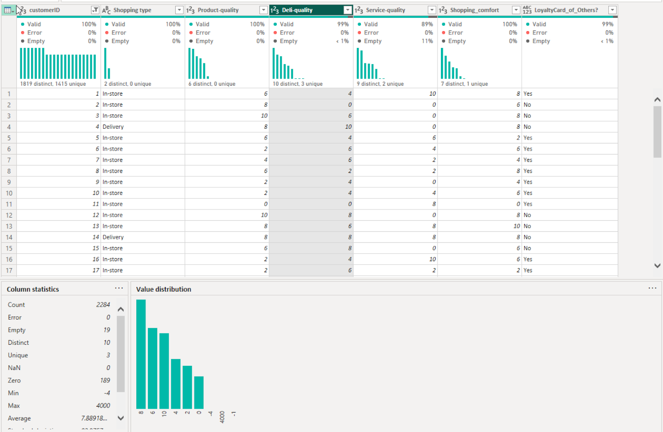
Survey (Deli-quality)
Rows with empty values removed
Invalid values such as -4, 4000, -1

Slide 11
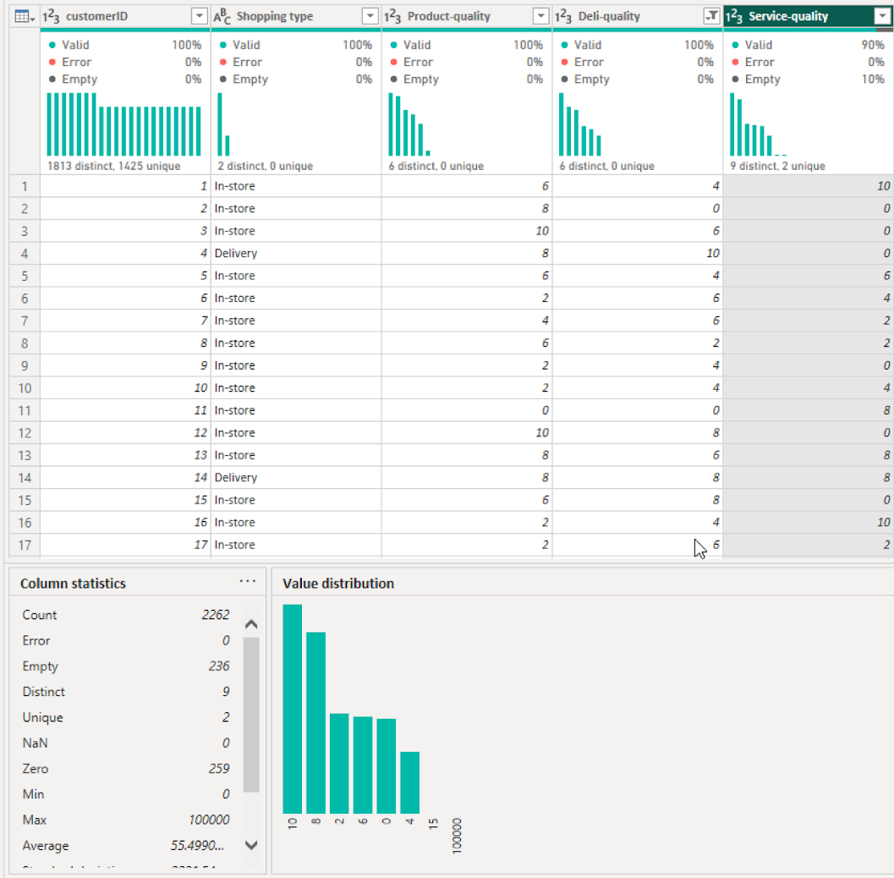
Survey (Service-quality)
Invalid values such as 15,10 000 removed
Rows with empty values are instead replaced with an average value of 6

Slide 12
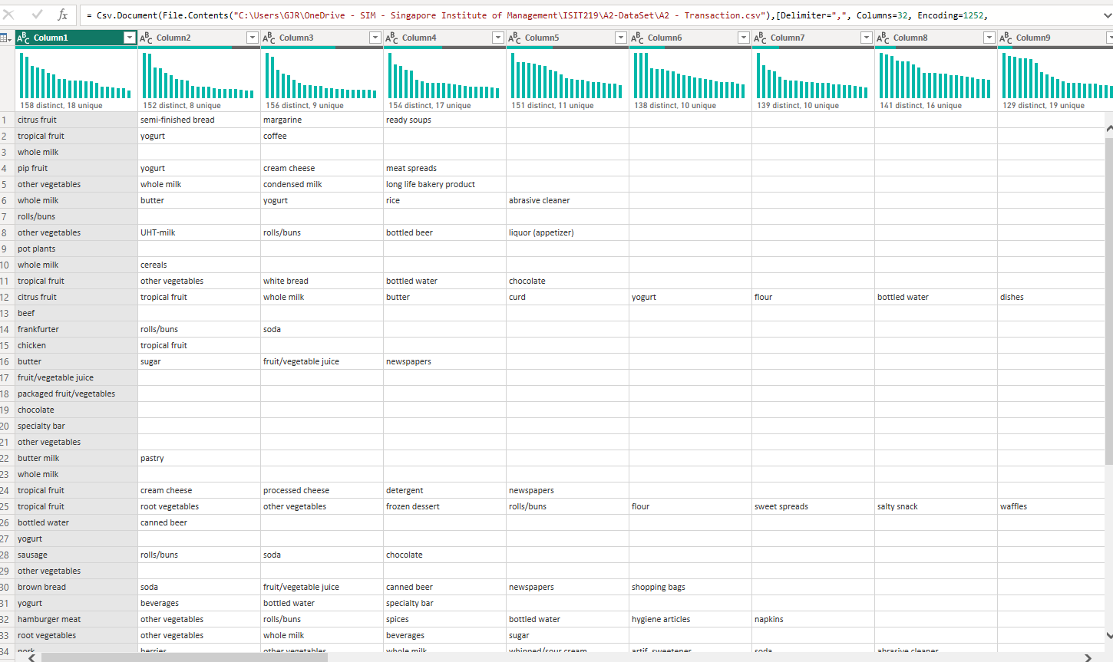
Transaction (overview)

Slide 13
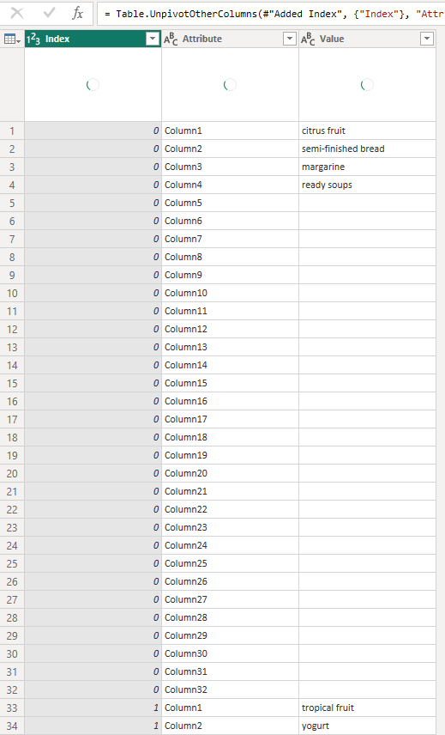
Transaction (overview)
Index column generated to generate TransactionID
Columns are unpivoted

Slide 14
Data Analysis

Slide 15
Survey Analysis
Classification technique used prelabeled groupings and decision tree.
Why Classification?
The following 2 patterns were derived:
In-store shopping vs Delivery preference
Satisfaction levels and how it relates to whether customers own loyalty card of others
Notes:
For the analysis of the Survey dataset, the classification technique for knowledge creation was applied. The predefined groups that were used to classify the data were based on the age demographics of the survey participants of the following: Generation Z (18-28), Millennials (29-43), Generation X (44-59) and lastly Baby Boomers (>60).
Classification was used in this scenario in order to understand how the different age groups of our customers prefer to shop.
Decision tree was used to determine whether customers owned loyalty cards of others based on their overall satisfaction
The following 2 patterns were derived:
Most participants did In-store shopping despite delivery having higher average ratings
Customers who were satisfied generally do not own loyalty card of others

Slide 16

Notes:
Highlight the ratings between the shopping types

Slide 18
Transaction Analysis
Association Rule Mining (Market Basket Analysis) and Clustering technique used
Why were the 2 methods chosen ?
The following 2 knowledge were derived:
Item that were bought together
Identifying the outlier
Notes:
Market Basket Analysis is widely used in the retail industry to uncover and understand consumer purchasing patterns. MBA unveils many opportunities for cross-selling, product placements, inventory management etc for business owners making it a crucial aspect of data analysis
After MBA was done, clustering was used to group the products into similar areas highlighting how strong the relationship in the product is.
The following 2 knowledge were derived:
Items under the same broad category eg (sweets, meats, vegetables) tend to bought together frequently
Some items that were often purchased together were hard to explain eg Detergent - Beef

Slide 20
Profile Analysis
Classification using decision tree used & association analysis using heatmap
Why was Decision Tree and Heatmap used ?
The following knowledge was derived:
  Majority don’t pay using credit card regardless of their backgrounds
Notes:
Decision tree was used as it allows to filter across multiple different categories to determine the final leaf node which in this case was whether credit payment was used. This allows us to understand the preferred payment methods of customers across their different factors.
Heatmap was used to measure the relationship of two factors on a given outcome (credit card payment)
The following 2 knowledge were derived:
Most do not use credit card payment when it comes to purchases being done, illustrating a preference for alternative forms of payment such as cash/debit
Across all the different customer segments, there was not an instance where credit card payment was in the majority even among those who were more educated and held higher paying jobs

Slide 23
Recommendations
Enhancing In-store Shopping Experience
Having Promotions for Delivery
Optimising Product Placements and Bundles
Credit Card Related Benefits
Removing items that are not commonly sold
Notes:
Enhancing In-store Shopping Experience
Since majority of customers still prefer shopping physically, more can be done in terms of improving overall experience of the customer
For instance, better customer service, shorten wait times for checkouts, having a wider selection of deli etc
Having Promotions for Delivery
As those who have tried delivery services are quite satisfied with it, more can be done to attract attention to it and get more customers to use it
Optimising Product Placements and Bundles
Using the information obtained from Transaction analysis, items purchased together can be placed nearer to each other or bundled up as a promotion
Credit Card Related Benefits
Getting customers to engage in using their credit card for payment can result in greater spending leading to more cash flow for the business
Hence, having benefits tied to credit cards may entice customers more to switch over to credit form of payment
Removing items that are not commonly sold
By doing so, the supermarket get to free up more inventory space for other more popular products, reducing shelf time of such products.

Slide 24
Part B

Slide 25
Background
Rapid growth in smart home technology adoption
Users increasingly depend on interconnected devices:
  Smart lighting,
  Smart air-conditioning,
  Security systems,
  Smart voice assistants and etc

Slide 26

Our Problem Domain
Common issues that user faces:
  User lack of technical knowledge to diagnose and fix device malfunctions efficiently
  Existing support resources are fragmented, inconsistent, or difficult to navigate
  Troubleshooting methods vary across different brands and device types

Slide 27
Our Aim
Assist non-technical home users in identifying and solving common problems with their smart devices, in order to improve reliability, convenience, and user satisfaction in smart home environments.

Slide 28
System Goal
Diagnosis Accuracy
  Correct identification of issues and solutions
User Satisfaction
  Users can resolve problems using the system
Device & Issue Coverage
  Supports a wide range of devices and common problems

Slide 29
ES-Builder Diagram
Our ES-Builder

