Slide 1
Movement
By Crystal Hess
http://csed.fun

Slide 2
Learning Goals
Practice reading and then modifying code that you didn’t write
Use variables to store and manipulate an object’s position
Use conditionals to control when actions can and cannot occur

Slide 3
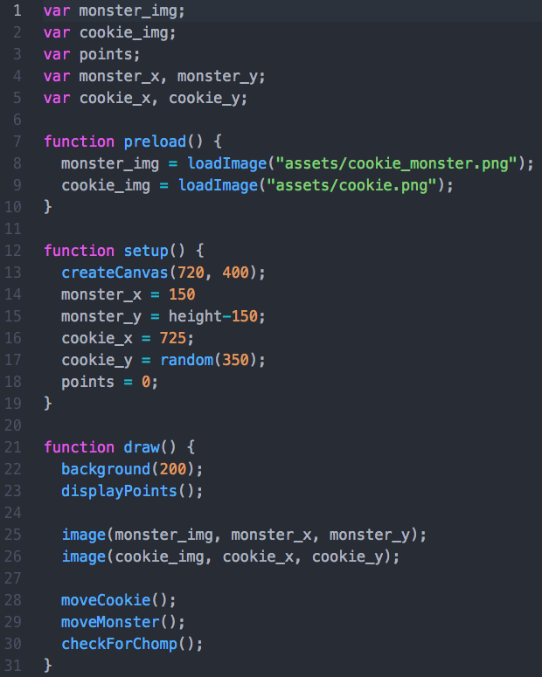
A look at the starter code
Don’t run the code yet! Just read it!
Lines 1-5: do you know what each of these variables will represent?
Lines 7-10: where can you find these images in your documents?
Lines 12-18: draw a loose sketch of that the setup of the canvas will look like.
Lines 21-31: explain in your own words what happens during each iteration of the draw() loop.

Slide 4
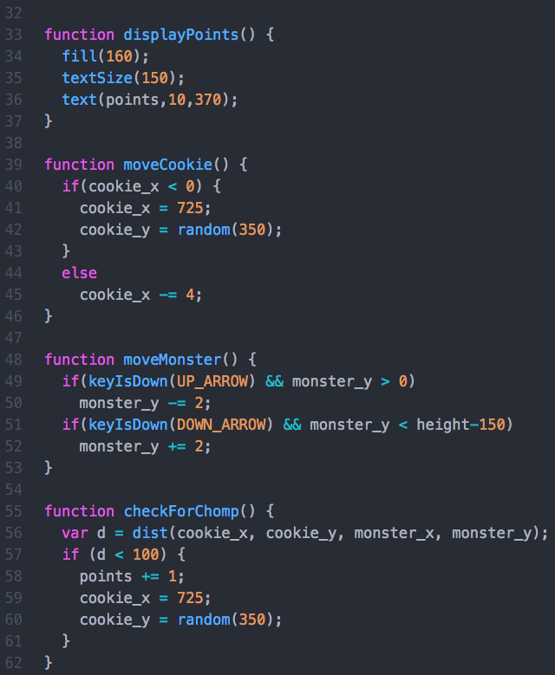
A look at the starter code
Lines 33-36: where do you expect to see the points displayed on the screen?
Lines 39-46: in which direction will the cookie move?
What happens when/if the cookie moves off screen? How does the program know the cookie has moved off screen?
Lines 48-53: How and when does the monster move?
Lines 55-62: When does a chomp occur? What happens when there’s a chomp?

Slide 5
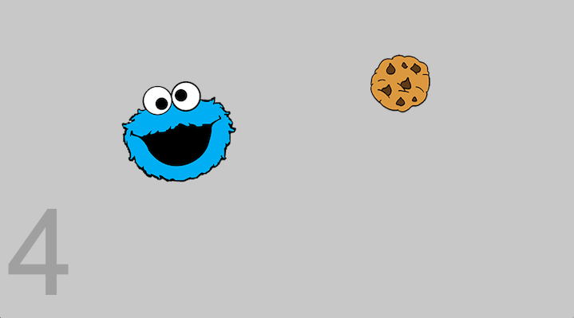
Ok, now run the code...

Slide 6
Features to add (with a pair)
Track the number of cookies that are missed and end the game after 3 misses
Decide: how do you want to track misses? With a number or with a string?
Decide: do you want to display the number of misses on the screen? How?
Decide: how are you going to end the game? Place a big message blocking the screen?
Added Fun
Decide: do you want the game to be able to be restarted? How would this work?
Add a piece of pie and a piece of cake that randomly appear and move on the screen to be eaten. Make it so that eating the pie or cake count as a miss.
Decide: what do you want the images to look like? Where do you need to save them?
Decide: how fast do you want the pie and cake move?
Decide: do you want it to be possible for all three items to appear at the same time? Or do you want them to appear one at a time?
Added Fun
Decide: how can you prevent the food items from overlapping each other?

Slide 7
Fun Extensions
Give Cookie Monster the ability to move in any direction, but not off the screen
Make the cookies speed up every time you catch one
…Come up with your own!

