Slide 1
Meet Edison
By Crystal Hess
http://csed.fun

Slide 2
Learning Goals

Slide 3
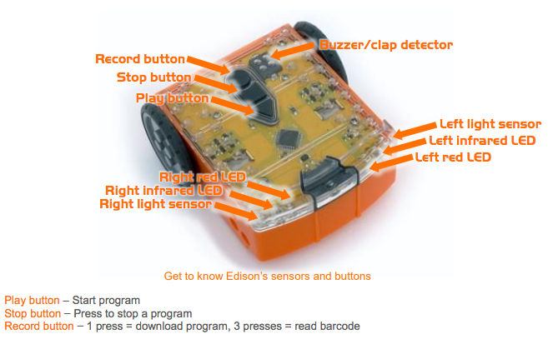
Getting started with Edison
Edison is a robot that you can program with block programming or the programming language Python
It comes equipped with sensors, outputs, and motors
We download programs onto Edison using sound, kind of like an old school modem ☺

Slide 4
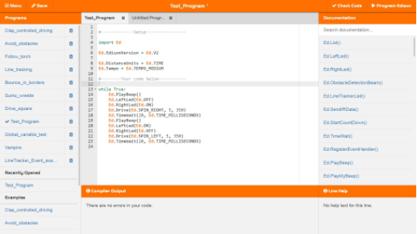
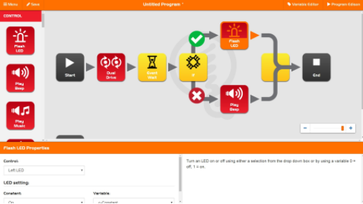
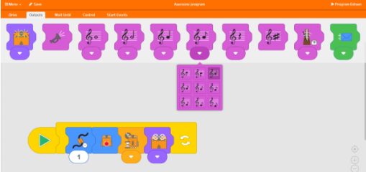
Programming Options
Program Edison using Python with the EdPy web-based IDE
www.edpyapp.com/
Program Edison using a visual block programming language
www.edblocksapp.com
Program Edison using a hybrid graphical and text-based program
www.edwareapp.com

Slide 5
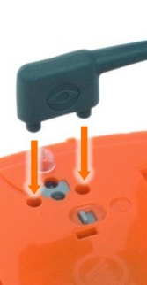
Downloading a Test Program
Go to www.edpyapp.com
Open the Example called Test_Program
Plug in the EdComm cable to the headphone socket
Make sure your computer sound is all the way on and up
Click on the button to ✔️Check Code
Make sure Edison is on, and push the ⚫ on Edison to Record a new program
Click on the button to ▶ Program Edison
You should hear some sounds followed, which will then stop
Disconnect the EdComm cable, and push the ▲ on Edison to start the program
Push the ◼️ on Edison to stop the program

