Slide 1
Artificial Intelligence

Slide 2
What is Intelligence?
What are the indicators?

Slide 3
What is Intelligence?
Quantity of information?
Speed of processing?
Are any computers intelligent yet?
Are all people intelligent?

Slide 4
AI Examples
Game Playing
Robot Control
Problem Solving
Machine Vision
Natural Language Processing
Intelligent Tutoring Systems
These days, it’s basically applied machine learning

Slide 5
Game Playing
Checkers
Chess
Go
Why games?
What does it mean for a game to be “solved”?
What games will AI not be able to solve anytime soon?

Slide 6
What IS a Problem?
How do we go about solving a problem?

Slide 7
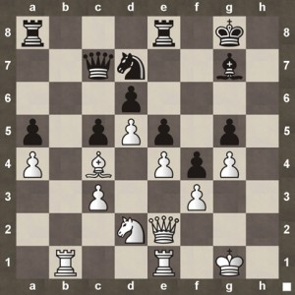
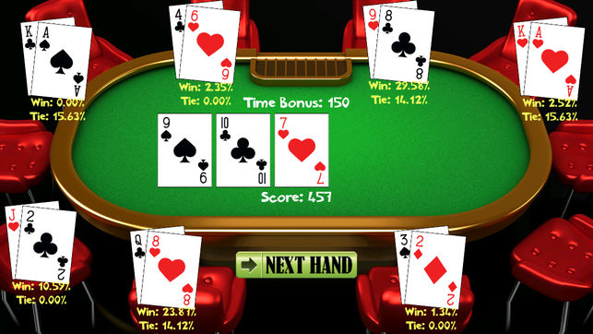
States
Independent, complete representation of a situation/problem
Picture of a game board
Save file for a video game
Other examples?

Slide 8
State Space
A problem can have any number of states
Actions change one state into another
This web of states and connections forms the state space
Somewhere in the state space are “desirable” states
Goal states

Slide 9
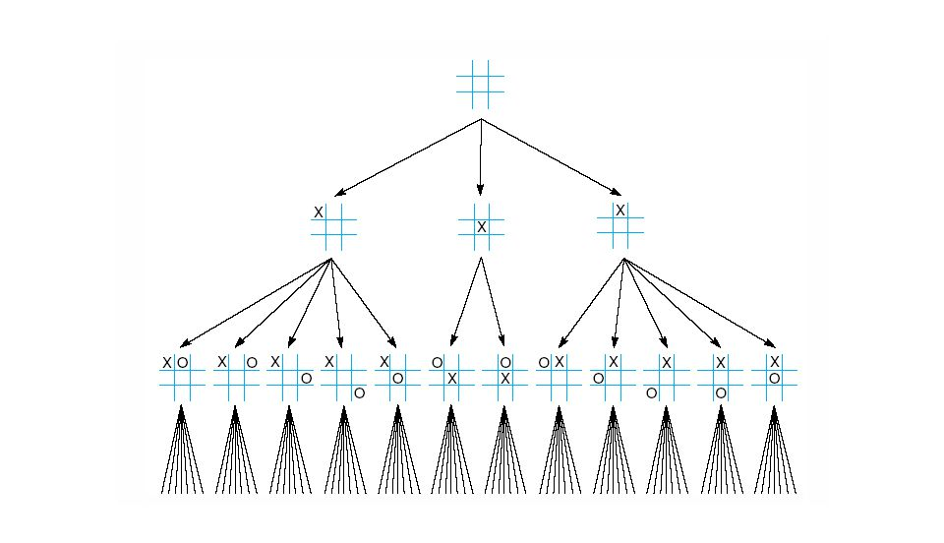
Tic-Tac-Toe State Space

Slide 10
Search Methods
Now solving a problem simply means navigating the state space
How do we do that?
Blind Search
Demo

Slide 11
Get Smarter - Heuristics
Blind search kinda sucks
Let’s guess how far the solution is from a given state
Heuristic
In the maze: distance to the exit
A* Search

Slide 12
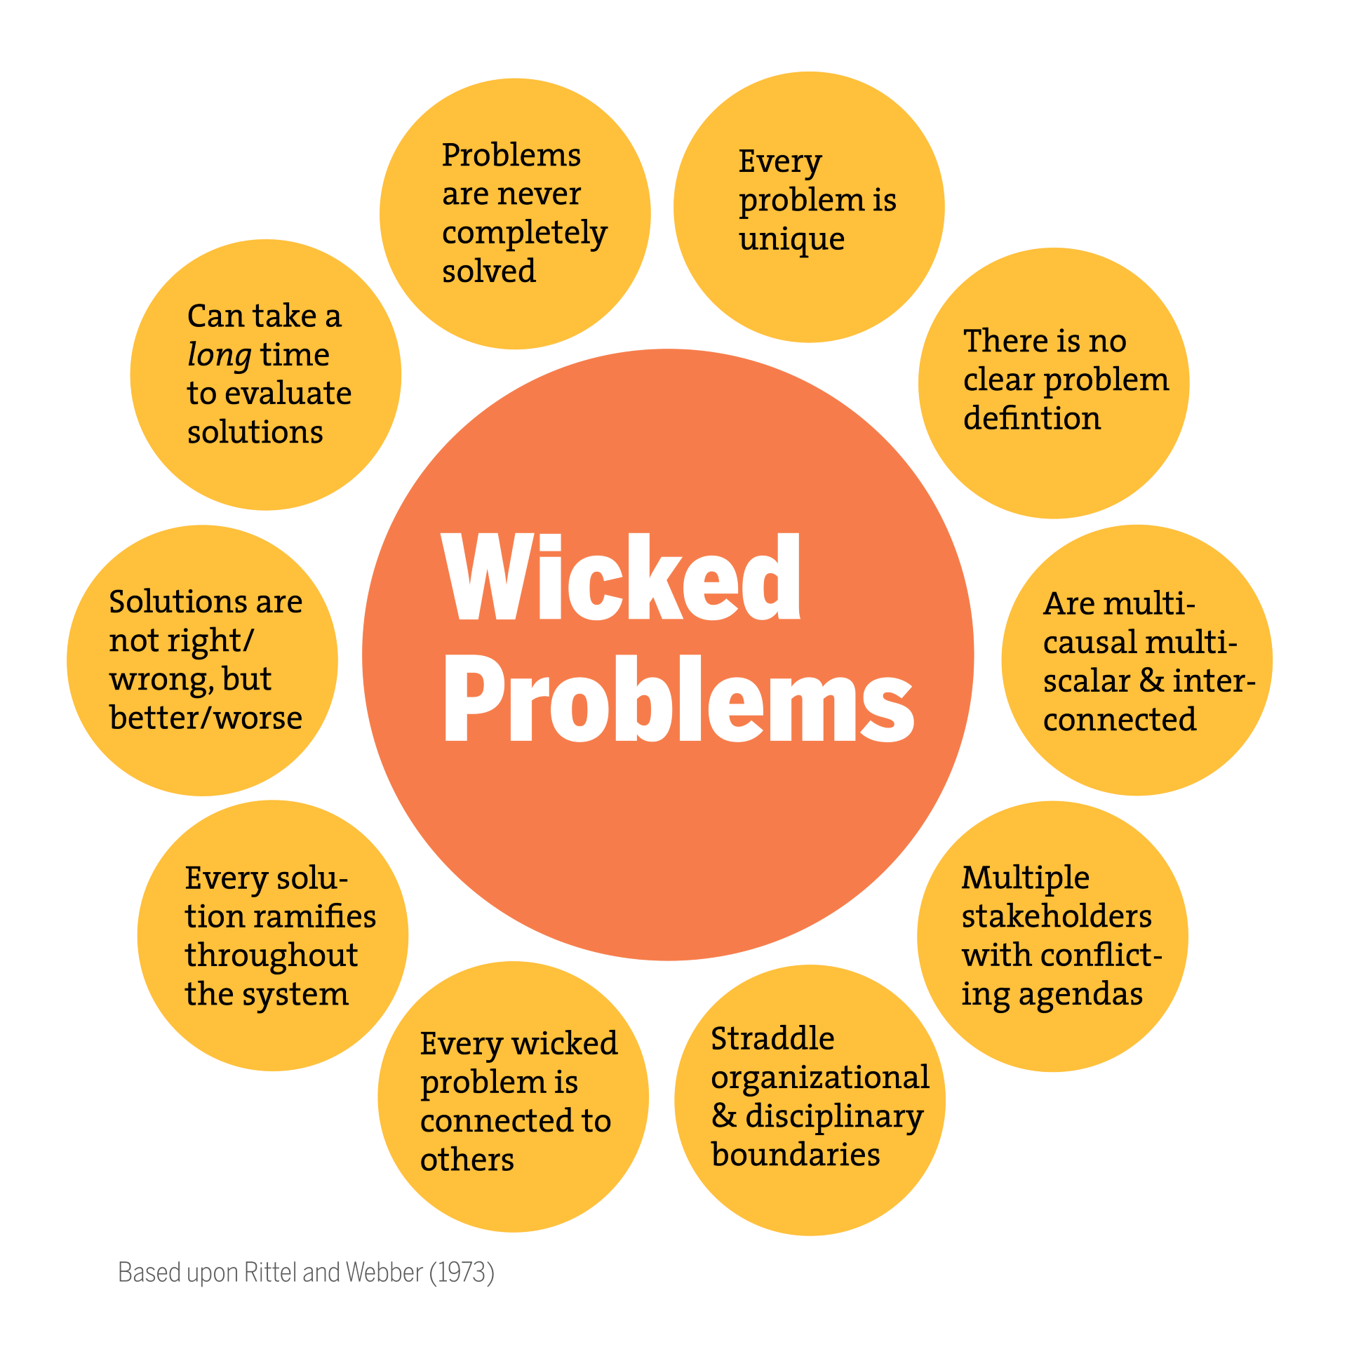
When This Breaks Down - Wicked Problems
What if we can’t know
the state, or our
actions, or what a
goal state looks like?
Unfortunately, most
modern problems are
this

Slide 13
Robot Control
Robots can’t know everything in advance
No knowledge of state space
Reinforcement Learning
Develop behaviors evolutionarily, not through pre-programmed routines
Sometimes lots of error

Slide 14
Computer Vision
Text Recognition
Facial Recognition
Automated Driving
Medical Imagery
Face Construction/Recreation
3D Model Reconstruction

Slide 15
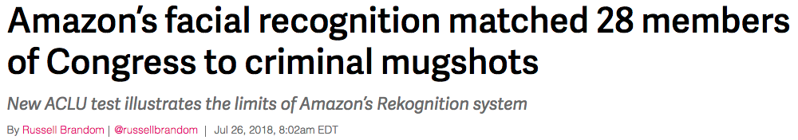
AI Bias
AI are NOT unbiased, they are exactly as biased as the people that make them
“11 of the 28 false matches misidentified people of color (roughly 39 percent), . Only twenty percent of current members of Congress are people of color, which indicates that false-match rates affected members of color at a significantly higher rate.”

Slide 16
Intelligent Tutoring Systems
Observe student behavior to create profile
Assess how a student is progressing
Adapt material to suit student’s needs
Model student engagement and frustration to maintain focus
Yep, Watson is here too

Slide 17
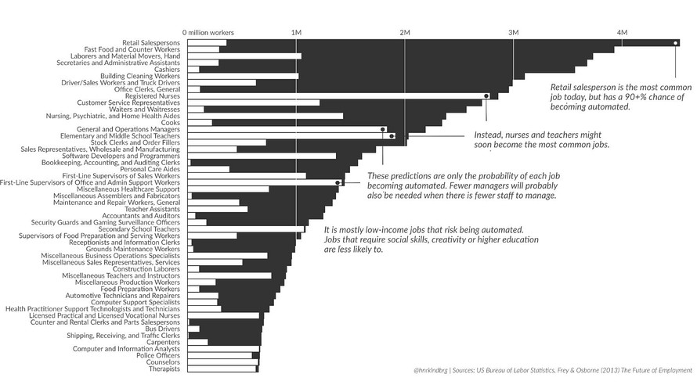
Automation

Slide 18
Bug Rob about (appropriate) stuff Whenever you want!
robthomp@uw.edu

