Slide 1
Machine Learning with Perceptrons

Slide 2
Machine Learning
Using statistical methods to make computers “learn” to do tasks when given example data. The methods improve the more example data is given.

Slide 3
Some Vocab
Classification
Taking unknown input and assigning it to one or more known classes of data
What ML is trying to do most of the time
Feature
A subset of a data point with all the “good” data
Training
Giving the ML algorithm example data to improve the classifier
Testing
Using different data from training to assess the classifier

Slide 4
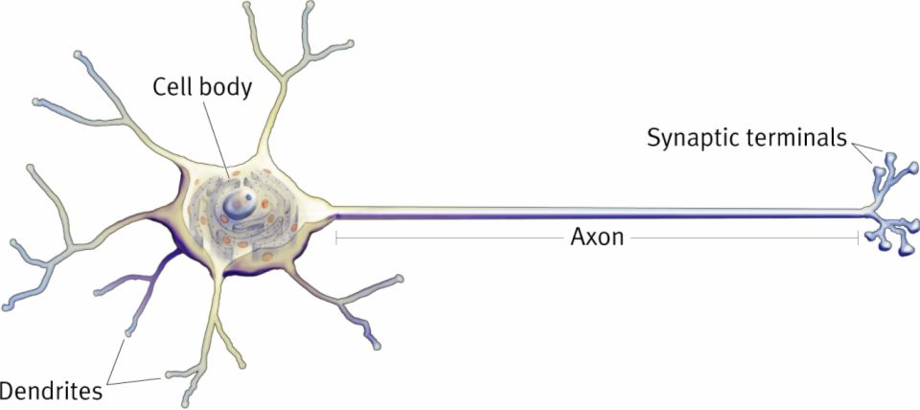
Perceptrons
Attempt to mimic biological neurons
Multiple inputs summed together -> single binary output
Mathematically, actually pretty simple
Can be stacked to increase complexity
Leads to things like neural networks and deep learning

Slide 5
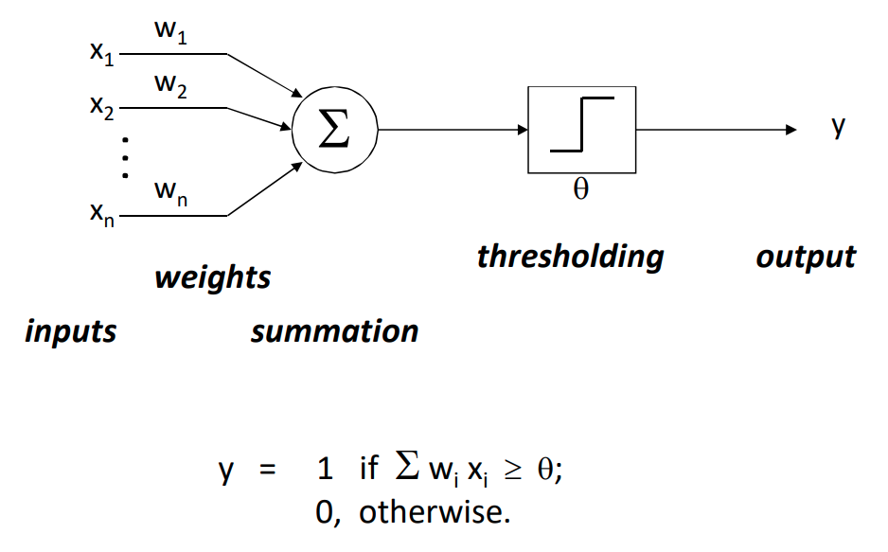

Slide 6
Letter Example
Weight Vector
Test Data 1
1 | 1 | 1 | 1
1 | -1 | -1 | 1
1 | 1 | 1 | 1
1 | -1 | -1 | 1
1 | 1 | 1 | 1
1 | 0 | 0 | 1
1 | 1 | 1 | 1
1 | 0 | 0 | 1
Θ = 11.5
Test Data 2
1 | 0 | 0 | 1
1 | 1 | 1 | 1
1 | 0 | 0 | 1
1 | 0 | 0 | 1
What will this perceptron output for each of these two inputs?

Slide 7
Training the Perceptron
Get a whole bunch of negative and positive examples X
Create arbitrary initial classifier
w₀ = (0,0,0,…)
Θ₀ = 1
Create constant to determine how “important” each new data point is
c = 1 (to keep it simple)

Slide 8
Training Algorithm
Classify X_{k} with w_{k} and Θ_{k}
Was it correct?
Move on to the next one
If not
Was it a false negative?
w_{k+1} = w_{k} + c * X_{k} and Θ_{k+1} = Θ_{k} – c
Was it a false positive?
w_{k+1} = w_{k} - c * X_{k} and Θ_{k+1} = Θ_{k} + c
Repeat the above until the classifier stops being wrong on any training data

Slide 9
Pseudocode
while (not converged)
for (xk in trainingData)
output = xk * wk
if (output is false-negative)
wk = wk + c*xk
threshold = threshold – c
else if (output is false-positive)
wk = wk – c*xk
threshold = threshold + c

Slide 10
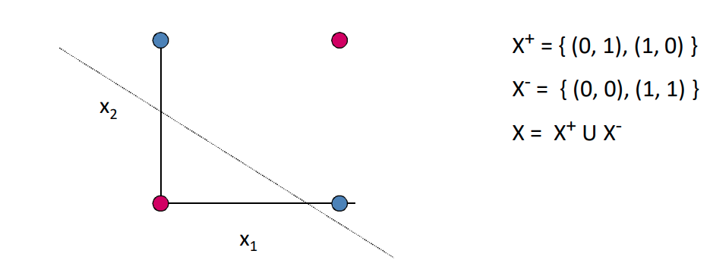
Convergence Issues
Classifier won’t always converge
Linear Separability

Slide 11
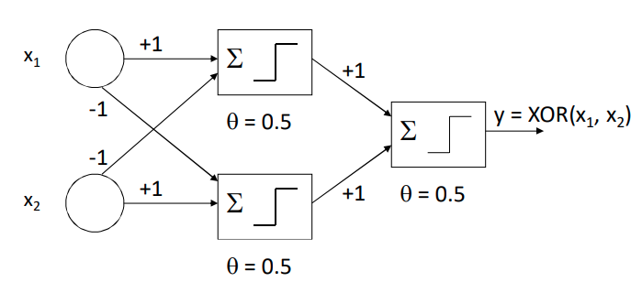
Solution: Add More Perceptrons!

Slide 12
Let’s Make and Train a Writing Classifier
Get a (REAL) dataset of drawn numbers
https://archive.ics.uci.edu/ml/datasets/Optical+Recognition+of+Handwritten+Digits
Get the “optdigits.tra” file
Get the skeleton code from the class website
We’re writing this in R
But I’ve done most of the syntax work for you

Slide 13
Very Brief R Intro
Statistical programming language
Good for math and creating data visualizations
Free!
Can program in a console like Unix
Or write scripts like most programming languages
Assignment operation looks like “variable <- value”

Slide 14
More Things to Try
See if you can figure out what the rest of the perceptron code is doing
I’ve commented most of it
Alter the code to work with a different dataset
You will probably have to change some numbers at least
Practice more things in R
https://www.statmethods.net/r-tutorial/index.html
https://www.cyclismo.org/tutorial/R/

