Slide 1
Machine Learning with Perceptrons

Slide 2
Machine Learning
Using statistical methods to make computers “learn” to do tasks when given example data. The methods improve the more example data is given.

Slide 3
Some Vocab
Classification
Taking unknown input and assigning it to one or more known classes of data
What ML is trying to do most of the time
Feature
A subset of a data point with all the “good” data
Training
Giving the ML algorithm example data to improve the classifier
Testing
Using different data from training to assess the classifier

Slide 4
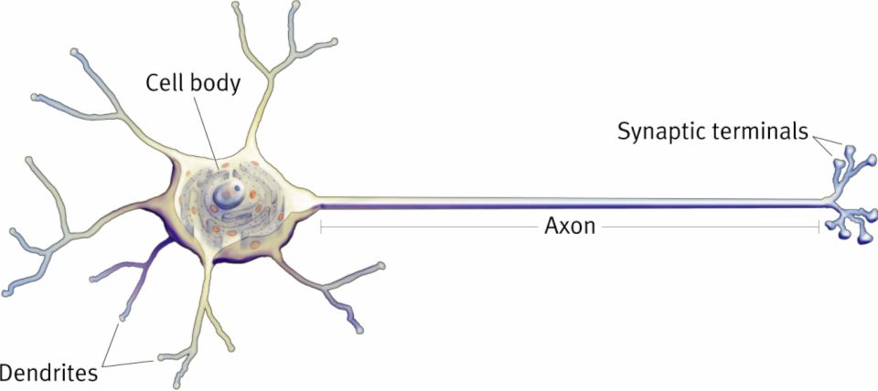
Perceptrons
Attempt to mimic biological neurons
Multiple inputs summed together -> single binary output
Mathematically, actually pretty simple
Can be stacked to increase complexity
Leads to things like neural networks and deep learning

Slide 5
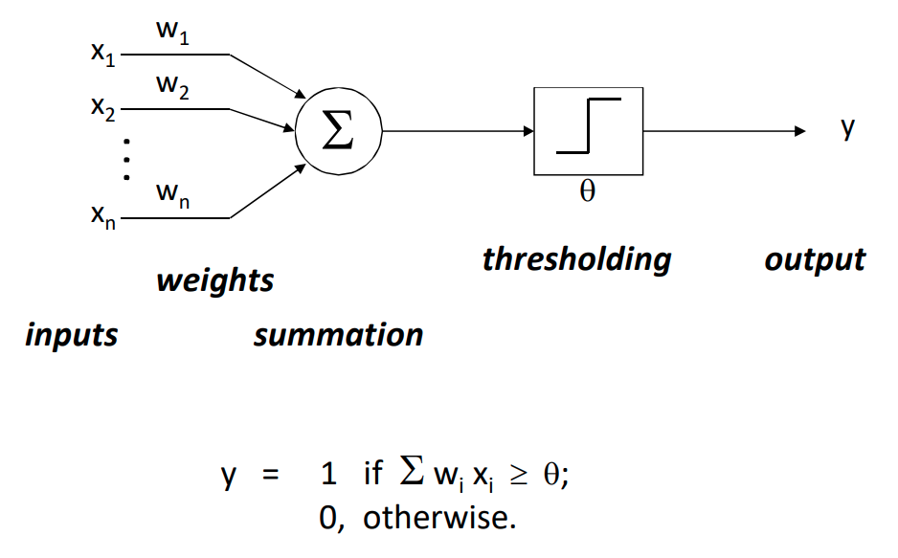

Slide 6
Letter Example
Weight Vector
Test Data 1
1 | 1 | 1 | 1
1 | -1 | -1 | 1
1 | 1 | 1 | 1
1 | -1 | -1 | 1
1 | 1 | 1 | 1
1 | 0 | 0 | 1
1 | 1 | 1 | 1
1 | 0 | 0 | 1
Θ = 11.5
Test Data 2
1 | 0 | 0 | 1
1 | 1 | 1 | 1
1 | 0 | 0 | 1
1 | 0 | 0 | 1
What will this perceptron output for each of these two inputs?

Slide 7
Training the Perceptron
Get a whole bunch of negative and positive examples X
Create arbitrary initial classifier
w₀ = (0,0,0,…)
Θ₀ = 1
Create constant to determine how “important” each new data point is
c = 1 (to keep it simple)

Slide 8
Training Algorithm
Classify X_{k} with w_{k} and Θ_{k}
Was it correct?
Move on to the next one
If not
Was it a false negative?
w_{k+1} = w_{k} + c * X_{k} and Θ_{k+1} = Θ_{k} – c
Was it a false positive?
w_{k+1} = w_{k} - c * X_{k} and Θ_{k+1} = Θ_{k} + c
Repeat the above until the classifier stops being wrong on any training data

Slide 9
Pseudocode
while (not converged)
for (xk in trainingData)
output = xk * wk
if (output is false-negative)
wk = wk + c*xk
threshold = threshold – c
else if (output is false-positive)
wk = wk – c*xk
threshold = threshold + c

Slide 10
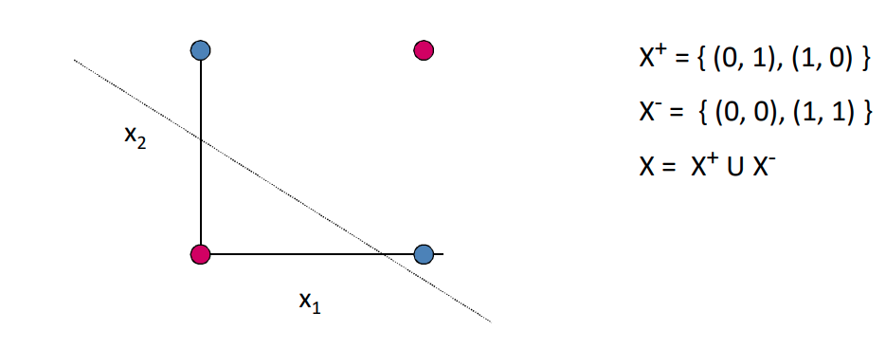
Convergence Issues
Classifier won’t always converge
Linear Separability

Slide 11
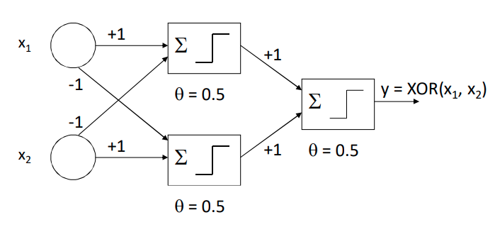
Solution: Add More Perceptrons!

Slide 12
Let’s Make and Train a Writing Classifier
Get a (REAL) dataset of drawn numbers
https://archive.ics.uci.edu/ml/datasets/Optical+Recognition+of+Handwritten+Digits
Get the “optdigits.tra” file
Get the skeleton code from the class website
We’re writing this in R
But I’ve done most of the syntax work for you

Slide 13
Very Brief R Intro
Statistical programming language
Good for math and creating data visualizations
Free!
Can program in a console like Unix
Or write scripts like most programming languages
Assignment operation looks like “variable <- value”

