Slide 1
Functions & Interactivity
By Crystal Hess
http://csed.fun

Slide 2
Learning Goals
What is a function?
What is a keyword?
What does it mean to implement, call, and/or override a function?

Slide 3
Functions
Try it!
Duplicate your creature sketch to creatureV2.0
Move everything in setup() EXCEPT creating the canvas and setting the background to a new function called draw()
Set the background to a random color (explore random() in the docs)
Try moving the background to draw() and see what happens. Why does this happen?
Allow for code to be repeated more easily
Define/implement – put stuff in the {}s
**Use/call – tell it to execute
**Overriding – giving a new definition/implementation to an inherited function
setup() is called when the program is first run, just like Arduino
Arduino has loop() that infinitely repeats, in p5.js, we use draw()
**Will learn more about these later

Slide 4
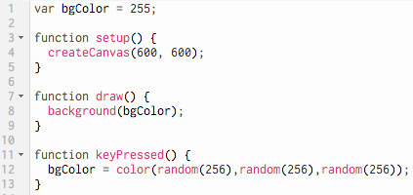
Interactivity
Consider the code here
What is happening on Line 1?
Line 8?
Lines 11-13?
What do you expect to see when you first run the program?
What about after you push <enter> on the keyboard?
keyPressed() is built-in function that you can find in the p5.js API

Slide 5
Move the Creature
Let’s try something using the fact that the draw() function is being called repeatedly…
Add translate(mouseX, mouseY); at the top of draw() (inside the {}s though)
Note that mouse is written in lowercase letters, and the X and Y are uppercase; this is required, as these are keywords in p5.js
After adding the code run your program and move your mouse.
What happened?
Why?

