Slide 1
Computational Linguistics

Slide 2
Main Goals
Model and Map Natural Languages
Natural Language Processing (NLP)

Slide 3
Speech Synthesis
Vocoder and Voder (1939)
Now can be done reasonably well in the browser!
window.speechSynthesis.speak(new SpeechSynthesisUtterance("she saw me"));
Impersonation
Challenges
Homographs, emphasis, new phonemes, context, objective evaluation

Slide 4
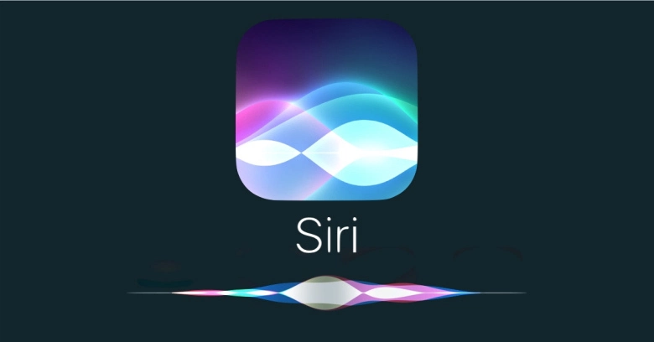
Speech Recognition
Advanced through machine learning
It’s a classification problem

Slide 5
Grammars
Break down language into its recognizable component parts
Create a “tree” of language
Plenty of examples
http://tomato.banatao.berkeley.edu:8080/parser/parser.html
Can be run in reverse to generate language (naively)
https://www.poem-generator.org.uk/

Slide 6
Language Understanding
AI-hard
We get this, we can get anything
May not even be measurable
What is “understanding”?
Turing Test
Watson
Chinese Room

