Slide 1
Cryptography and Security
How to keep secrets secret
when other people don’t want them to be

Slide 2
Brief History
Entirely just encryption for a long time
Turning a message into something unintelligible
We don’t get into secure communication until the modern age
Around for probably as long as writing has been
Julius Caesar was a fan over 2k years ago
Ciphers
The methods for encrypting and decrypting information
Used all over the world for 1000s of years
Many early version crack-able, but worked on the layman
Computers made cipher cracking suddenly much more possible
Ciphers become more complex too though
Generally a movement from linguistic theory -> math and complexity

Slide 3
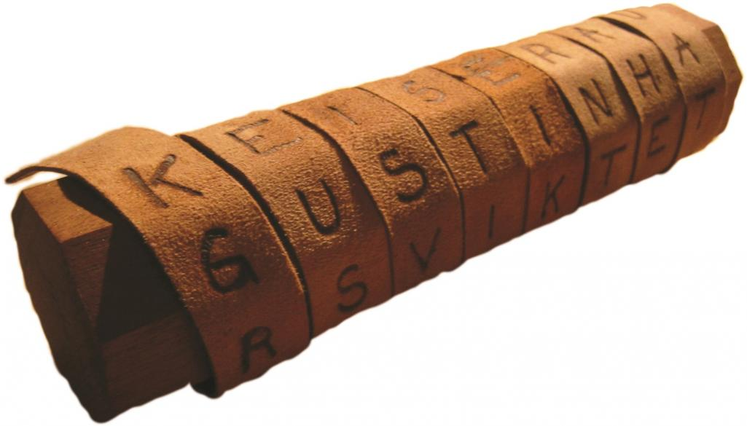
Transposition Ciphers
Take the letters already there and jumble them up
E.g. Rail Transposition
“Secret message” gets put on N “rails”
Our encrypted message becomes
“seseertesgcma”
S |  |  |  | E |  |  |  | S |  |  |  | E
 | E |  | R |  | T |  | E |  | S |  | G
 |  | C |  |  |  | M |  |  |  | A

Slide 4
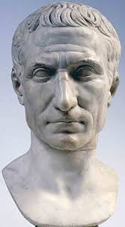
Substitution Ciphers
Replace every letter with a consistent alternative
E.g. Caesar Cipher
Replace each letter with the letter 3 spaces ahead of it in the alphabet
“Attack at dawn” becomes “dwwdfn dw gdzq”
These types are monoalphabetic and easy to crack
Better substitution methods are…

Slide 5
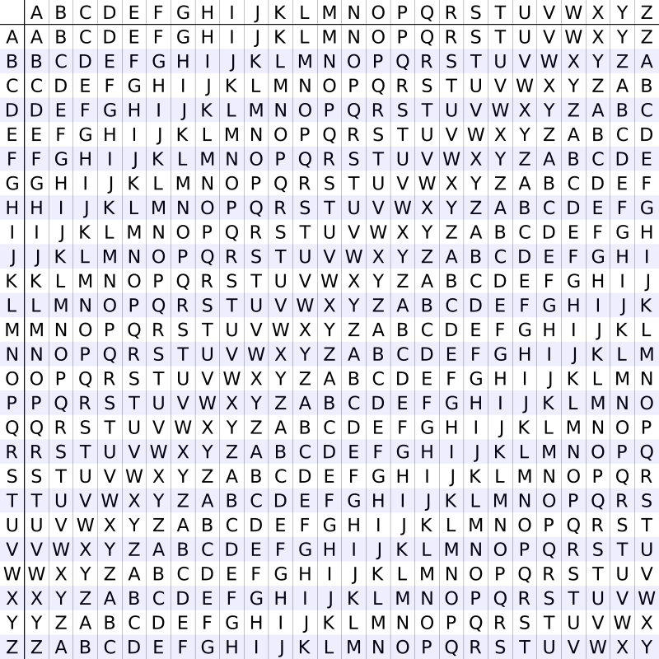
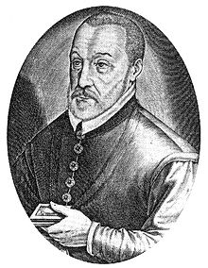
Polyalphabetic Cipher
Like the Caesar cipher, but change the distance between letters on each new letter
Vigenère square

Slide 6
Vigenère Cipher
Pick a code word, e.g. “locked”
Repeat the code word over the message to match the length
“secret message” + “lockedlockedl”
The letter from the repeated code
word decides what Ceasar cipher
we use on that letter
Our message becomes
“dsebiwxsucejp”

Slide 7
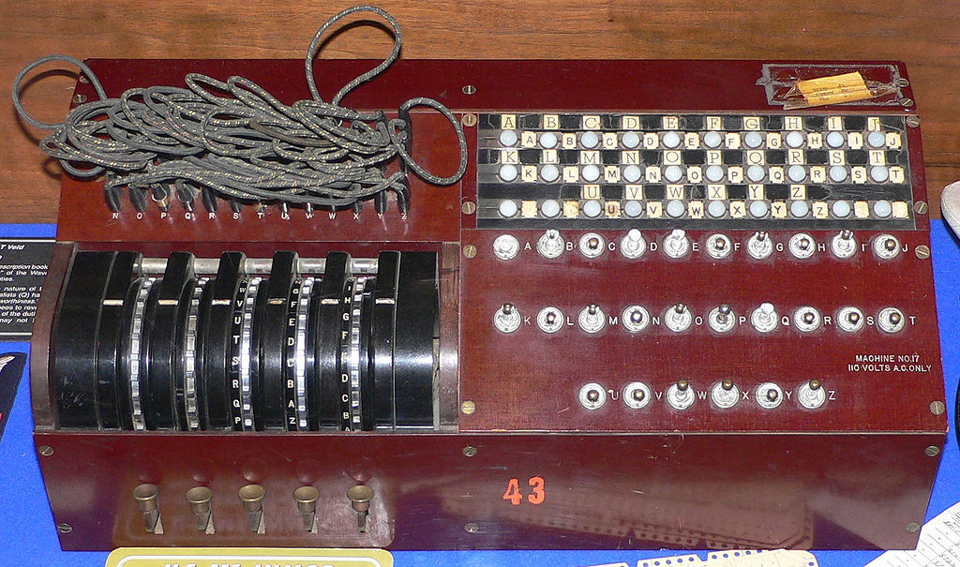
The Enigma Machine

Slide 8
Steganography
Keep people from knowing there’s any information at all
E.g.
Invisible ink
Messages in clothes or tattoos
Hide it in other writing
In the margins
Change the font
The first letter of each line of writing
Morse code
Jeremiah Denton

Slide 9
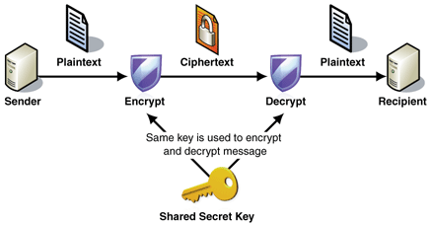
Modern Methods – Symmetric Key Cryptography
“My friend and I have the same key for one lock”
Similar to the ciphers we saw, but based in numbers instead of letters
The only (publicly) known encryption method until 1976
Both parties have to have the same key
This sucks! Why?

Slide 10
Public Key Cryptography
What modern software typically uses
Introduced (publicly) by Diffie and Hellman in 1976
Potentially known in secret since at least 1970
The biggest advancement in crypto since polyalphabetic ciphers
Basic idea: separate the encryption and decryption ciphers
Share the encryption cipher with whoever (public key)
Keep the decryption cipher for yourself (private key)
Anyone can send a message to you and only you will be able to decrypt it
Why is this a big deal?

Slide 11
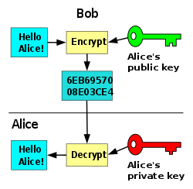
RSA (Rivest-Shamir-Adleman)
First detailed public key system
Still widely used
SSH, SSL, OpenPGP
Start with two prime numbers:
p = 13
q = 17
Calculate their product n = p * q = 13 * 17 = 221
And their totient t = (p – 1)*(q – 1) = 12 * 16 = 192

Slide 12
RSA
Pick a 3rd prime that isn’t a divisor of t
e = 23 t/e = 192/23 = 8.347…. we’re good
Now we need a number d where (d * e) % t = 1
This is the long step, but the lowest example is 167

Slide 13
RSA
We’ve got everything now, to recap
p = 13
q = 17
n = 221
t = 192
e = 23
d = 167

Slide 14
Encrypting the Message
The public key uses n and e
Call our plaintext message M, which has been converted to one big number
Call our encrypted message E
E = Me % n
E.g. if our message is 16, then the encrypted one is
15²³ % 221 = 59

Slide 15
Decrypting the Message
The private key uses n and d
M (the original message) = E^{d} % n
E.g. 15 = 59¹⁶⁷ % 221
Our message is decrypted and we didn’t have to share the private key with anyone

Slide 16
Why is this safe?
In a real scenario, p, q, and thus n are very, very large numbers
2048 bits each, about 10⁶¹⁷
d is the important #, but can’t be figured out without p and q
We can safely share n because it would take a really long time to find p and q
Brute force
Best attempt so far was hundreds of connected computers factoring a 768-bit number over two years, with over 2000 years of total computing time
Complexity increases exponentially as the bits go up

Slide 17

Now for the other side…
Can a cipher be completely unbreakable?
One-time pad
Can a whole system be secure?

Slide 18
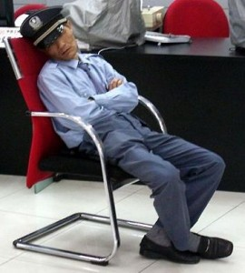
Social Engineering
Most security breaches are from human error
Easiest way into most systems
The most secure system in the world is useless if it employs even one idiot
Phishing
Keylogging
Eavesdropping
Ignoring/breaking the air gap

Slide 19
Breaking Ciphers - Cryptanalysis
What do we know and what can be found out?
What would be useful to know?
Rail Transposition
If we know the # of rails we can solve it, and it’s easy to guess

Slide 20
Frequency Analysis
If we know they used a substitution cipher, how do we break it?

Slide 21
Frequency Analysis
If we know they used a substitution cipher, how do we break it?
English (or any natural language) has predictable patterns
Some letters appear far more often than others

Slide 22
Crack a Message
Encrypted message:
XLIVIMWRSAECCSYEVIGVEGOMRKXLMWQIWWEKI
What are the most common letters?

Slide 23
Crack a Message
Encrypted message:
XLIVIMWRSAECCSYEVIGVEGOMRKXLMWQIWWEKI
What are the most common letters?
I,V,W,E are each > 10% of the total, M at 8%
I has the most at 5x

Slide 24
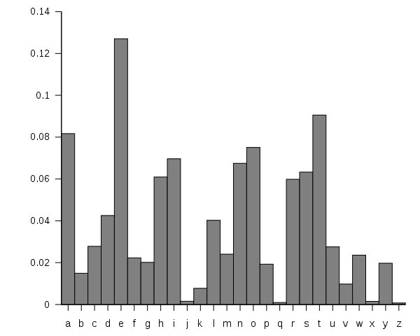
English Letter Frequency

Slide 25
Now We Guess
Naïve guess
I -> E
If the cipher is monoalphabetic, that’s all we need
Why?

Slide 26
Does It Work?
XLIVIMWRSAECCSYEVIGVEGOMRKXLMWQIWWEKI

Slide 27
It Works!
THEREISNOWAYYOUARECRACKINGTHISMESSAGE

Slide 28
Unicity Distance
How much ciphertext do we need to know we can crack it?
For simple ciphers the answer is usually very little
About 50 characters for polyalphabetic
Keep in mind this ignores computation cost
The longer the message, the more vulnerable it is

Slide 29
What about RSA?
If the users are smart, and the keys are well-chosen, what do we have left?

Slide 30
What about RSA?
If the users are smart, and the keys are well-chosen, what do we have left?
Still plenty of options

Slide 31
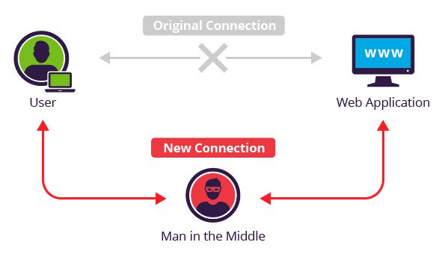
Man in the Middle
Alice asks for Bob’s public key, but Eve intercepts the message and sends her public key instead
Eve does the same to Bob with Alice’s response
Now she fully controls all communication between them

Slide 32
Side-Channel Attacks
Computers are physical, imperfect machines
Huge number of things we can do to gather more information
Examine the cache
Meltdown & Spectre
Look at processing time for various inputs
Look at power usage for various inputs
Examine improperly wiped data
Works outside of computers too
Detecting sound with lasers pointed at vibrating windows
Reading body movement by analyzing changes in room’s electrical circuit

Slide 33
Let’s Play a Game…
Decrypt your login access, keys are the passwords with the numbers stripped out
Username: pc11 Password: mGKq6hu9
Encrypted PC Name: MTKDAB
Username: pc12 Password: Vxwc36jU
Encrypted PC Name: HLFCEY
Username: pc13 Password: 8cmopGP7
Encrypted PC Name: YTWSHTA
Username: pc14 Password: xBb6Zx3u
Encrypted PC Name: BJHGQ
Username: pc15 Password: qRgcCc58
Encrypted PC Name: DZTG
Pick one and figure out which PC it logs into

