Slide 1
Meet Edison
By Crystal Hess
http://csed.fun

Slide 2
Learning Goals
Note the nuances of programming in Python
Explore the documentation for Edison Programming
Set a goal for your program and then figure out how to accomplish it.

Slide 3
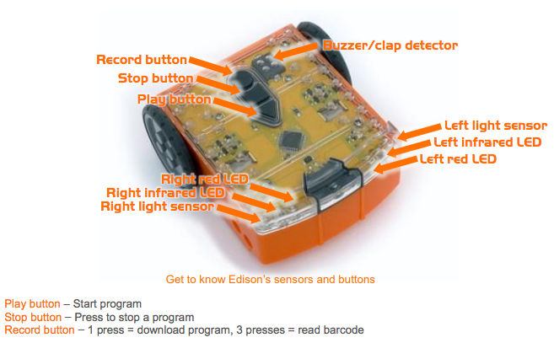
Getting started with Edison
Edison is a robot that you can program with block programming or the programming language Python
It comes equipped with sensors, outputs, and motors
We download programs onto Edison using sound, kind of like an old school modem ☺

Slide 4
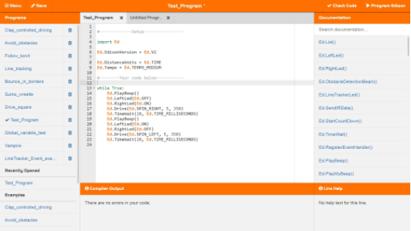
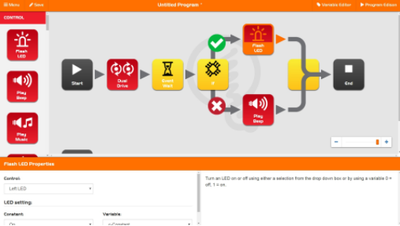
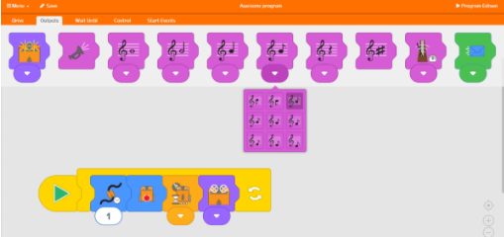
Programming Options
Program Edison using Python with the EdPy web-based IDE
www.edpyapp.com/
Program Edison using a visual block programming language
www.edblocksapp.com
Program Edison using a hybrid graphical and text-based program
www.edwareapp.com

Slide 5
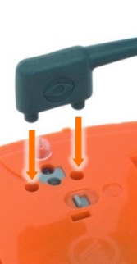
Downloading a Test Program
Go to www.edpyapp.com
Open the Example called Test_Program
Plug in the EdComm cable to the headphone socket
Make sure your computer sound is all the way on and up
Click on the button to ✔️Check Code
Make sure Edison is on, and push the ⚫ on Edison to Record a new program
Click on the button to ▶ Program Edison
You should hear some sounds followed, which will then stop
Disconnect the EdComm cable, and push the ▲ on Edison to start the program
Push the ◼️ on Edison to stop the program

Slide 6
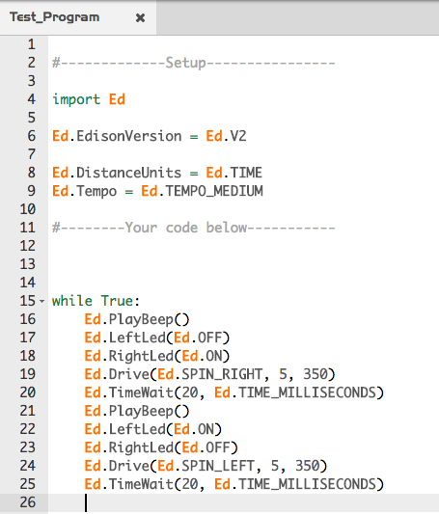
Programming Edison
Edison sure seems confused in Test_Program!
Explore how the program works by looking at the documentation for each method used
Ed.PlayBeep()
Ed.LeftLed()
Ed.RightLed()
Ed.Drive()
Ed.TimeWait()
How does Python look similar to Arduino (C++) and p5.js (JavaScript) languages?
How does it look different?

Slide 7
Explore Edison Programming
Make Edison drive in a square shape.
Make Edison beep every time he turns in the NW corner of the square.
Make Edison flash his lights every time he turns in the NE corner of the square.

Slide 8
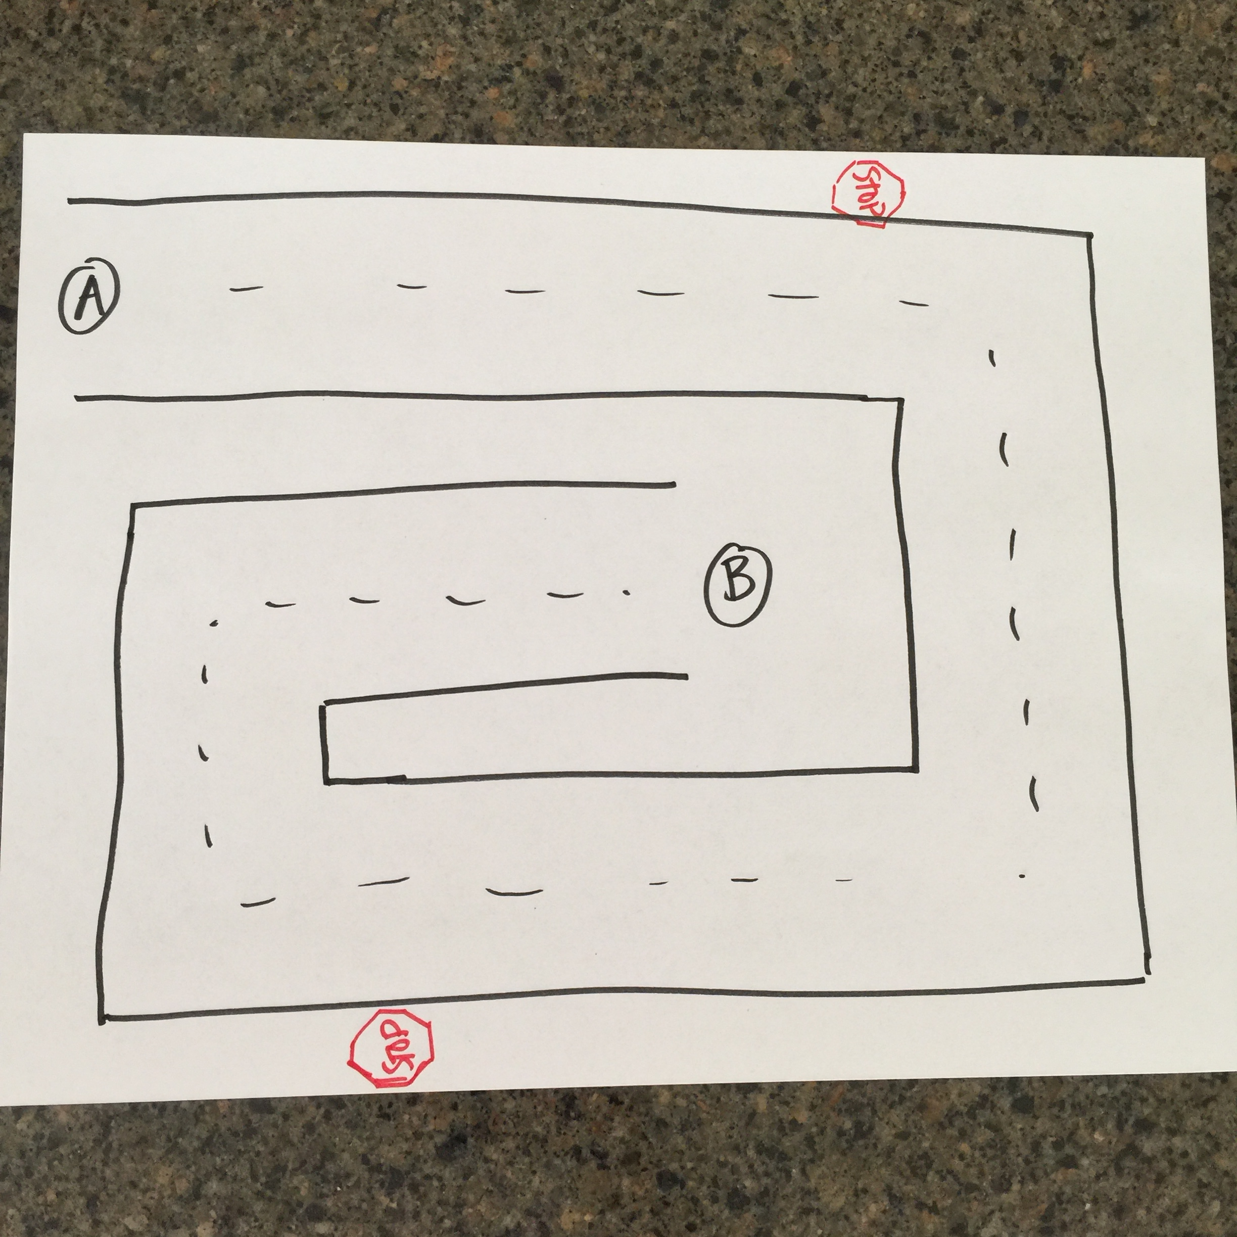
Activity: Stay on Course
Using a large sheet of paper, draw a course for Edison to follow.
Only use straightaways and 90 degree turns for this course!
Have a starting point (A) and an ending point (B).
You may draw stop signs on the course to indicate that Edison must stop there for at least 1 second!
Program your Edison to complete your course.
First go (A) to (B)
Then go backwards (B) to (A)
Trade courses with another team and program that course.

