Slide 1
Introduction to 3D Graphics with three.js
Adapted from slides by Crystal Hess

Slide 2
Learning Goals
What is three.js?
What is “the documentation”?
How does the coordinate system work in 3D?
What can a for-loop be used for?
Note similarities between programming languages used to code in three.js (JavaScript) and Arduino (c/c++)

Slide 3
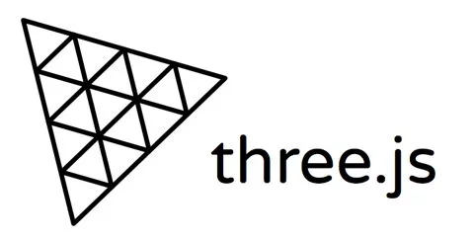
What is three.js?
JavaScript library
Runs in a web browser
Uses WebGL to run graphics calculations off of the graphics card
Relatively accessible and (mostly) platform-agnostic 3D graphics

Slide 4


Slide 5
Basic Lingo
Scene
Where the objects exist
Camera
How we view the scene
Lighting
How anything is visible
Renderer
The technical details for how a virtual scene becomes something we see on the screen

Slide 6
Example: Basic
Download the class repo and open the web->three_projects->00_basic folder
Open three.html with a browser
Open project.js with a text editor
Play with the code!
Try changing some camera numbers
What happens if you set the mesh material to wireframe: false?
De-comment the axesHelper to see the scene’s axes drawn for you
How does js look similar to the Arduino language?
How does it look different?

Slide 7
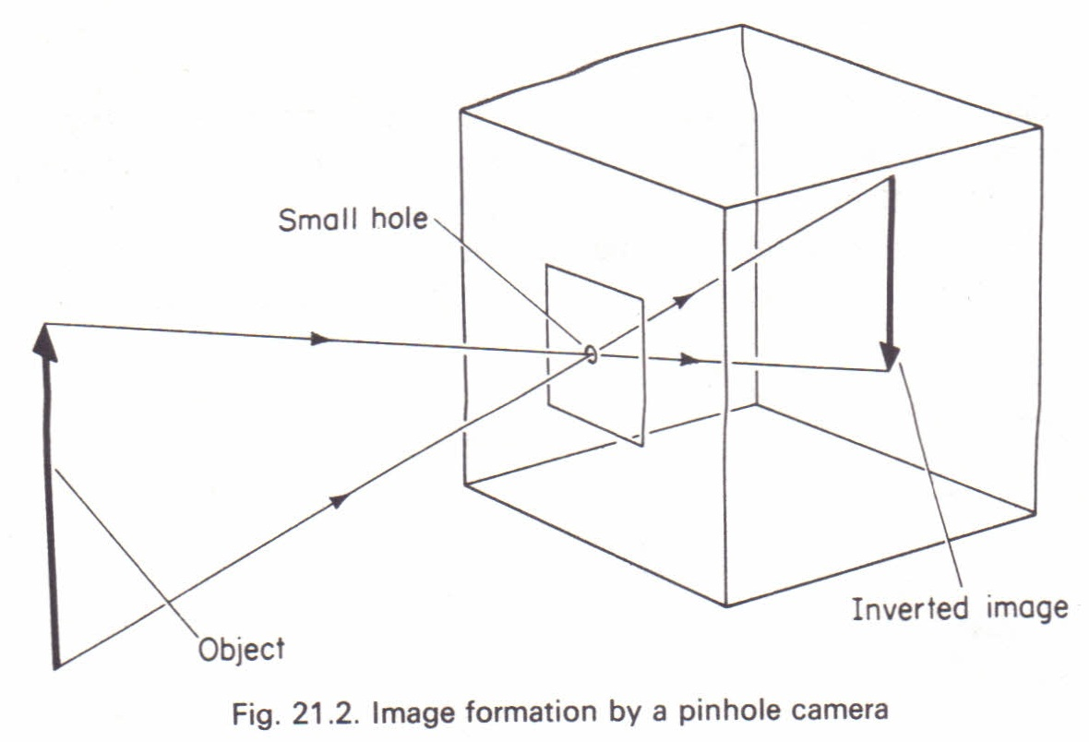
The Camera
Graphics cameras are modeled like old pinhole cameras

Slide 8
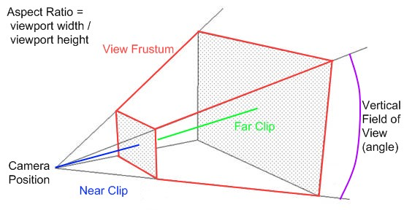
The Synthetic Camera

Slide 9
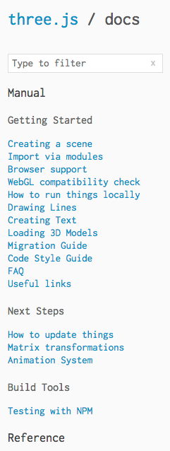
The three.js API
Remember the Documentation!
https://threejs.org/docs/index.html

Slide 10
Example: Lighting
Now open the 01_sphere_with_lighting project
What’s different?
Try commenting out the ambient light in the code
Turn that back on and try it without the point light code
Add a new point light
Play with the sphere’s metal-ness and rough-ness values (range 0.0-1.0)
What do you think they do?
Try it with the flat shading turned off
Added Fun
Replace the point light with a directional light
Make the sphere use a different material than MeshStandardMaterial

Slide 11
Common Light Types
Ambient
That dim glow that’s everywhere
Point Light
Just like a lightbulb
Directional Light
Light coming from one direction, everywhere
Looks like daylight
Spotlight
Just like you would think
What would this be most similar to?

Slide 12
Material Lighting Properties
Diffuse (aka “roughness”)
Like a matte finish
Brighter when the light source is perpendicular to the surface
Specular (aka “metalness”)
Makes a thing look shiny
Brighter when the light source is a the same angle to the surface as the camera
Together with ambient lighting these are commonly known as the “Phong” model of graphics lighting
Other lighting stuff (these mostly require ray-casting):
Reflection
Refraction
Caustics

Slide 13

For Loops
Open the 02 project, Loops and Events
Consider the code here
Can you make the line of spheres longer?
Can you make the spheres stack vertically instead of line up?
Can you space the spheres farther apart?
Can you make the spheres larger?
Can you make each one larger than the last?
Added Fun
Make each sphere be a different random color
Make each object be a random shape

Slide 14
Shadows
Shadows are tricky, they cost a lot to compute
4 steps required
Let the renderer know we are using shadows
Enable shadows on the light source (and decide how detailed they will be)
Make at least one object that can cast a shadow
Make at least one object that can receive the shadow
What actually happens to make a shadow?
The light source creates a new camera that’s only b+w
Only objects that cast shadows show up in the camera
The “screen” of this camera is shown on objects that accept shadows

Slide 15
Playing with Shadows
Open the 03 Shadow project
Try changing the shadowMap size to something smaller (like 256)
These values are basically the “resolution” of the shadow
Change the object to something else, see if the shadow changes
De-comment the shadowCameraHelper to see the area the light’s shadow camera is looking
Add a second light source and make multiple shadows appear

Slide 16
Want to do even more?
Check out the three.js examples page
https://threejs.org/examples/
Download some of them and read the code, see if you can make it even better!

