Slide 1
"The forest our ancestors planted — powering the village they built."
先人が植えた森が、今、村に豊かさをもたらす。
Notes:
Good [morning/afternoon], everyone, thanks for having me.
I'm Rob Oudendijk — an engineer who's called Japan home for 35+ years: 13 in Tokyo, 2 in Fukushima, and the last 15 tucked away in Mitsue, Nara.
Living out here, I've seen two things happening at once: rural villages quietly running out of people, and the rest of the world running out of energy — thanks to AI, data centers, and EVs all showing up to the party at the same time.
So I thought: what if these two problems just... solved each other?
That's the Mitsue-kun Project.
Rural Japan's problem:
Forests nobody's tending — planted with cedar, no food for wildlife, so the boars and deer come raid the fields instead
Fewer people, more grey hair
Infrastructure creaking at the joints
The tech world's problem:
AI and data centers are power-hungry monsters
Nowhere to charge an EV out here
Everyone wants "carbon-neutral," nobody wants to pay more for it
Our fix: take the overgrown cedar nobody wants, burn it smartly in a biomass CHP unit (combined heat + power — think one engine, two useful outputs), and replant the cleared areas with native forest instead. That gives the animals food and cover again — so they stay in the hills and leave the village fields alone.
Forest gets restored, animals get fed, village gets jobs and power, tech gets its clean electrons. Everybody wins — including the boars.

Slide 2
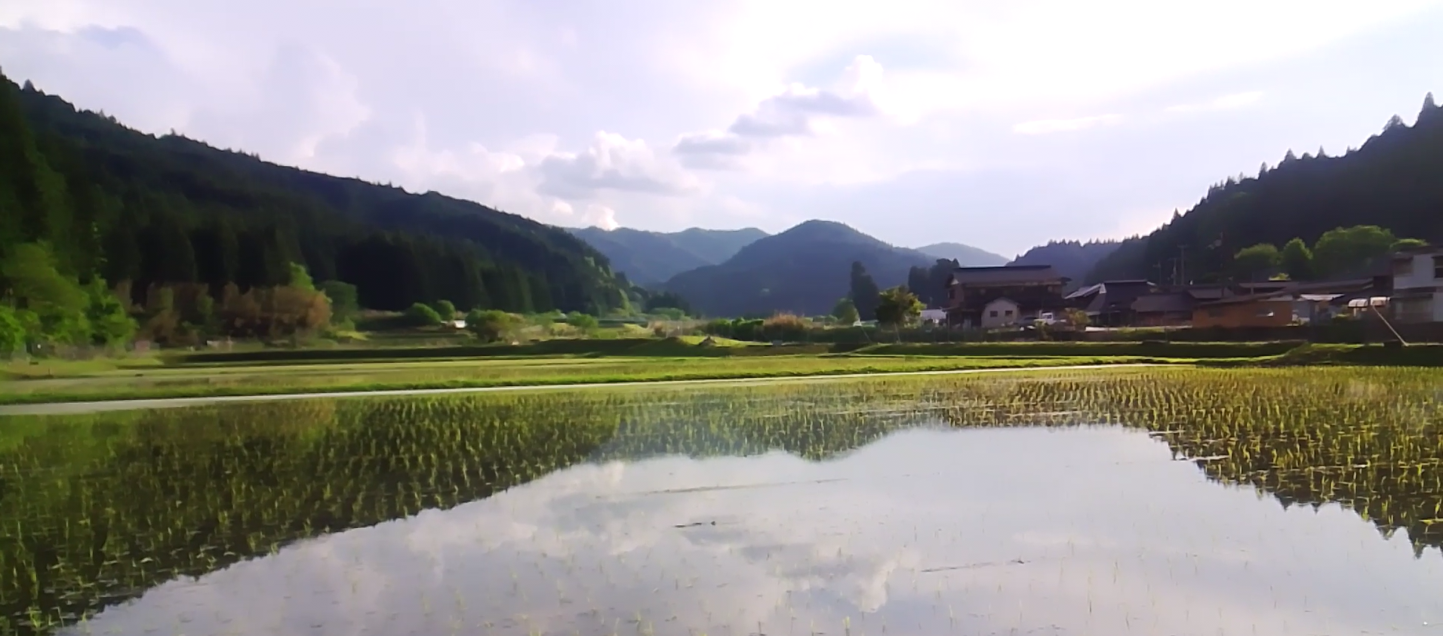
YR-DESIGN · SAFECAST
IMPACT INVESTMENT PROSPECTUS · インパクト投資
NARA, JAPAN · 2026
A 25-YEAR MODEL FOR RURAL REGENERATION
Mitsue AI Data Center Project
御杖AIデータセンタープロジェクト
Restored forest, local clean energy, and a community-owned data center — one integrated system, openly documented for any village to follow.
森林再生・地域エネルギー・コミュニティ所有のデータセンター。どの集落も辿れる、公開された統合モデル。
Mitsue Village · 御杖村, Nara
HORIZON · 期間
PHASE · 段階
ADVISORS · 顧問
25 years
0 · Pre-foundation
Ozzie · Dome · Takata
Notes:
Morning, everyone — welcome to Mitsue: ninety-three percent forest, under fifteen hundred people, and doing its best impression of a village slowly vanishing into the trees. Over the next ten minutes, I want to convince you this is exactly the place to prove something bigger: that rural decline isn't a one-way street — it can be reversed by a model that pays its own bills, and copy-pasted anywhere else fighting the same slow fade. Consider this your invitation to help fund the proof.

Slide 3
THE THESIS · 命題 · 02
A replicable model for rural regeneration.
地方再生の、再現可能なモデル。
Forest
Energy
Compute
森林再生
地域エネルギー
演算 — エンジン
Aged cedar restored to native broadleaf — turning a liability into feedstock and habitat.
Biomass heat and existing solar — local power, kept local, with the grid as backup.
A community-owned data center — the revenue engine that finances everything else.
Key idea
The data center is the engine. The forest and the village are the return. データセンターはエンジン、森と集落がリターン。
Notes:
Here's the whole idea, and it's refreshingly simple. Most rural revival plans fail because they run on subsidy forever — like a houseplant that dies the moment you stop watering it. Ours is wired the opposite way: restore the forest, make clean energy, run a small community-owned data center — each one feeding the next, until the loop pays for itself. And here's the twist I really want you to remember: the data center isn't the point. It's the engine. The forest, the jobs, and the village's future — that's the actual return.

Slide 4
THE CHALLENGE · 現状の課題 · 03
Four problems — or four raw materials
四つの課題は、見方を変えれば四つの資源。
<1,500
93%
2
~92%
Residents, and falling
Forest, much unmanaged
Closed school / unused factories
Energy imported
人口減少・高齢化（65歳以上が過半）
森林率93%・放置された人工林
旧御杖小学校・遊休工場 — 維持費のかかる遊休資産
エネルギーの大半を域外に依存
An aging community that needs new work and reasons to stay.
Aged cedar: a pollen, fire and landslide liability — and a fuel.
A maintained building earning nothing — ready to be repurposed.
Money leaves the village every month to buy power and fuel.
Population & forest: Mitsue Village statistics / Census. Energy import share illustrative — Japan Energy Database indicators. 出典：御杖村統計・国勢調査／エネルギーは試算
Notes:
Let's be honest about the hand we're dealt. Population: under fifteen hundred, heading toward half that, and more than half of who's left qualifies for the senior discount. The mountains are ninety-three percent forest — but it's mostly aging cedar nobody's managing, which is less "majestic woodland" and more "pollen bomb waiting to landslide." The old elementary school shut down and now just costs the village money to sit there empty. And almost every yen we spend on energy leaves town. Four problems — or, if you squint, four raw materials waiting for a use.

Slide 5
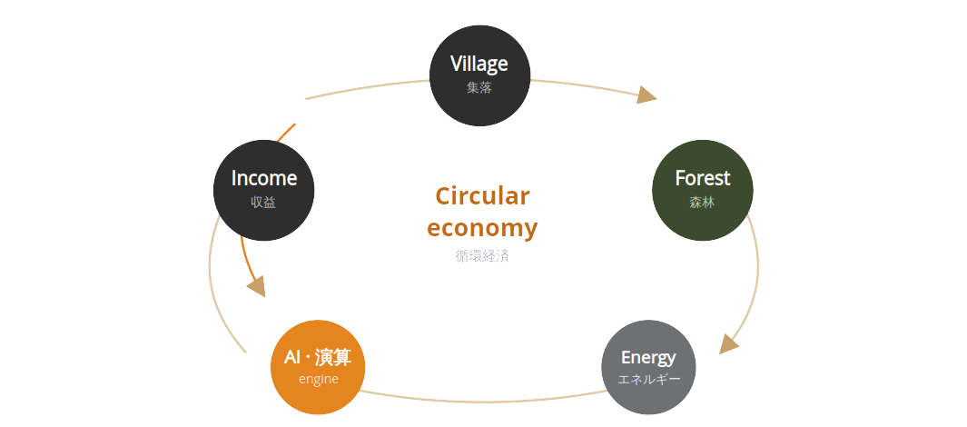
THE CIRCULAR MODEL · 循環モデル · 04
A loop, not a line
Each output is the next input. Revenue returns to the forest and the village.
直線ではなく、循環。各段階が次を支える。
収益は森と集落へ還る。
Notes:
Picture a loop, not a line. The village manages the forest. The forest gives up timber and fuel. That fuel makes heat and power. That energy runs a small data center. The data center earns money. And that money flows back into the forest, the jobs, and the village. Subsidy might give it the first push, but after that the wheel keeps turning on its own — no hamster required.

Slide 6
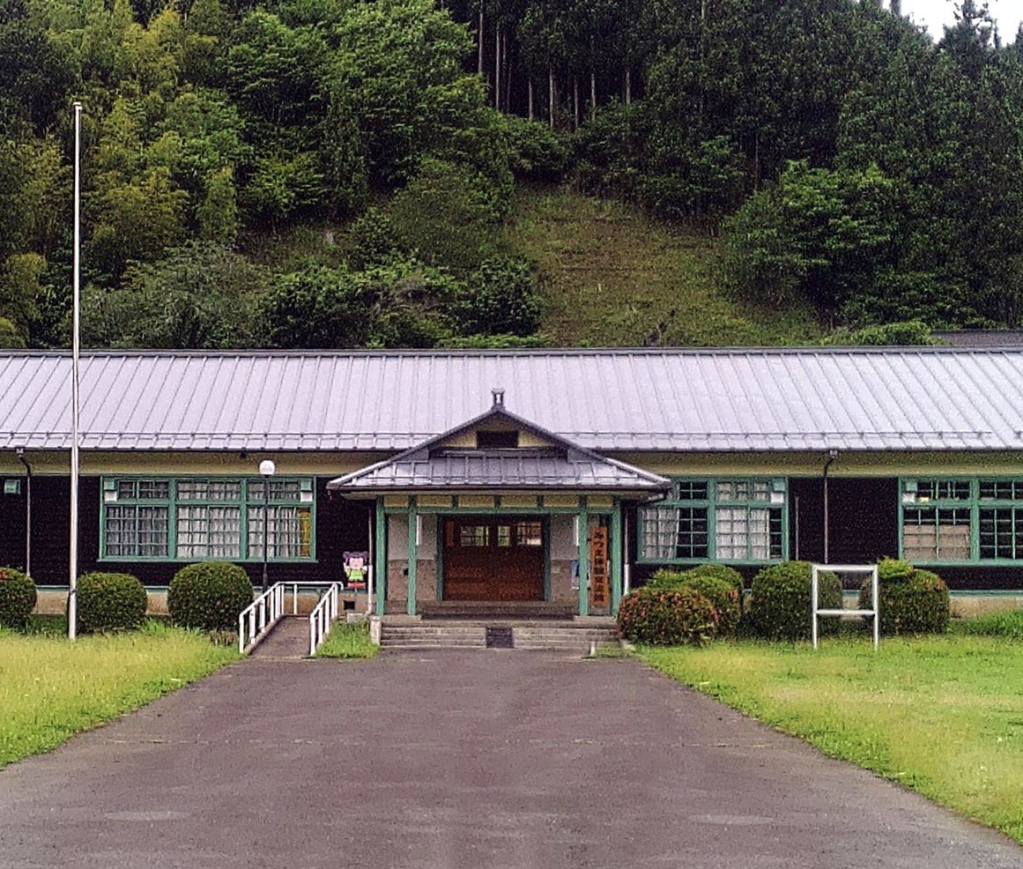
THE ENGINE · エンジン · 05
A community-owned data center
コミュニティ所有の小規模データセンター
The closed Mitsue Elementary School — or an unused factory site — repurposed as a small, energy-efficient edge & AI compute facility — powered entirely by local renewable energy, owned by the community it serves.
01
Sized for accountability & ownership, not hyperscale economics.
Former Mitsue Elementary / Unused Factory · 旧御杖小学校・遊休工場
02
Reuses a stranded public asset instead of building new.
03
Generates the recurring revenue that funds the loop.
Notes:
Now, the engine — the bit that makes this an investment, not a donation. We take the shuttered elementary school and turn it into a small, energy-efficient data center: edge and AI compute, running entirely on local renewable power. It's deliberately small — sized for accountability and community ownership, not some hyperscale monster. But it does something the forest and village can't do alone: it earns recurring revenue, year after year, to fund everything else.

Slide 7
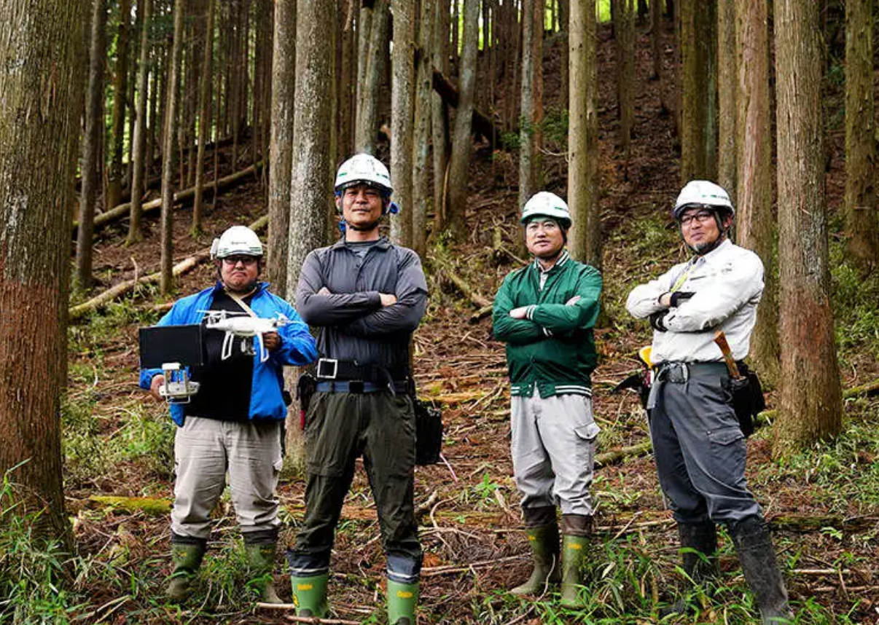
FOREST RESTORATION · 森林再生 · 06
From liability to asset
負債から資産へ — 25年の生態系再生。
Today · 現状
Aged sugi cedar monoculture — pollen, landslide and fire risk, little habitat.
↓ 25-year phased restoration
2050 · 想定
Native broadleaf forest — biodiversity, water retention, timber & biomass.
Thinnings → energy feedstock 間伐材を燃料に
Biodiversity & watershed 生物多様性と水源
J-Credits revenue layer Jクレジット収益
In cooperation with private landowners, the Mitsue Forestry Cooperative, and the Forestry Agency (林野庁).
Notes:
The forest is where the environmental payoff lives, and it's a proper twenty-five-year project. Postwar Japan planted huge cedar monocultures and then just... walked away. We're swapping them out in phases for native broadleaf trees, working with landowners, the village forestry co-op, and the Forestry Agency. That does three things at once: the old cedar becomes fuel, biodiversity and water retention come back, and we pick up carbon credits along the way. Liability, meet feedstock.

Slide 8
ENERGY SYSTEM · エネルギー設計 · 07
Power first — for compute & charging
電力優先 — データセンターとEV充電へ。
1 · Power first
Electricity runs the AI data center and the EV charging network — the demand we are building for. 電力をデータセンターとEV充電へ。
THE REALISTIC MIX · 現実的な電源構成
Biomass
Baseload power · ベースロード電源
Existing solar
Daytime generation · 日中の太陽光
Grid
Backup & peaks · 系統（バックアップ）
2 · Heat, captured second
Not biomass alone, and not a replacement for the village's solar — a resilient blend.
Recovered heat is a by-product we will use as demand emerges — no committed off-taker yet. 排熱は需要が定まり次第活用。
Notes:
Priority check, because it drives everything else: power comes first. The whole point is electricity — running the data center and building out EV charging. That's the demand we're chasing. Heat is real, and we'll capture it, but nobody's promised to buy it yet, so we treat it as a bonus, not a foundation. The mix stays simple: biomass for baseload, the village's existing solar by day, grid as backup — biomass isn't a solo act, it's part of a band.

Slide 9
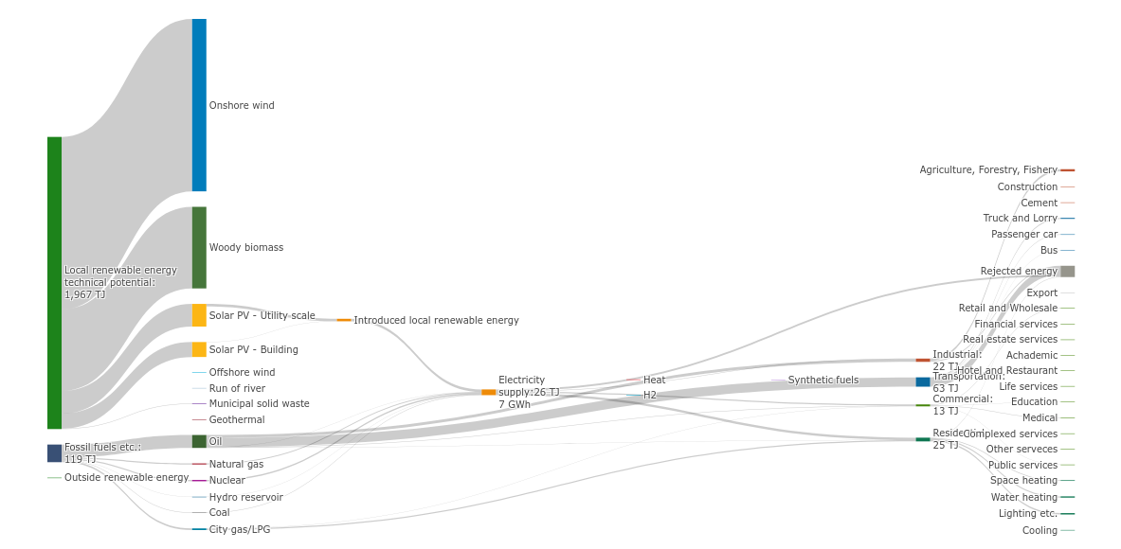
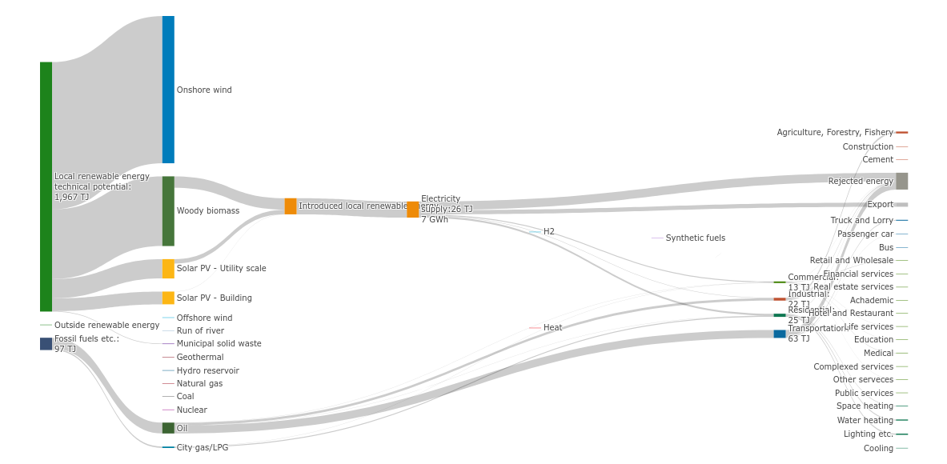
BIOMASS OPPORTUNITY · バイオマスの可能性 · 08
Untapped — but not for long
地域再生可能エネルギーポテンシャル 1,967 TJ — 木質バイオマスが最大の柱
2022 BASELINE · Fossil fuels: 119 TJ · Minimal renewables in use
2032 TARGET · Fossil fuels: 97 TJ · Local renewables introduced
THE BIOMASS CASE
The right bar in both diagrams shows 1,967 TJ of local renewable energy potential — woody biomass (dark green) is the dominant resource by far. Today, almost none is captured. The Mitsue AI Data Center Project changes that: sugi thinnings feed a CHP unit, generating baseload electricity and heat year-round. Every cubic metre of timber harvested for forest restoration becomes fuel — closing the loop between reforestation and energy self-sufficiency.
Indicators: Japan Energy Database (Tohoku University, CC BY-NC). Mitsue values illustrative — confirm via Future Energy Simulator. 出典：地域エネルギー需給データベース／数値は試算
Notes:
Here's the number that should raise eyebrows: 1,967 terajoules of local renewable potential sitting mostly untouched, and wood biomass is by far the biggest slice of that pie. Right now we're basically ignoring it. The Mitsue-kun Project changes that — sugi thinnings feed straight into a CHP unit, making baseload power and heat all year round. Every log we cut to restore the forest becomes fuel. Reforestation and energy independence, solving each other's problem.

Slide 10
PROFILE IN NUMBERS · 現状と将来 · 08
From dependence to surplus
依存から余剰へ — エネルギー自立への転換
Today · 現状
2050 · 想定
Energy self-sufficiency 自給率
▲ +107pt
Import dependency 域外依存率
▼ −67pt
TODAY
8%
TODAY
92%
2050
115%
2050
25%
Energy trade balance 経済収支
flips +
Energy-related CO₂ CO₂排出量
▼ −73%
TODAY
−¥2.0億
TODAY
11 kt
+¥0.8億
3 kt
2050
2050
Indicators: Japan Energy Database (Tohoku University, CC BY-NC). Mitsue values illustrative — confirm via Future Energy Simulator. 出典：地域エネルギー需給データベース／数値は試算
Notes:
Now the numbers investors actually care about. Today, Mitsue imports about ninety percent of its energy and self-sufficiency sits in the single digits — basically, we're buying electricity like takeout every night. By twenty-fifty, the model flips that: energy self-sufficiency over a hundred percent, import dependency down to a quarter, the trade balance flipped from red to black, and emissions cut by about three-quarters. Illustrative numbers pending the full simulator run — but the direction isn't really in question.

Slide 11
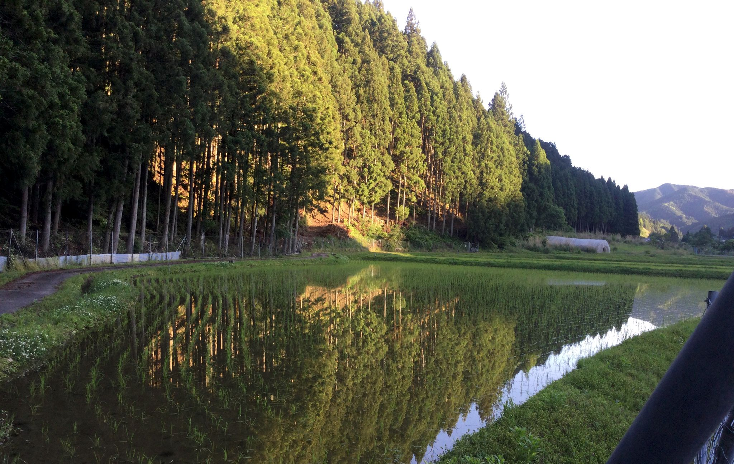
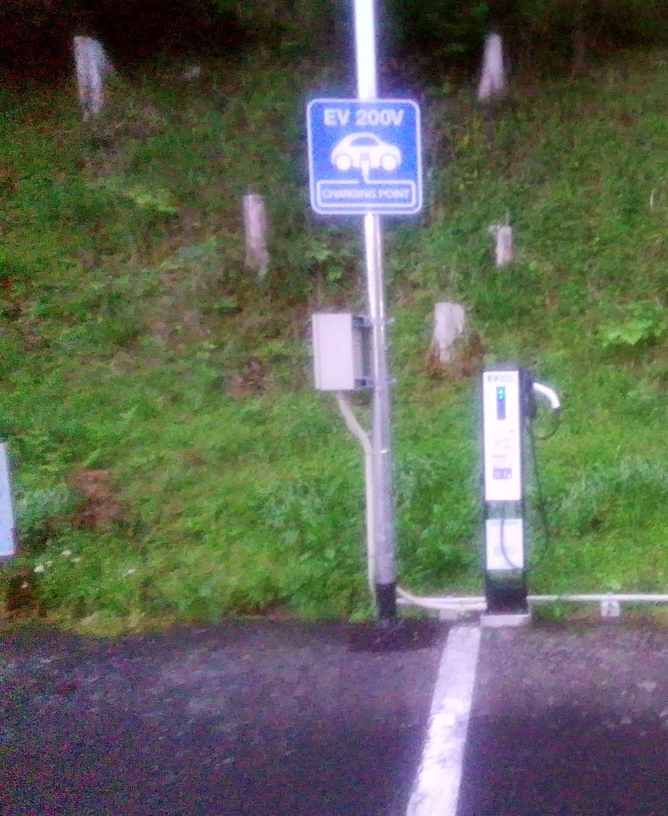
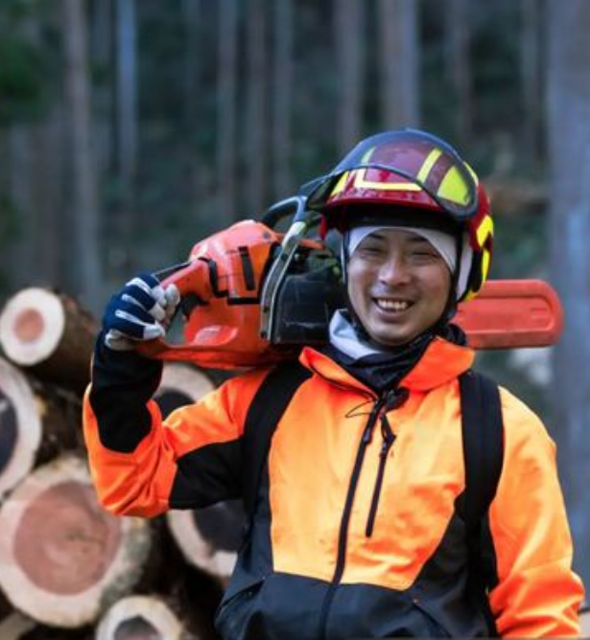
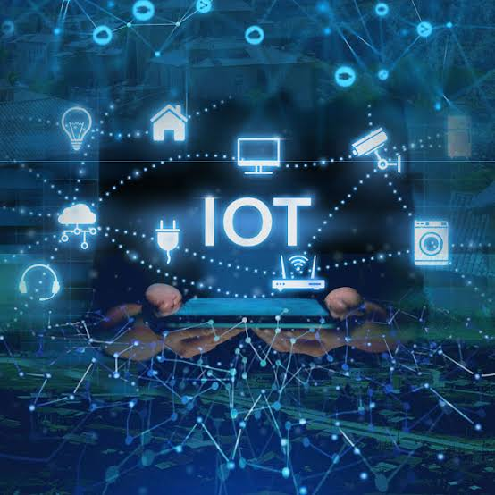

FIVE RETURNS · 五つのリターン · 09
One investment, five returns
一つの投資が、五つのリターンを生む。
Ecological
Energy
Economic
Digital
Knowledge
生態系
エネルギー
経済
デジタル
知識（公開）
Restored watershed, biodiversity, carbon drawdown.
Self-supply and an end to exported cash.
Jobs in forestry, operations and hosting.
Edge compute & connectivity for rural Japan.
Open-licensed — the multiplier other villages copy.
Notes:
So what does an investor actually walk away with? Not one return — five, and they stack. Ecological: a restored watershed and carbon pulled down. Energy: a village that stops shipping cash out the door. Economic: real jobs in forestry, operations, hosting. Digital: edge compute rural Japan is starving for. And knowledge: because we publish everything openly, every lesson becomes a template someone else can copy — legally, and on purpose. That last one is the real multiplier.

Slide 12
PHASED EXECUTION · 段階的実行 · 10
Five phases, gated by funding
資金ゲートで区切られた五段階 — 早すぎる拡大はしない。
Phase 0
Phase 1
Phase 2
Phase 3
Phase 4
Pre-foundation
Foundation
G2
Pilot design
G3
Pilot build
G4
Operate & scale
Months 1–3
G1
Months 4–9
¥30–50M
Months 10–18
¥80–200M
Months 19–30
Months 31+
¥0–0.5M
¥3–8M
¥3–8M
¥15–30M
¥80–200M
Revenue
Variable
Trust, founding team, charter
Legal entity, feasibility, advisors
Engineering, partners, permits
First-stage build, commissioning
Operations, monitoring, replication
◀ YOU ARE HERE
Miss a gate → hold & re-pitch or descope. Never accelerate into an under-resourced phase. ゲート未達なら保留・縮小。
Notes:
This is the part that should make a cautious funder relax a little. We're not asking for one giant cheque up front. The first three years break into five phases, each behind its own funding gate — miss a gate, and the plan is honest: we pause and re-pitch, or we scale back, never barrel ahead unfunded. Right now we're in Phase Zero: pre-foundation, self-funded, no press, no flashy website — exactly where a sensible project should be before asking anyone for money.

Slide 13
FUNDING STACK · 資金構成 · 11
Five layers, staged over three years
YEAR 1 → YEAR 3
五層の資金 — 単一財源に依存しない。
¥11M → ¥134M
SOURCE · 財源
YEAR 1
YEAR 3
L1
Founder / private capital 自己資金
¥3M
¥1M
L2
Government grants 補助金（NEDO・METI・奈良県・村）
¥5M
¥80M
L3
Foundations 財団（日本財団 ほか）
¥3M
¥20M
L4
Corporate partnerships 企業連携（CSR・蘭日）
—
¥30M
L5
Operating revenue 事業収益（ホスティング・FIT・EV・Jクレジット）
—
¥3M
Illustrative planning targets, not commitments. Actual mix depends on grant outcomes & partnerships in Phases 1–2. 計画上の目標値（確約ではない）。
Notes:
The money is layered just like the phases. Five sources, each unlocked by what came before, so we're never betting everything on a single donor. Founder capital gets it moving. Government grants — NEDO, METI, the prefecture, the village — do the heavy lifting. Foundations and corporate partners add more. And by year three, actual operating revenue starts pulling its own weight. We go from about eleven million yen in year one to roughly one hundred thirty-four million by year three — planning targets, not promises, and we say so out loud.

Slide 14
LONG-TERM RETURN · 長期リターン · 12
An asset, not an expense
一度きりの支出ではなく、25年生み続ける資産。
THE FUNDING MIX INVERTS · 財源は反転する
FOUR RECURRING STREAMS · 収益源
Year 1
Year 3
Year 25
Compute hosting ホスティング
Grants
Energy feed-in (FIT/FIP) 売電
Grants
Self- sustaining
EV charging EV充電
Revenue + partners
Carbon credits (J-Credits) Jクレジット
A 25-year horizon — the bridge to localized small-scale power generation.
~Grant-dependent
Revenue begins to carry it
Operating revenue carries it
Notes:
Here's the case for patience. A grant gets spent once and then it's gone, like a firework. What we're building keeps producing for twenty-five years and beyond. As the phases mature, the funding mix flips — it starts almost entirely grant-dependent and ends up carried by four recurring revenue streams: compute hosting, energy feed-in, EV charging, carbon credits. Twenty-five years is the bridge between today's rural deficit and the smaller, local power generation we expect down that road. You're not funding an expense — you're seeding something closer to an endowment, just made of forest, energy, and servers instead of stocks and bonds.

Slide 15
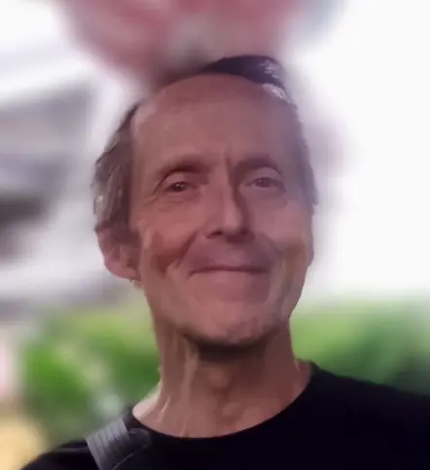
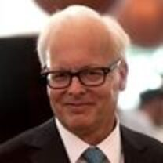

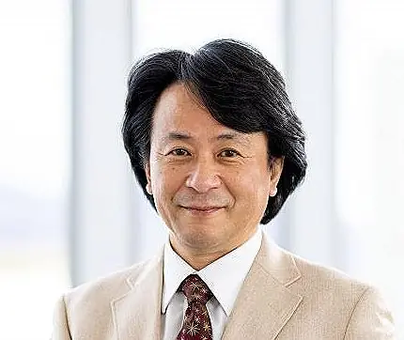
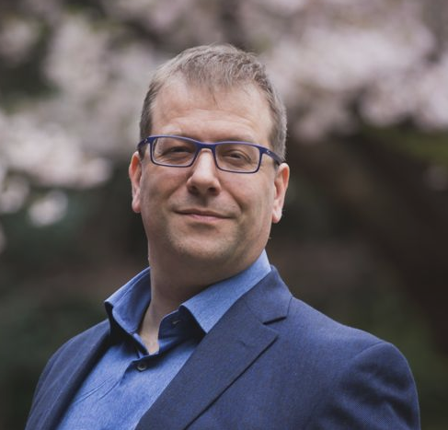
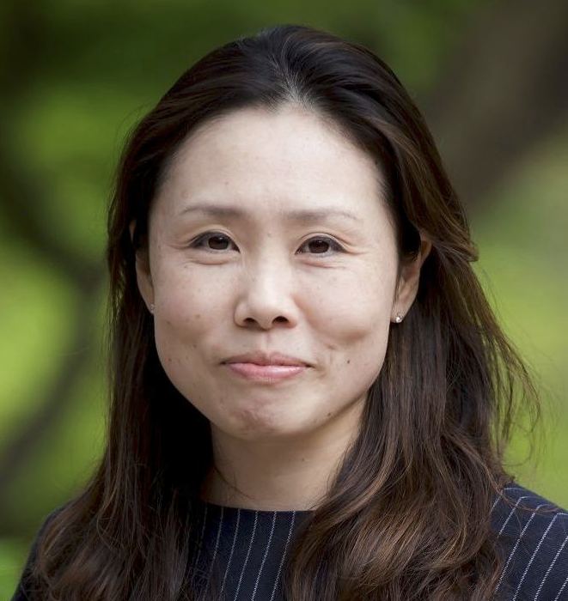
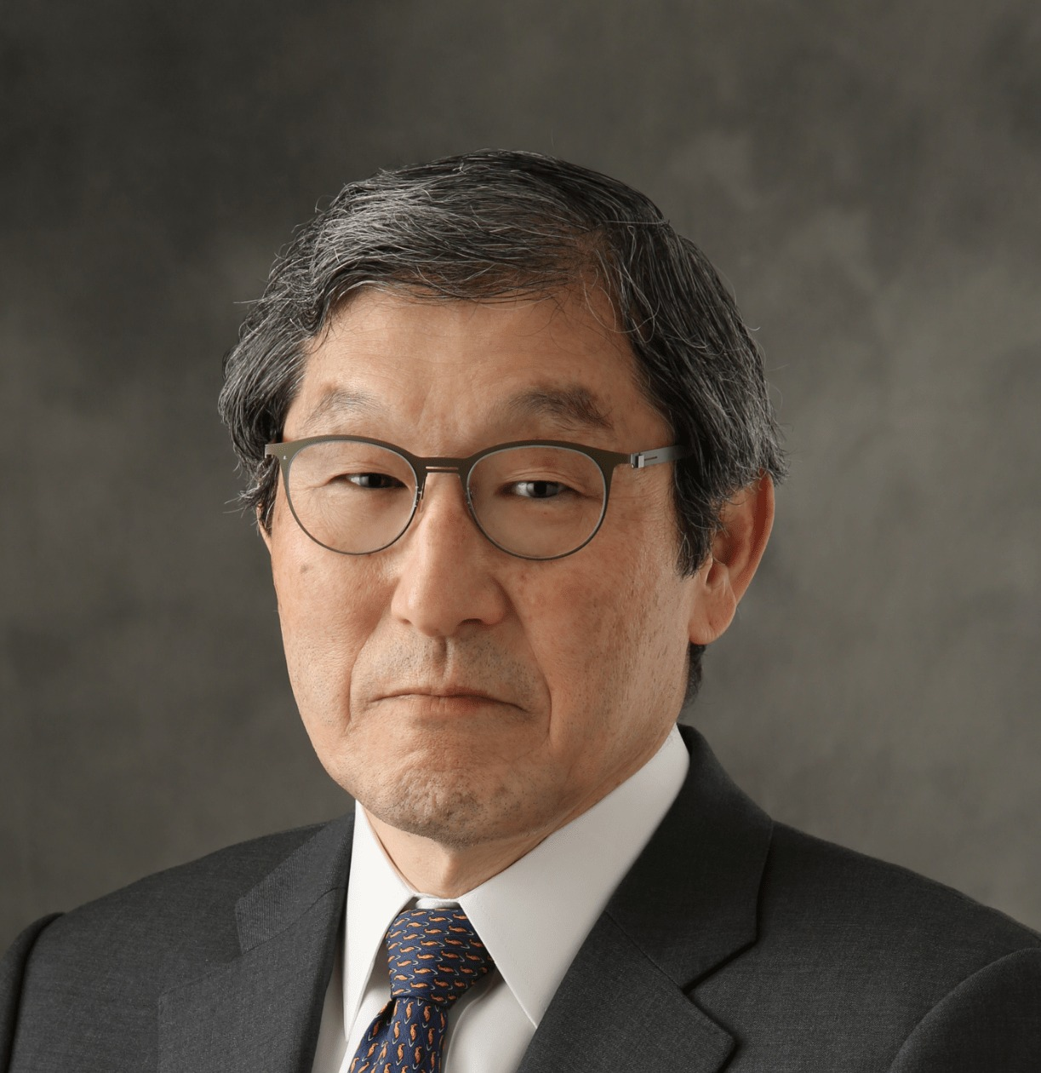
GOVERNANCE & ADVISORS · 体制と顧問 · 13
Small team, serious people, open books
少人数・確かな顔ぶれ・公開された会計。
ADVISORY BOARD · 顧問
Ray Ozzie
San Poisson
Takuo Dome
Evin Zoet
Yoshiko Zoet-Suzuki
Henry Takata
Executive Chair, Blues
Project Manager
Prof. Emeritus, Osaka Univ. Director, Inochi Forum
Co-Rep. Director, Transom
Co-Rep. Director, Transom
Business Development, SynTech
PROJECT LEAD · 代表
Rob Oudendijk
YR-Design · Safecast
LEGAL PATH · 法人形態
一般社団法人 → NPO → 認定NPO — tax-deductible status.
Notes:
Quick who's-who. I'm Rob Oudendijk, of YR-Design and Safecast — Safecast being the open environmental-data network that came out of Fukushima, which should tell you how seriously we take transparency. Legally, we're moving from a general incorporated association today toward certified non-profit status, so donations become tax-deductible. And we've got some genuinely heavyweight advisors: Ray Ozzie, San Poisson, Professor Emeritus Takuo Dome, and Evin Zoet and Yoshiko Zoet-Suzuki of Transom. Small team, serious people, and the books are open.

Slide 16
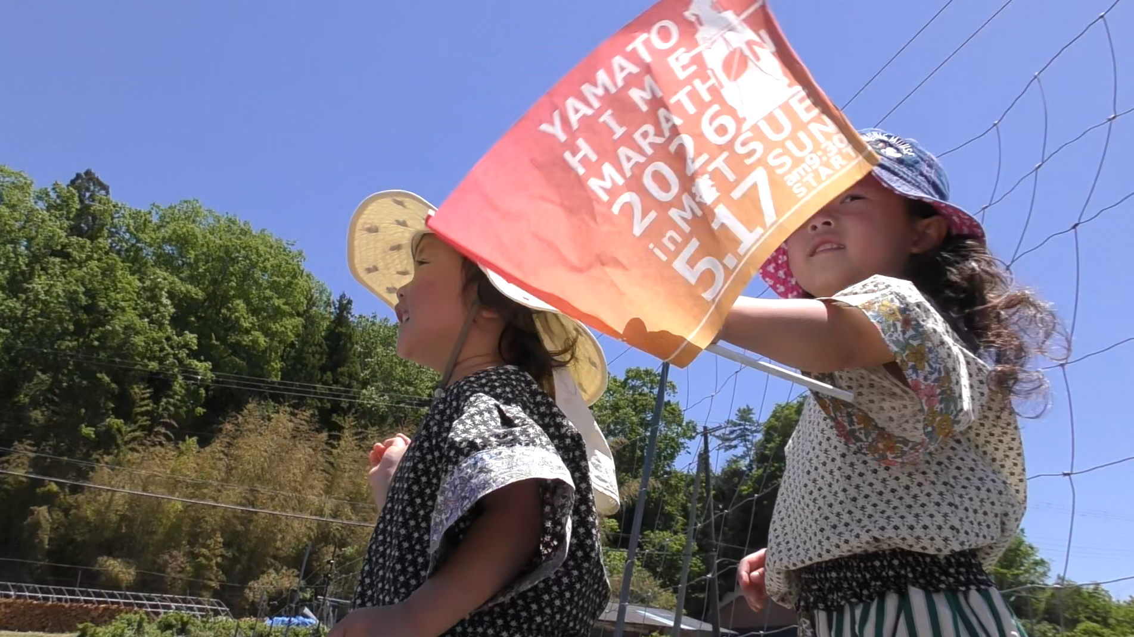
REPLICATION · 横展開 · 14
One village, an open blueprint
御杖は終着点ではなく、原型。公開された設計図。
100s
of depopulating municipalities share the same four raw materials. 同じ条件を持つ自治体は数百。
THE OPEN PLAYBOOK · 公開設計図
Every method, dataset and financial record is released under open licences . The deliverable isn't the data center — it's the repeatable playbook.
01
Restoration & energy methods
02
Financial model & open accounts
03
Governance & legal templates
手法・データ・会計をすべて公開。成果物はデータセンターではなく、再現可能な「型」。
04
Environmental & energy data
Notes:
Here's why this is worth more than just one village. Mitsue isn't the destination — it's the prototype. Hundreds of depopulating towns across Japan sit on the exact same raw materials: empty forest, a shuttered school, a fat energy bill, and a shrinking population. Everything we learn — methods, finances, governance — gets published openly. So the real product here isn't the data center. It's the playbook. Fund Mitsue once, and you're quietly funding the template for a few hundred more.

Slide 17
THE INVITATION · ご提案 · 15
Help write the blueprint, not just fund a village.
一つの村への出資ではなく、地方再生の設計図づくりに参加を。
NOW SEEKING · GATE 1 · 現在募集中
Founding partners welcome — government, foundation, corporate, and impact investors. Open books from day one.
¥3–8M
Phase 1: entity · feasibility · advisors
LEAD
ORG
LOCATION
Rob Oudendijk
YR-Design · Safecast
Mitsue, Nara · 御杖村
Notes:
So here's the ask. We're in Phase Zero, looking for partners to help us clear Gate One — three to eight million yen to stand up the legal entity, the feasibility work, and proper advisors for the next phase. Come in as a founding partner — government, foundation, corporate, impact investor, doesn't matter which. What you get isn't a logo on a wall. You get a stake in the first fully documented model for reviving rural Japan — and bragging rights for having helped write the blueprint everyone else copies. Thank you. Let's talk.

